Slide 1




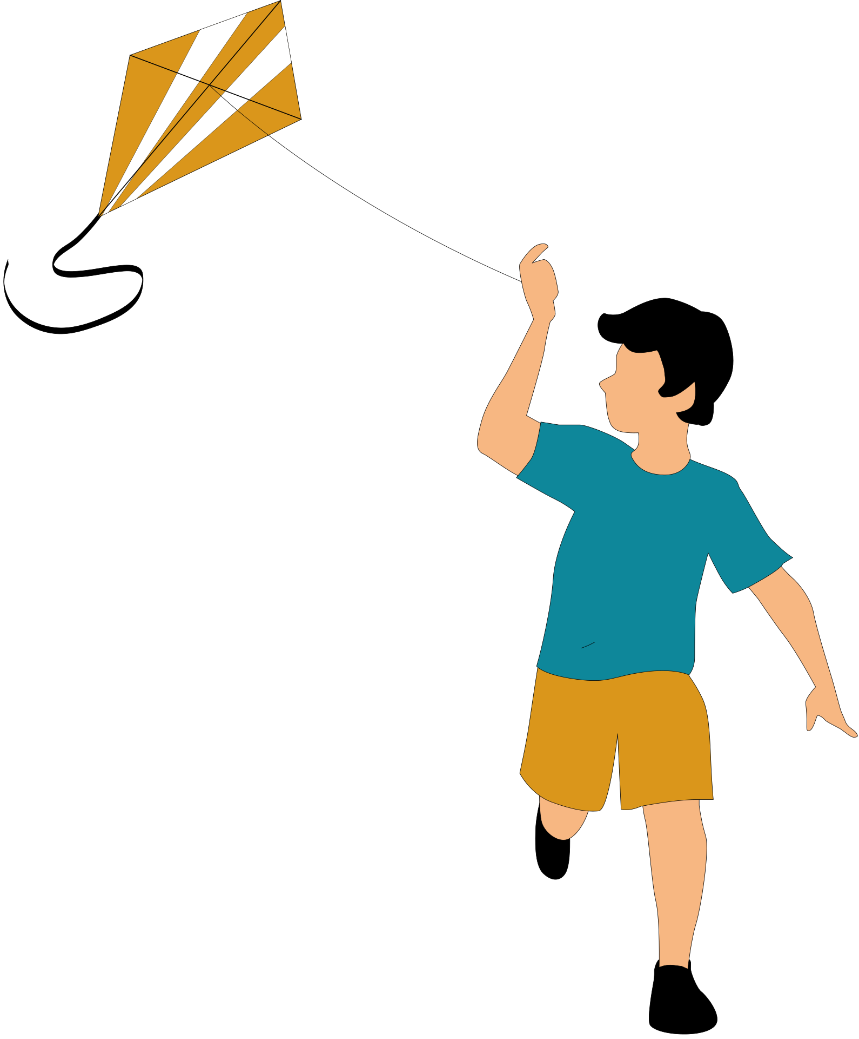

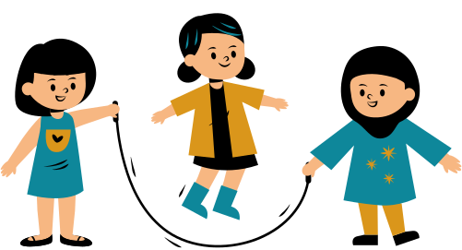

OPAL Assembly
06.05.2026

Slide 2
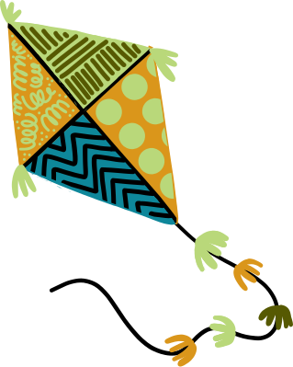

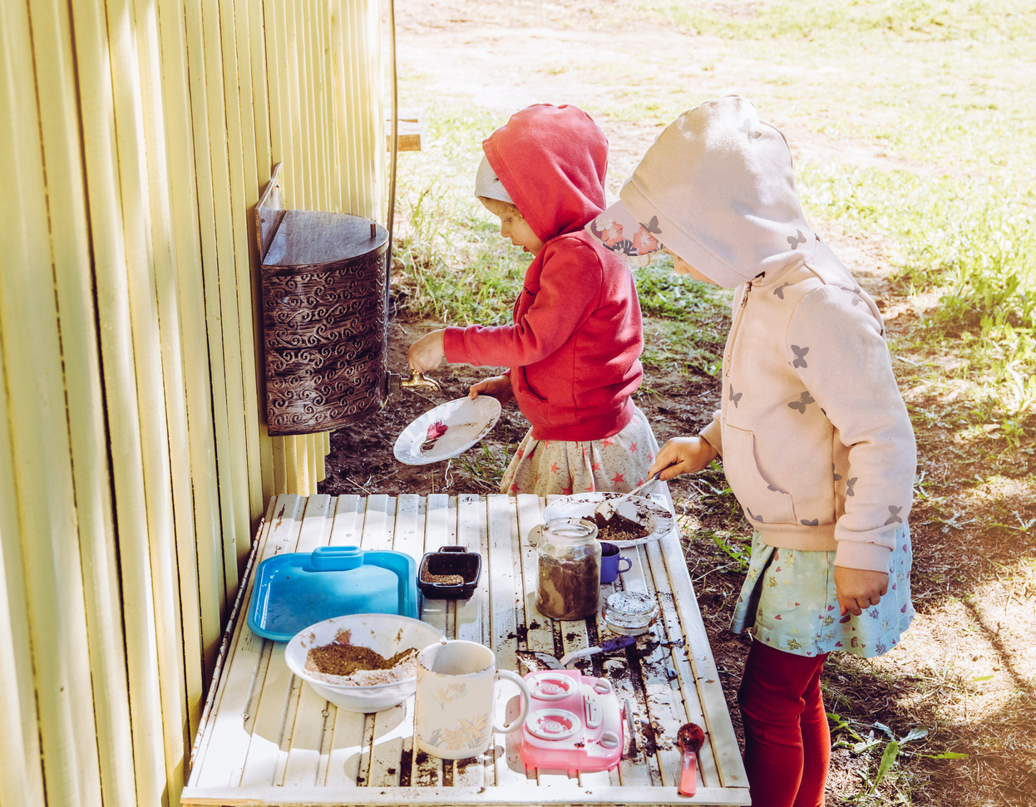

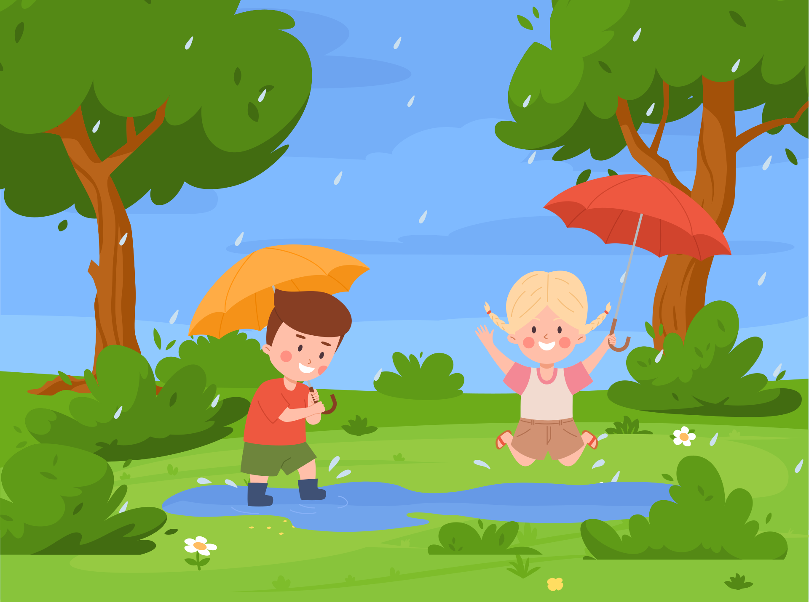
OPAL at Newark
Every couple of weeks we will have a focus on different skills we can develop through OPAL and how to use different equipment safely in the playground or an update on how OPAL is going in Newark.
Our focus today is about all of the new equipment in the playgrounds!

Slide 3
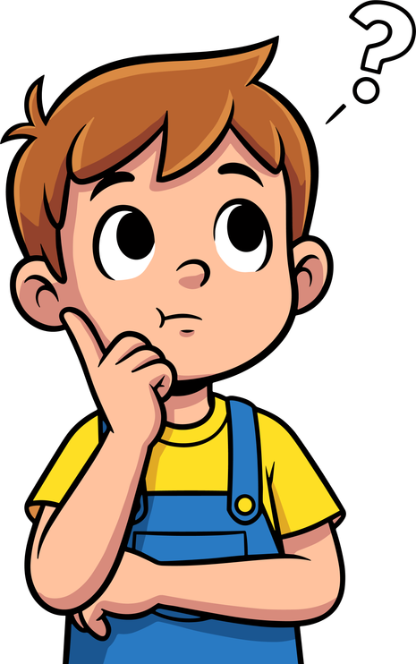


Safety in the Playground
Thinking - Think before you do something
Checking - See if it’s safe to walk /climb on/build with (ask someone if you are not sure)
Looking- Make sure its not broken before using it

Slide 4
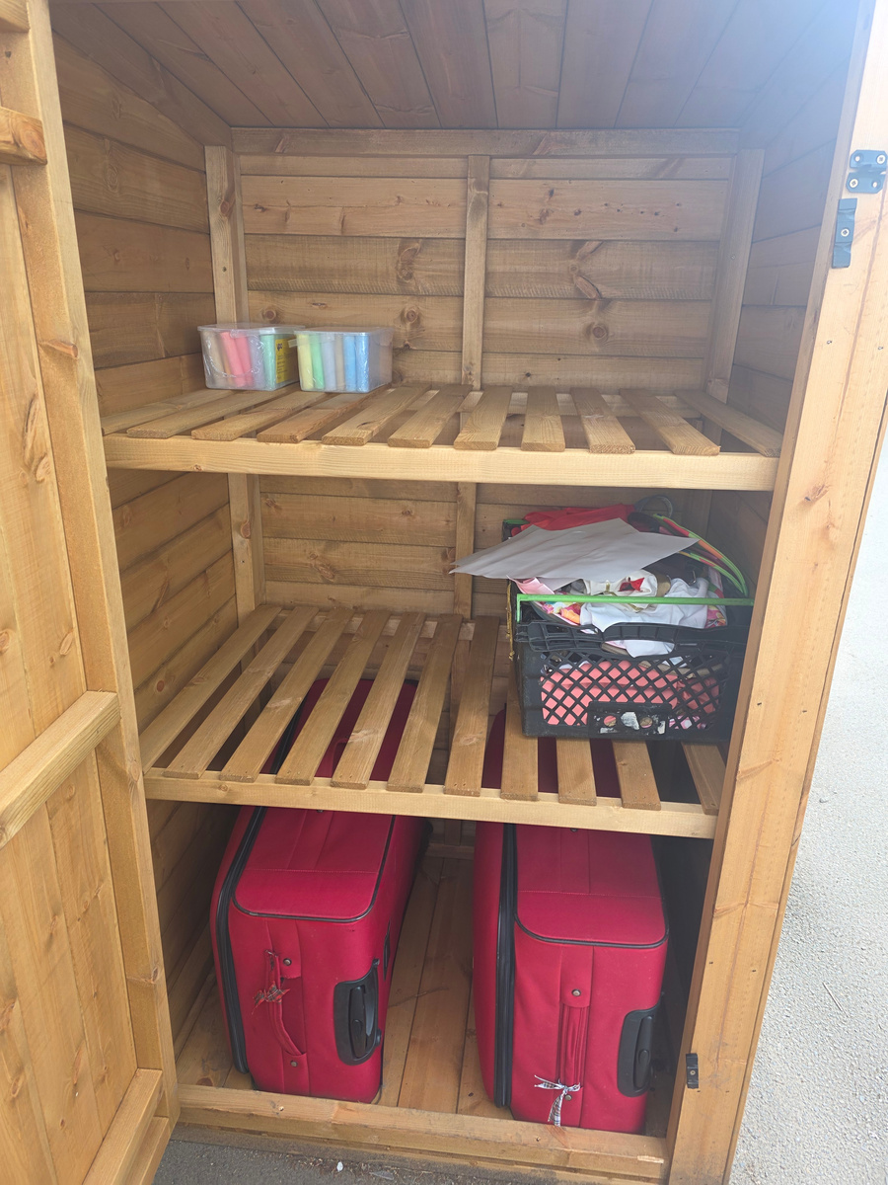
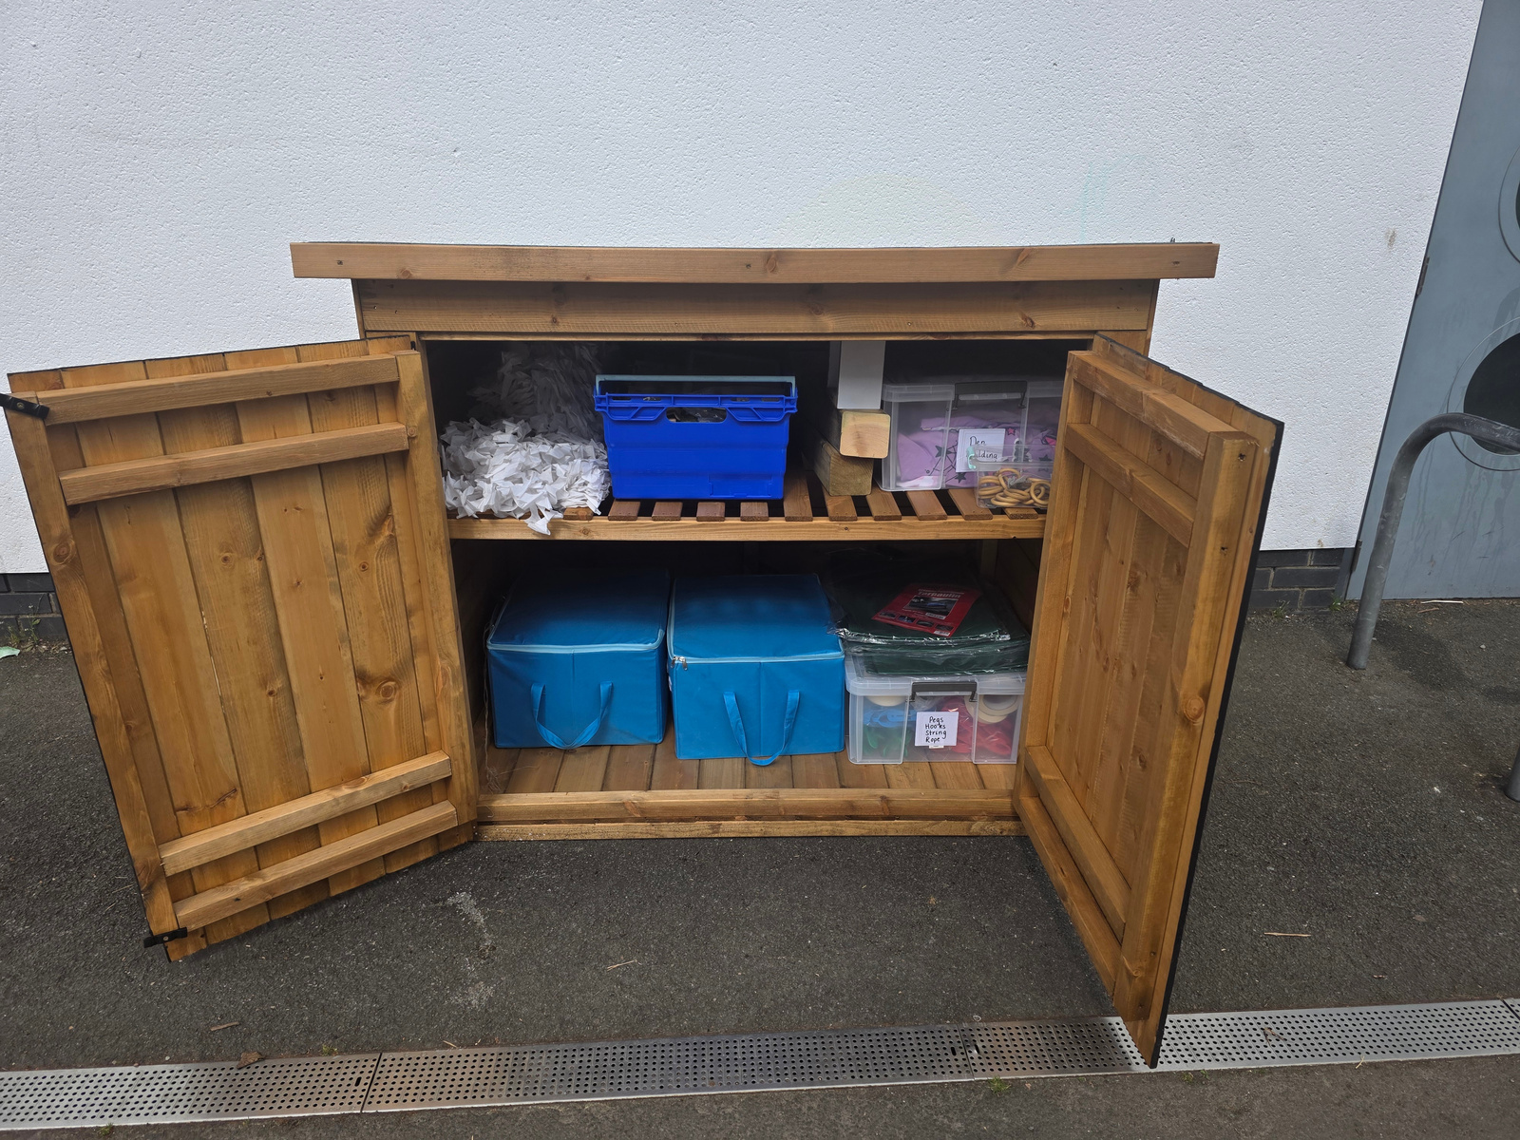
New equipment in the Playgrounds!
The sheds have started to get new equipiment in them!
We should be putting most things back in the sheds, unless it is things such as tarpaulin that can be left out overnight.

Slide 5
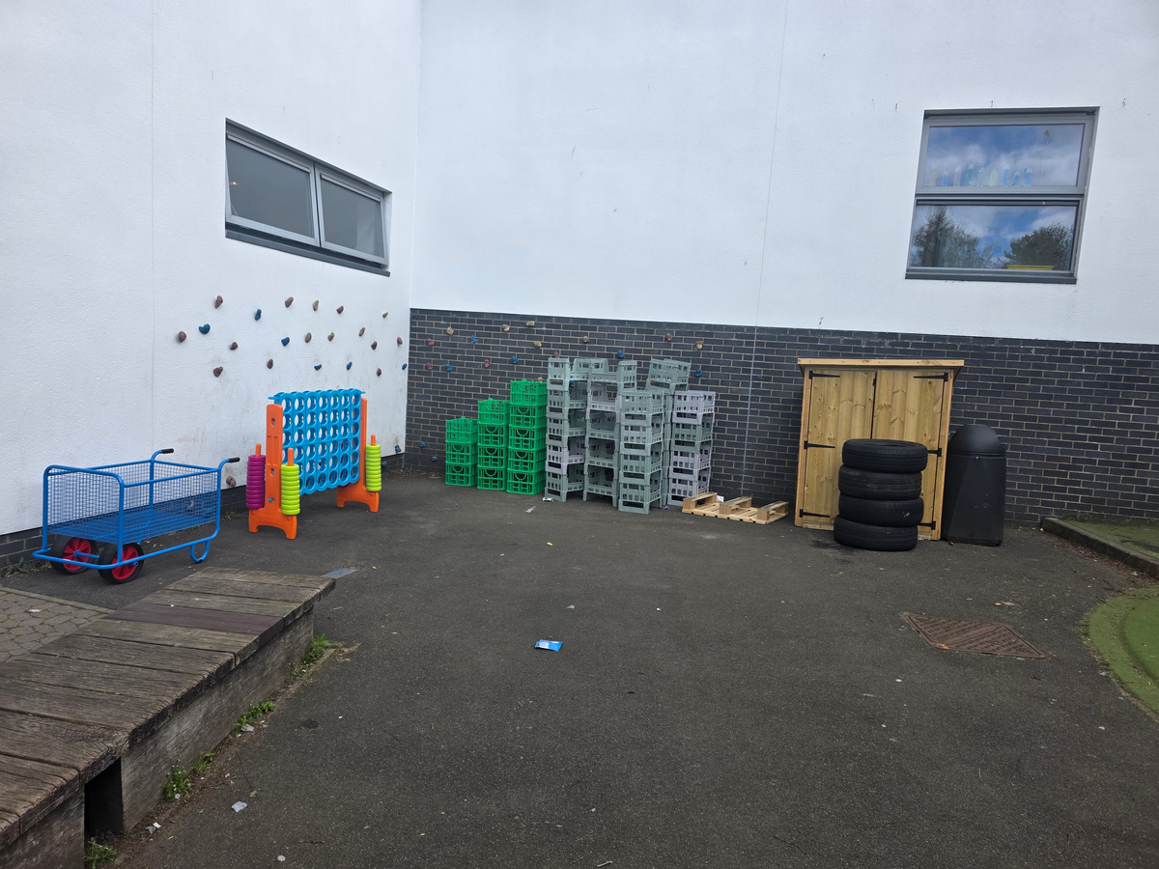
New equipment in the Playgrounds!
Some of the older children said that Den Building was much more fun in the middle playground, so all of the plastic crates are at the climbing wall, there are some palettes in the middle playground as well.

Slide 6
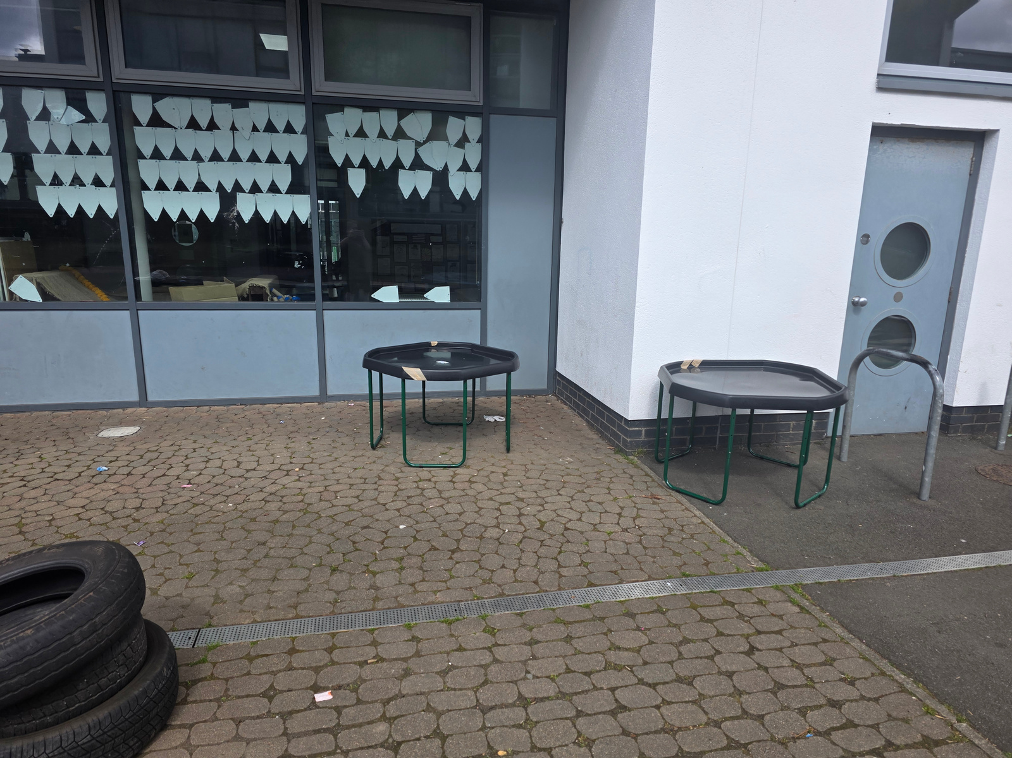
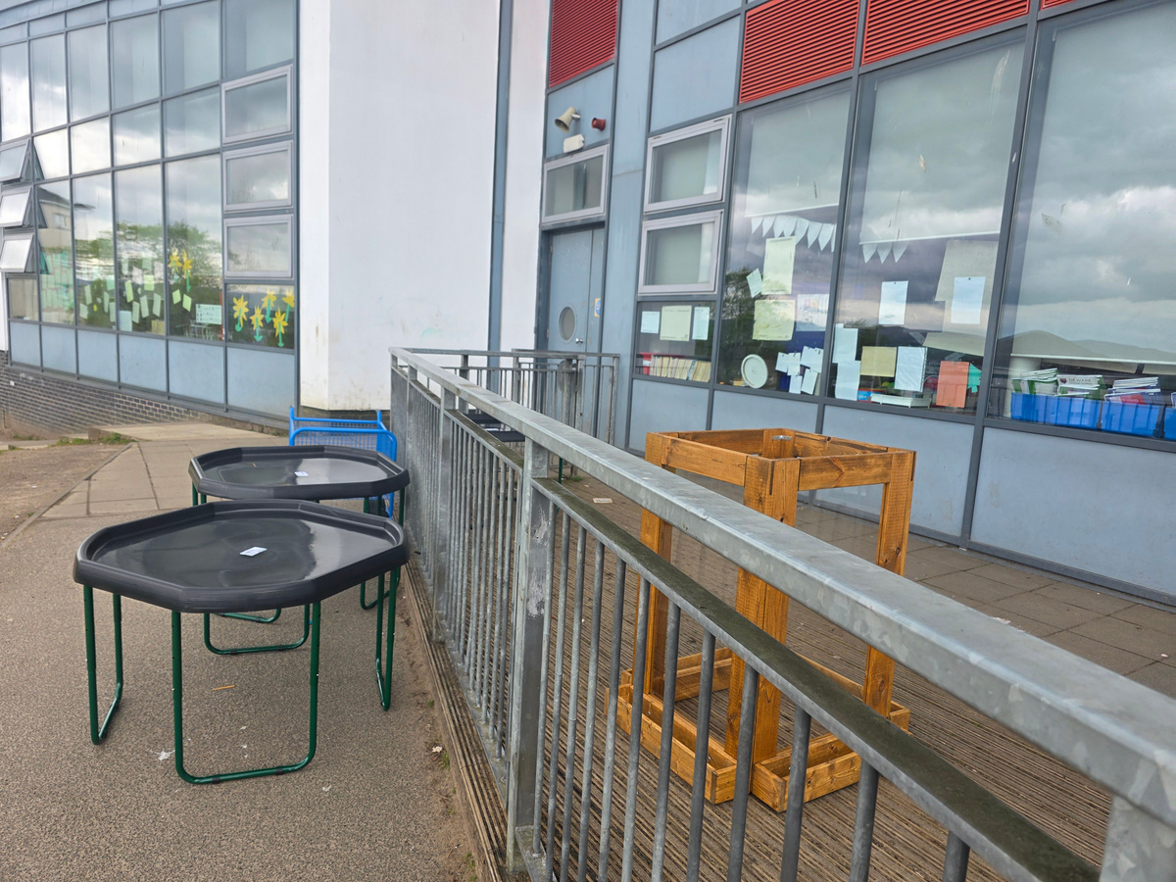
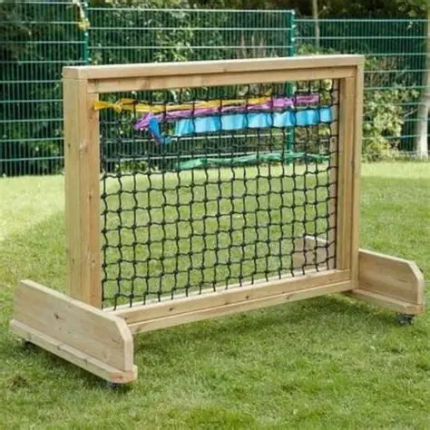
New equipment in the Playgrounds!
Tuff trays for Lego, crafting, play in all playgrounds. Do you have any ideas to share?
Weaving- Infant and Middle Playground. There is 1 box of ribbon to be stored in the shed between the toilets.

Slide 7
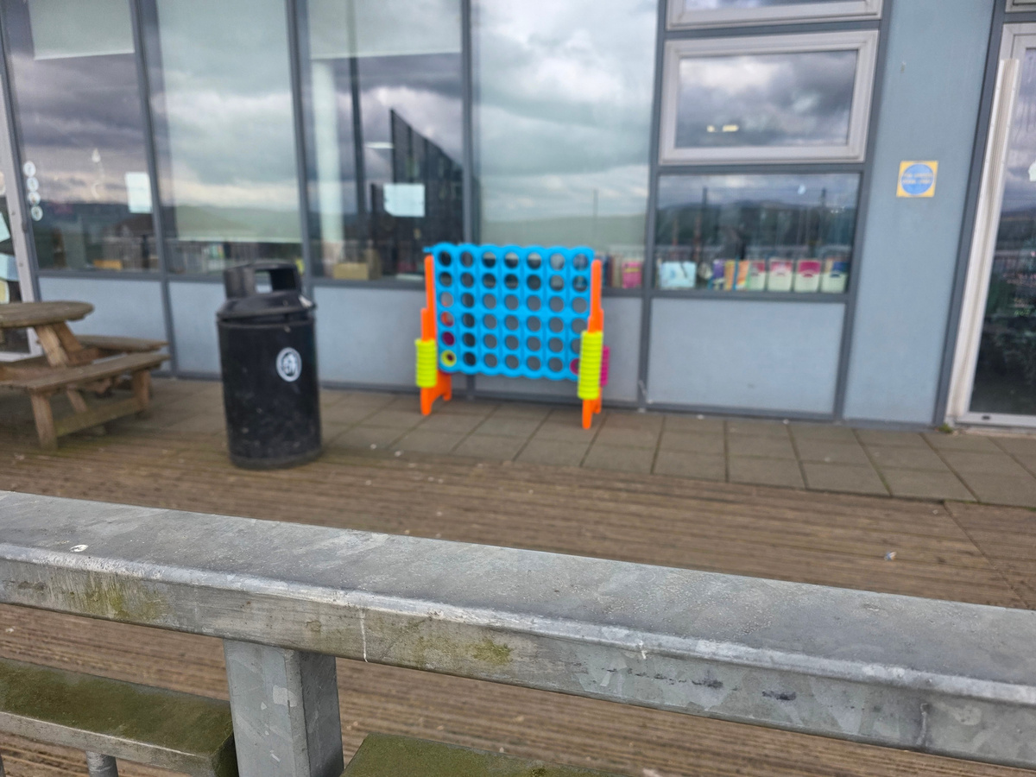
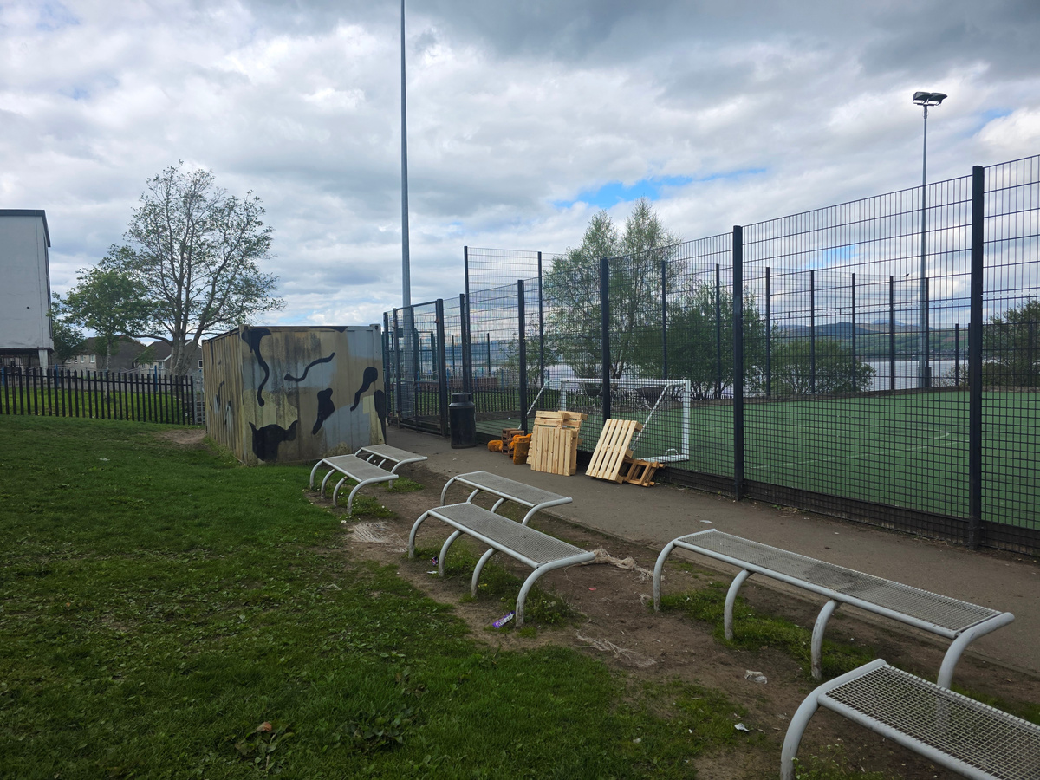
New equipment in the Playgrounds!
Connect-4 in every playground.
Loose Parts in back playground.

Slide 8
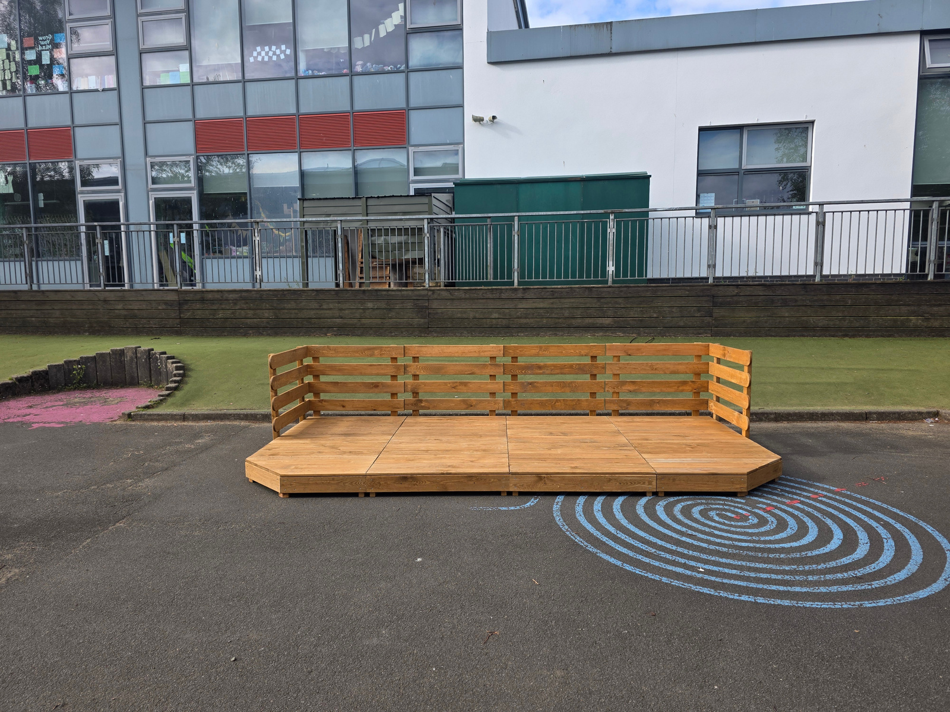
New equipment in the Playgrounds!
Stage!
We all know Mrs Deegan loves to show off her dancing in the middle playground, now there is a full stage for this!
Remember it is for everyone.

Slide 9
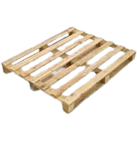
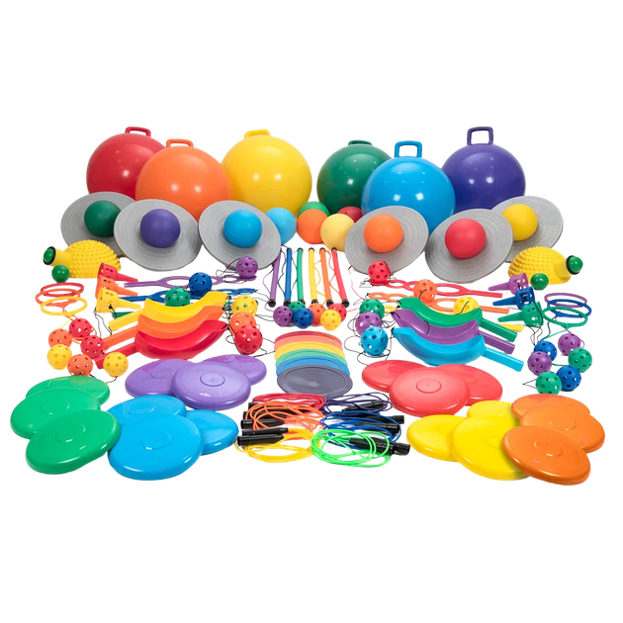
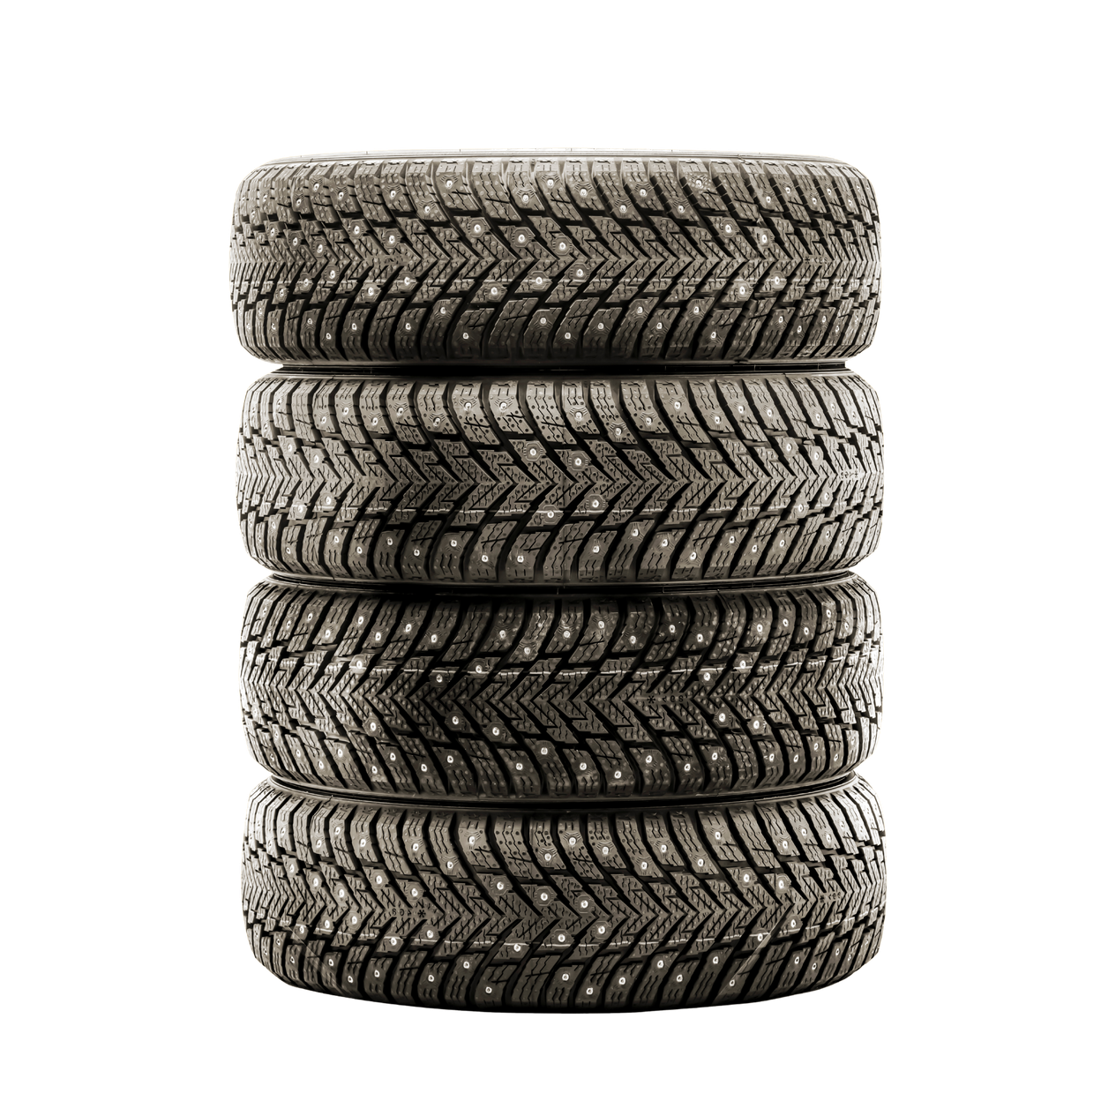
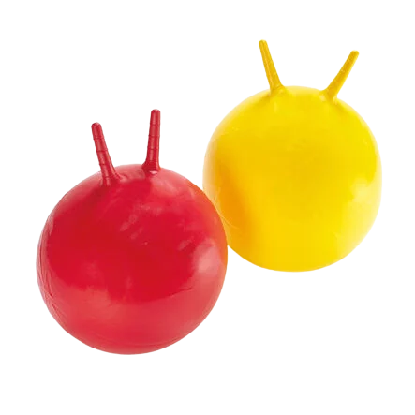
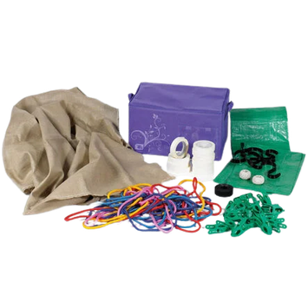
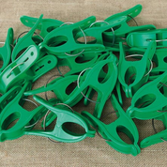
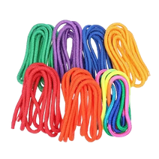
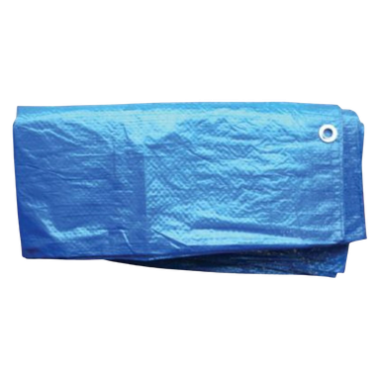
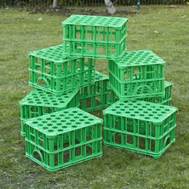
Remember: What we already had!

Slide 10

We know that it can be tricky when you have to come in for lunch and leave what you are buildng, if you are planning to come back to it after finishing your lunch, you can ask a PSA for an ‘Under Construction’ sign to attach to your build to avoid others dismantling it.

Slide 11
OPAL Superstar Award!

Slide 12

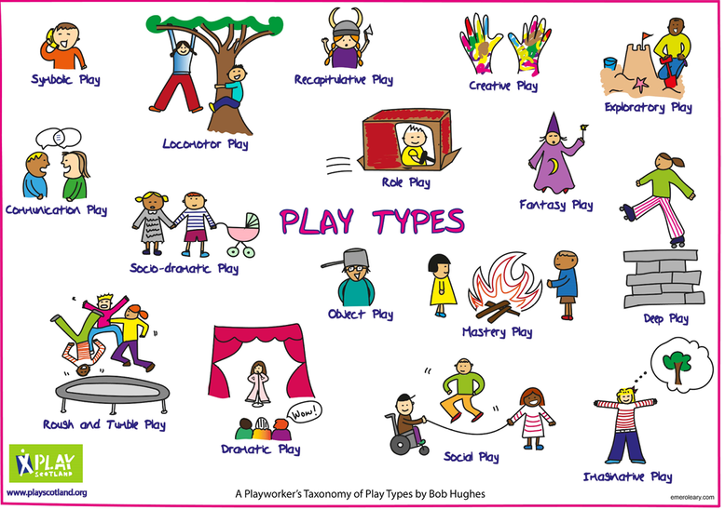
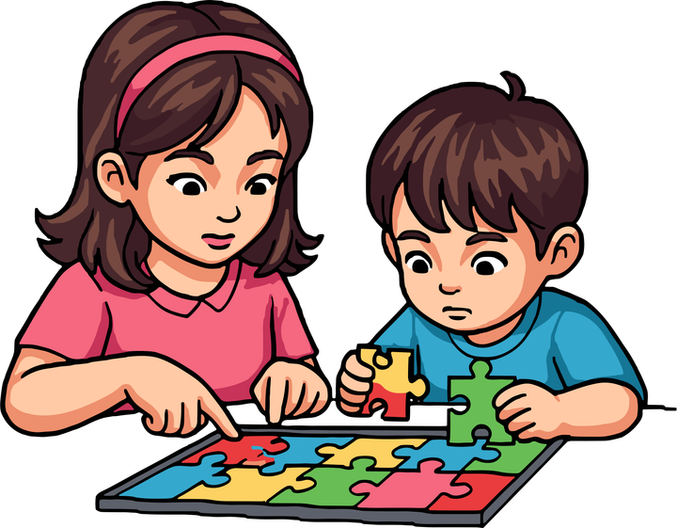


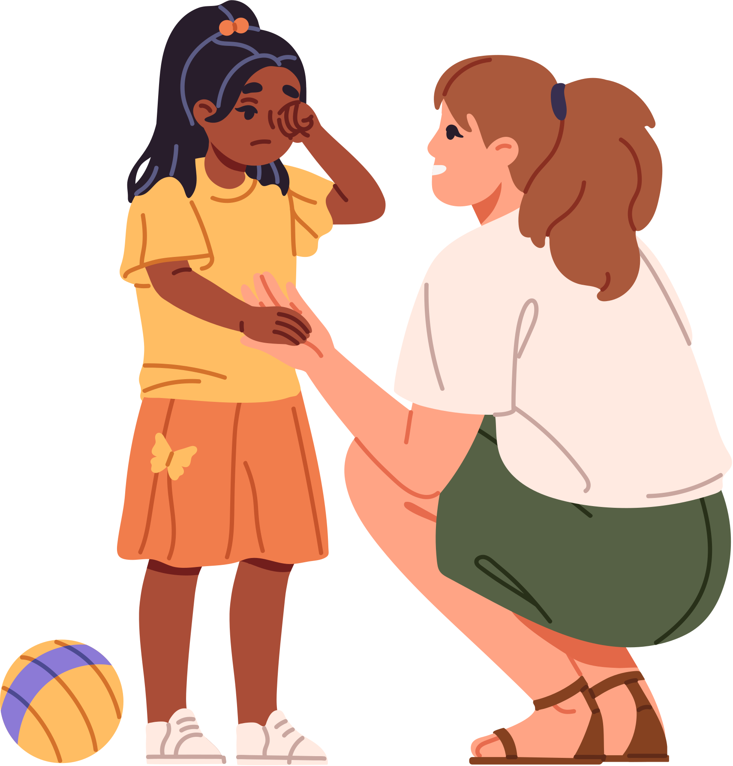
Risk Awareness
•Think before you build
• Check for hazards
• Ask an adult if unsure
• Play safely and responsibly
Work as a team! #TogetherWeShine
Remember!
• Share ideas
• Take turns
• Help each other
• Listen and communicate
HAVE FUN!
BE CREATIVE!
WORK TOGETHER!
Respect the Playground and Each Other
Look after all of the equipment-put it back where it belongs, no throwing equipment
Keep the playgrounds tidy-EVERYONE tidies up!
When the bell goes make sure there is no equipment left out
If you are unsure about anything, ASK AN ADULT

