Slide 1

King’s Oak Nursery Class
Handbook 2026 -2027
King’s Oak Nursery Class
35E Crawford St,
Greenock
PA15 2DX
Telephone: 01475-714685
Email: office@kingsoakprimary.inverclyde.sch.uk
Management Team
Head of Establishment Mrs Kirstin Glancy
Depute Head of Centre Mrs Staci Deans
“From tiny acorns, mighty oaks grow”

Slide 2

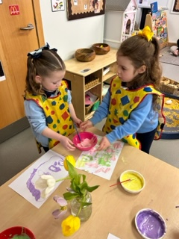
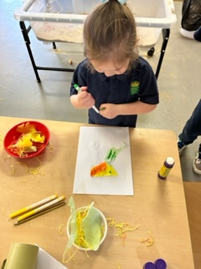
Contents
Welcome
Our Staff Team
Establishment Information
Vision, Values & Aims
Open Hours & Holiday Information
GIRFEC Information
Useful nursery Information
Meals and Snacks
Our play and learning
Establishment procedures for reporting to parents
Equal Opportunities and Social Justice
Medical and Health Care
Child Protection
PATHs
Home Links/ Useful partnership information
Additional Support Needs
Care Inspectorate
Complaints Procedure
GDPR and useful addresses

Slide 3
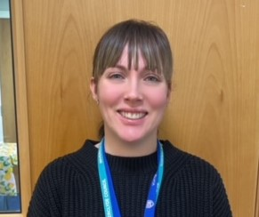
Welcome to King’s Oak Nursery Class
Welcome from Staci
Hi, my name is Staci Deans and I am the Depute Head of the nursery class. On behalf of all the staff welcome to King’s Oak Nursery Class.
We are delighted to be part of your child’s learning journey and we provide a warm and nurturing environment, where children feel safe, happy and supported throughout their time with us.
At King’s Oak Nursery we value our parents/carers and families contribution and involvement in our service and are looking forward to working in partnership with you to get the best outcomes for our children.

Slide 4
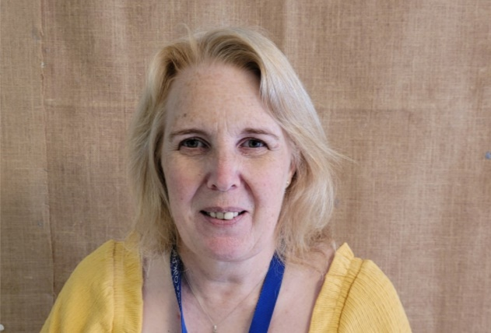
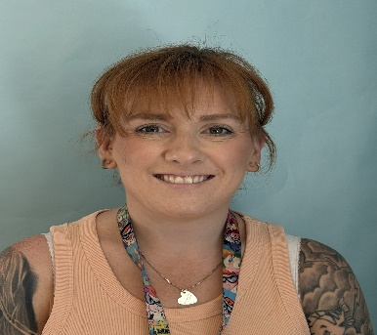
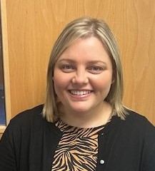
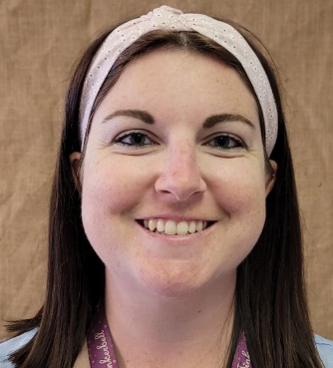
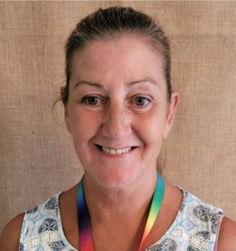
Our Staff Team
Early Years Education & Childcare Officer
Mrs Lorna McDonald
Red Group
Early Years Education & Childcare Officer
Miss Eilish Gisbey
Green Group
Depute Head of Nursery Class
Mrs Staci Deans
Equity & Excellence Lead
&
Early Years Education & Childcare Officer
Miss Michelle Ross
Peripatetic
Early Years Education & Childcare Officer
Miss Sarah McAlister
Blue Group
Early Years Support Assistant
Mrs Debbie McKillop

Slide 5
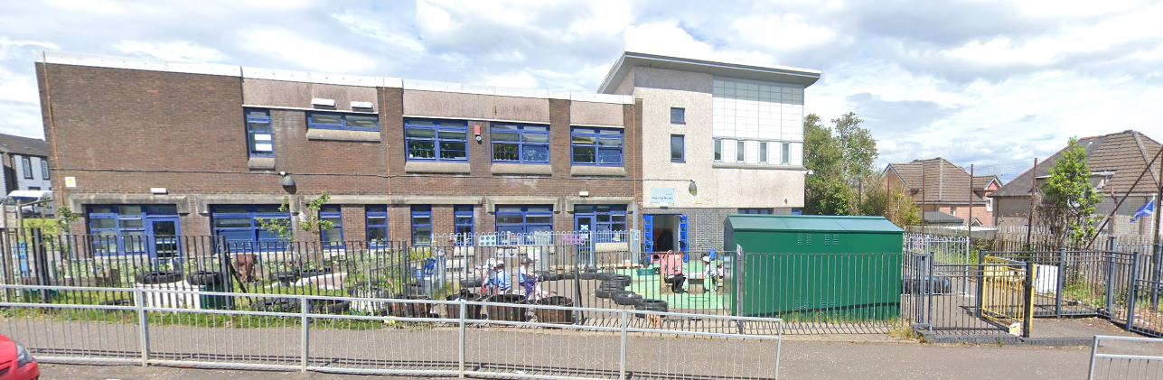
Establishment information
In King’s Oak Nursery Class we have capacity for 24 children during term time.
Session times operate between 9am and 3pm.
Children must be three years of age before being allocated a place.
All children aged 3 and over are entitled to an 1140 hours Early Learning placement as their core entitlement.

Slide 6

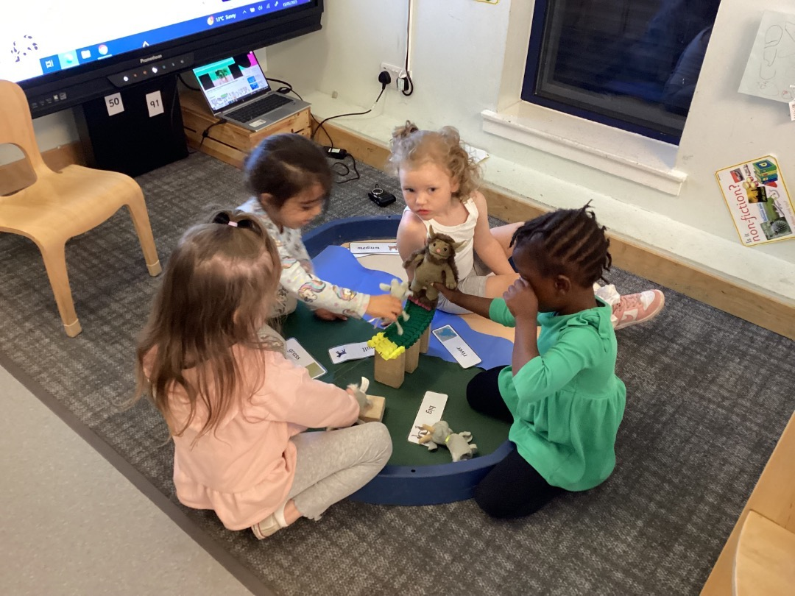
Vision, Values & Aims
Vision
At King's Oak, we believe 'From Tiny Acorns, Mighty Oaks Grow' and that in our pursuit of excellence and equity everyone can achieve.
Values
To provide a safe, happy and motivating learning environment for children to grow and learn.
To nurture and encourage curiosity, wellbeing and respect.
To develop a culture of ambition and achievement whilst learning and playing.
To encourage children to take responsibility for their learning and behaviour.
Ensure all children can achieve their full potential academically, emotionally and physically.
To provide an interactive partnership involving school, nursery, home, outside agencies and the community.

Slide 7

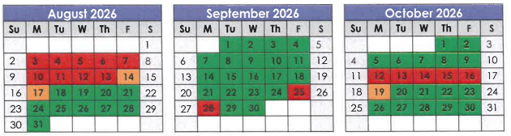
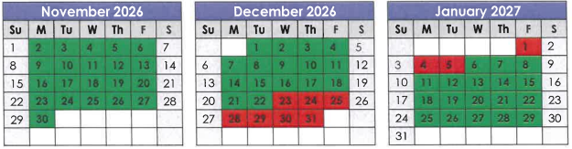
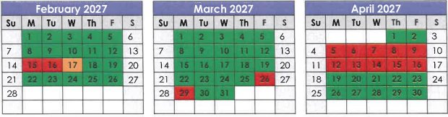
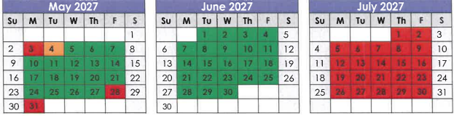

Open Hours & Holiday Information
Nursery doors open at 9am when the bell rings
Nursery closes at 3pm. Doors will open at 2.45pm (If needed you can collect your child prior to 2.45pm by ringing the bell)
All children must be collect by 3pm.

Slide 8
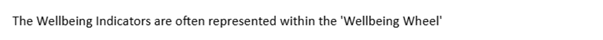


GIRFEC
At King's Oak Nursery we adhere to the principles of GIRFEC (Getting It Right for Every Child)
GIRFEC is the national approach to supporting every child in Scotland and ensuring their wellbeing regardless of circumstance, and that any additional support from external agencies is timely, appropriate and specific to each child and their situation. Children's rights, specifically the United Nations Convention on the Rights of the Child (UNCRC) as well as parents' rights are the drivers behind this approach.
The SHANARRI Wellbeing Indicators have been developed as a way of assessing a child's wellbeing, identifying any issues which need resolved and then putting in appropriate support to help the child.

Slide 9
Useful Nursery Information
When you arrive at nursery you will require to sign in. Sheets can be found on the table straight ahead.
Your child has their own peg with a symbol beside their name to allow them to recognise where to hang their coat.
When you arrive at nursery your child will choose their lunch from the choices on the lunch board
Your child will have a bag hanging on their peg with their name on it. Please provide a full change of clothes including underwear. Even if your child is toilet trained they may still participate in play which requires a full change.
Please bring indoor shoes to nursery for your child to change into on arrival.
If your child requires nappies or pull-ups, please provide a stock of these along with wipes to be kept in the nursery.

Slide 10
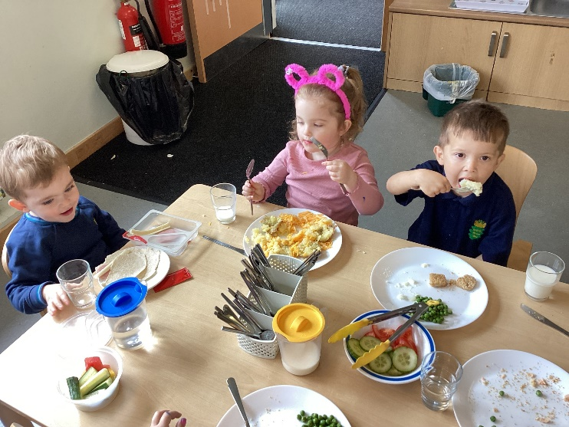
Meals & Snacks
Snack/Lunch
Every child will be provided daily with a hot/cold lunch option, soup and a piece of fruit, free of charge. Milk, water is also included.
We provide a rolling lunch over two sittings where children choose when to access lunch. We hope that children continue to enjoy a sociable lunch with their friends, reinforce good hygiene practices and have opportunity to try new foods.
The lunches will be served in the playroom and this will provide less interruptions to children’s learning.
You will be provided with our lunch menu prior to your child staying for lunch.
Healthy snacks will also be provided in the morning and afternoon. If you wish for your child to bring their own packed lunch with them please read our Oral Health Leaflet to help us promote healthy eating for children. No drinks are required as part of a packed lunch. We ask that parents and carers are mindful of healthy food options.

Slide 11
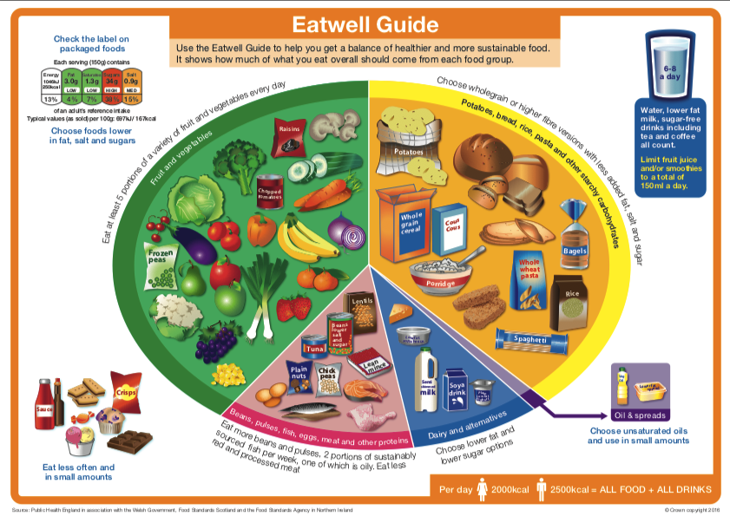

Healthy Packed Lunch Guidance
Why have packed lunch guidance?
As a healthy eating nursery we encourage good eating habits for our children and provide guidance to support children making healthy choices. All our snack menus are created to ensure a healthy balance across the week. This guidance has been produced to guide parents, carers and children about what choices should be made for healthy packed lunches.
A healthy lunch gives children the energy they need to learn an play for the rest of the day.
PLEASE ENSURE THAT GRAPES ARE CUT IN HALF LENGTHWISE TO AVOID CHOKING!
Packed Lunch Advice for Parents/Carers
If your child brings a packed lunch to nursery, try to avoid putting in crisps, processed cakes, biscuits and sugary drinks. These tend to be high in sugar, fat and salt, low in essential nutrients and can;
Increase the risk of tooth decay
Lead to excess weight gain
Reduce concentration levels in the afternoon
Small changes often lead to big improvements and are more likely to be accepted by the whole family.
Buying smaller portion sizes (eg snack size) or plainer alternatives can get things moving in the right direction. Visit www.nhs.uk/change4life for more practical, realistic tips to improve daily diet and activity routines. You may wish to provide your child with hot soup etc in a flask. We cannot reheat soup etc but if it is in a flask this will be of an adequate temperature at lunchtime.

Slide 12
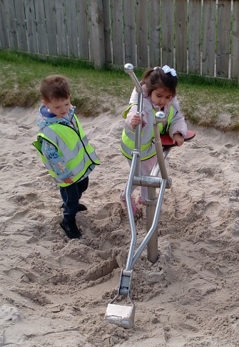
Our Play and Learning
A Curriculum for Excellence by Education Scotland is the document we use to track your child’s development and plan possible next steps of learning. Nursery children access early level which then transitions to Primary 1 ensuring progression & continuity in your child’s learning journey. The Curriculum is split in to eight subject areas … Maths & Numeracy, English & Literacy, Health & Wellbeing, Science, Technology, Religious & Moral, Expressive Arts and Social Studies.
Staff are skilled to encourage children to find their own interests and engage in play initiated by the child. We are responsive to their needs and often ‘plan in the moment’. Children are more inclined to show high levels of engagement when they are able to explore their own interests within an enabling environment.
We aim to keep parents/carers actively involved through ‘Stay and Play’ which runs throughout the term.

Slide 13

Learning Journals
Learning Journals is a tool for your nursery to be able to record significant learning for your child and enable you to see what they have been doing. For you, this means you can log in to your profile and see these events and comment and contribute.
You can access your child’s profile in 2 ways
using the website from an internet browser https://parentzone.yourlearningjournals.co.uk/
Through the Parent app which is free to download from the Apple Appstore or google Play Store (search Learning Journals for Parents).
Observations
Observations are a record of significant learning linked to curriculums and frameworks. These are what the staff use to evidence progress and development. You can click on the Learning Outcomes tab of each observation to see which outcomes have been experienced in the observation.
Stories
Stories are a really nice way for us to share something with you. Not as comprehensive as an observation, but they share a nice moment – it might be a fun day, a birthday party, sports day or opportunity that we think you would love to hear about.

Slide 14

Establishment procedures for reporting to parents/carers
At King’s Oak Nursery class, we operate a keyworker system. We work with parents/carers to support the learning of the individual child by talking and sharing information on a daily basis. Parents/carers are invited to work alongside keyworkers to develop their child’s personal plan. We are using Online Learning Journals to record children’s learning at nursery and share this with parents/carers. We welcome your contributions and achievements from home and we share information with parents through Groupcall, letters, newsletters and email.
As we operate an open door policy, if you have any questions regarding your child’s learning and development please do not hesitate to contact Staci to discuss this further.

Slide 15
Equal opportunities and Social Justice
“Inverclyde Education Service is committed to ensuring that no children or members of staff or service users receive less favourable treatment on any grounds including gender, race, disability, age , sexual orientation, religion or belief. We have a moral, social and legal obligation to mainstream and put equality at the heart of everything we do. We aim to promote a culture in which equality of opportunity exists for all. We are opposed to all forms of discrimination, direct or indirect, and aim to eliminate all discriminatory practices. We will ensure, that in our schools and other educational establishments equality permeates the curriculum and underpins all our policies and practices in terms of access to education. We must ensure that all our children achieve their full potential to develop physically, emotionally and academically. Finally, we believe that equality and inclusion should be a given right, where everyone is valued and treated with respect”.

Slide 16


Medical and Health Care
At enrolment parents/carers are asked to give information about their child’s health. It is important that the nursery is kept informed of any medication that your child requires or of any known illness or allergies. Please keep staff informed so that information can be kept up to date at all times.
If your child requires medication, during his/her time at the nursery, you should discuss these requirements with Staci. You will need to fill in a form which authorises nursery staff to administer the medication to you child in line with Care Inspectorate guidance.
If your child becomes ill while at the nursery we will inform you of the situation. If we are unable to contact you we will contact your emergency numbers given at enrolment. It is important to keep emergency contact information up-to-date at all times particularly if you change phone number.
If your child has a minor accident while at nursery, the incident will be dealt with and recorded. We will inform you at the time, if necessary, or when you collect your child.
There are qualified first aid workers within the nursery. If at any time your child is ill with an infectious condition please contact the nursery for advice as to how long your child should remain off nursery so as to help protect other users of the nursery.

Slide 17

Child Protection and Safeguarding
Inverclyde Council Education Services has Child Protection Guidelines and Procedures which all schools and establishments are required to follow. Education Services work very closely with other agencies namely Police Scotland, Social Work Services, NHS Greater Glasgow and Clyde and the Children’s Reporter to support children. Common responsibilities of all staff are to protect children from abuse and exploitation, to respond appropriately when abuse is identified, and to ensure whenever possible that all children are able to exercise their right to be raised in a warm, stimulating and safe environment with the support of staff, their families and carers.

Slide 18
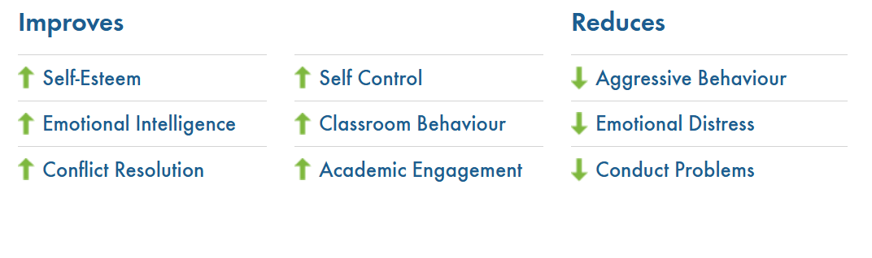
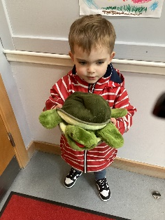
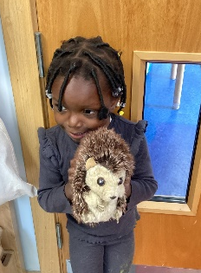
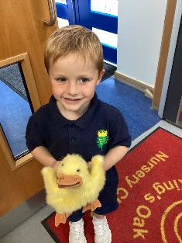
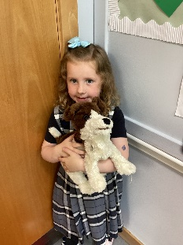
Paths
At King's Oak Nursery we are using PATHS® which is a social and emotional learning programme for nursery and primary school children which empowers them to develop the fundamental social and emotional learning skills which will enable them to make positive choices throughout life.
The PATHS® Programme promotes positive mental health and emotional well-being in nursery using four mascots:Twiggles the tortoise, Henrietta the hedgehog, Daphne the duck and Duke the dog.

Slide 19

Home links / Useful partnership information
We encourage active participation in your child’s learning. It is important to develop a partnership model where we work together to enable your child to maximise their potential. We will regularly share with you a record of your child’s achievements and would be grateful for any contributions you make to enable us to celebrate your child’s achievements at home and the community here at the nursery.
The centre produces a newsletter on a regular basis to keep you informed of events and planned activities which will supports your child’s learning. If you would like to become involved in any way in your child’s learning while they are at nursery or have anything you would like to be included within the newsletter please speak to a member of staff. As we are committed to working in collaboration with all parents/carers this is in line with Inverclyde councils parental involvement strategy.
We have a question of the month book, you said/we did board at the nursery entrance and are committed to making improvements through your suggestions and contributions.
We also offer ‘Stay and Play’ sessions and invite families in throughout the year to contribute in various events.

Slide 20

Additional Support Needs
Every member of staff has a responsibility to support the learning of all children. The type of support offered will vary according to the needs of children. This includes consideration given to children who have a disability, children with social, emotional and behavioural difficulties, children with learning difficulties of a specific or general nature, children who are exceptionally able, those who demonstrate underachievement relating to gender issues, children whose learning has been interrupted through absence or illness, bilingual children who have English as an additional language, travelling children and those children whose family circumstances impact on attendance and learning. Partner agencies may be asked to offer support where necessary.
The authority’s policy in relation to provision for additional support needs
A child or young person’s needs are identified at the earliest possible stage and can be met in a number of ways, for example by adaptations to the curriculum or learning environment, as well as input from other professionals and on occasion support from visiting specialists. The appropriateness of the support is determined through a process of assessment, planning and monitoring, working jointly with parents and carers, and is regularly reviewed.

Slide 21

Care Inspectorate
The nursery is inspected on a regular basis by the Care Inspectorate to ensure we maintain a high quality of provision in line with the National Care Standards outlined by the agency.
Care Inspectorate
Social Care and Social Work Improvement Scotland
4th Floor
1 Smithhills Street
PAISLEY
PA1 1EB
Tel: 0141 843 4230
You can view our most recent report here:
file:///C:/Users/DeansS/Downloads/InspectionReport-323406.pdf
King’s Oak Nursery Class - CS2003016351

Slide 22
Complaints Procedure
At King’s Oak Nursery Class we are committed to providing a high-quality service and strive to ensure that families are happy with our provision.
However, if parents/carers have complaints or concerns about any aspect of our service they should contact the Depute Head of Nursery Class or the Head Teacher. King’s Oak Nursery Class adheres to Inverclyde Council’s Complaints Policy and follows the associated guidelines. Most minor complaints and concerns are normally dealt with immediately and are quickly resolved to the satisfaction of those involved. Complaints, which are not resolved at this stage or are of a more serious nature, require a more formal procedure.
Complaints Procedure
In King’s Oak Nursery Class, we strive to ensure that families are happy with our early years provision. However, if you have a concern or wish to make a complaint, please speak to;
Mrs Staci Deans – Depute Head of Nursery Class, Mrs Lynne Wilson - Depute Head Teacher or Mrs Kirstin Glancy - Head Teacher
Formal Complaints must be completed in writing. All complaints will be responded to within 3 working days and details entered into our complaints book.
If we are unable to deal with your complaint to your satisfaction, then you should contact either;
Education Headquarters at: or
Complaints Care Inspectorate
Inverclyde Council Compass House
Municipal Buildings 11 Riverside Drive
24 Clyde Square Dundee
Greenock DD1 4NY
PA15 1LY Email - admin.educationhq@inverclyde.gov.uk Tel: 0141 843 4230

Slide 23
GDPR and Useful Addresses
Information on children, parents and guardian is stored on a computer system and may be used for teaching, registration, assessment and other administrative duties. In processing personal information, Inverclyde Council must comply with
the General Data Protection Regulations and Data Protection Act 2018.
Although this information is correct at time of presenting, there could be changes affecting any of the matters dealt with in the document –
(a) Before the commencement or during the course of the school year in question.
In relation to subsequent years.
For further information please refer to https://www.inverclyde.gov.uk/site-basics/privacy
Although this information is correct at the time of presenting, there could be changes affecting any of the matters dealt
with in this document
before the commencement or during the course of the school year in question
In relation to subsequent years
Ruth Binks
Corporate Director
Education, Communities &
Organisational Development
Municipal Buildings
Clyde Square
Greenock PA15 1LY
Tel: 01475 – 717171
Yvonne Gallagher
Early Years Manager
Education Services
Customer Service Centre
Municipal Buildings
Clyde Square
Greenock PA15 1LY
Tel: 01475 – 717171

