Slide 1

Welcome to...
Primary 6/5

Slide 2
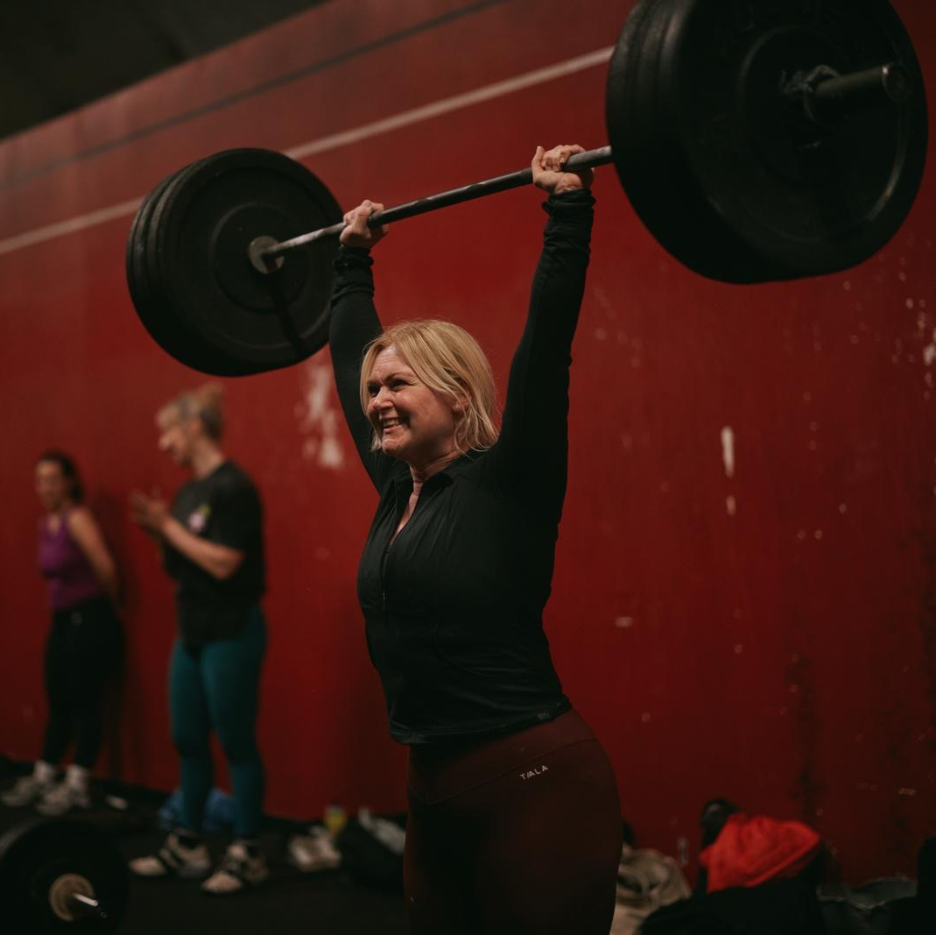
Hello, I am Miss Wilkins
Hello P6/5, I’m so so excited to be teaching you this year and I know we will just have the best year!
I already know some of your very well but I’m looking forward to getting to know some new faces too!
I have so many lovely ideas for our learning journey together this year, and I can’t wait to get started in August!

Slide 3
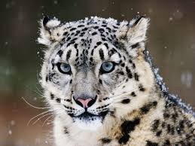

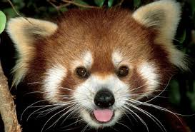
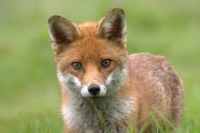
Hello, I am Miss Wilkins
Click on the boxes below to reveal some fun facts about me
This is my third year teaching at KPS, and my 8th year as a primary teacher. Before that however, I used to be a music teacher and really love Musical Theatre!
If I’m not at the gym, I love reading, listening to podcasts or playing rugby next to Mrs K!
I love going to the gym and train both Olympic Weightlifting and CrossFit. I won a Bronze medal at the European Masters Championships this June in weightlifting and PE is one of my favourite lessons of the week
My favourite subjects to teach are: music, art, writing numeracy and of course PE.
I love animals so much and my favourite animals are snow leopards, foxes and red pandas.
I love to travel and have visited over 20 different countries around the world. I’m not sure however, that I could tell you which one was my favourite!

Slide 4
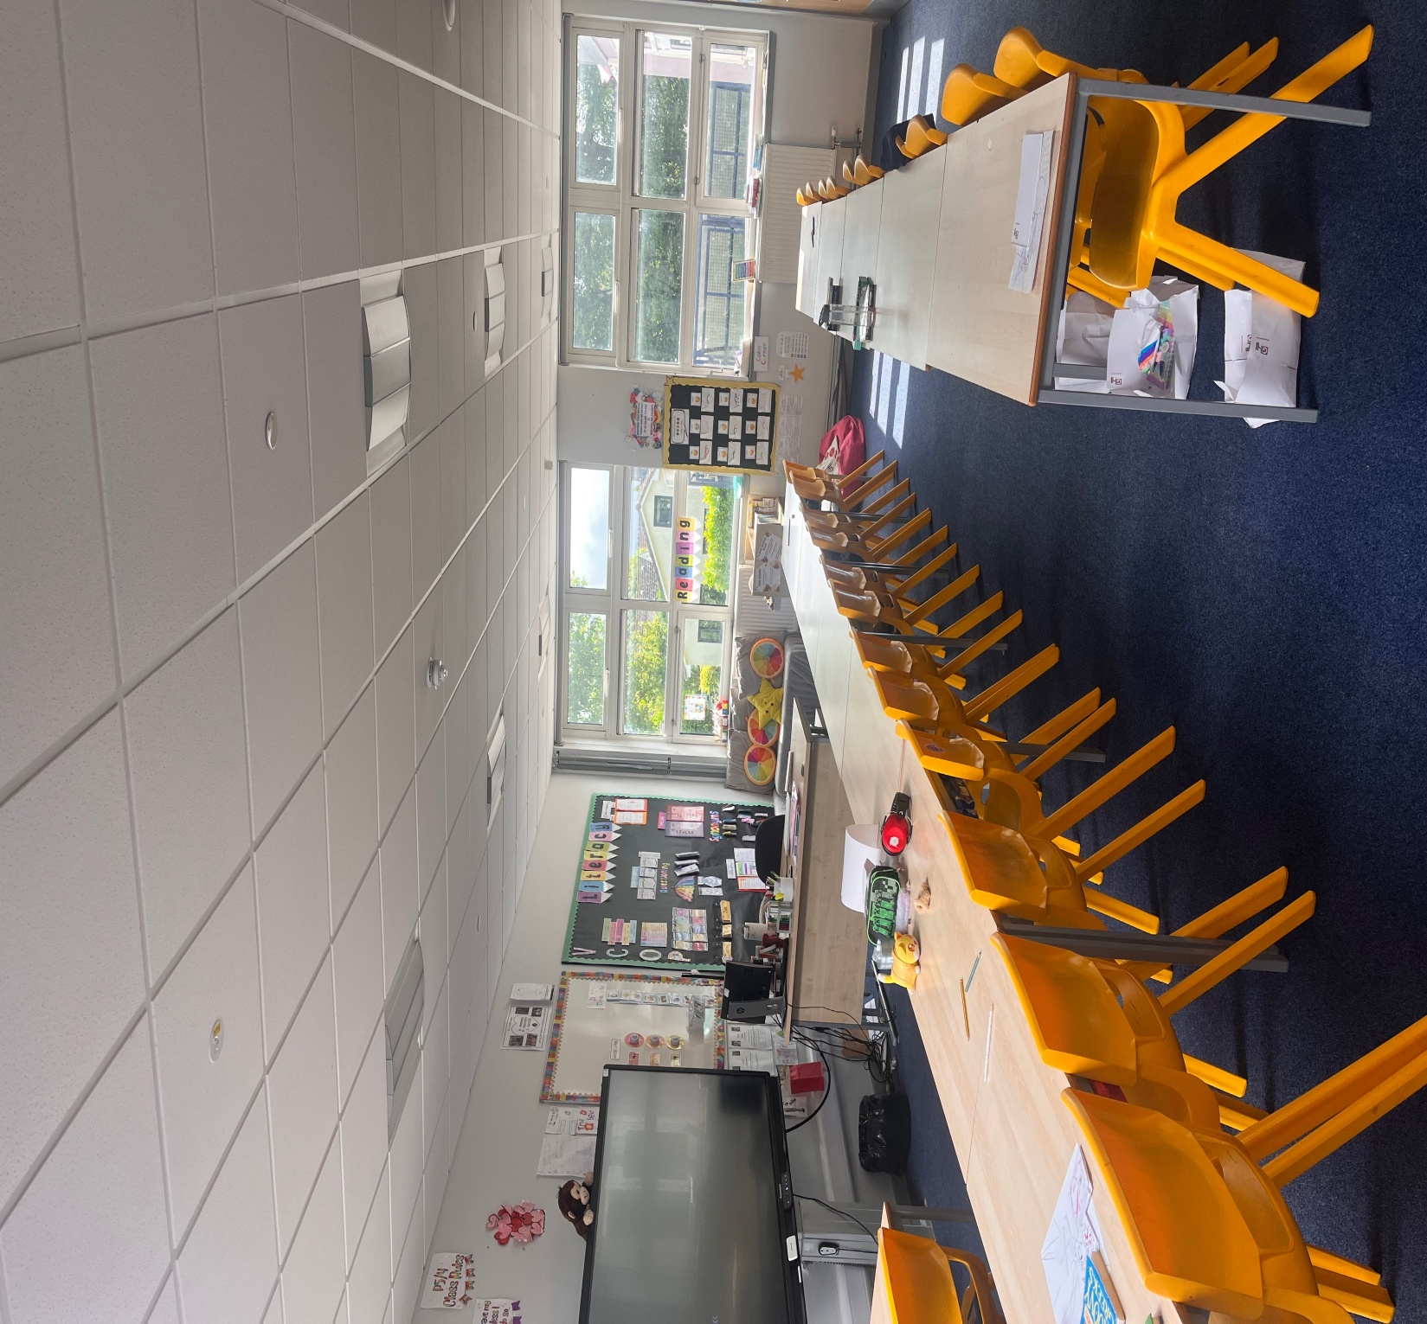
Here is your classroom.

Slide 5
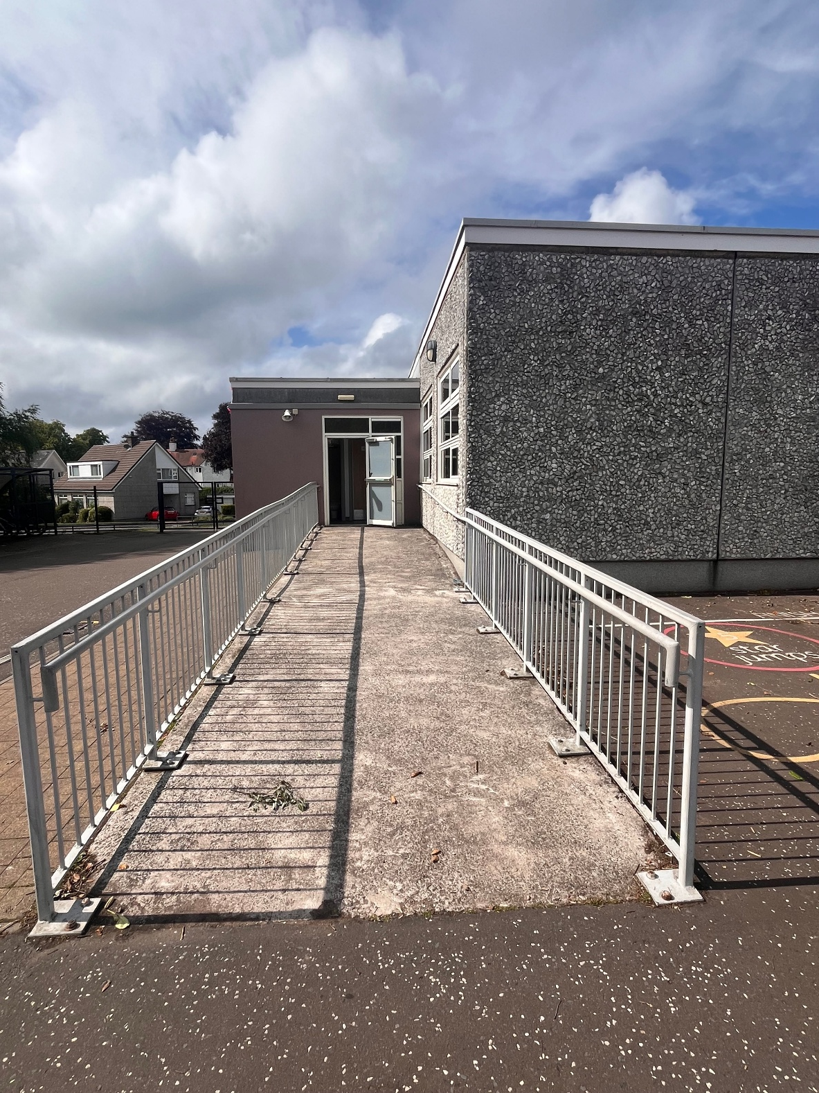
This is the way you will enter and exit your classroom…

Slide 6


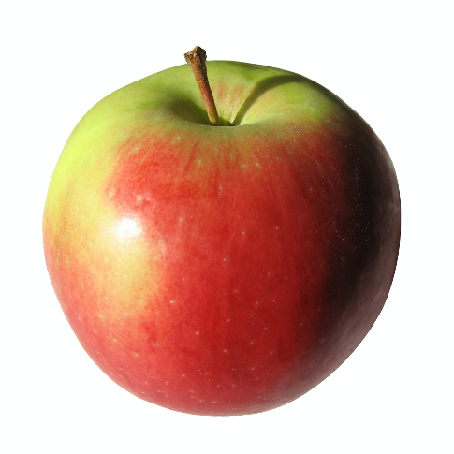
What to bring to school
You will need…
a filled water bottle
a snack
and
You will also bring a packed lunch or order from the school menu.
You can wear either full or relaxed school uniform with no branded items.

Slide 7

Here are some subjects you will be exploring in school…
Numeracy
Health & Wellbeing
Literacy
Outdoor Learning/Topic
STEM
Expressive Arts

Slide 8
KPS - Our School Values
In P6/5, everyone is welcome and everyone matters. We all have different strengths, interests and things we find tricky, and that's what makes our class special.
My goal is to make sure every child feels included, supported and able to do their very best.
Throughout the year, we'll work together to show our school values of Kindness, Positivity and Success, helping each other, celebrating our achievements and making sure everyone has the chance to shine.

Slide 9
Find us on Twitter!
@MissW_KPS
@KilmacolmPS

Slide 10
I can’t wait to see you!
I am super excited to be your teacher in August and we can’t wait to join you on your exciting adventures.
Take care and have a relaxing summer,
Miss Wilkins

