Slide 1

Welcome to...
Primary 5

Slide 2
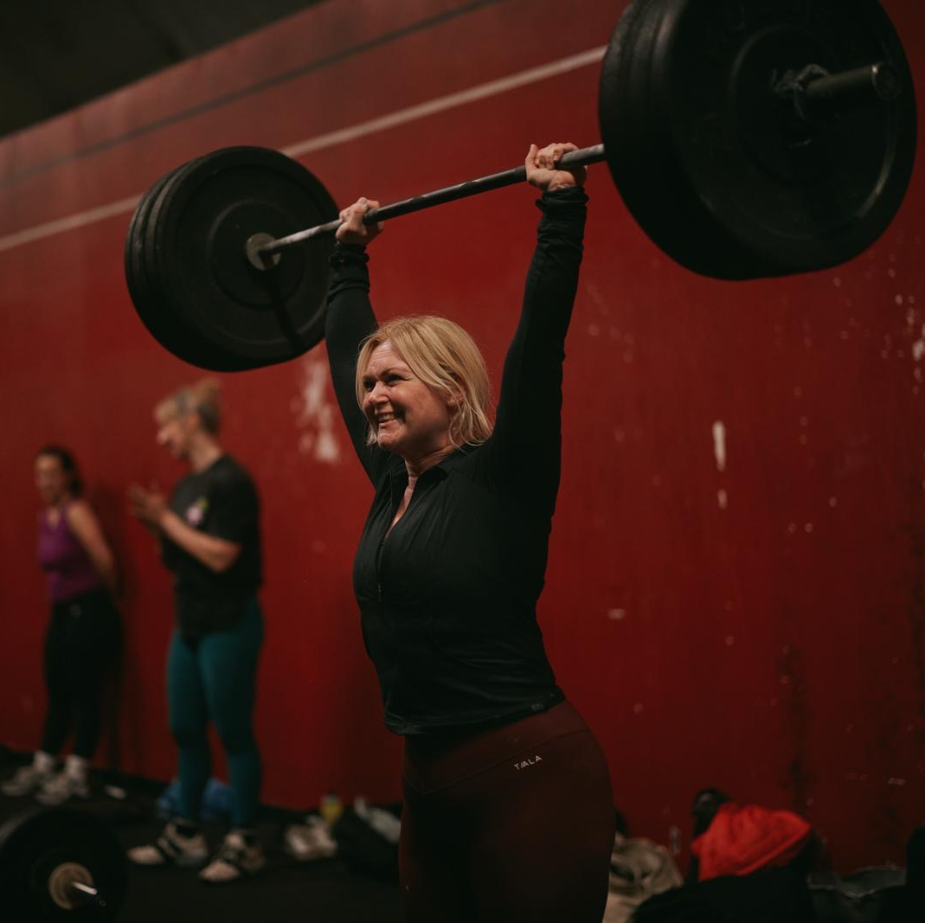
Hello, I am Miss Wilkins
Hello P5, I’m so so excited to be teaching you all again this year and I know we will just have the best year!
I will be teaching you from Tuesday – Friday each week, but I’m also delighted to say that Mrs K will be teaching you on Mondays when I’m not here.
I have so many lovely ideas for our learning journey together this year, and I can’t wait to get started in August!

Slide 3
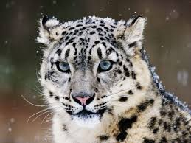

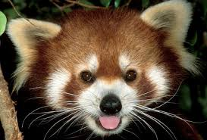
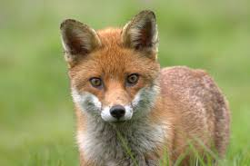
Hello, I am Miss Wilkins
Click on the boxes below to reveal some fun facts about me
This is my second year teaching at KPS, and my 7th year as a primary teacher. Before that however, I used to be a music teacher and really love Musical Theatre!
My favourite colours are blue and yellow.
I love going to the gym and train both Olympic Weightlifting and CrossFit. I won a Silver medal at the European Masters Championships in weightlifting and hope to make it back to the podium this year!
My favourite subjects to teach are: music, art, writing and numeracy.
I love animals so much and my favourite animals are snow leopards, foxes and red pandas.
I love to travel and have visited over 20 different countries around the world. I’m not sure however, that I could tell you which one was my favourite!

Slide 4
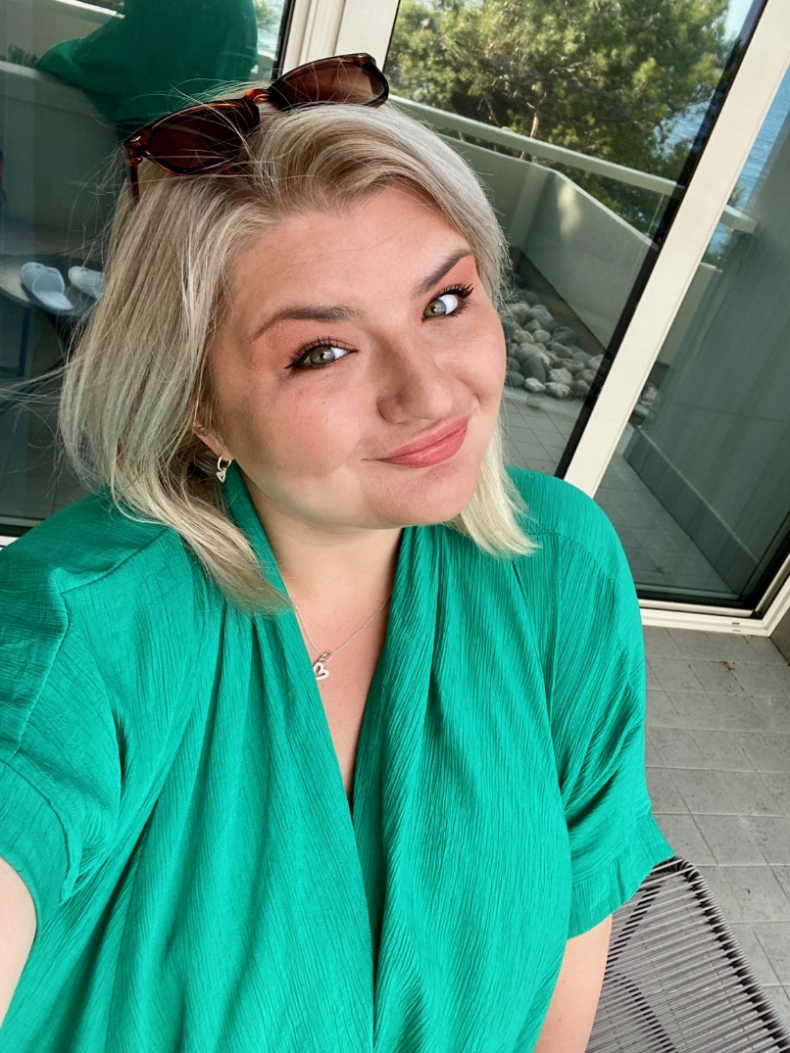
Hello, I am Mrs K!
Hello P5!
My name is Mrs K, but you know that already! I am so excited to be working with Miss Wilkins again this year and to be teaching you in P5!
I will be your teacher when Miss Wilkins has her RCC time and all day on Wednesdays.
I have lots of exciting things planned for our time together!

Slide 5
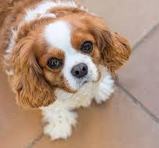
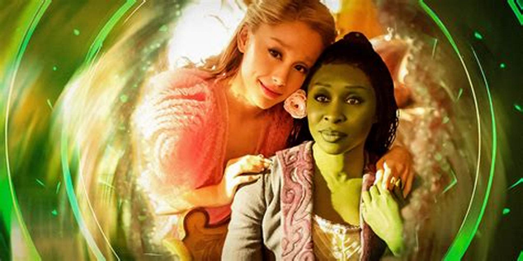
Hello, I am Mrs K…
Click on the boxes below to reveal some fun facts about me
I have 3 children. Eddie who is 7 and Thea who is 6, you probably know them! Our big boy Jack is 18 and at University!
My favourite colours are green and pink.
I love reading and you might see me at the Kilmacolm Library!
My favourite things to teach are reading skills, writing, art and topic.
I love dogs! I have two cute but crazy dogs called Roly and Phoebe.
I love the movie Wicked and can’t wait to see Part 2!

Slide 6
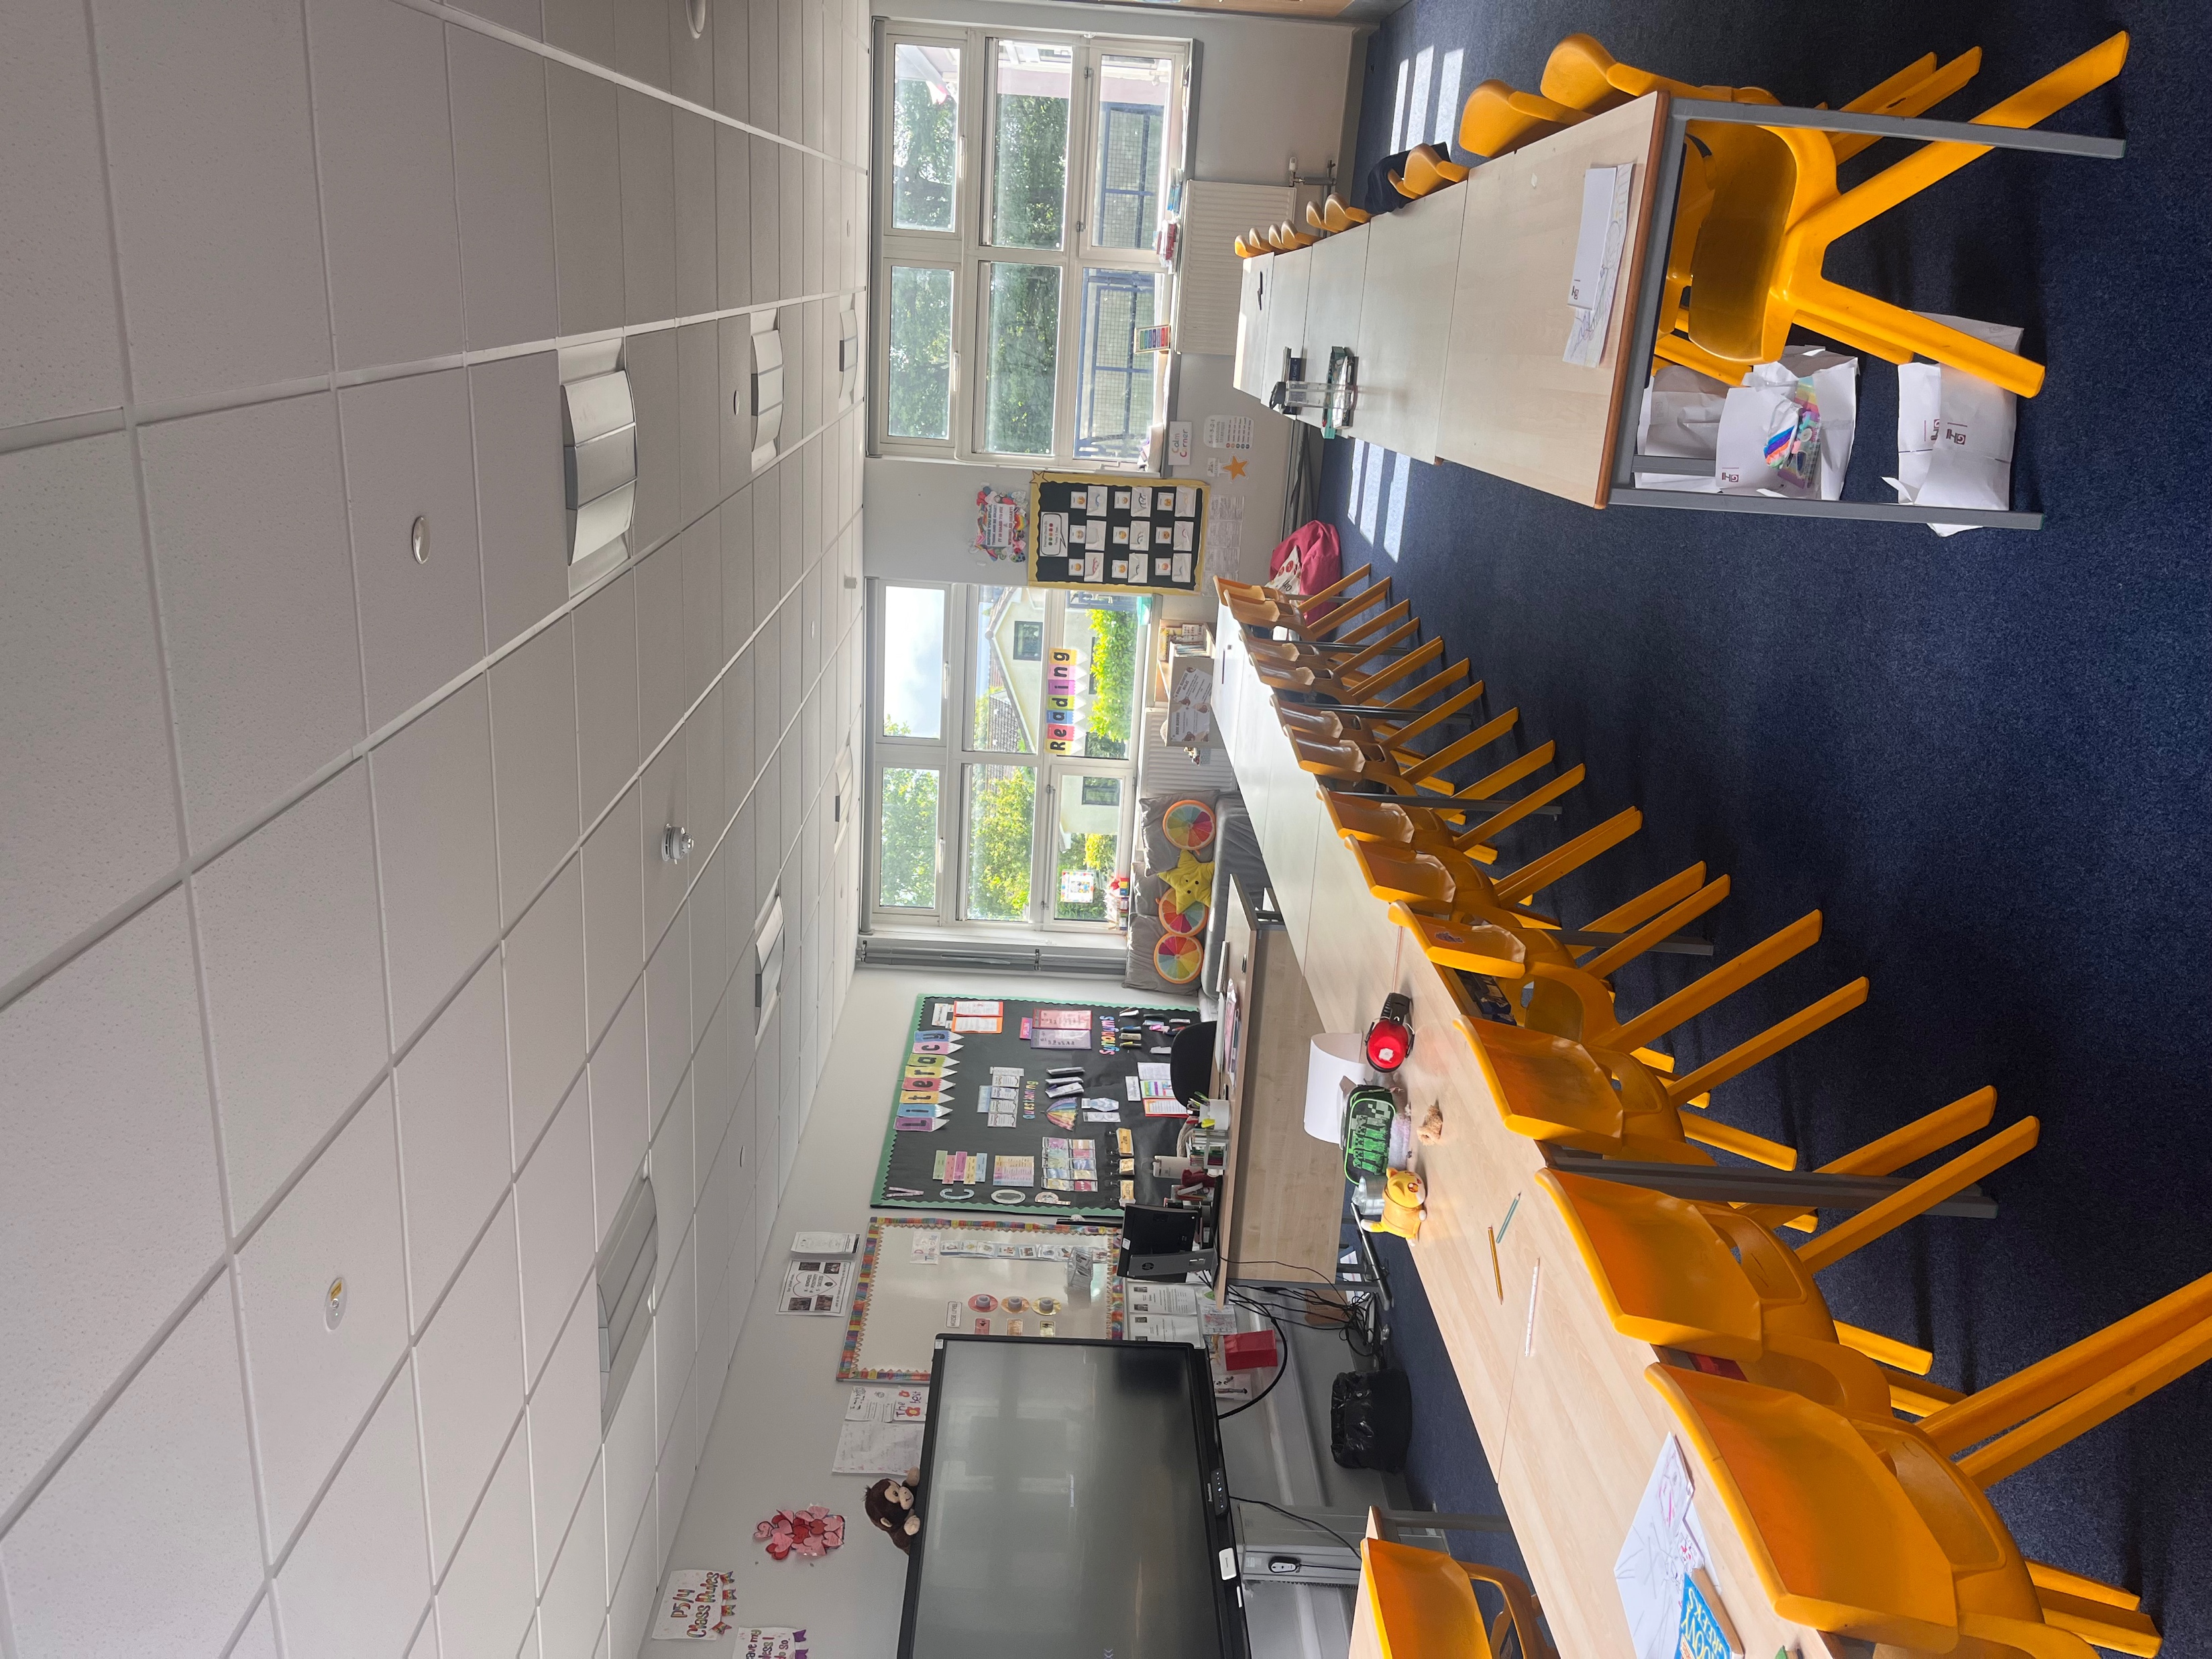
Here is your classroom.

Slide 7
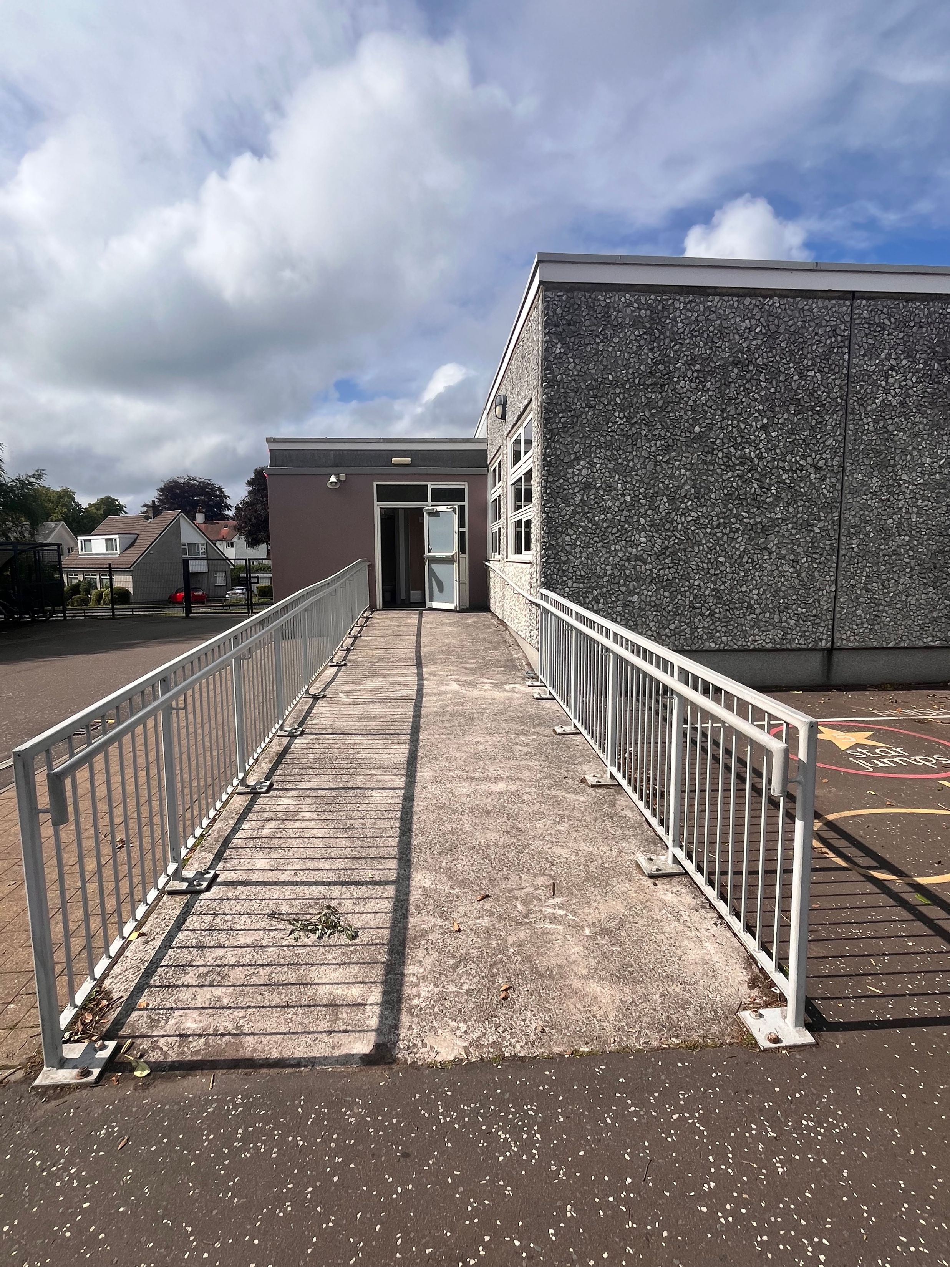
This is the way you will enter and exit your classroom…

Slide 8
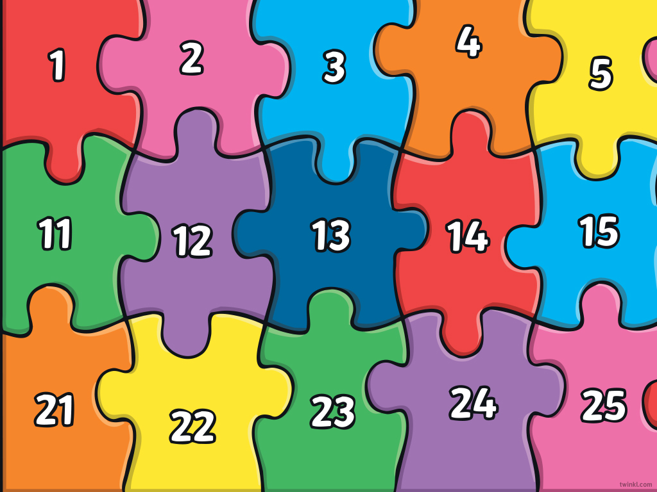

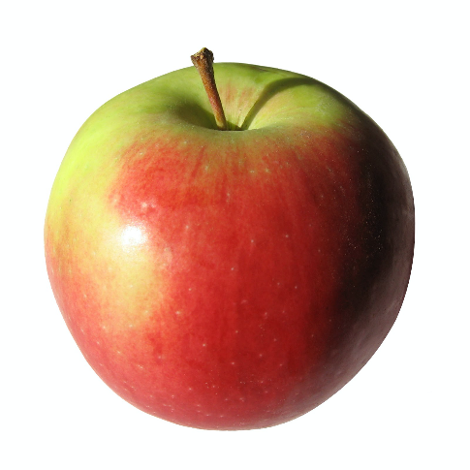
What to bring to school
You will need…
a filled water bottle
a snack
and
You will also bring a packed lunch or order from the school menu.

Slide 9

Here are some subjects you will be exploring in school…
Numeracy
Health & Wellbeing
Literacy
Outdoor Learning/Topic
STEM
Expressive Arts

Slide 10
Find us on Twitter!
@MissW_KPS
@MrsK_KPS
@KilmacolmPS

Slide 11
We can’t wait to see you!
We are super excited to be your teachers in August and we can’t wait to join you on your exciting adventures.
Take care and have a relaxing summer,
Miss Wilkins and Mrs K

