Slide 1
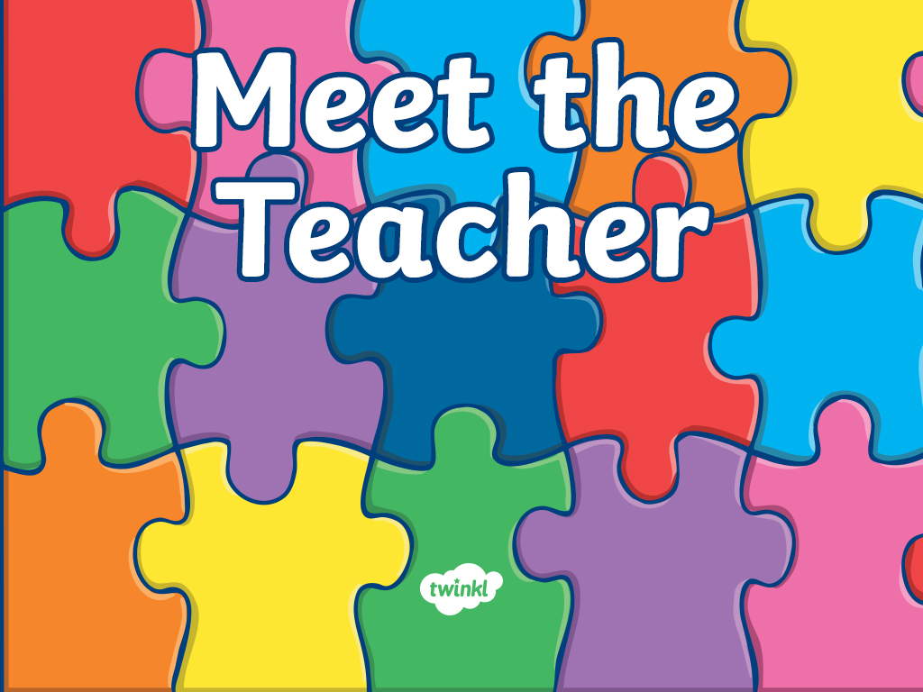
Welcome to...
Primary 4
with Miss Bradley and Mrs K

Slide 2
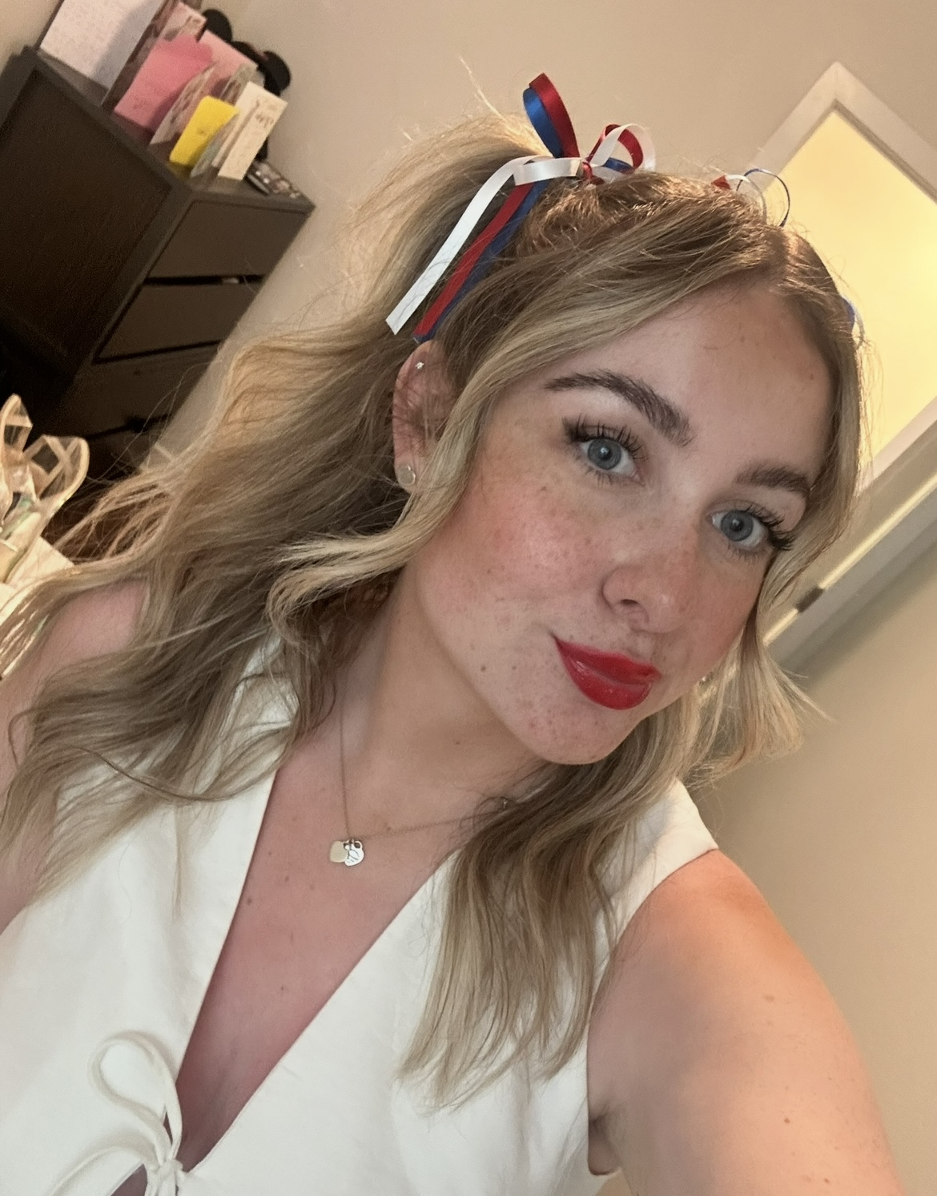
Hello, I am Miss Bradley!
Hello P4!
My name is Miss Bradley and I’m a brand new teacher at KPS! I feel so lucky that my very first class here is you ! I’ve already heard how amazing P4 is, and I can’t wait to learn, laugh, and explore lots of new things together this year.
I’ll be teaching you from Monday through to Thursday mornings, and I’ll be working closely with the lovely Mrs K – we’re both super excited for all the fun and learning ahead. Let’s make it a fantastic year!

Slide 3
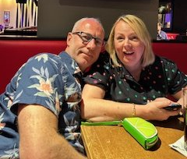
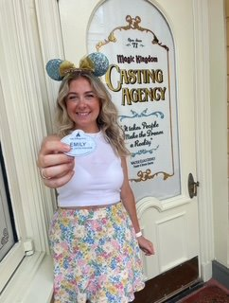

Hello, I am Miss Bradley…
Click on the boxes below to reveal some fun facts about me
I am an only child and live at home with my mum and dad!
My favourite colour is pink!
I love keeping fit and going to the gym… but I equally love food, especially pizza and chocolate.
My favourite things to teach are numeracy and topic! But I cannot wait to teach some STEM lessons!
I love Disney and worked for Disney in Florida last summer!
My favourite movies are Harry Potter and ALL of the Disney movies!

Slide 4
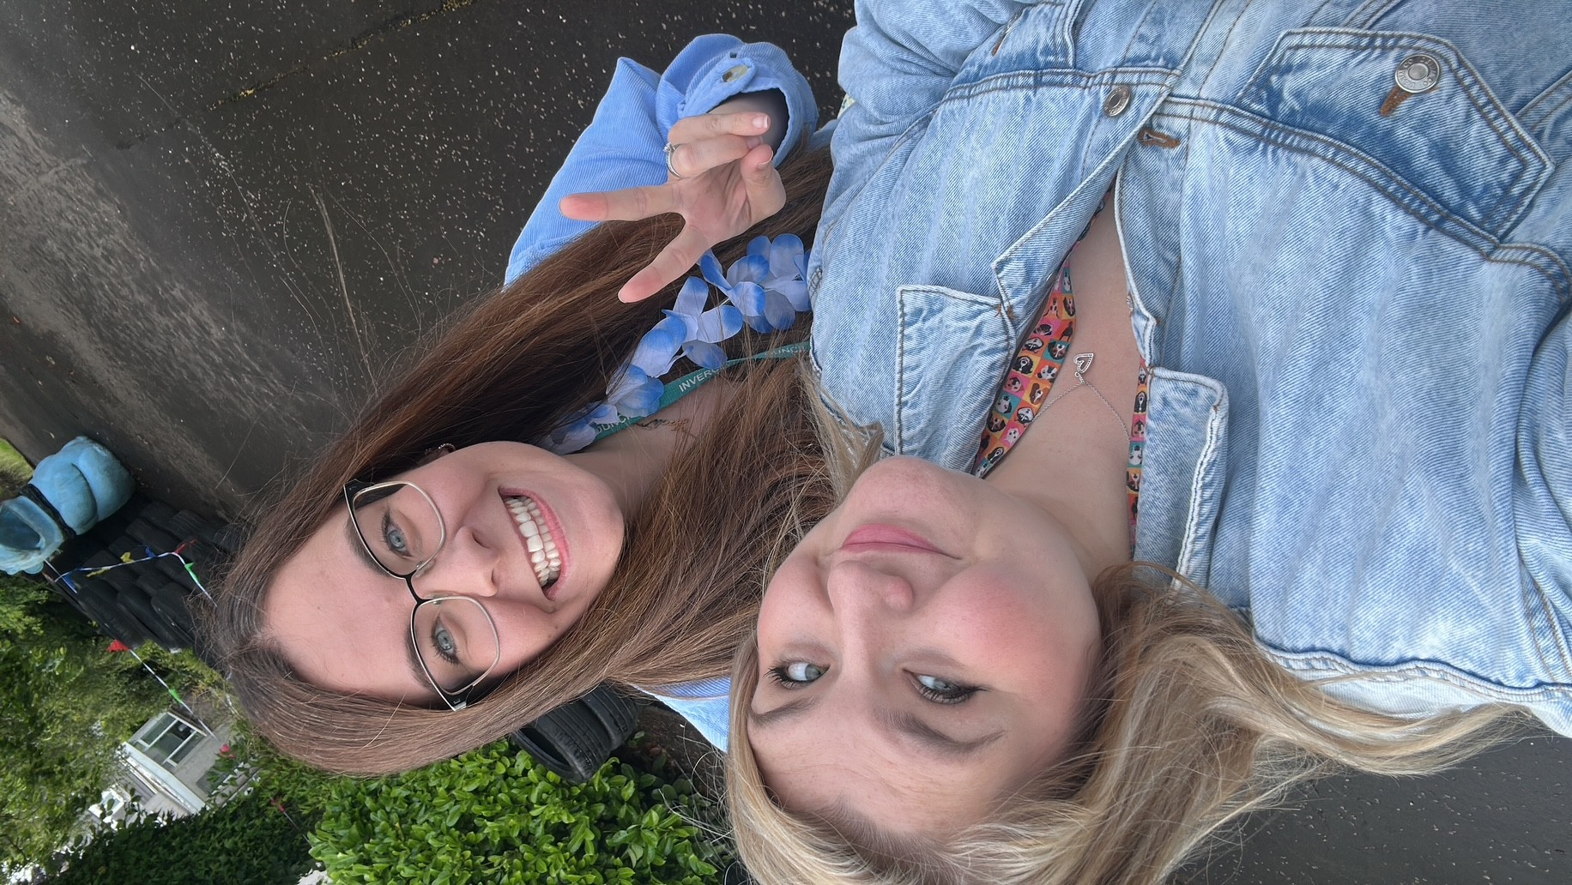
Hello, I am Mrs K!
Hello P4!
My name is Mrs K, I have been a teacher at KPS since 2018 so I already know most of your faces- I might even have taught some of your brothers and sisters!
I am so excited to be working with Miss Bradley this year. I will be teaching you on Thursday afternoons and all day on Fridays. I can’t wait to get started!
Mrs Hughes and I having fun at KPS Fest!

Slide 5
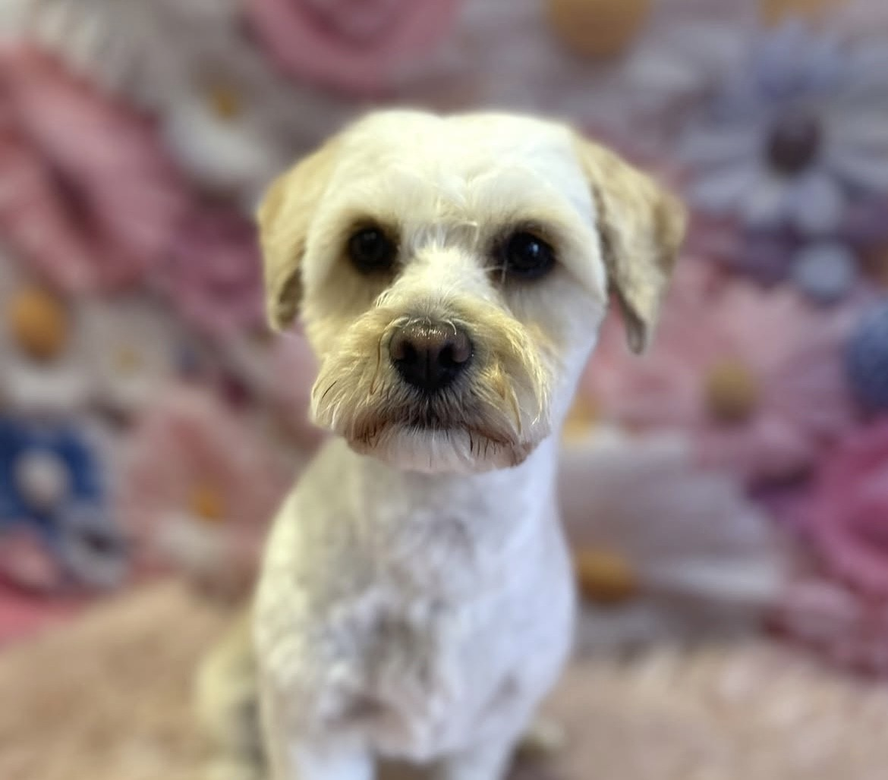
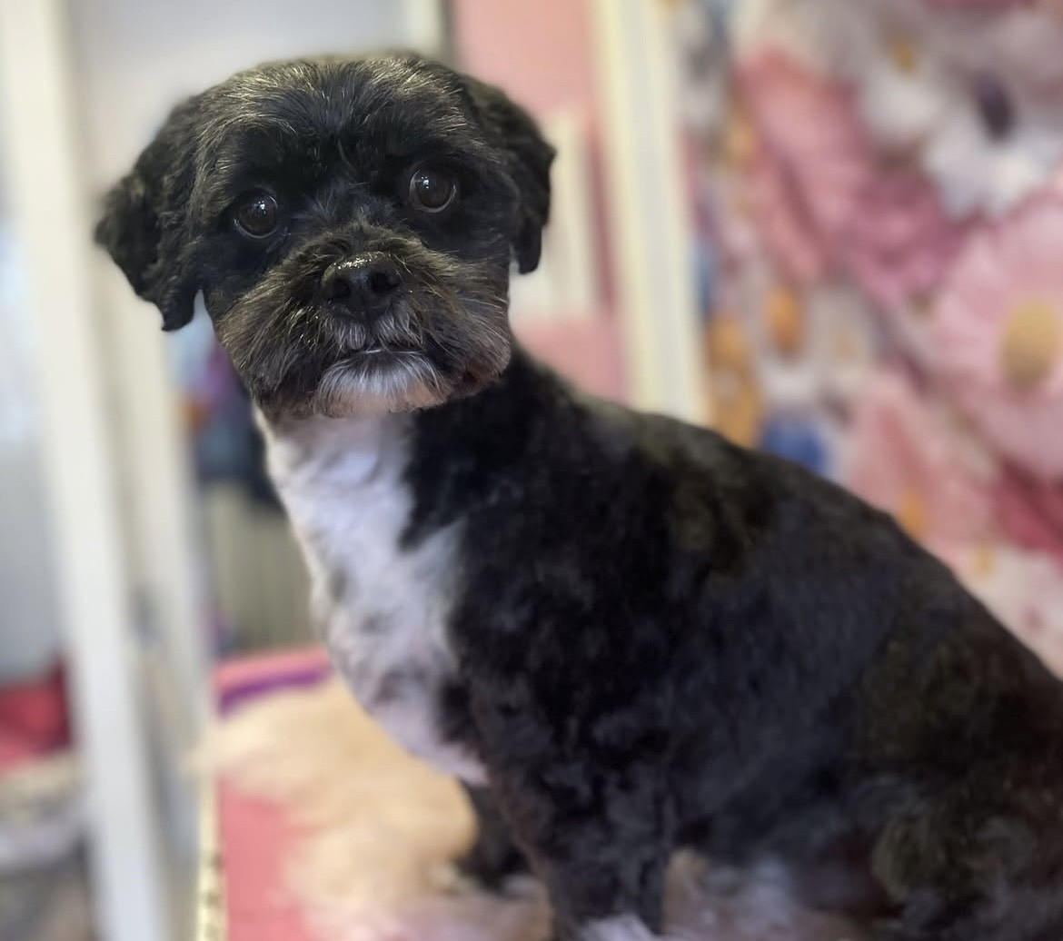

Hello, I am Mrs K…
Here are some fun facts about me…
I have 3 children. Eddie is 7 and Thea is 6, you probably know them!
Our big boy Jack is 18 and at University!
My favourite colours are green and pink.
I love reading and you might see me at the Kilmacolm Library!
My favourite things to teach are reading skills, writing, art and topic.
I am dog daft! I have two cute but crazy dogs called Roly and Phoebe.
I love the movie Wicked and can’t wait to see Part 2!

Slide 6
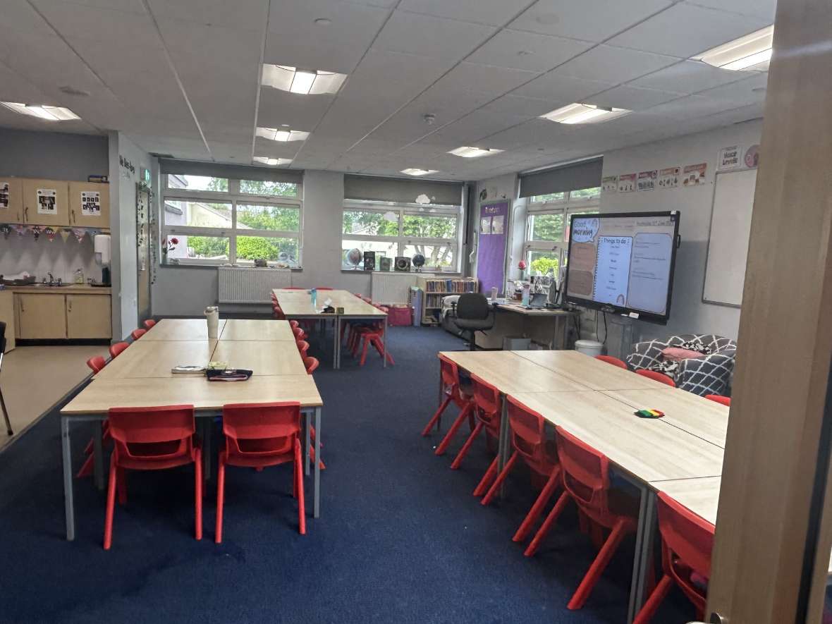
Here is your classroom.

Slide 7
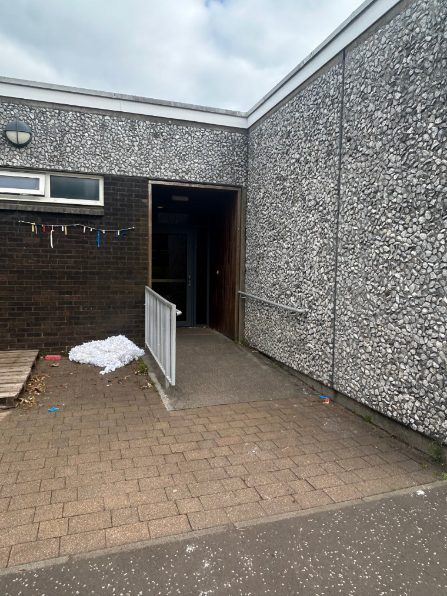
This is the way you will enter and exit your classroom…

Slide 8
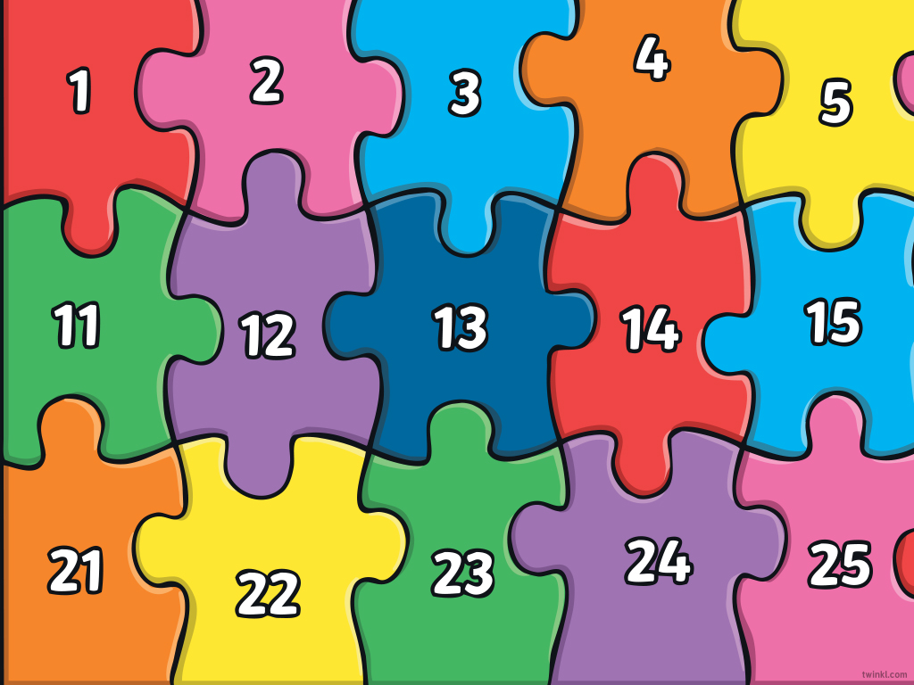

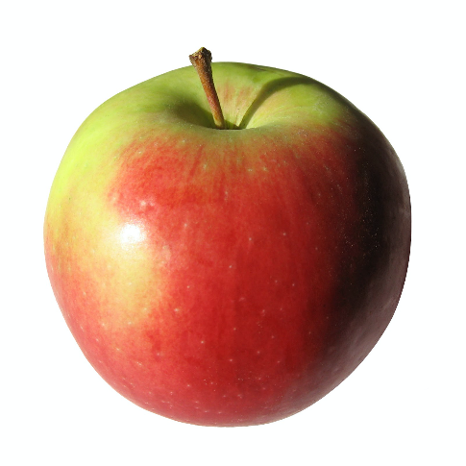
What to bring to school
You will need…
a filled water bottle
a snack
and
You will also bring a packed lunch or order from the school menu

Slide 9

Here are some subjects you will be exploring in school…
Numeracy
Health & Wellbeing
Literacy
Outdoor Learning/Topic
STEM
Expressive Arts

Slide 10
Find us on Twitter!
@MissBradley_KPS
@MrsK_KPS
@KilmacolmPS

Slide 11
We can’t wait to see you!
We are super excited to be your teachers in August and we can’t wait to join you on your exciting adventures.
Take care and have a relaxing summer,
Miss Bradley and Mrs K

