Slide 1
Welcome to...
Primary 5/4
with
Miss McMullan and Mrs Addison

Slide 2
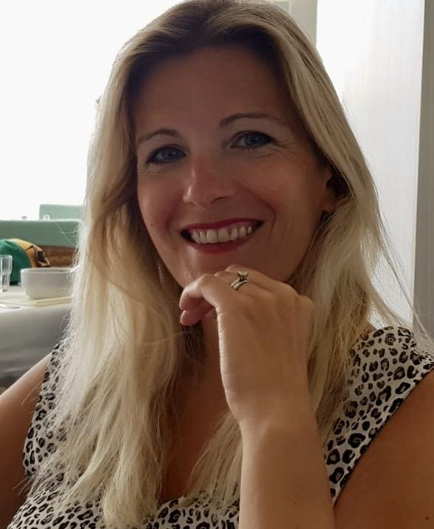
Hello, I am Mrs Addison!
Hello boys and girls, my name is Mrs Addison and I will be teaching P5/4 this year!
I have had the pleasure of working with lots of you already and I am really looking forward to getting to know the rest of you this year.
I live with my husband, Craig and my two children Isla who is 12 and Harris who is 10. ☺
I love teaching in KPS! In our school we are all a great team and are lucky to have the best children!
I can’t wait to see all of you in August! We are going to have lots of fun learning together! ☺

Slide 3
Hello, I am Mrs Addison!
Click on the boxes below to reveal some fun facts about me
I love reading and going for long walks.
My favourite food is Chinese!
I love spending time with my husband and my two children.
I wear contact lenses!
I love travelling, seeing new places and having fun at a beach!
My favourite colour is blue!

Slide 4
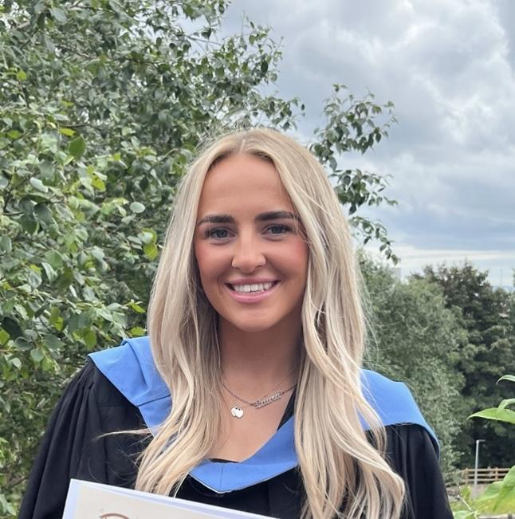
Hello, I am Miss McMullan
Hello! I'm Miss McMullan, and I'm delighted to be your teacher this year.
I cannot wait to meet each of you and watch you grow as we start our school year in August. We're going to have a fantastic time learning together, exploring new ideas, tackling challenges, and celebrating our achievements.
This is my first year teaching at KPS, and I feel incredibly fortunate to join such an amazing school. I look forward to contributing to an environment where everyone feels valued and encouraged to do their best.
I can't wait to see you all in August where we will start this exciting adventure together!

Slide 5
Hello, I am Miss McMullan!
Click on the boxes below to reveal some fun facts about me
I love being outdoors and going long walks with my dog.
I enjoy lots of different sports.
My favourite subjects to teach are maths and PE!
I love travelling and exploring new places.
I enjoy spending time with family and friends.
My favourite colours are pink and blue.

Slide 6
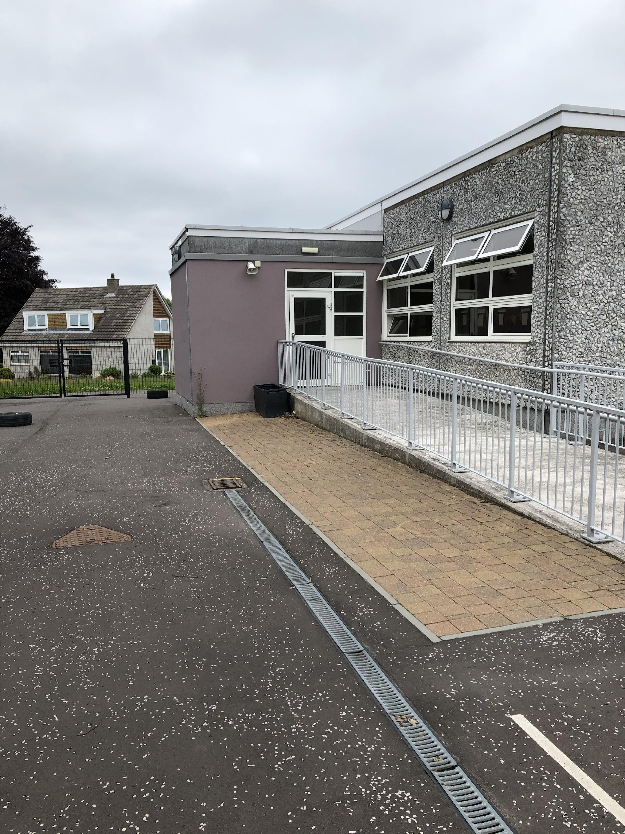
Here is the entrance to the P5/4 classroom…

Slide 7
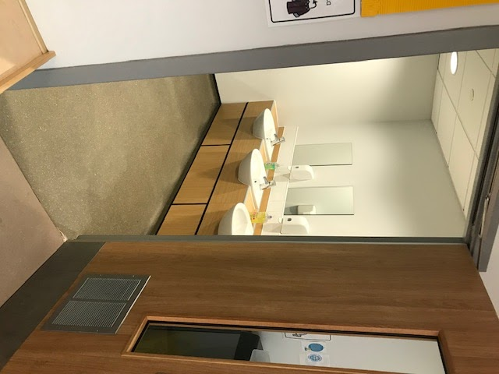
Hand washing
You will wash your hands when you come into school and regularly throughout the day

Slide 8
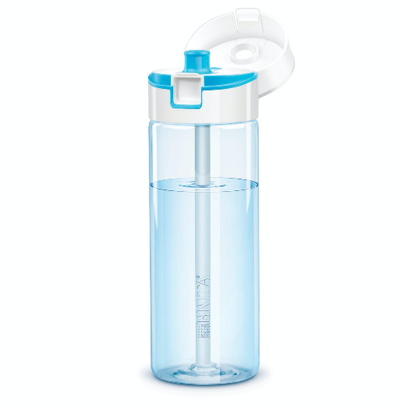
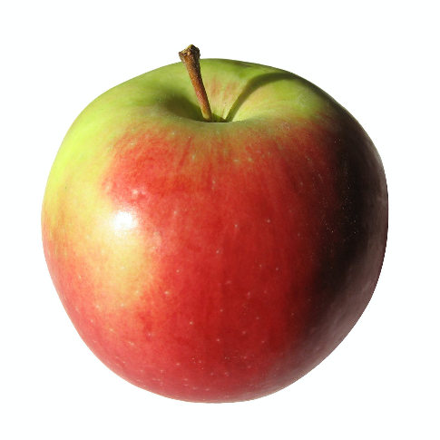
What to bring to school
You will need…
a filled water bottle
a snack
and
You will also bring a packed lunch or order from the school menu

Slide 9
Here are some subjects you will be exploring in school…
Numeracy
Health & Wellbeing
Writing
Outdoor Learning
Reading
Spelling

Slide 10
Find me on Twitter!
@mrs_addisonKPS
@KilmacolmPS

Slide 11
I can’t wait to see you!
I hope you have a lovely summer and I am really looking forward to seeing you all in August.
Take care!
☺ Miss McMullan and Mrs Addison ☺

Slide 12
