Slide 1
Welcome to...
Primary 4 with
Mrs Kretowicz

Slide 2
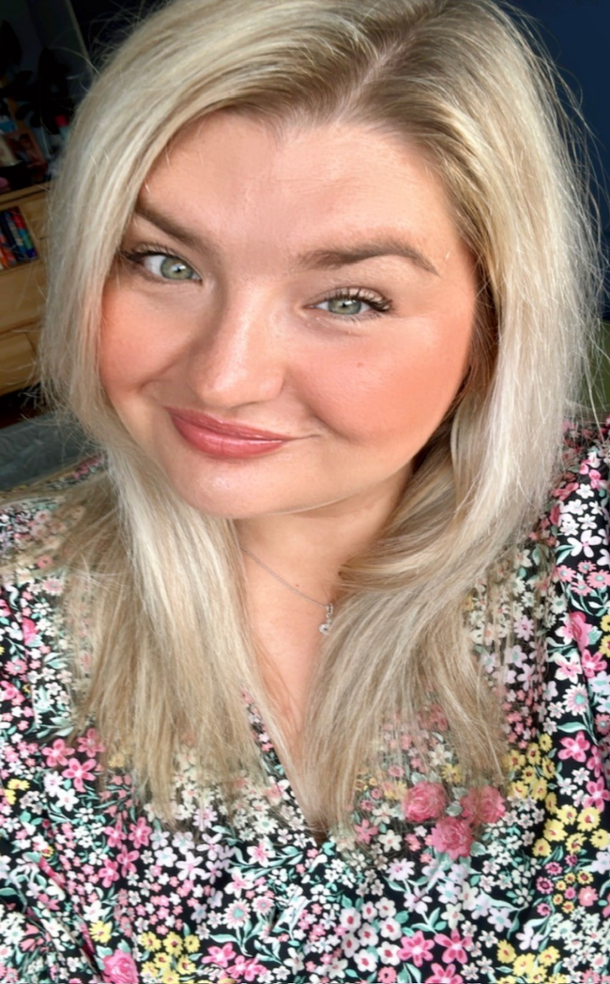
Hello everyone! I am Mrs Kretowicz, but you can call me Mrs K. ☺
Welcome to Primary 4!
I’ve been a teacher at KPS for quite a while now and for the last 4 years I’ve been teaching the oldest children in the school. I might even have taught some of your big brothers and sisters!
I am delighted to be making an exciting change this year. I’ve heard fabulous things about you all from Mrs Boyle and Mrs Nicholson so I feel very lucky to be the P4 teacher!
I hope you all have a lovely summer and I can’t wait to see you again in August!

Slide 3
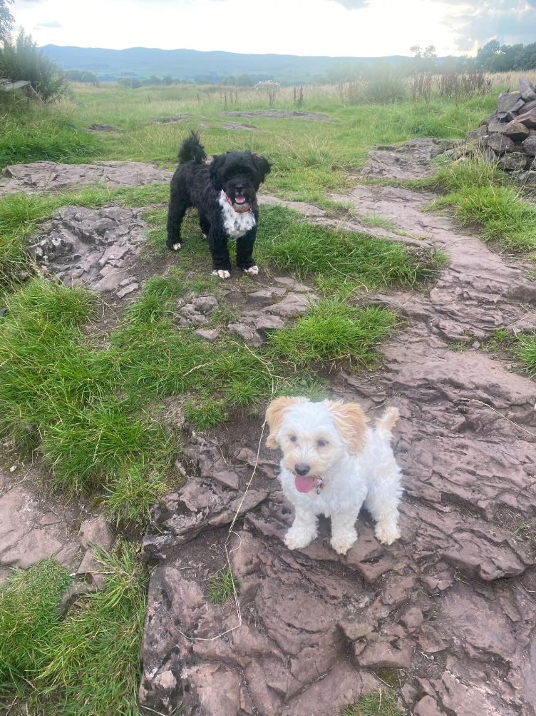
Getting to know each other…
Here are some facts about me and I would love to hear some facts about each of you!
I have 3 children:
Jack who is 17, Eddie who is 6 and
Thea who is 5. Some of you may
remember
Eddie from nursery!
My favourite animals are dogs. I have two dogs called Roly and Phoebe. They get up to all sorts of trouble but are very sweet!
My favourite colour is pink.
In my spare time I like to read, go on long walks and spend time with my family.

Slide 4
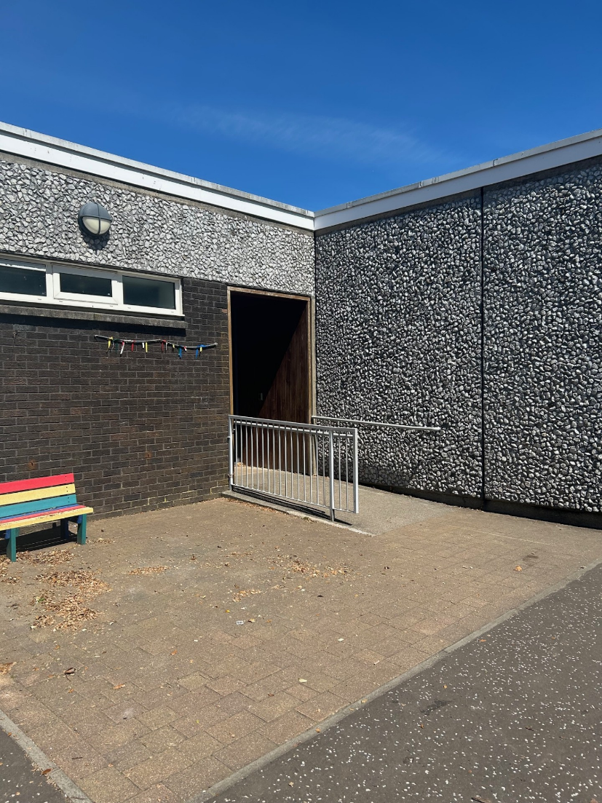
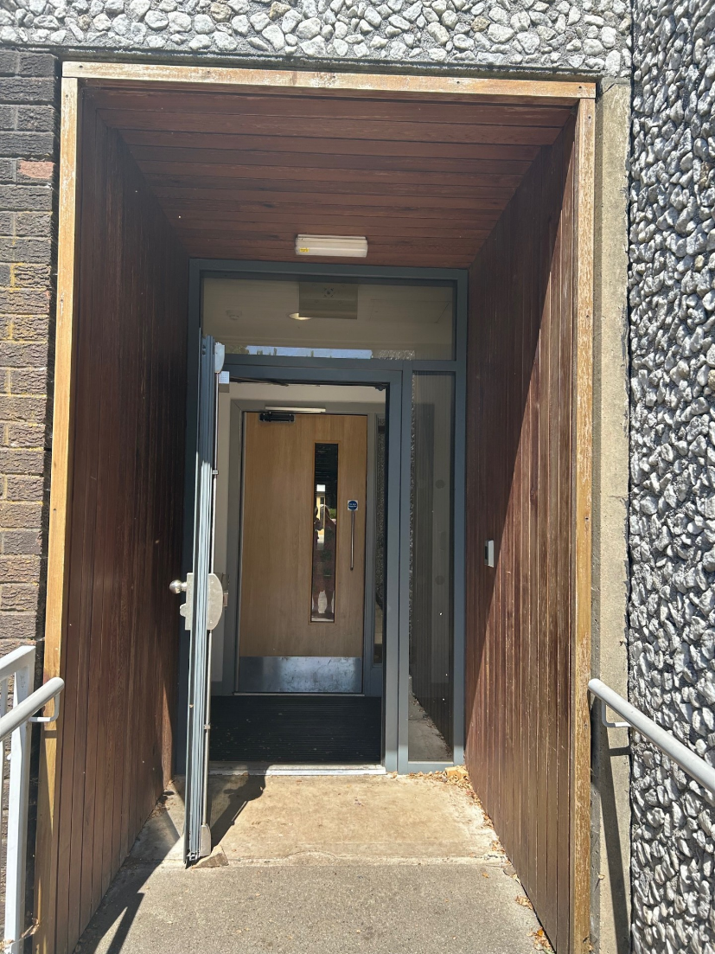
Here is the entrance and exit you will use to come into school in the morning and leave in the afternoon…

Slide 5
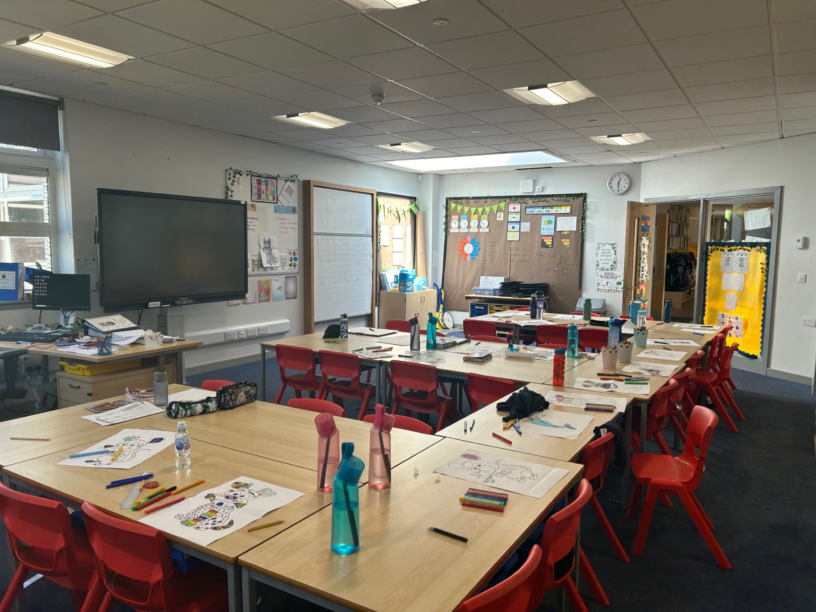
This is the P4 Classroom:

Slide 6
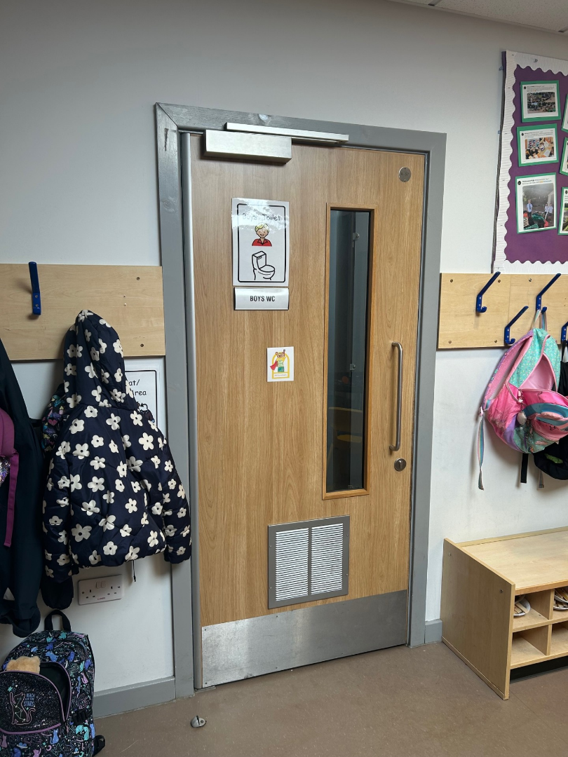
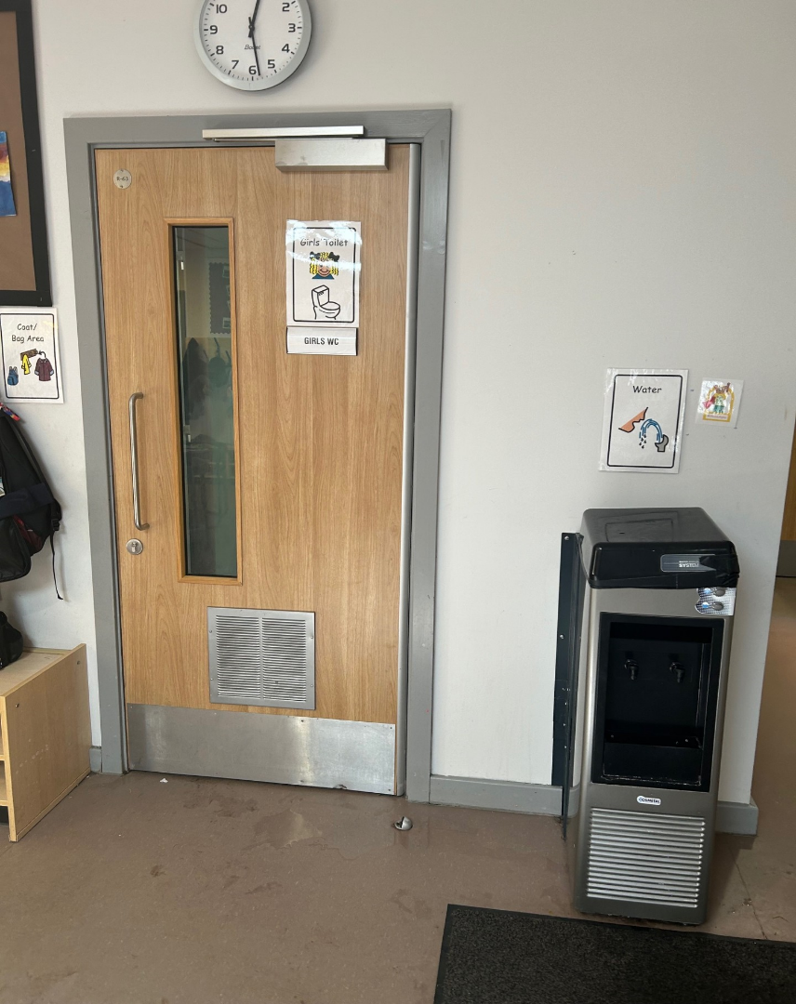
These are the toilets you will use in P4…

Slide 7
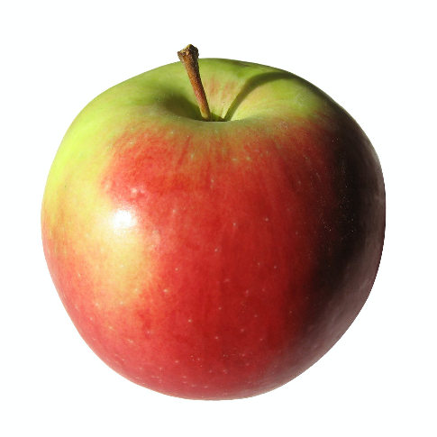
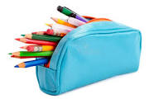
What to bring to school…
A water bottle
A snack
A pencil case
and
and
and very importantly a …
For lunch you can bring a packed lunch or order from the school menu.
In hot weather; bringing a sun hat and wearing sun cream is also a very good idea!

Slide 8
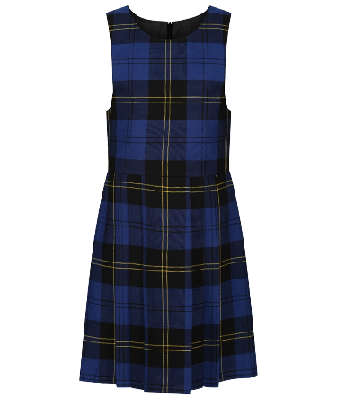
School Uniform
Next year at KPS you can wear full school uniform or relaxed uniform. Relaxed uniform may include;
a white polo shirt (school logo optional)
a blue jumper (school logo optional)
leggings/joggers
one pair of shoes
a waterproof jacket.
No Branded jumpers or hoodies please!

Slide 9
Here are some subjects you will be exploring in school…
Expressive Arts:
Drama/Music/Art & Design
Numeracy
STEM:
Science, Technology, Engineering and Maths
Literacy
Social Sciences:
History, Geography and Modern Studies- these will be explored through our topic work.
Health and Wellbeing

Slide 10
KPS Values
K for Kindness We love being kind at KPS! This means showing kindness to your classmates, school staff and respecting school equipment.
P for Positivity Every day in P4 is a fresh start! During P4 we will be learning about and using a Growth Mindset which will help us to stay positive!
S for Success Success in P4 means trying your best and celebrating the achievements of everyone in our class.

Slide 11
Find us on Twitter!
Mrs Kretowicz- @MrsK_KPS
Whole school - @KilmacolmPS
Mrs McPherson- @MrsMcPhersonKPS

Slide 12
See You Soon Primary 4!
I hope you all have a lovely summer break and I am really looking forward to seeing you in back in August!
Take care,
Mrs K

