Slide 1
Welcome to...
Primary 6/5
with
Mrs Crawford

Slide 2
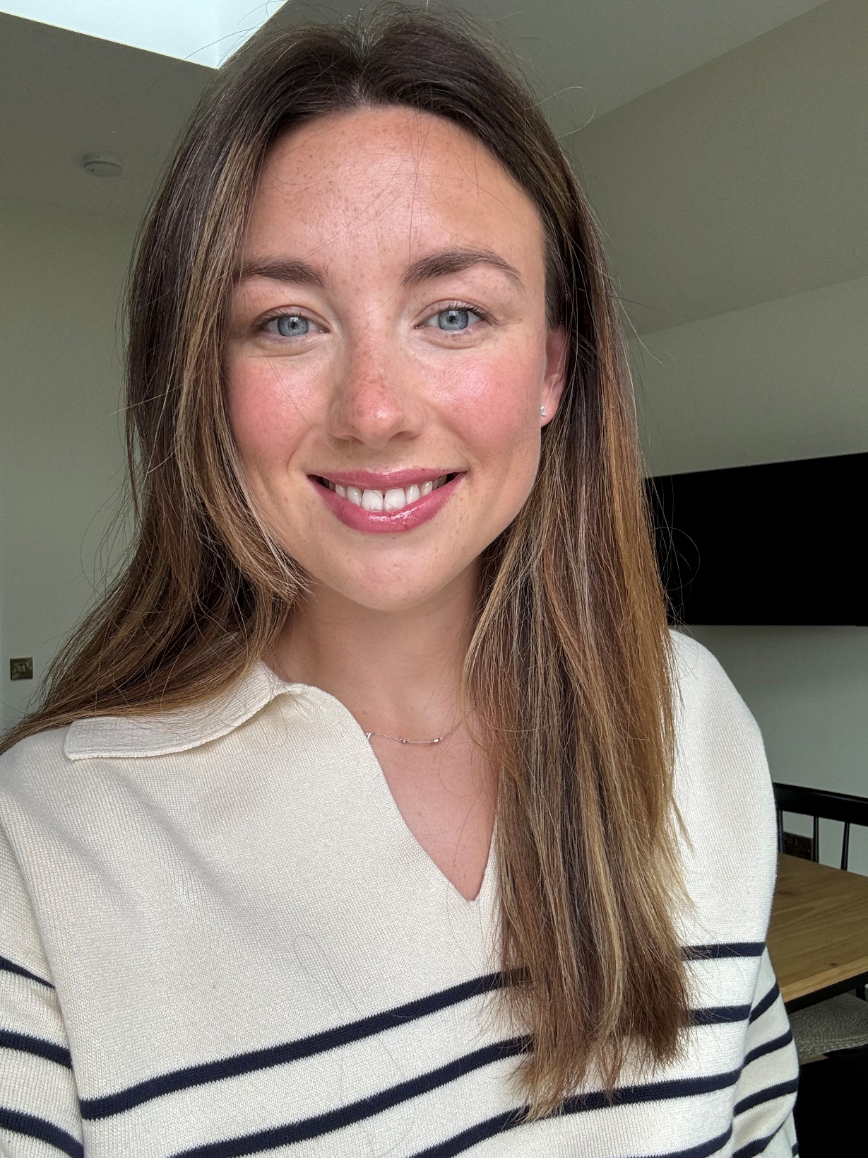
Hello, I am Mrs Crawford
Primary 6/5
I am so excited to meet you all! Before we get started on our fun-filled year together, let me introduce myself.
I moved to the village a few years ago and live with my husband, Blair, and our two children: Miles, who is 3, and Ottilie, who is 18 months. Having 2 little ones means I am a Paw Patrol and Bluey expert!
Now for some fun facts ☺

Slide 3
Hello, I am Mrs Crawford!
Some fun facts about me..
I love reading and listening to podcasts.
My favourite food is chocolate, I have such a sweet tooth!
I love spending time with my husband and my two children.
I really enjoy swimming.
I love travelling and visiting new places especially countries with a warmer climate than Scotland!
My favourite colour is pink.

Slide 4
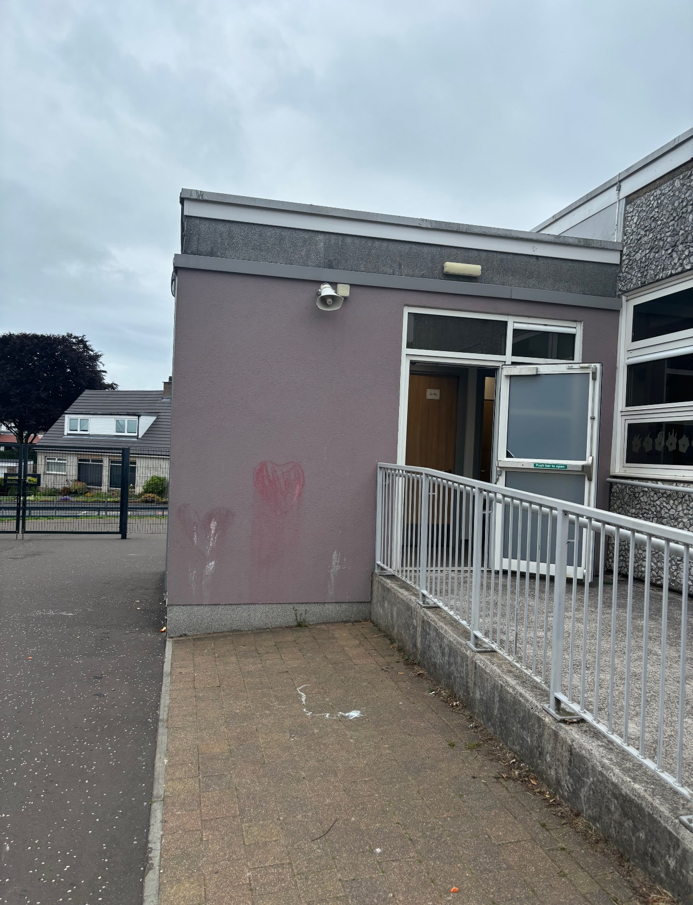
Here is the entrance to the P6/5 classroom…

Slide 5
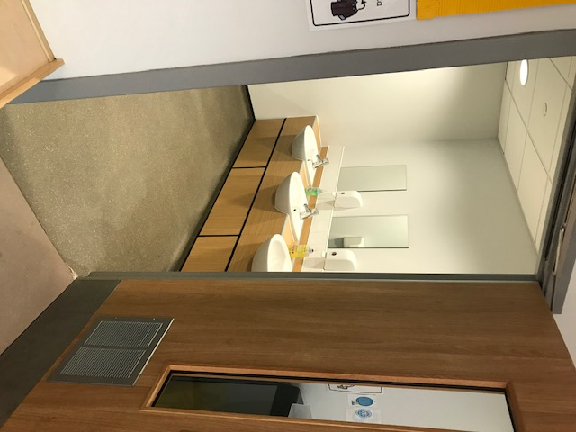
Hand washing
You will wash your hands when you come into school and regularly throughout the day

Slide 6
What to bring to school
You will need…
a filled water bottle
a snack
and
You will also bring a packed lunch or order from the school menu

Slide 7
Here are some subjects you will be exploring in school…
Numeracy
Health & Wellbeing
Writing
Outdoor Learning
Reading
Spelling

Slide 8
I can’t wait to see you!
I hope we all have a fantastic summer and I look forward to seeing you in August.
Take care!
☺ Mrs Crawford ☺

