Slide 1
Welcome to...
Primary 2/1
with
Mrs Gemmell

Slide 2
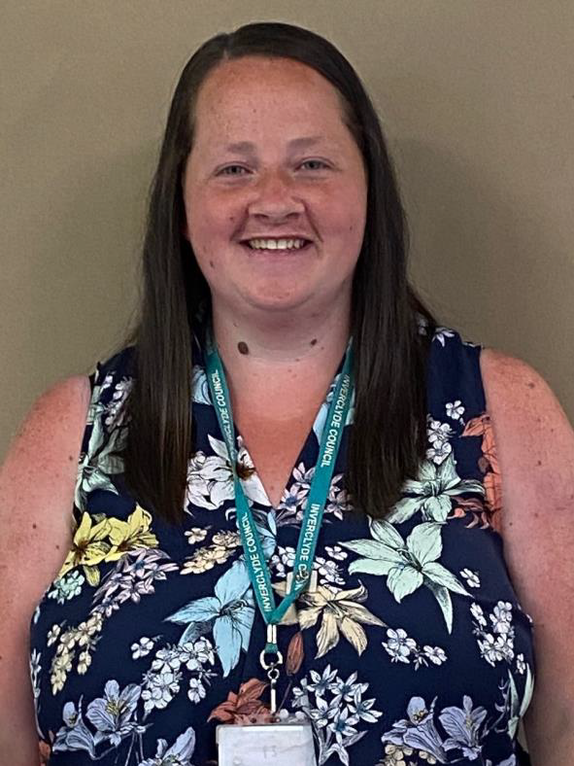
Hello, I am Mrs Gemmell!

Slide 3
A little bit about Mrs Gemmell!
Click on the boxes below to reveal some fun facts about me
I really love swimming!
I love spending time outdoors!
I love spending time with my husband and my three children.
My favourite food is sandwiches!
I love travelling, seeing new places and having fun at a beach!
My favourite colour is blue!

Slide 4
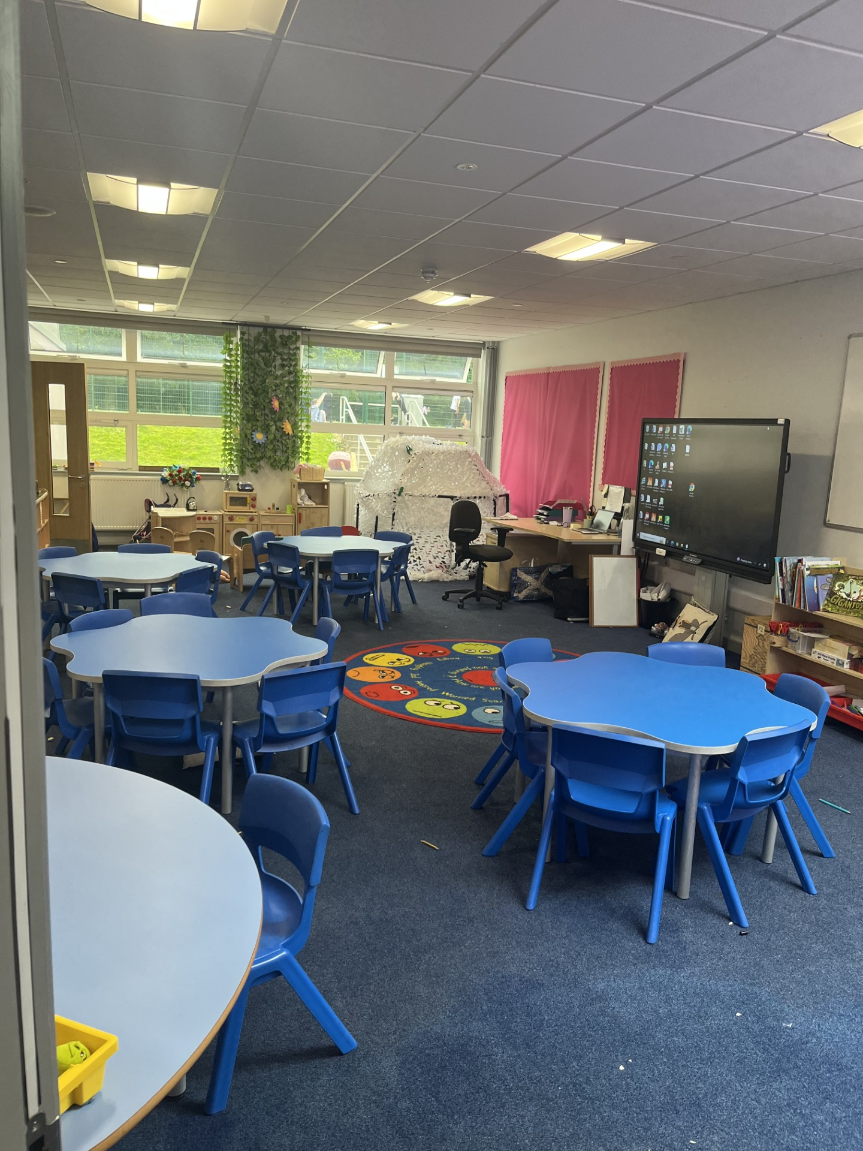
Here is our P2/1 Classroom!

Slide 5
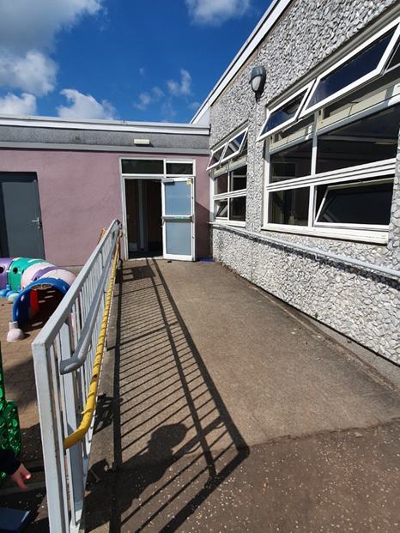
Here are the entrances and exits for the P2/1 classroom…

Slide 6
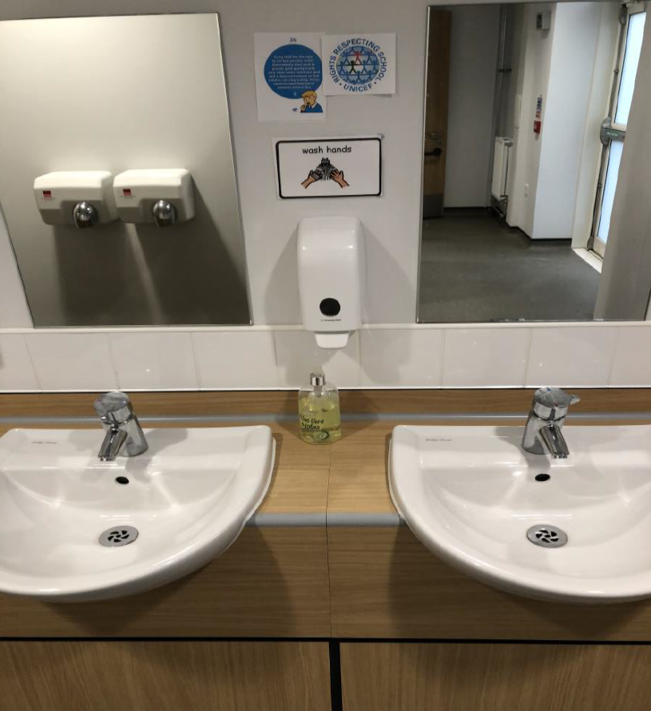
Hand washing
You will wash your hands when you come into school and regularly throughout the day.

Slide 7
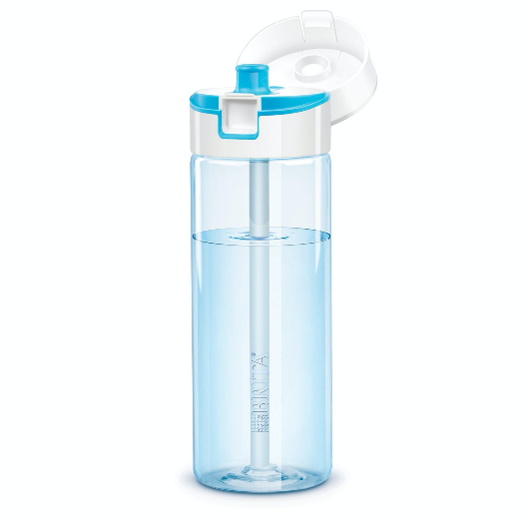
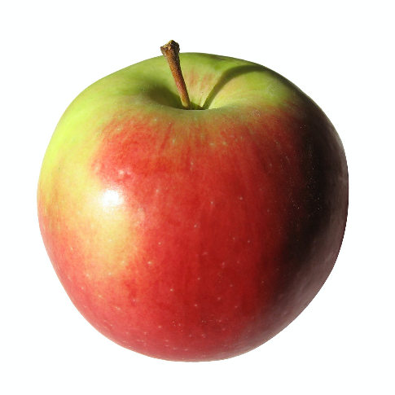
What to bring to school
You will need…
a filled water bottle
a snack
and
You will also bring a packed lunch or order from the school menu.

Slide 8
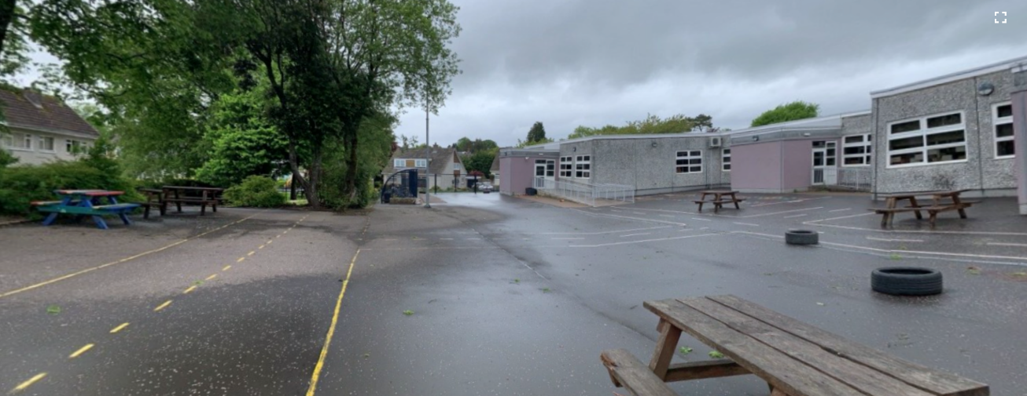
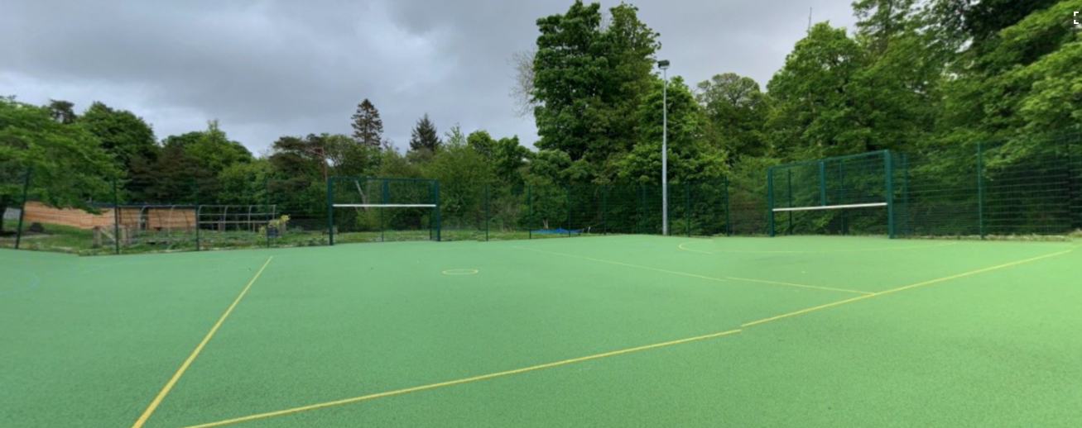
Break times
You will enjoy break times in the school playground and on the MUGA.

Slide 9
Here are some subjects you will be exploring in school…
Numeracy
Health & Wellbeing
Writing
Outdoor Learning
Reading
Spelling

Slide 10
Find me on Twitter!
@MrsGemmell_KPS
@KilmacolmPS

Slide 11
I can’t wait to see you!
I hope you have a lovely summer. I am really looking forward to seeing you all in August.
Take care!
Mrs Gemmell

