Slide 1

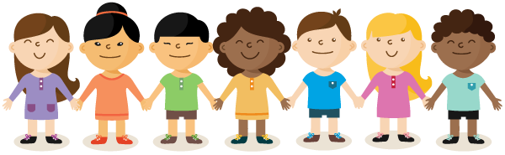
Welcome to P3

Slide 2

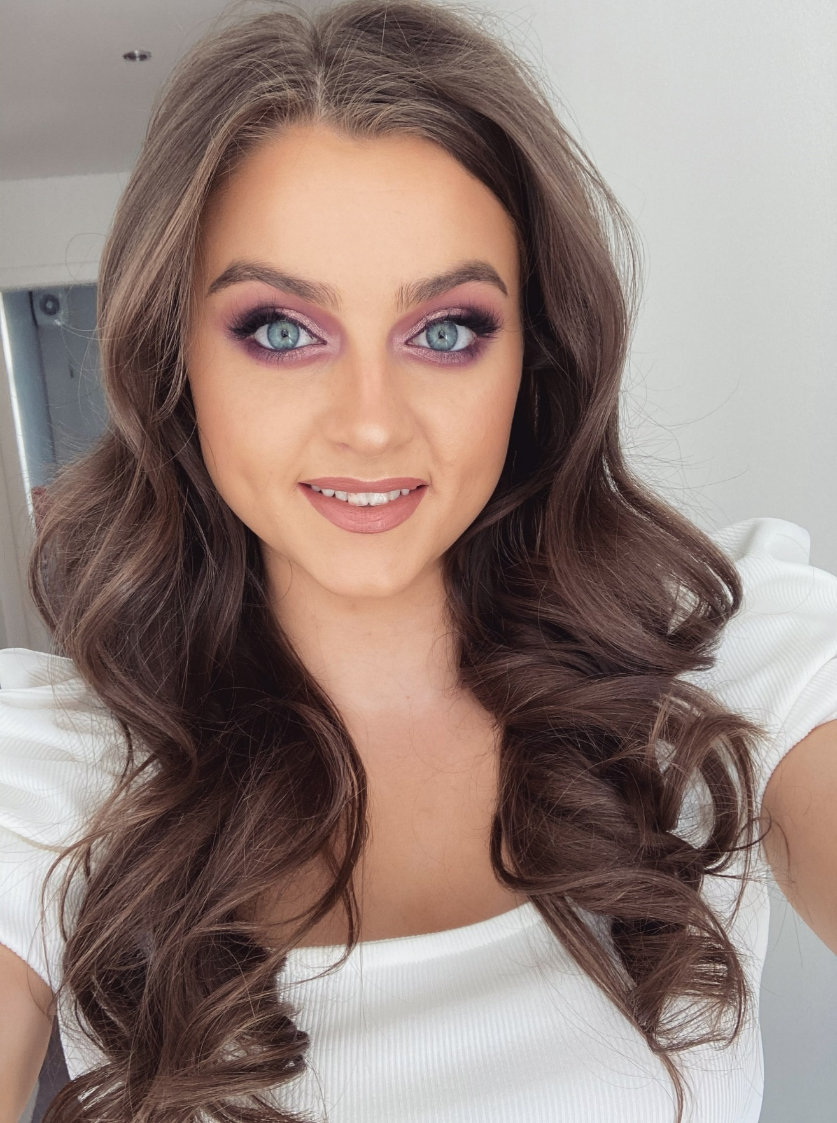
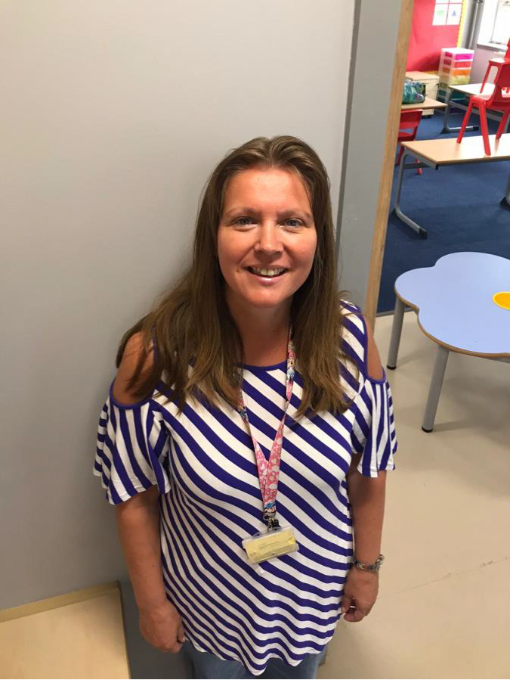
Meet the Teacher
Hi boys and girls,
I’m Mrs Boyle and I am your P.3 teacher. I have been in Kilmacolm Primary School for a very very long time and I love it! I’m sure I have taught some of your brothers and sisters.
I have 2 children, Tom who is 14 and Milly who is 11. I also have 2 black cats called Pickle and Pepper who are brother and sister and they are 2 years old.
When I’m not at school I like to be outdoors, going for walks and reading.
I am looking forward to seeing you all in August!

Slide 3

Get to know Miss Boyle
Here are some fun facts about me:
I absolutely love animals especially cats! I enjoy reading and I make sure I do it every day, normally before I go to sleep. I also love being outdoors and I make sure I go for a walk or even sit outside and read a few times a week. I have a fear of sharks but lucky I am not likely to meet one in Scotland! One of the other things I enjoy is socialising with my friends and family!
Love for animals
100%
Reading
75%
Being outdoors
80%
Love of sharks
1%
Friends and family
70%

Slide 4
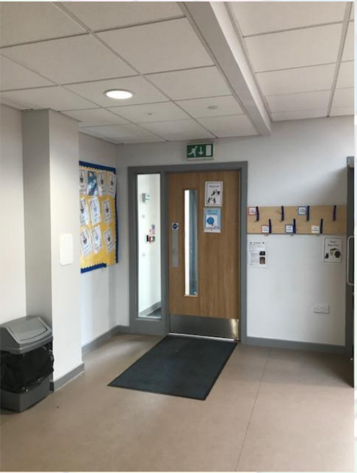
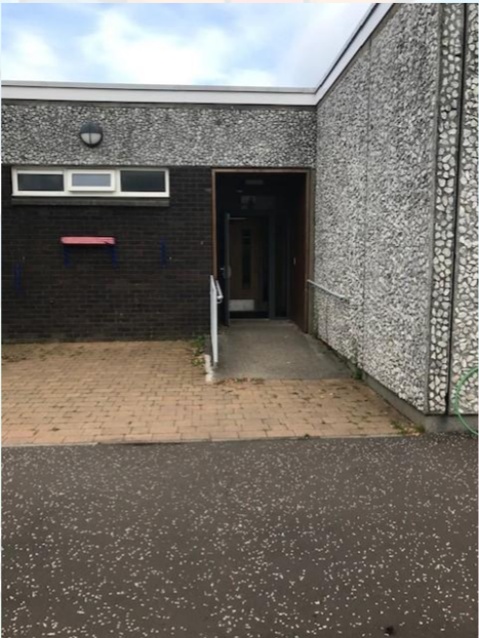
Entry and Exit

Slide 5
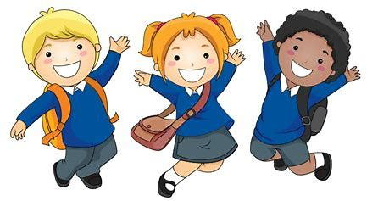

Uniform
Full school
uniform
Relaxed school
uniform
Boys: grey trousers/shorts
Girls: grey pinafore/skirt or tartan pinafore/kilt or blue summer dress
Boys & Girls: white shirt and school tie, navy school (or plain) sweatshirt/ sweater/ cardigan/ fleece.
Navy leggings/joggers (no branded items).
White polo shirt (with or without the school badge)
Navy school sweatshirt/ hoodie (no branded items).
The children will need a pair of wellies/outdoor shoes for Outdoor Learning days.
The children can wear school shoes or trainers to school (no need to buy a separate pair of indoor shoes).

Slide 6
August
P3
Start Time: 9.00am
Finish Time: 3.00am

Slide 7



What to bring to school
Packed lunch or order from the school menu
A filled water bottle
A snack

Slide 8
The Curriculum
Mathematics
Writing
Reading
Spelling
Outdoor learning
Art and Design
Health and Wellbeing
Science
Modern Languages

Slide 9


Play-based learning
We will be incorporating some play-based learning into the P3 curriculum. Play encourages children to be independent and autonomous learners, developing a sense of responsibility and self-motivation towards their learning.
1. Games play
Games can help to consolidate skills in any subject. For example, card games & board games will be used to improve knowledge and understanding in mathematics. Games are also great for building team-work skills.
Some types of play
3. Role play
Role play improves social skills and allows for opportunities for speaking and listening across the curriculum. For example, pretend play will be used to help children develop story telling skills and imagination for creative writing.
2. Exploratory play
This kind of play allows children to be an explorer or investigator. For example, in loose parts play the children will be developing creative and critical thinking skills by encouraging them to explore different materials, use their imagination and experiment freely.

Slide 10
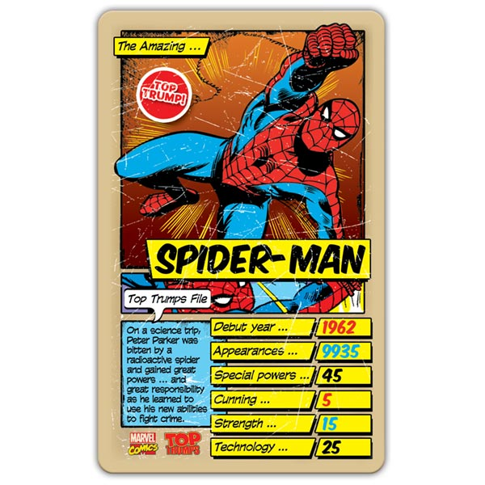
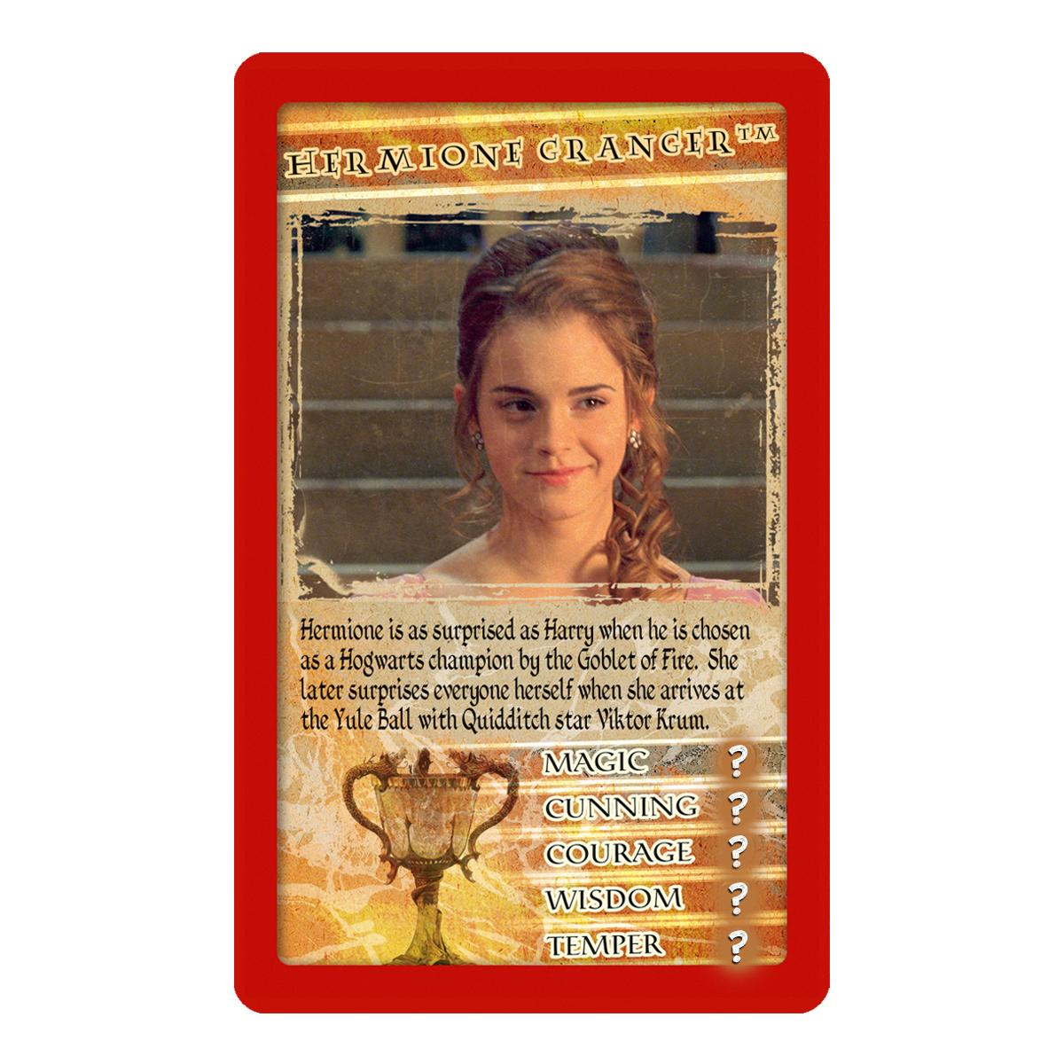
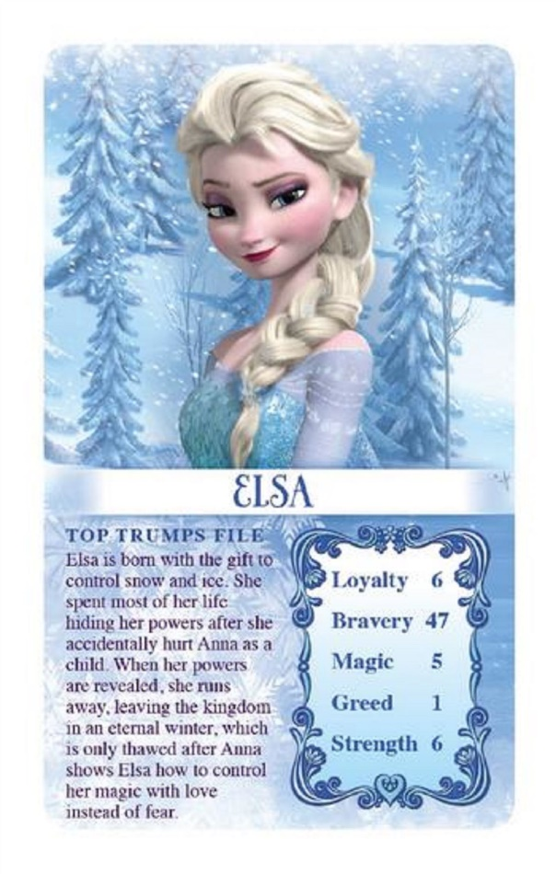
Top Trumps
Can you think about some awesome facts to include on your own Top Trump card?
On the first day we will be creating a class set of Top Trump cards that we will display on the wall. This will help us to get to know you even better! Over the summer have a think about what facts you would like to share with us.
You might want to think about:
Likes/dislikes
Hobbies
Favourite sport/colour/food
Do you have a special talent?

Slide 11
Find us on X
@P3KilmalcolmPS

