Slide 1
Welcome to...
Primary 1
with
Mrs O!

Slide 2
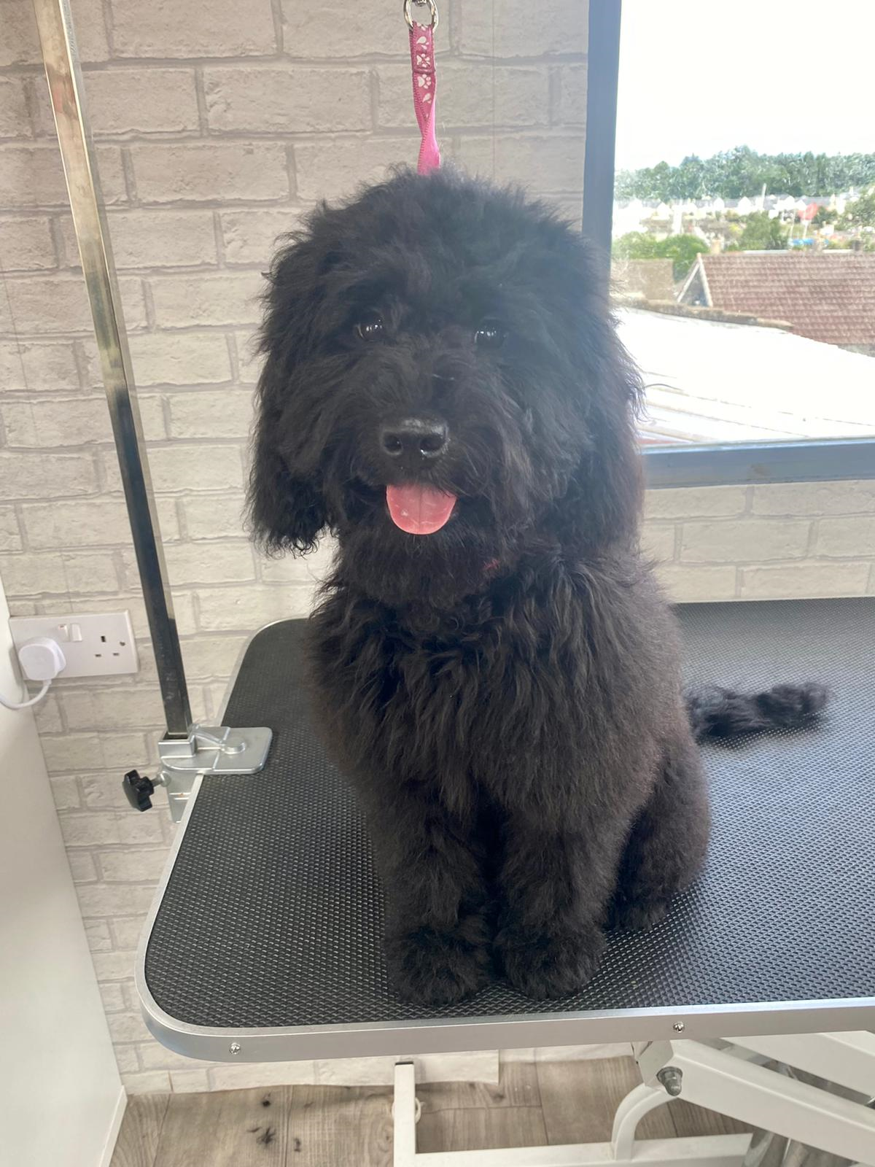
Hello, I am Mrs O!
Hello Primary 1, I am Mrs O’Donnell and I am the lucky lady who is going to be your teacher this year!
I am so excited to join you on your new adventure and am sure that you will have the most magical time!
I live with my husband Barry and my two children, Holly and Ben.
I also have a little fur baby and he is called Murray!

Slide 3
Hello, I am Mrs O’Donnell!
Click on the boxes below to reveal some fun facts about me
I love spending time with my husband, big girl Holly and little boy Ben in Millport with our friends!
My favourite colour is pink!
I have a cute little doggy called Murray and he is 3. He is a cockapoo and is very energetic!
I like to have fun and can be a bit silly sometimes!
I am obsessed with Disney and sing Disney songs to anyone who will listen!
I enjoy eating lots of different types of food!

Slide 4
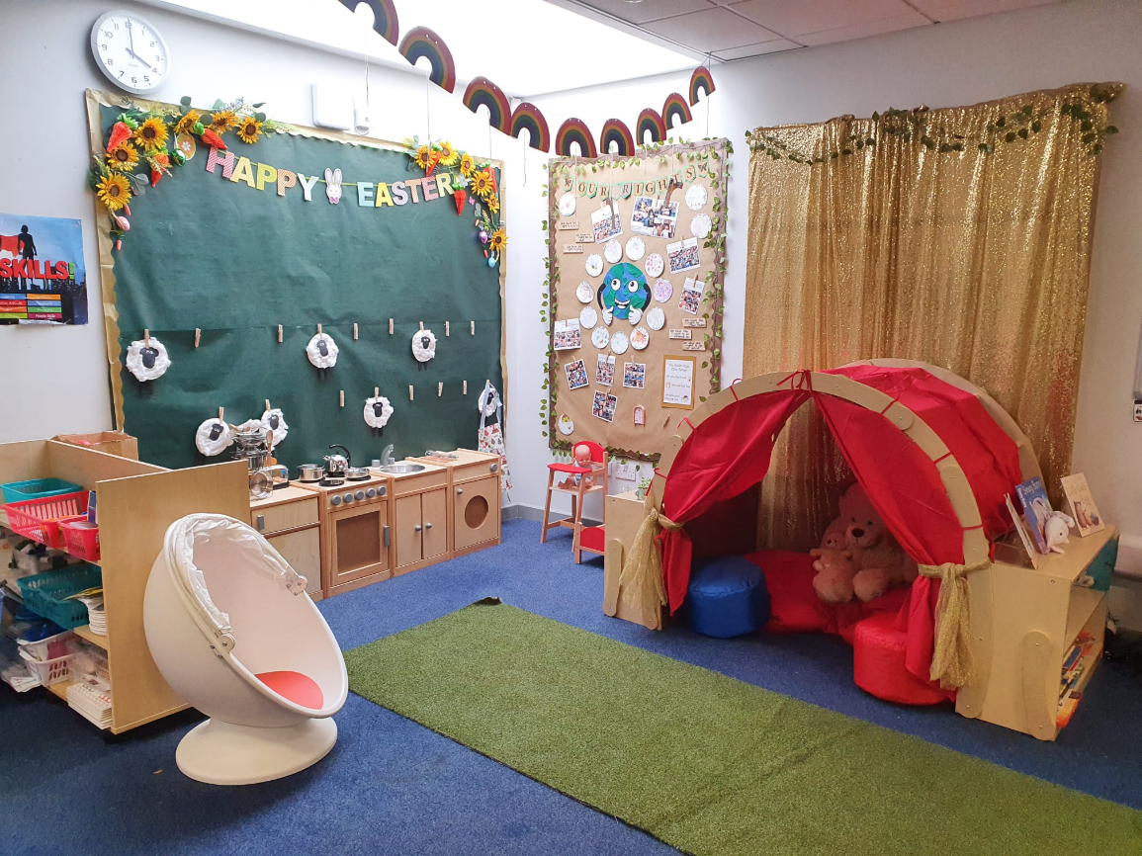
Here is your classroom.
It will look a little different when you start school and it will be more colourful!

Slide 5
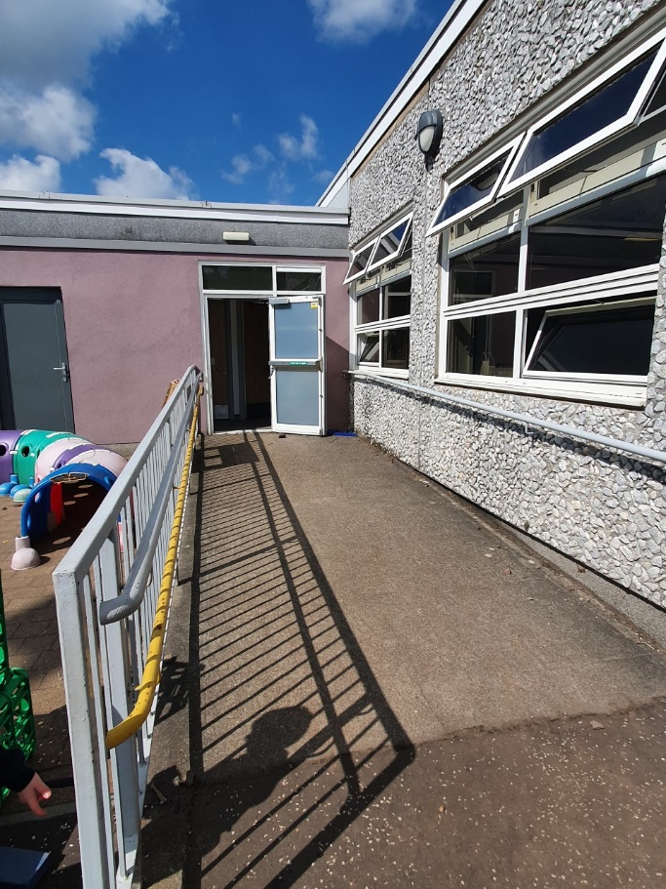
This is the way you will enter and exit your classroom…

Slide 6
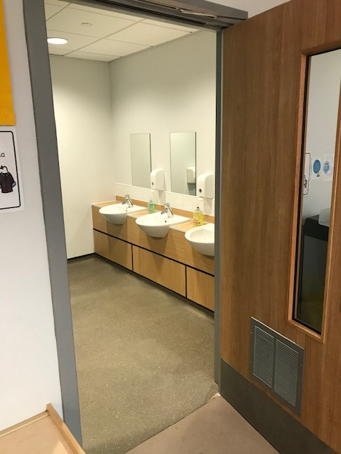
Hand washing
You will wash your hands when you come into school and regularly throughout the day

Slide 7
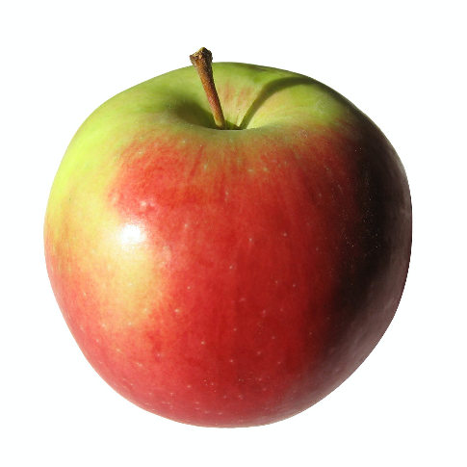
What to bring to school
You will need…
a filled water bottle
a snack
and
You will also bring a packed lunch or order from the school menu

Slide 8
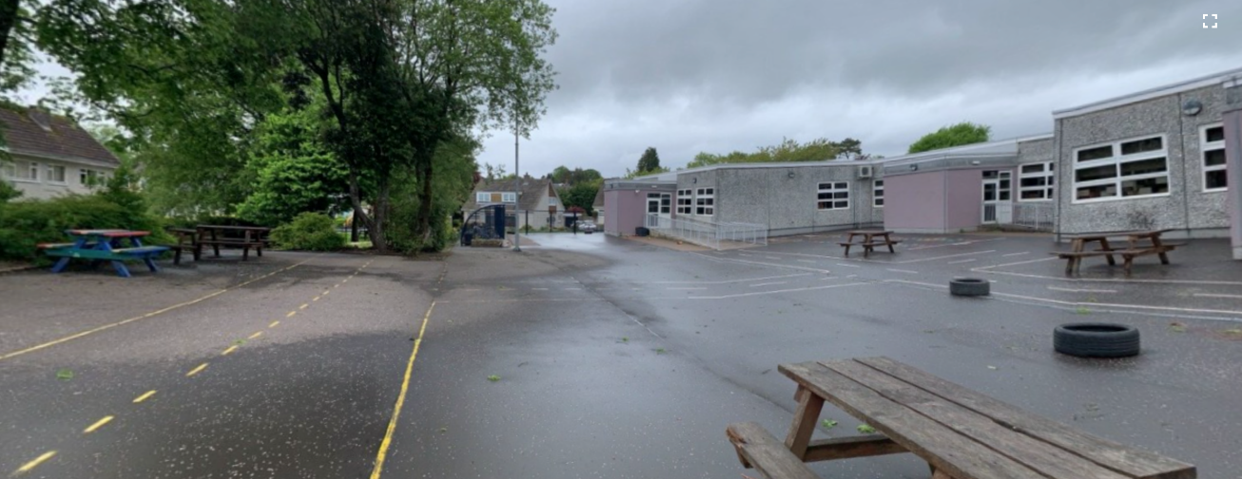
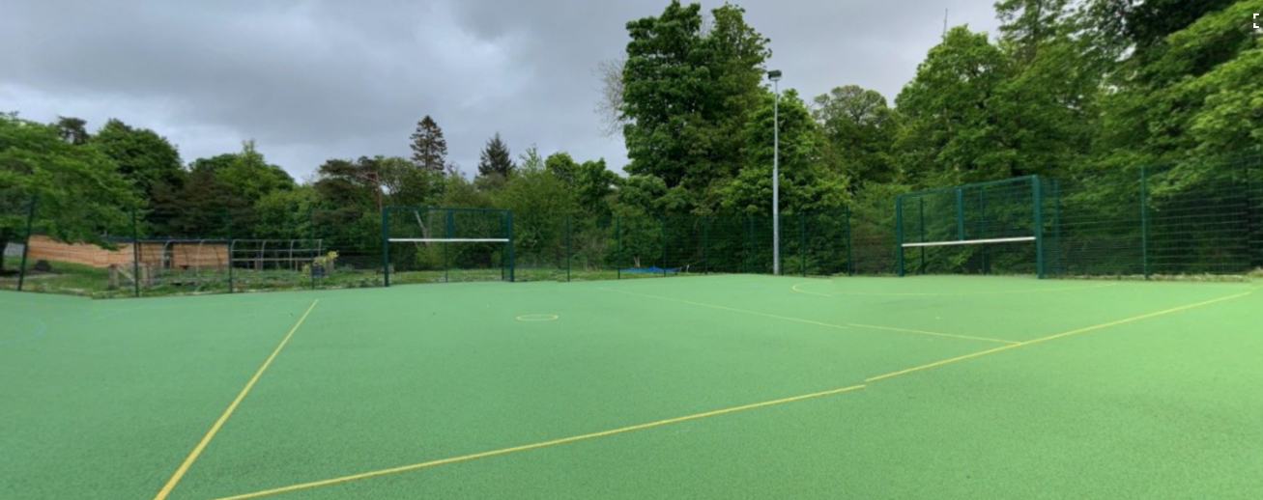
Break times
To ensure 2m social distancing, we will have staggered breaks at playtime and lunchtime

Slide 9
Here are some subjects you will be exploring at home and in school…
Numeracy
Health & Wellbeing
Writing
Outdoor Learning
Reading
Spelling

Slide 10
Find us on Twitter!
@MrsO’Donnell_KPS
@KilmacolmPS

Slide 11
I can’t wait to see you!
I am super excited to be your teacher in August and I can’t wait to join you on your magical adventures.
Take care and have a relaxing summer,
Mrs O’Donnell ☺

