Slide 1
Welcome to Primary 5/4!

Slide 2
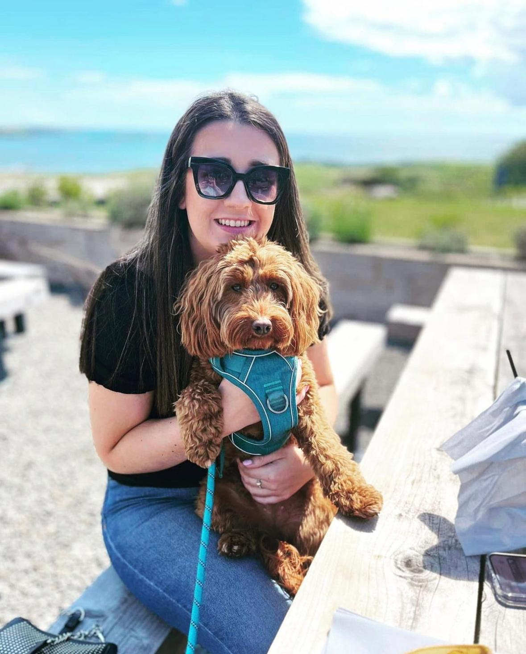
You’re maybe wondering who your new teacher will be…
My name is Miss Smith and this is my dog Mabel.

Slide 3
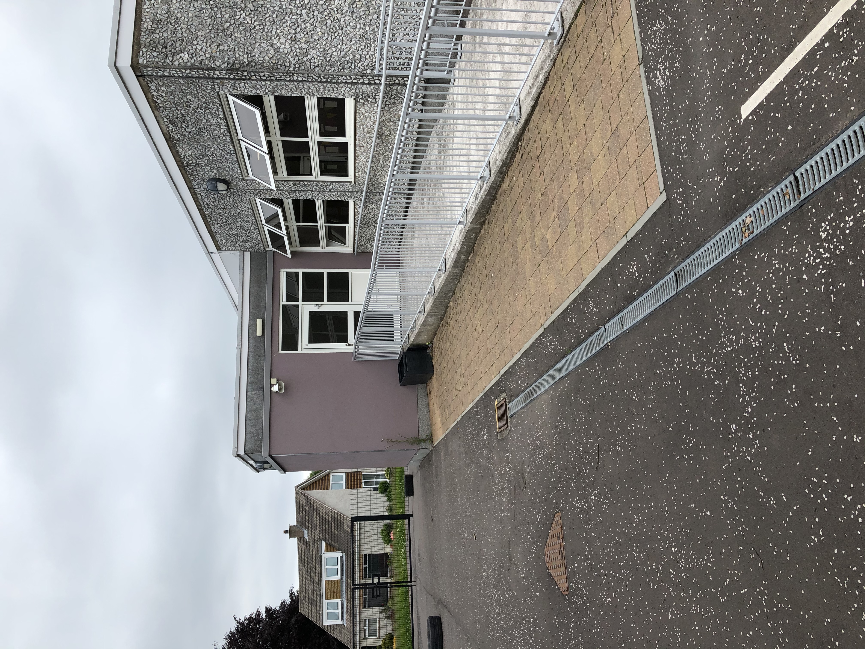
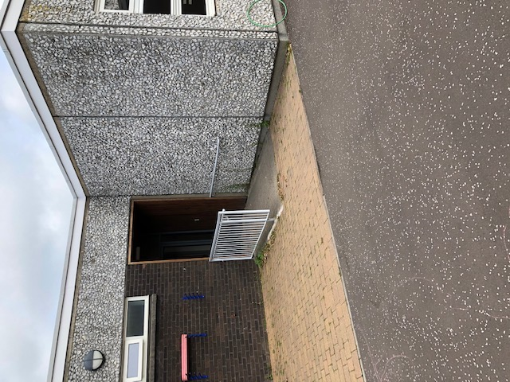
Entry and Exit
When you arrive at school you will enter and exit the Primary 5/4 classroom here…

Slide 4
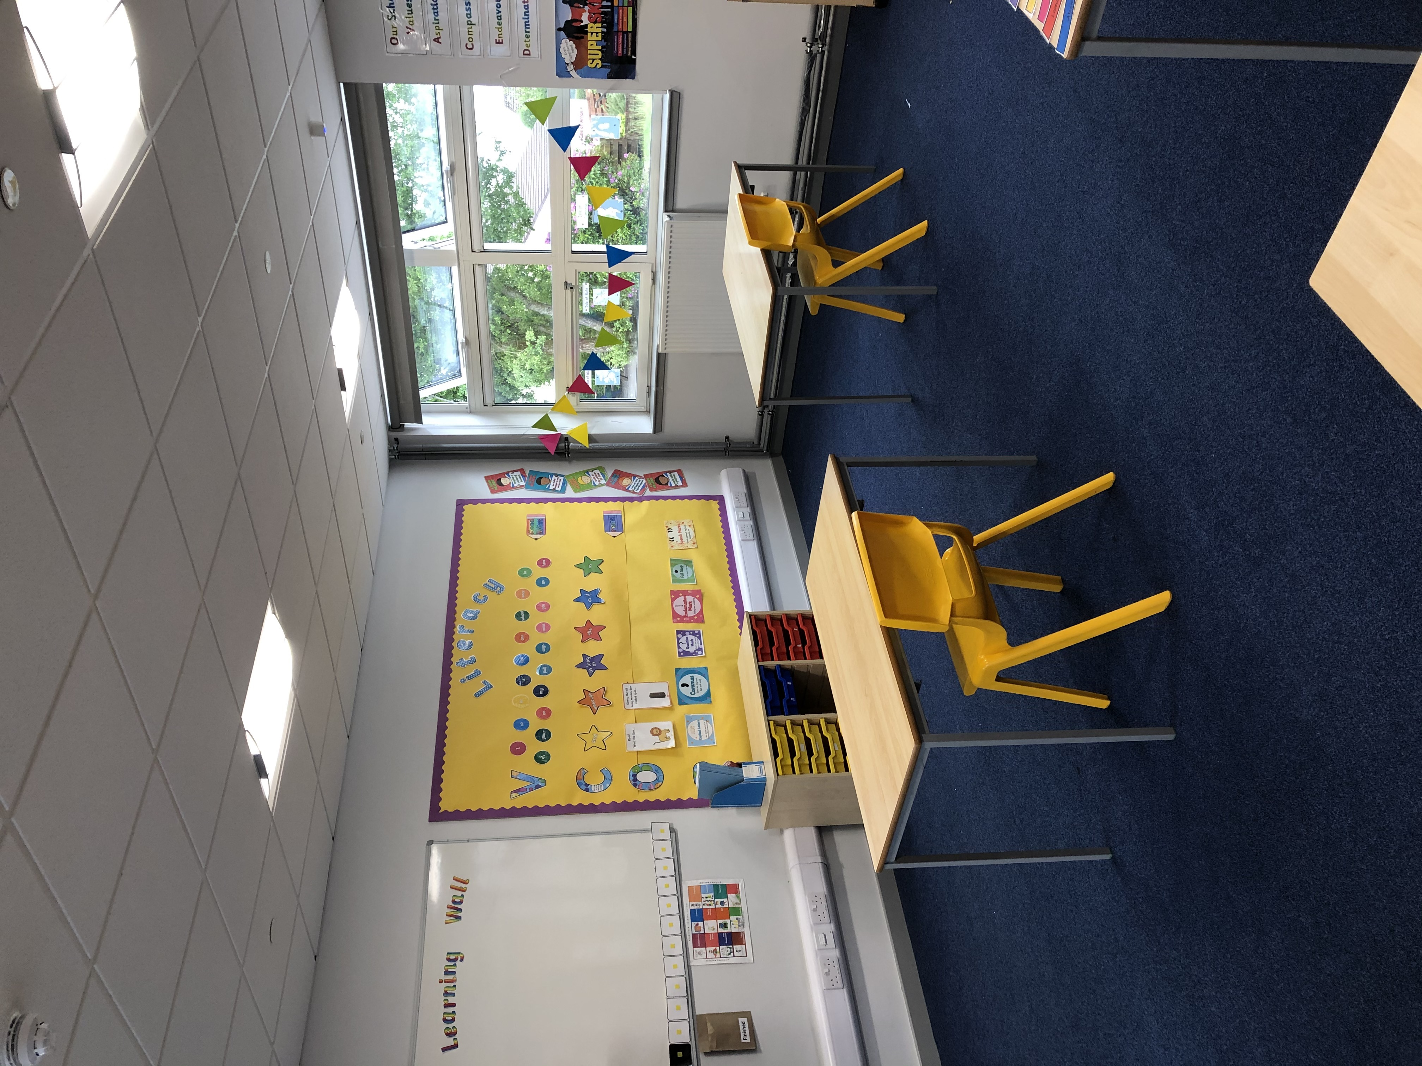
A look inside the classroom…
Take a look inside the Primary 5/4 classroom where our wonderful learning will take place! We can’t wait to see your beautiful work on the walls.

Slide 5
Can’t wait to see you in very soon!!

