Slide 1
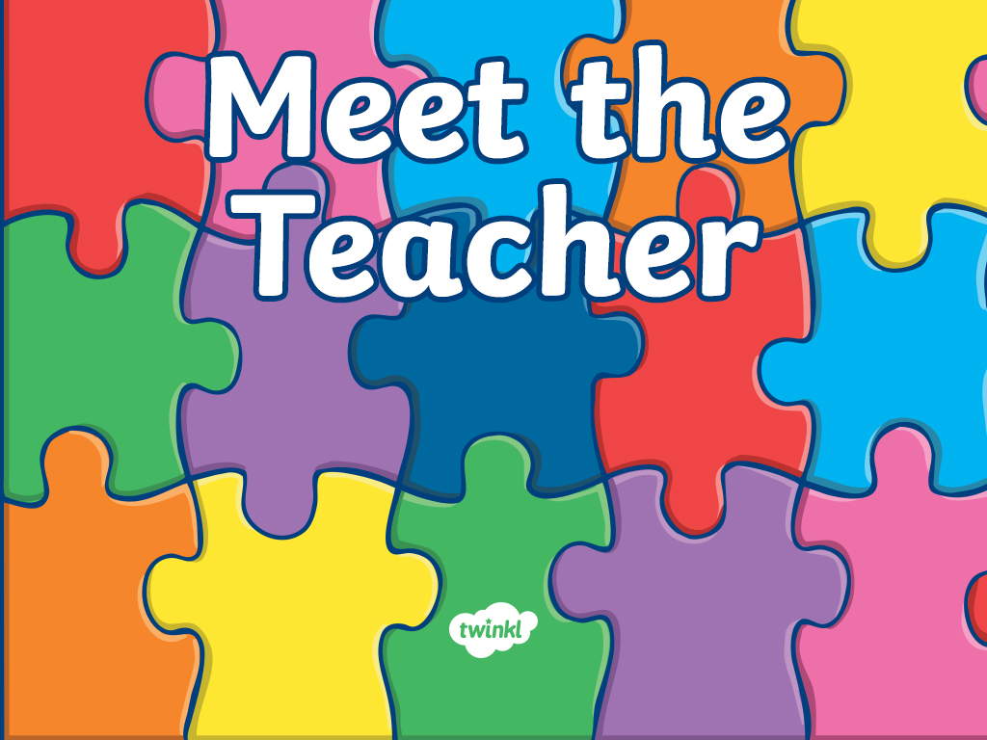
Welcome to...
Primary 6
with
Mrs Gemmell and Mrs McKeegan

Slide 2
Hello, I am Mrs Gemmell!

Slide 3
A little bit about Mrs Gemmell!
Click on the boxes below to reveal some fun facts about me
I really love swimming!
I love spending time outdoors!
I love spending time with my husband and my three children.
My favourite food is sandwiches!
I love travelling, seeing new places and having fun at a beach!
My favourite colour is blue!

Slide 4

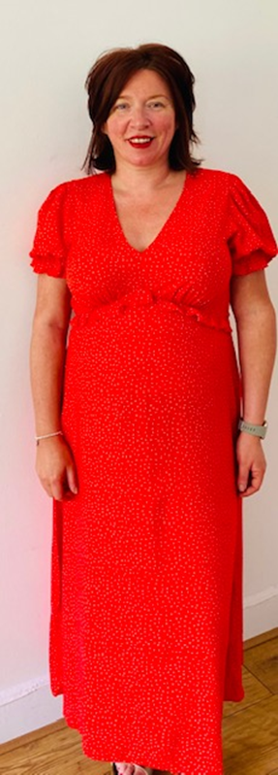

Slide 5
Hello, I am Mrs McKeegan!
Click on the boxes below to reveal some fun facts about me
I am married to Kenny and have two boys, Finlay who is 14 and Murray who is 11 years old.
I absolutely LOVE shopping!
My favourite colour is red.
I know a song to help you learn just about anything and if I don’t then I will make one up!
I love spending time with my friends and family which usually involves lots of laughter!
I have been teaching in KPS for over 20 years and I have even taught some of your parents!

Slide 6
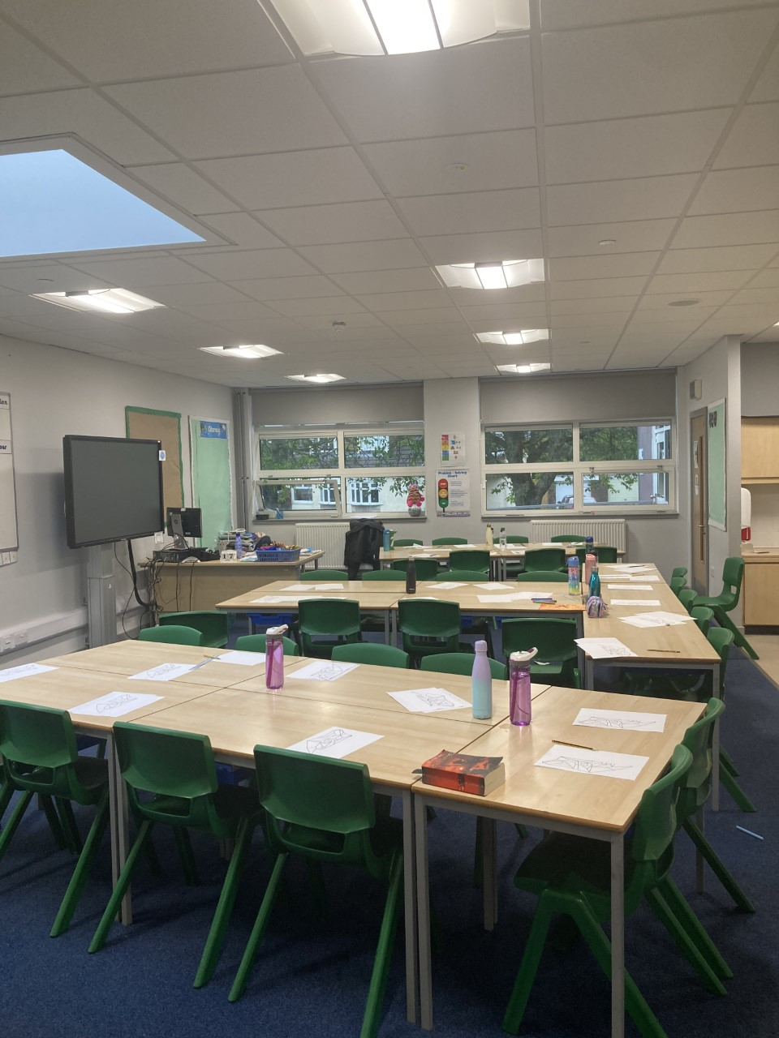
Here is our
P6 Classroom!

Slide 7
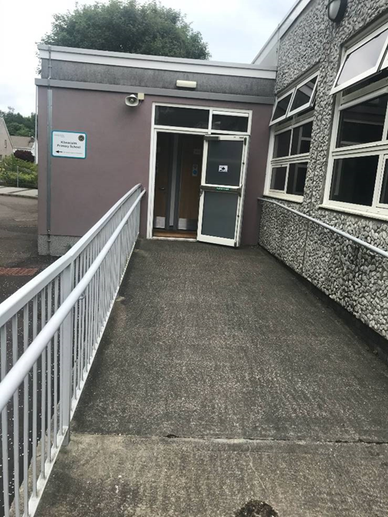
Here are the entrances and exits for the P6 classroom…

Slide 8
Hand washing
You will wash your hands when you come into school and regularly throughout the day.

Slide 9
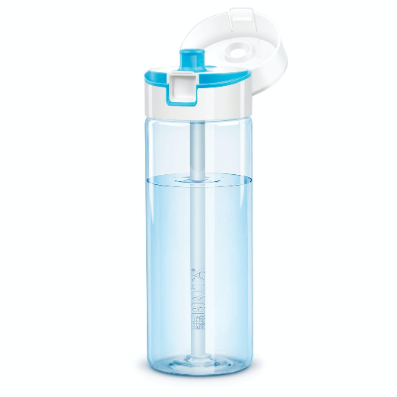
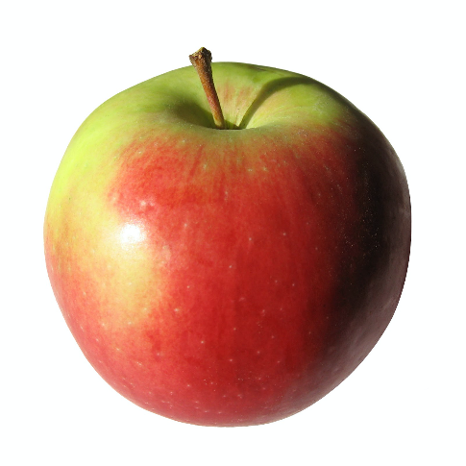
What to bring to school
You will need…
a filled water bottle
a snack
and
You will also bring a packed lunch or order from the school menu.

Slide 10
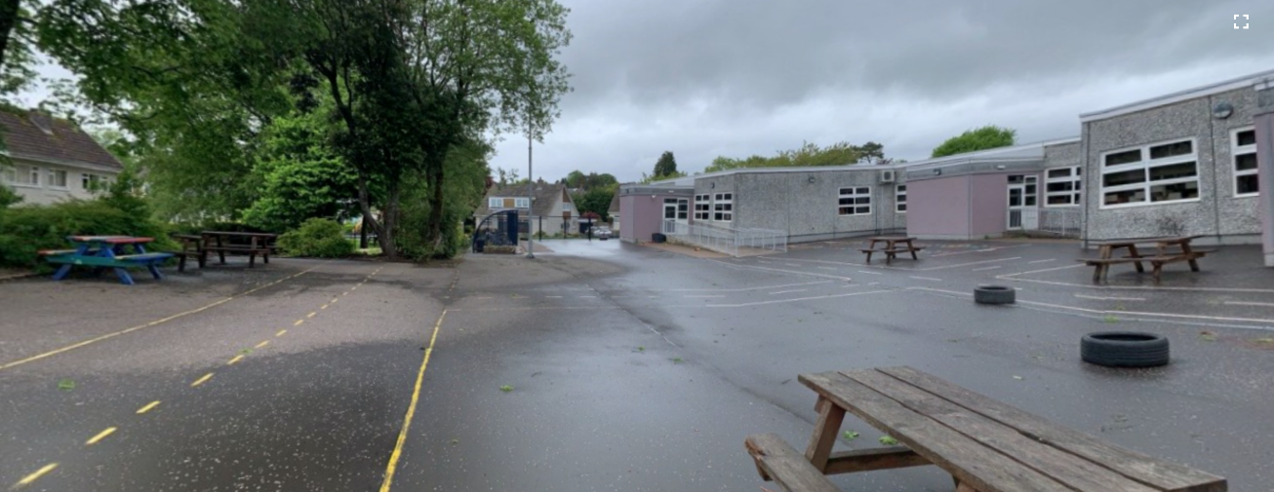
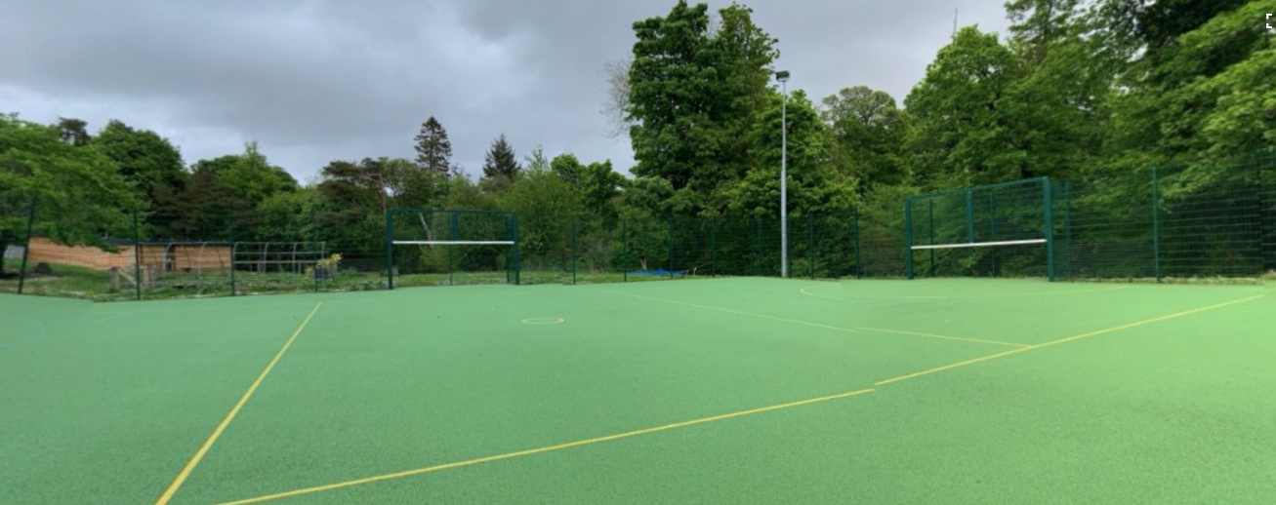
Break times
You will enjoy break times in the school playground and on the MUGA.

Slide 11

Here are some subjects you will be exploring in school…
Numeracy
Health & Wellbeing
Writing
Outdoor Learning
Reading
Spelling

Slide 12
Find me on Twitter!
@MrsGemmell_KPS
@KilmacolmPS

Slide 13
I can’t wait to see you!
We hope you have a lovely summer. We are really looking forward to seeing you all in August.
Take care!
Mrs Gemmell and Mrs McKeegan

Slide 14
