Slide 1
Welcome to...
Primary 4
with
Mrs Isaksen

Slide 2
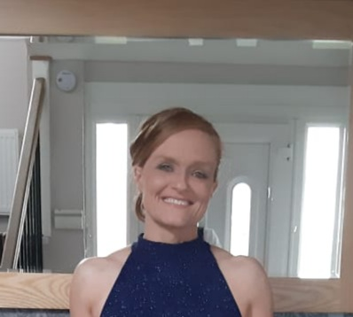
Hello, I'm Mrs Isaksen
Most of you know me as I've worked in the school for quite a while now and I may have taught your older brothers and sisters. I also live locally so you may have seen me around the village.

Slide 3
Hello, I am Mrs Isaksen!
Click on the boxes below to reveal some fun facts about me
I love exercising! I go to the gym most days and you may have seen me out running.
I have lived in Kilmacolm since 2017. I have two children in the school.
I enjoy art and love to paint. My favourite colour is purple.
I wear glasses when I am reading and writing.
I don't have any pets because I am allergic to cats and dogs.
I enjoy baking (and eating) cakes.

Slide 4
Here are some subjects you will be learning…
Numeracy
Literacy
Expressive Arts
RME
Social Studies
Science
Technologies
Health and Wellbeing

Slide 5
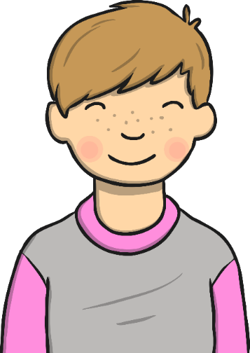
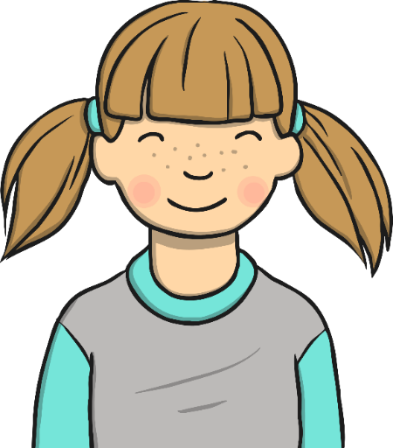
Expectations in P4
I have ONE very important rule that I want everyone to remember...
BE KIND TO EVERYONE!

Slide 6
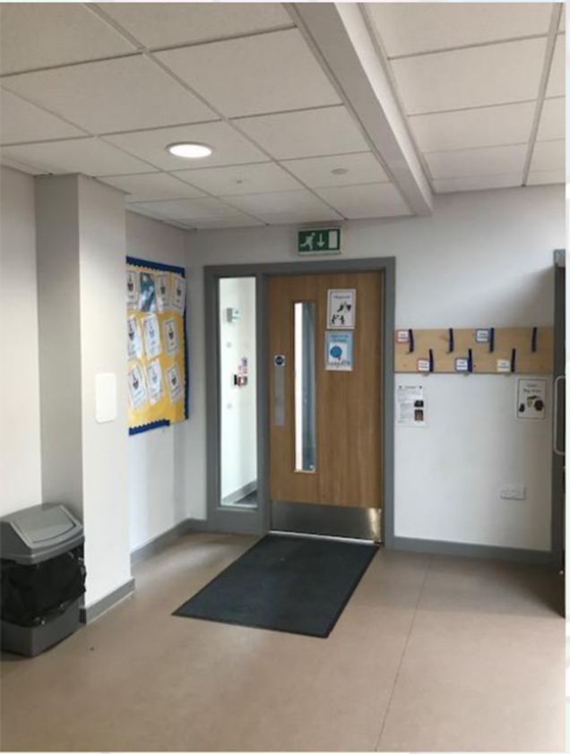
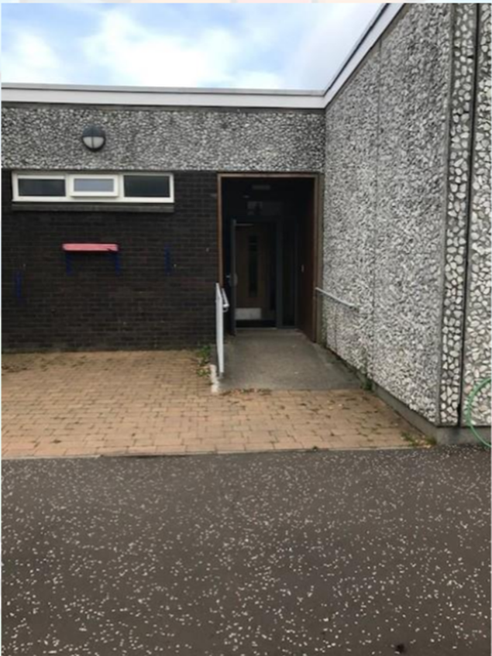
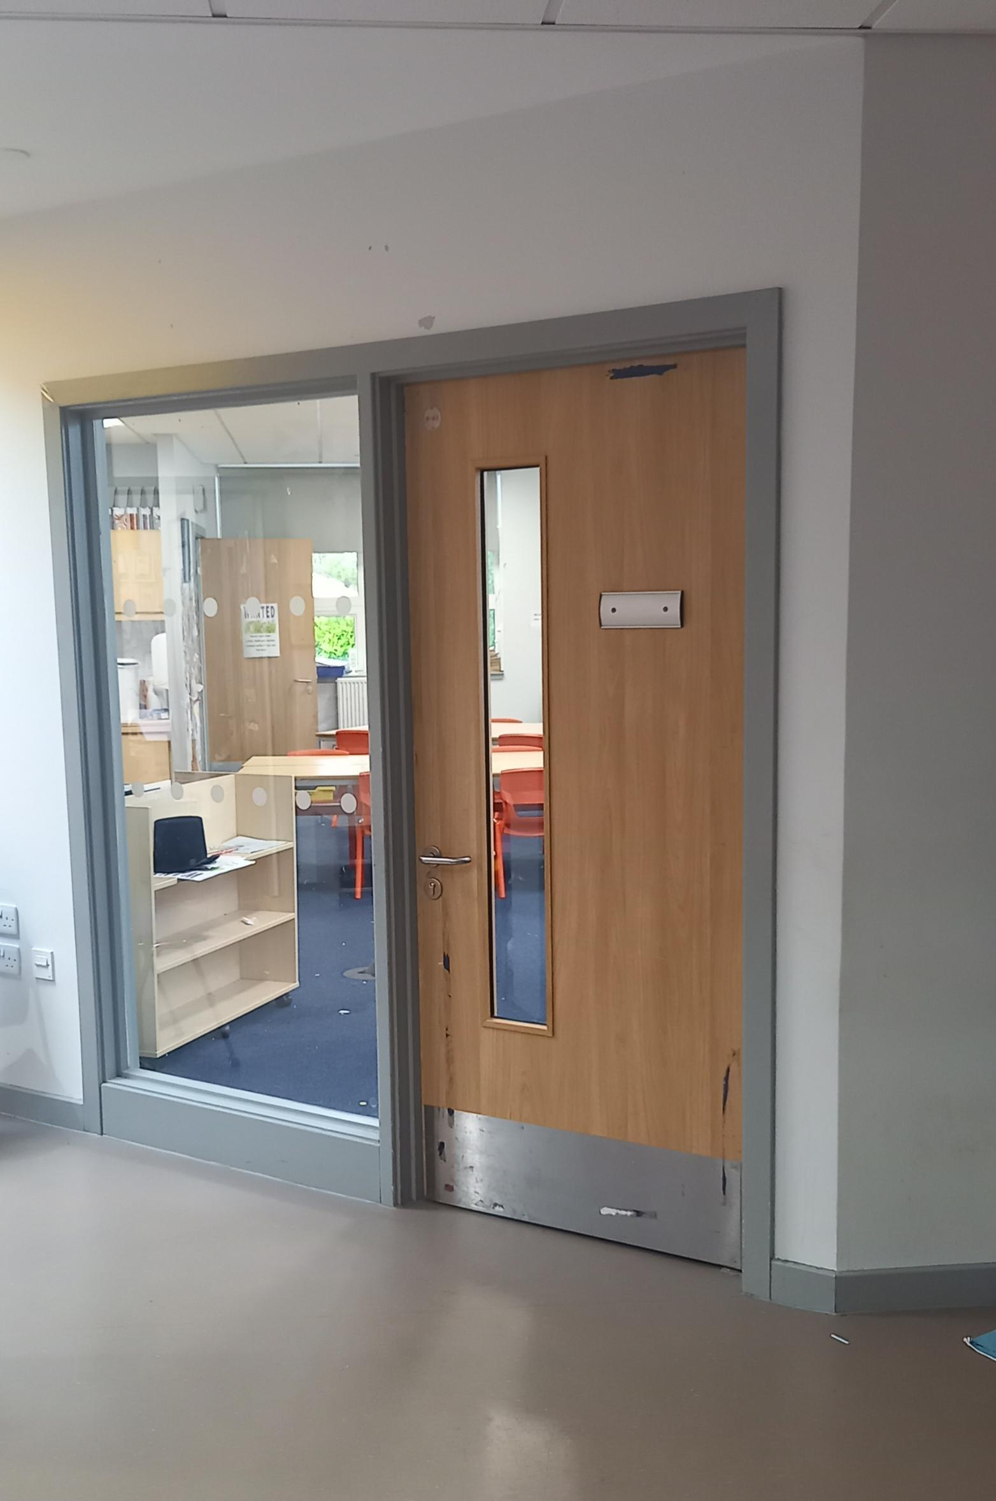
P4 Entrance and classroom

Slide 7
Follow P4 on Twitter!
@MrsIsaksen_KPS

Slide 8
I can’t wait to see you all again!
I hope you all have a lovely summer. I'm already looking forward to getting to know you all in August.
Take care,
Mrs Isaksen

