Slide 1


P7 Cyber Safety
Staying safe online

Slide 2

Who ARE WE ?
Jane Brown– Youth Worker
We work with young people all over in Inverclyde!
You will see us in schools, I Youth Zones, out and about in the local hotspots doing detached youth work and at community events such as our upcoming Youth in the Park…………..watch this space!!!
#YouthWorkChangesLives

Slide 3

Who USES Social Media?

Slide 4


Slide 5

SNAPCHAT ….
So Snapchat has been busy adding some new features ; the latest is a map showing users where their friends are located, along with curated events that are being updated through the ‘Our Story’ feature
First of all, make sure your app is up to date. On the camera page, pinch the screen as if you were trying to zoom out. You should be brought to the map, where you'll see any of your friends who have enabled the feature and curated events around you.
To disable location sharing …. Open Snapchat and go to the Snap Map. Click on your avatar and choose settings by tapping on the bar the pops up on the bottom of the screen. Enable Ghost mode, and you disappear from the map as far as other Snapchat users are concerned; your location is only visible to you.

Slide 6

KEY SAFETY POINTS
Can you remember the key points to keeping safe online?
Privacy Settings
Keep private information private
Don’t speak to people who you don’t know
Be kind!
REPORT / BLOCK / DELETE!
Think before you post!

Slide 7
Cyberbullying
NOUN
the use of electronic communication to bully a person, typically by sending messages of an intimidating or threatening nature:
"children may be reluctant to admit to being the victims of cyberbullying"

Slide 8
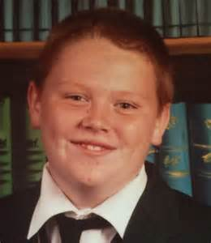
Case study: Ronan Hughes Aged 17
Ronan Hughes from Co. Tyrone took his own life in 2015 after being blackmailed into posting pictures of himself online.
This is not the first time in recent years this has happened to a young person in the UK. Horrible incidents like these are on the rise.
Daniel Perry, also aged 17 from Fife was another victim of a similar crime.

Slide 9
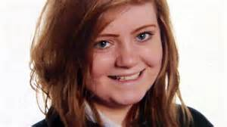
Case Study: Hannah Smith Aged 14
Hannah Smith, a 14-year-old girl from Lutterworth, Leicestershire, England, hanged herself in her bedroom on August 3rd, 2013. Her body was discovered by her older sister.
In the weeks leading up to her death, Smith had been subjected to cruel taunts and insults about her weight and a family death on Ask.fm, a question-and-answer social networking site that allows anonymous participation. Bullies on Ask.fm urged her to drink bleach and cut herself. According to Hannah’s father, she went to Ask.fm to look for advice on the skin condition eczema.

Slide 10





Times have changed…..
Bullying used to be something that happened at school………
Now it can go on constantly because of social media.
Help is always available! Talk to someone you trust if you are worried, upset or anxious about online behaviour.

Slide 11

Be the Bigger Person!

Slide 12

Digital Footprint
The things you put online can be seen by lots of people and might stay online forever. They are like digital footprints – a trail that people can follow, picking up pieces of information about you.
We all leave digital footprints and with every new profile, photo or comment we add. People that you know, and people you don’t, can learn a lot from them. Do you know what yours say about you?
Your footprints can show you at your very best or very worst.

Slide 13
5 Questions to Ask Before You Post!
1. What do I look like?
2. Is this ink permanent?
3. Am I giving away too much
4.Would I want this shared about me?
5. The Billboard Test.

Slide 14


Have you ever participated
in a Cyber Safety Session
before?

Slide 15

Do you know how to change your settings so you are safe online?

Slide 16


Do you know what
Cyber Bullying is?

Slide 17

Do you know where to report and get help if a situation online became a problem?

Slide 18





Who can Help?
Family, Teachers, Youth Workers

