Slide 1

Primary School Menu
Week 1
Catering

Slide 2
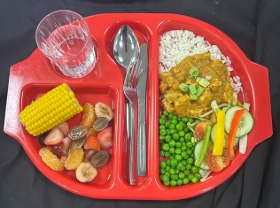
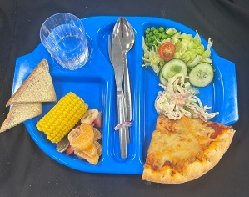
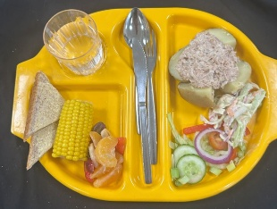
Primary School Menu
Week 1 - Monday
Quorn Katsu Curry with Boiled Rice
Cheese & Tomato Pizza
Baked Potato with Tuna Mayo
( or Cheese ) & Coleslaw

Slide 3
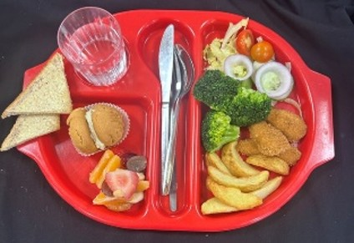
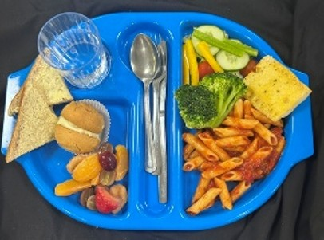
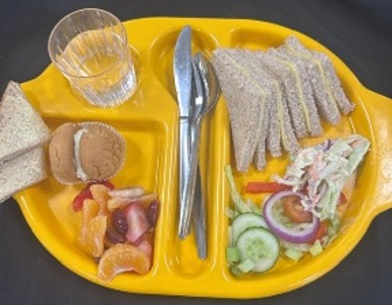
Primary School Menu
Week 1 - Tuesday
Chicken Goujons with Potato Wedges
Tomato & Basil Pasta with Garlic Bread
Cheese Sandwich & Coleslaw

Slide 4
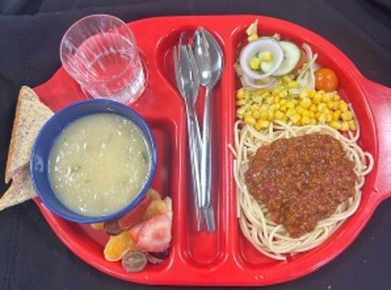
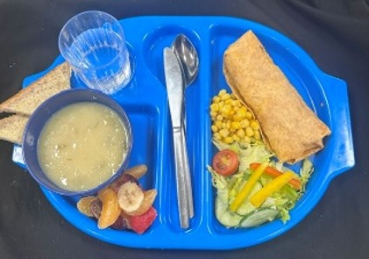
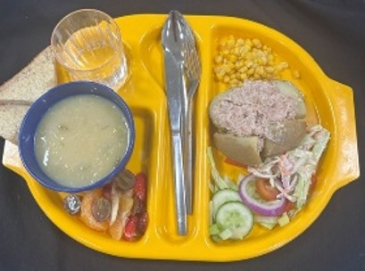
Primary School Menu
Week 1 - Wednesday
Beef Bolognaise with Pasta
Quorn Burrito Wrap
Baked Potato with Tuna Mayo
( or Cheese ) & Coleslaw

Slide 5
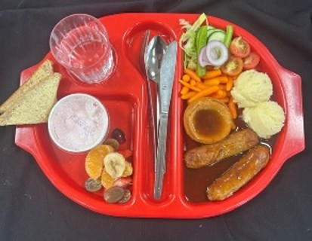
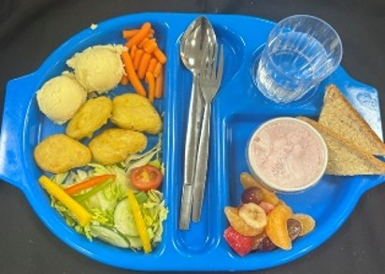
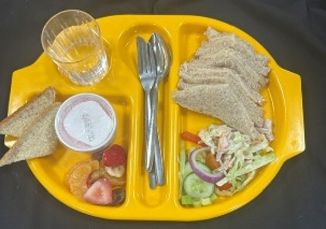
Primary School Menu
Week 1 - Thursday
Sausages with Onion Gravy, Mashed Potatoes & Yorkshire Pudding
Quorn Dippers with Mashed Potato
Chicken Sandwich & Coleslaw

Slide 6
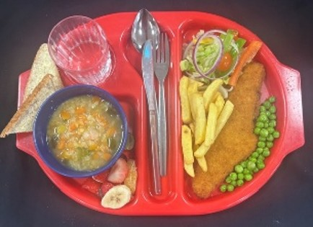
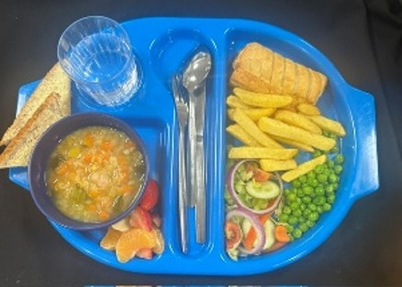
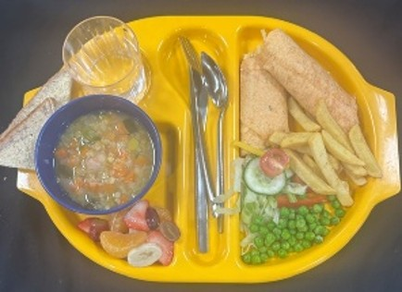
Primary School Menu
Week 1 - Friday
Fish & Chips
Vegan Sausage Roll & Chips
Cheese Wrap with Chips

Slide 7
Primary School Menu
Week 2
Catering

Slide 8
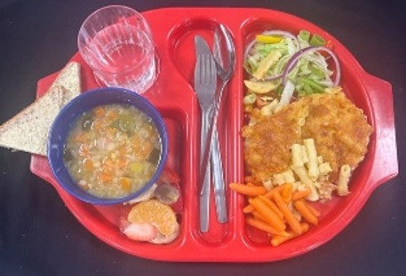
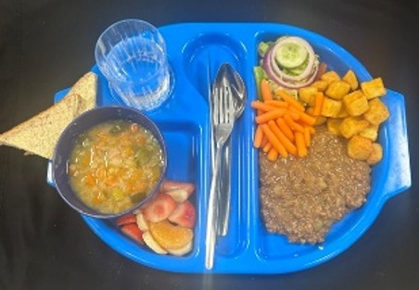
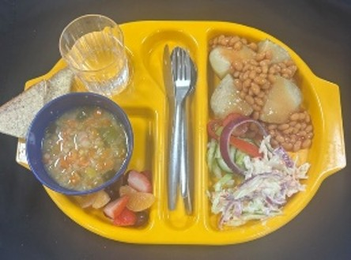
Primary School Menu
Week 2 - Monday
Macaroni Cheese
Meat Free Mince & Diced Potatoes
Baked Potato with Beans & Cheese
( or Tuna Mayo )

Slide 9
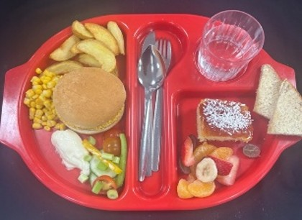
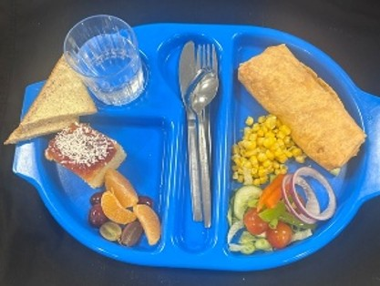
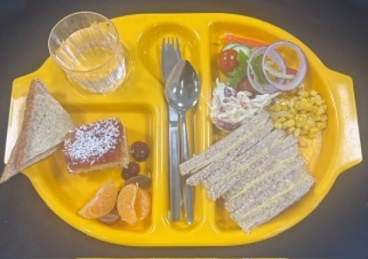
Primary School Menu
Week 2 - Tuesday
Chicken Burger in a Bun with Potato Wedges
Quorn Burrito Wrap
Cheese Sandwich

Slide 10
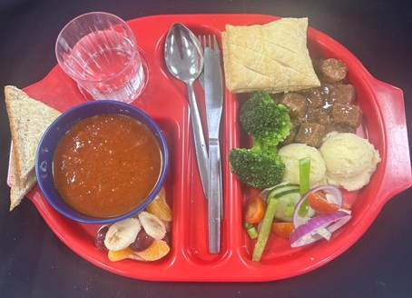
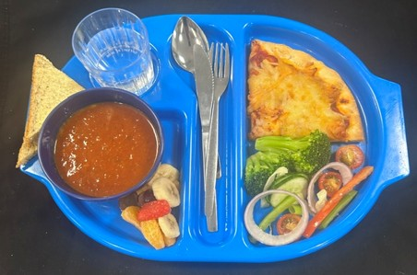
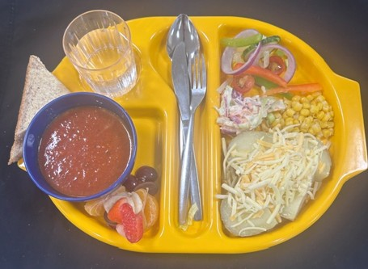
Primary School Menu
Week 2 - Wednesday
Steak & Sausage Pie with Mash Potato
Cheese & Tomato Pizza
Baked Potato with Beans & Cheese
( or Tuna Mayo )

Slide 11
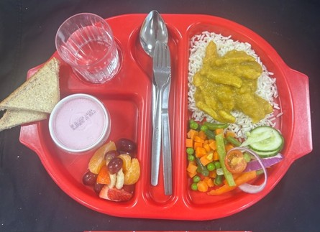
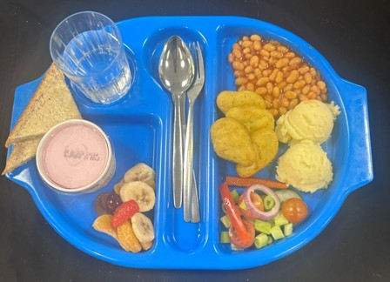
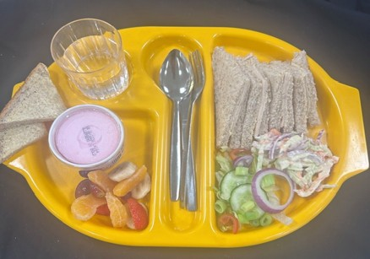
Primary School Menu
Week 2 - Thursday
Chicken Curry with Boiled Rice
Quorn Dippers with Mash Potato
Chicken Sandwich

Slide 12
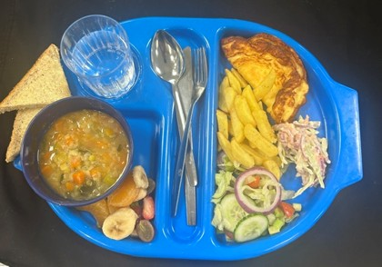
Primary School Menu
Week 2 - Friday
Fish & Chips
Omelette & Chips
Cheese Wrap with Chips

Slide 13
Primary School Menu
Week 3
Catering

Slide 14
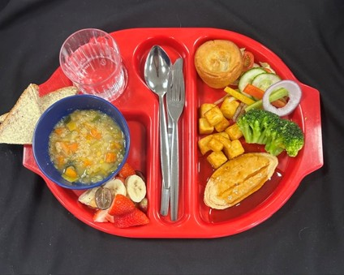
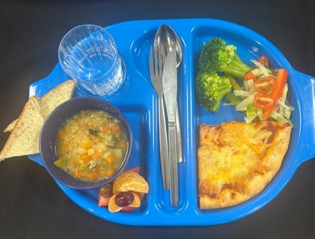
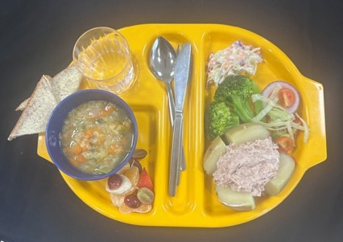
Primary School Menu
Week 3 - Monday
Roast Quorn Fillet with Gravy, Sliced Potato & Yorkshire Pudding
Cheese & Tomato Pizza
Baked Potato with Cheese
( or Tuna Mayo) & Coleslaw

Slide 15
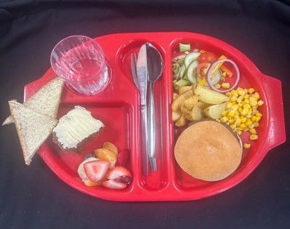
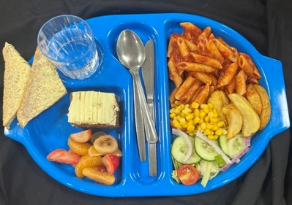
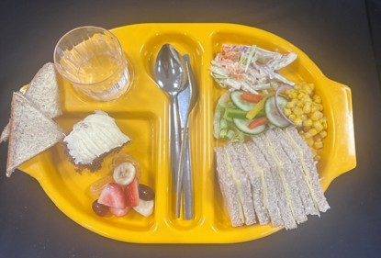
Primary School Menu
Week 3 - Tuesday
Cheese or Beef Burger in a Bun with Potato Wedges
Tomato & Basil Pasta with Potato Wedges
Cheese Sandwich & Coleslaw

Slide 16
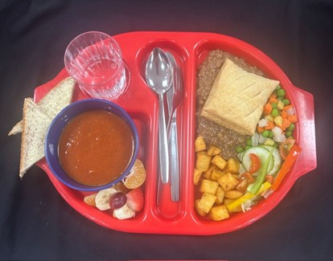
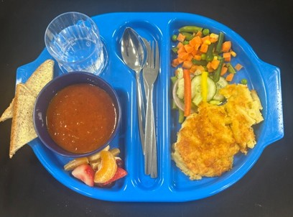
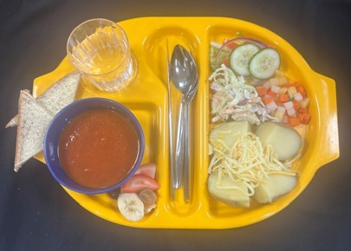
Primary School Menu
Week 3 - Wednesday
Mince Pie with Diced Potatoes
Macaroni Cheese
Baked Potato with Cheese
( or Tuna Mayo ) & Coleslaw

Slide 17
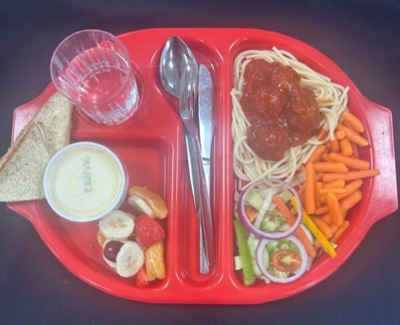
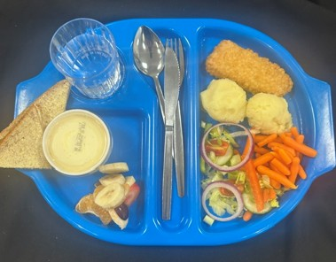
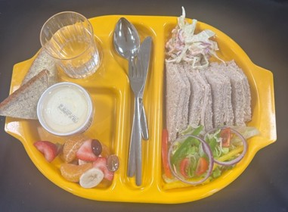
Primary School Menu
Week 3 - Thursday
Chicken Meatballs in Tomato Sauce with Pasta
Bubble Salmon with Mash Potato
Chicken Sandwich & Coleslaw

Slide 18
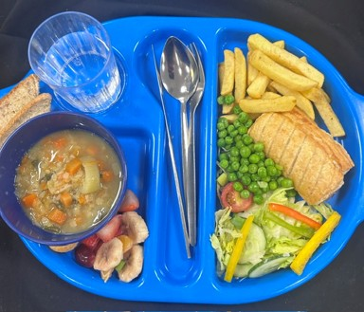
Primary School Menu
Week 3 - Friday
Fish & Chips
Vegan Sausage Roll with Chips
Cheese Wrap with Chips

