Slide 1

Strive for Five!

Slide 2
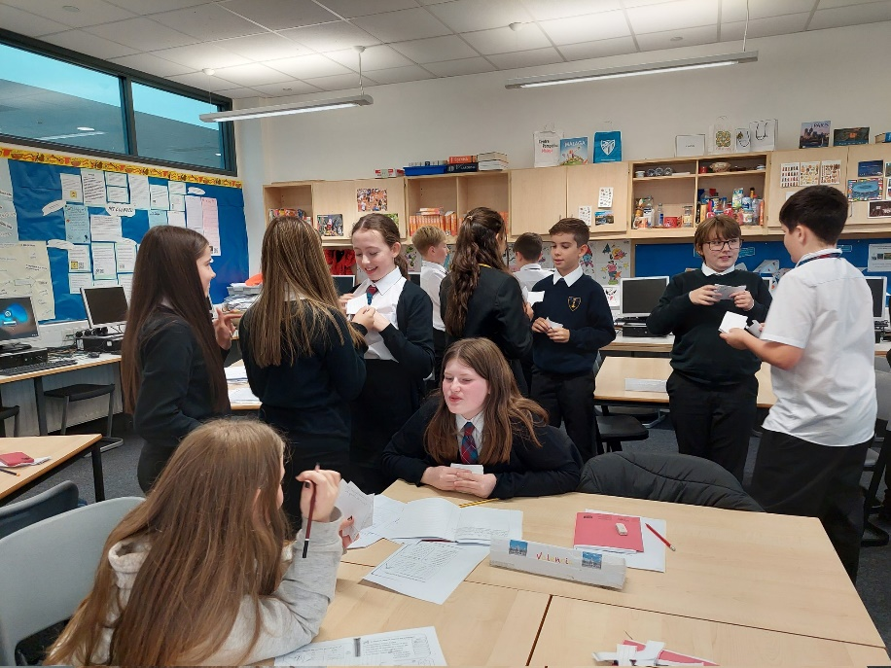
What is Strive for Five?
Rationale behind the programme
How parents can support the programme
BGE links to the senior phase
From the senior phase to….

Slide 3
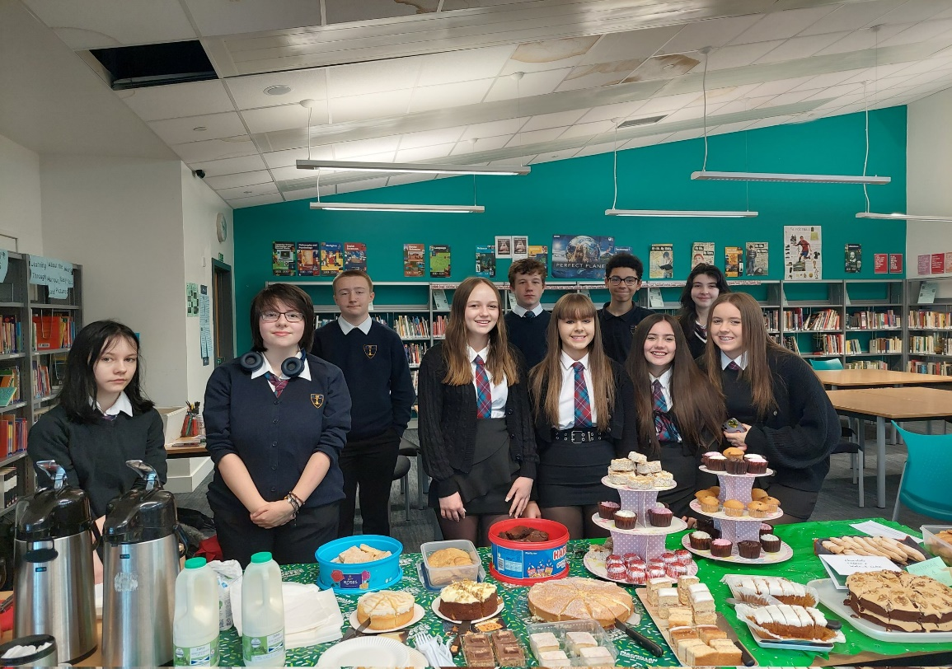
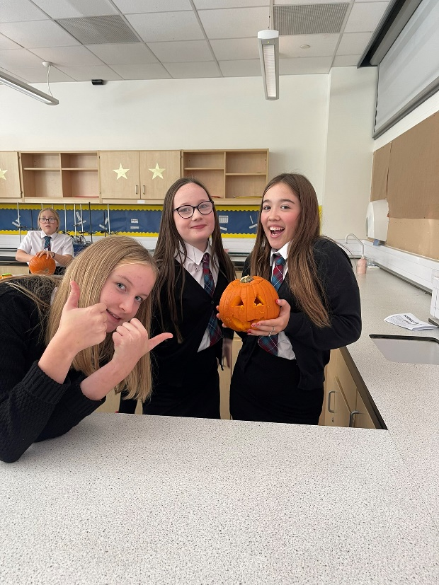
➢
Additional support for pupils who have been identified as having the potential to achieve at least 5 National 5 Awards in S4
Workshops run by Live-N-Learn throughout session- focusing on building confidence, resilience and a growth mindset.
Academic challenges set through Teams group
Access to Supported Home-Learning sessions within school

Slide 4
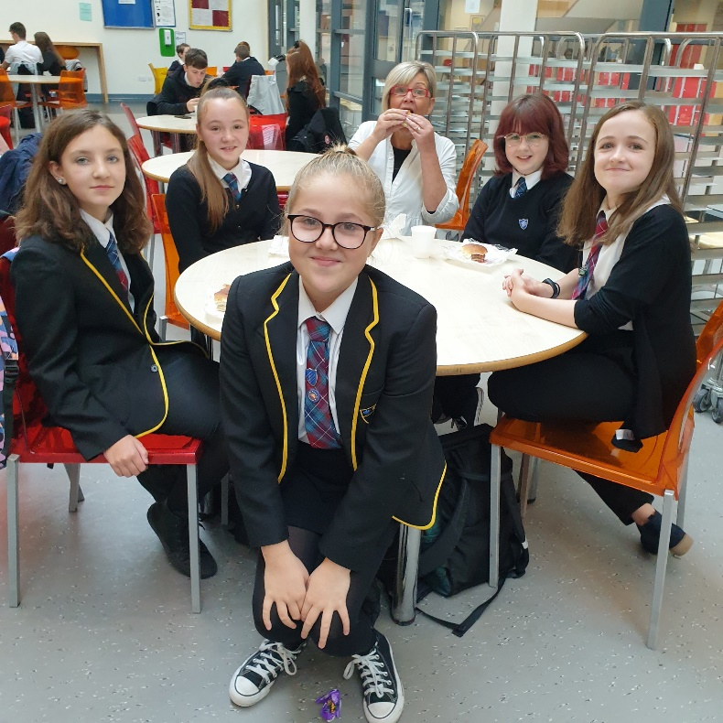
Rationale
Desire to ensure pupils are best-prepared for challenges of senior phase
Desire to increase and support motivation to succeed
Part of our overall focus on success as we build back from Covid
Raising awareness of potential
If you can see it, you can be it!

Slide 5

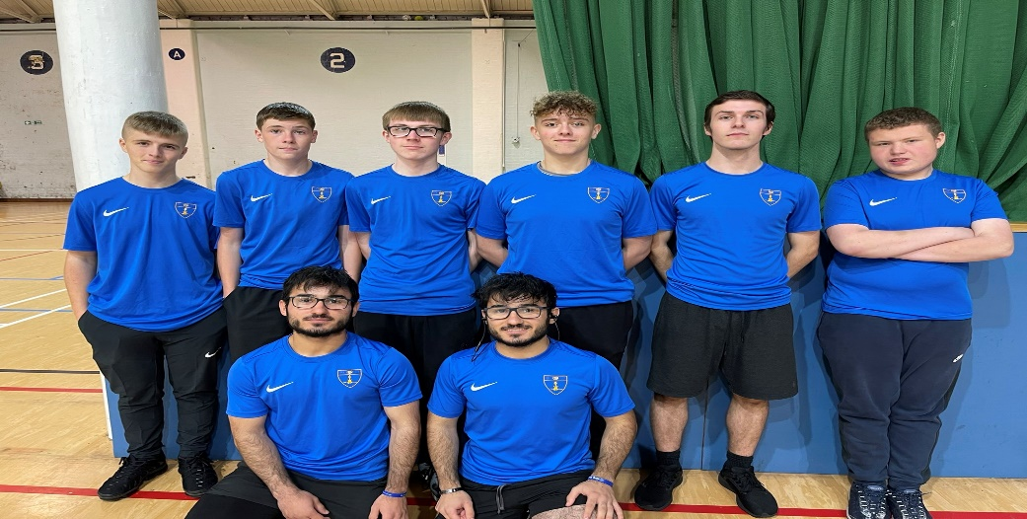
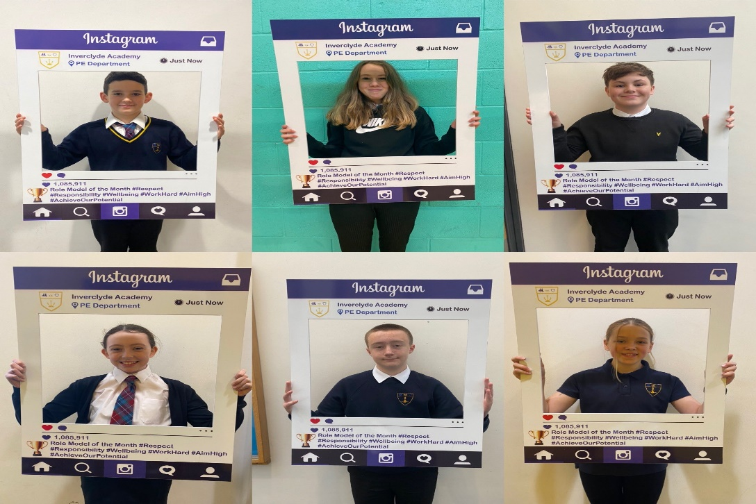
Live-N-Learn- fostering a GROWTH mindset
G = I don’t mind making mistakes
R = I don’t overreact in situations of conflict
O = I feel confident trying new things
W = With hard work I can achieve almost anything
T = I keep trying when things get difficult
H = I’m good at receiving feedback

Slide 6
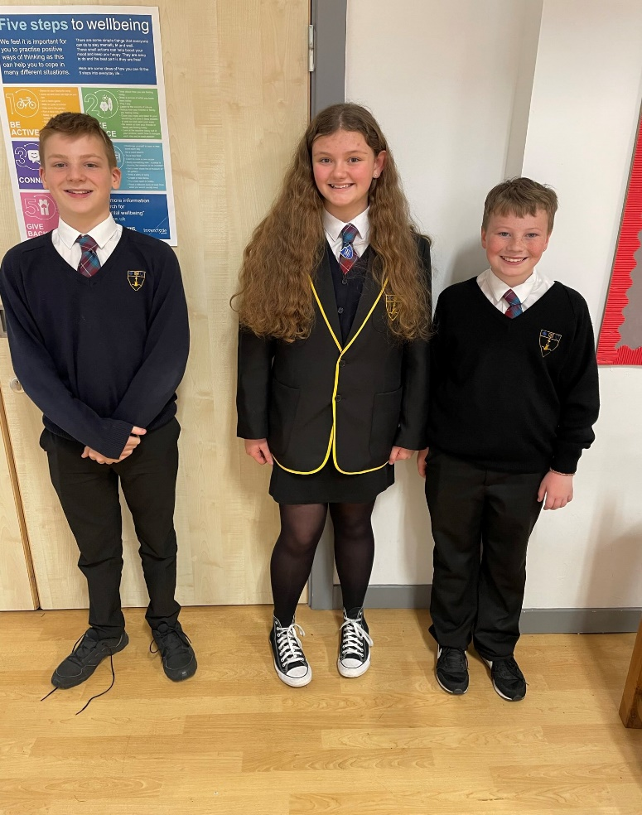
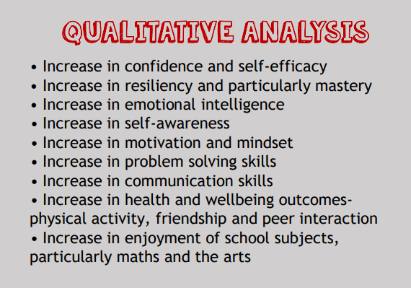

Slide 7
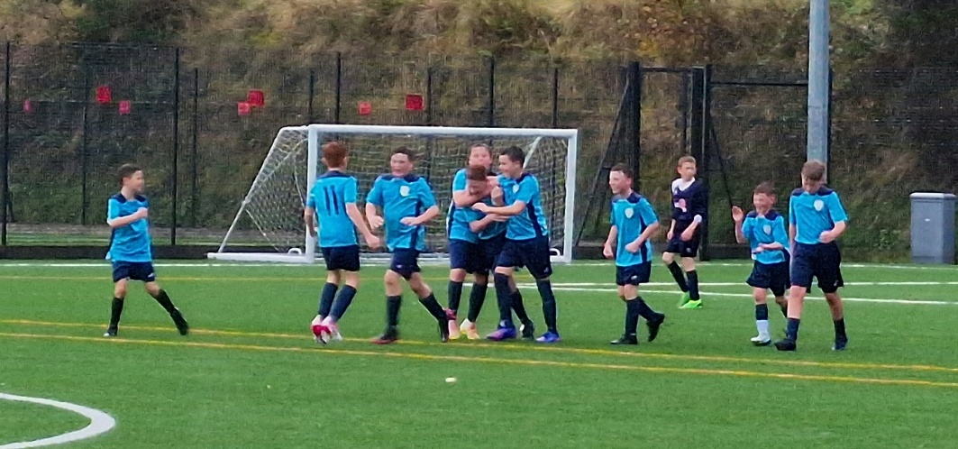
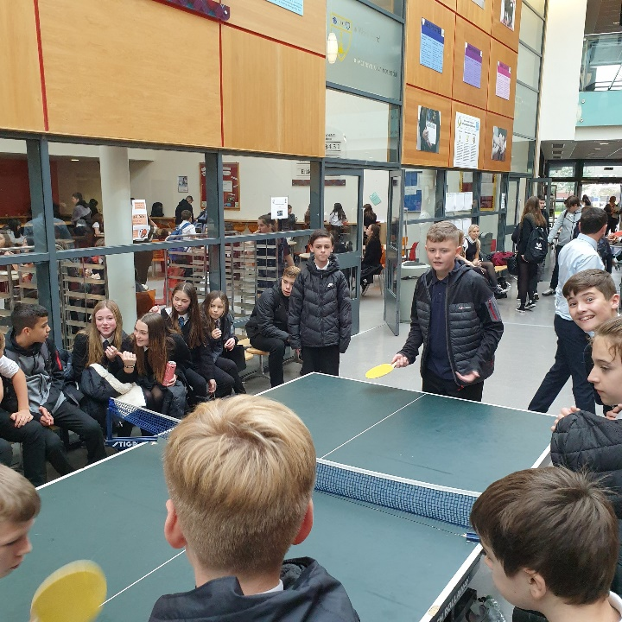
Young people will be immersed in the ‘Growth Mindset’ and quickly recognise their intelligence, personality and abilities are not simply predetermined at birth, but are things which are cultivated, developed & improved over time, through hard work, effort & perseverance. Their potential is unknown!

Slide 8
Senior Phase: Why do we strive for five?
29th September 2022
Employment
Apprenticeship
Training
College
University
RESPECT RESPONSIBILITY EQUALITY SUCCESS

Slide 9
Rationale:
In 2008, Education Scotland’s Building the Curriculum 3 described a curriculum where pupils are “entitled to experience a senior phase where he or she can continue to develop the four capacities and also achieve qualifications.” (p15)
In June 2014, Sir Ian Wood’s report, Education Working for All! Outlined the need for schools to design structures and programmes that deliver “the flexibility required to meet the needs of young people and employers” (2014, p.27) so that we can achieve the government’s vision of a Scotland that is a “fair and prosperous country” (DYW 2014, pi).
RESPECT RESPONSIBILITY EQUALITY SUCCESS
Notes:
Rationale:

Slide 10
The numbers…
Level 5+N5 | 2017 | 2018 | 2019 | 2020 | 2021 | 2022
A-D A-C | 31.9% 28% | 27.5% 17% | 41.3% 31.5% | 41.7% 37.9% | 31.5% 34% | 42.6% 35.7%
Level 5+@H | 2017 | 2018 | 2019 | 2020 | 2021 | 2022
A-D A-C | 9.2% 4.02% | 11.3% 10.63% | 12.3% 11% | 19.0% 13.9% | 15.0% 10.6% | 13.71% 8.9%

Slide 11
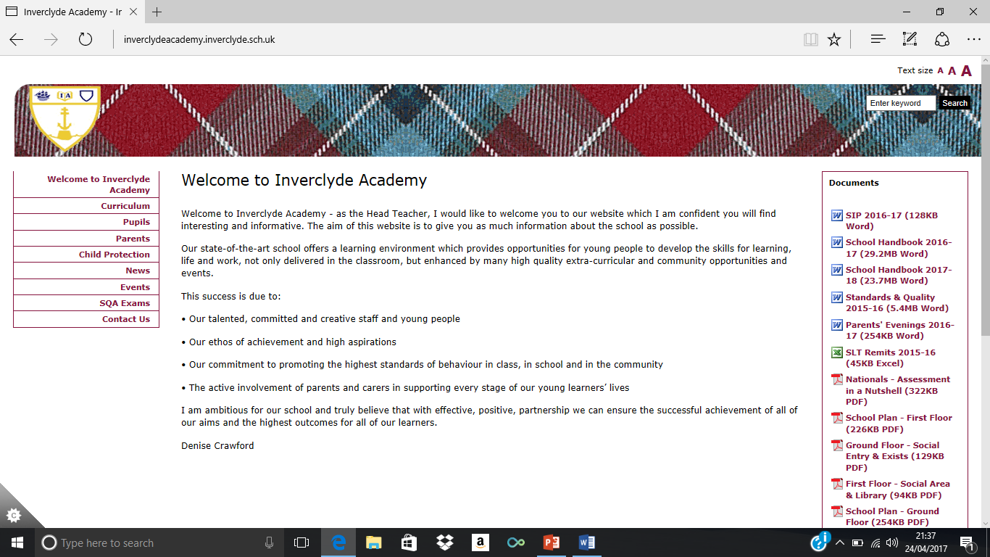
IA’s Senior Phase Structure:
Senior Phase includes all of S4, S5 and S6 – all/any classes can contain pupils from any of these year groups.
Pupils studying all N3-5, study 6 subjects and attend core PSE, RMPS & PE in S4.
If doing at least one Higher, pupils study 5 subjects and attend core PSE and DYW each week.
If doing any Advanced Highers, pupils can drop one column for each AH e.g. if doing 1 AH, they only do 4 subjects, if doing 2 or more AH, you only do 3 subjects.
S6 are expected to use the free columns productively and are encouraged to do volunteering.
RESPECT RESPONSIBILITY EQUALITY SUCCESS

Slide 12
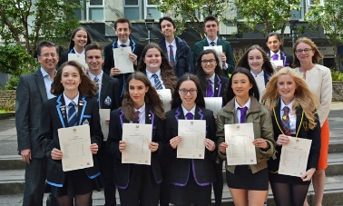
Consortium
In order to access the widest possible certification, we work with all our local secondaries:
Mostly S6 but some S5 if there are TT clashes
Mostly Advanced Highers but some Higher and occasionally N5s.
RESPECT RESPONSIBILITY EQUALITY SUCCESS

Slide 13
Leavers by destination – 2019-21

Slide 14
School:College Partnership
Higher National Certificate (HNC) is a Higher Education (HE) course starting at level 7.
Higher National Diploma (HND) is a Higher Education (HE) course starting at level 8.
HNC/D level courses typically require at least two Highers or have passed an NC course.
Most universities accept HNC/Ds as alternatives to the school entry requirements (Highers).
HNC holders can gain entry to first year in most and second year in some university courses.
HND holders can gain entry to second year in most and third year in some university courses.

Slide 15
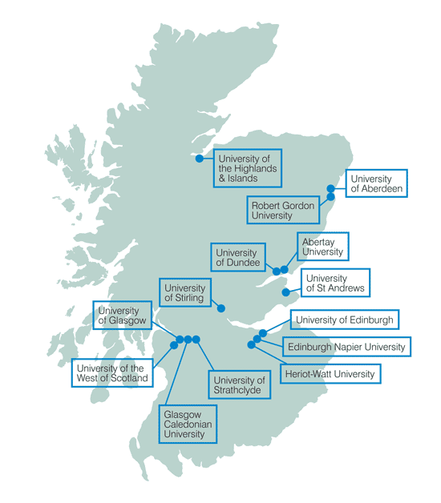
Universities:
We work with the following agencies to
support and encourage our young people
into Higher education.
Under the umbrella of Focus West, we have:
REACH - Vet Medicine, Medicine, Dentistry and Law
Access to a Career - Teaching
Top Up
Routes for All - 1-1 mentoring and career support for applying to Higher Education (college)
RESPECT RESPONSIBILITY EQUALITY SUCCESS
Notes:
Check with Catriona

Slide 16
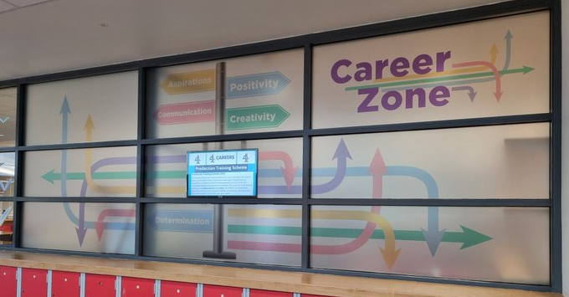
School Support
SDS Careers Advisor – Larry Hansen
DYW Worker – Chloe MacKay
They can also help research college and universities
RESPECT RESPONSIBILITY EQUALITY SUCCESS
Notes:
Check with Catriona

Slide 17


Larry Hansen
Careers Adviser
Skills Development Scotland

Slide 18


Slide 19
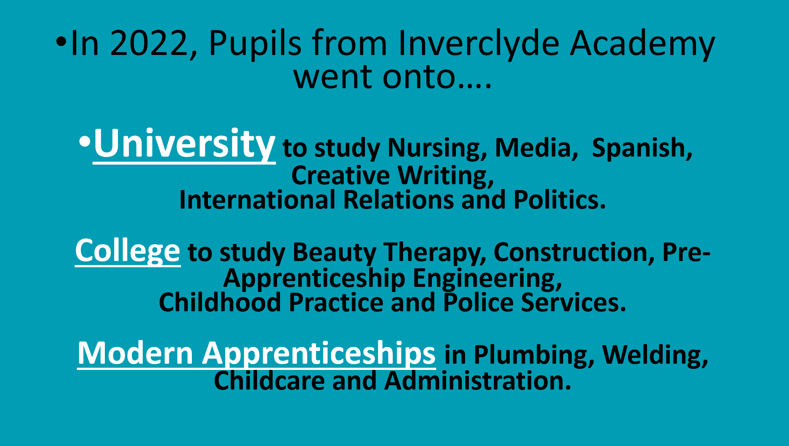

Slide 20
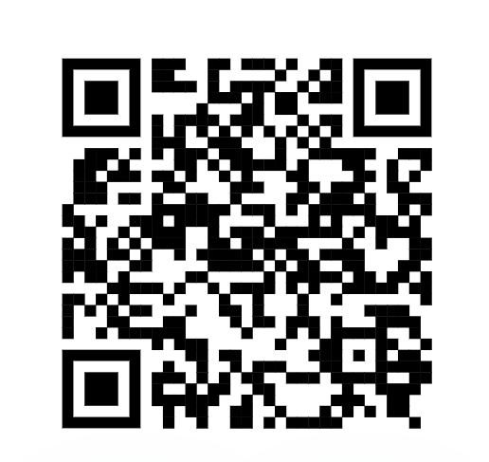
Thank You

