Slide 1
Student Awards Agency Scotland
FUNDING AWARENESS
www.saas.gov.uk

Slide 2
Who we are and what we do
An Executive Agency of the Scottish Government
Provide support, information and funding for all eligible students studying throughout the UK
Assess and process over 180,000 applications each year
www.saas.gov.uk

Slide 3
Residence Eligibility
Resident in the UK for three years
Resident in Scotland at start of course
Non UK or EU nationals must have ‘settled status’ in the UK
www.saas.gov.uk

Slide 4
Course Eligibility Full Time
Higher National Certificate (HNC)
Higher National Diploma (HND)
Degree
Nursing/Midwifery/Paramedic Science degree
Professional Graduate Diploma in Education (PGDE)
www.saas.gov.uk

Slide 5
Tuition Fees Study in Scotland
Tuition Fees Study in the rest of the UK
Your fees are paid if you study in Scotland. How much we will pay your college or university are shown below:
HNC, HND or equivalent − £1,285
Degree or PGDE − £1,820
HNC, HND or degree at a designated private college or university − £1,205
A fee loan of up to £9,250 is available to students studying at a publicly funded college or university in the rest of the UK
www.saas.gov.uk

Slide 6
How long will I be funded? Learner Journey
Funding available if you complete an HN level course and then study a degree
One additional year of funding if you need to repeat a year or change course
Fees paid in each year of your course
www.saas.gov.uk

Slide 7
Household Income
Gross income
Parents or parent’s partner
Partner or spouse
Student income
www.saas.gov.uk

Slide 8
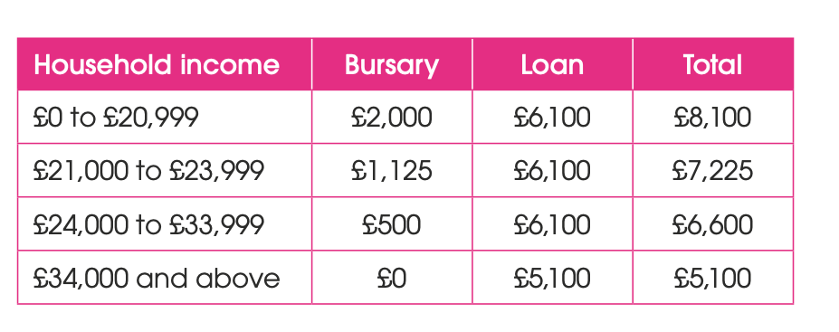
Young Students (under 25 at start of course)
For session 2022-23
www.saas.gov.uk

Slide 9
Payments
Fees paid in each year of your course
First payment is a double payment
Payment schedule will be on your Award Notice
www.saas.gov.uk

Slide 10
Repayment of Loan
The Student Loans Company (SLC) pay and collect your loan
You will not have to start repaying your loan until the April after you graduate or leave your course
The SLC will expect you to repay 9% of your annual income over £25,375
Your employer will take your repayments from your salary and these will show on your pay statement
Interest linked to inflation
Example 1:
Earn £26,000 a year
and repay £4.69 a month
Example 2:
Earn £30,000 a year
and repay £34.69 a month
www.saas.gov.uk

Slide 11
Allied Health Professions
Occupational therapy
Physiotherapy
Radiography
Podiatry
Speech/language/ therapy
Orthoptics
Dietetics
Prosthetics
Orthotics
Funding
Tuition fees paid
Bursary & loan
Placement expenses
www.saas.gov.uk

Slide 12
Nursing, Midwifery & Paramedic Science
Tuition fees paid
Bursary of £10,000 per year
Placement expenses
www.saas.gov.uk

Slide 13
Part-time Fee Grant
Higher Education Courses (levels 7-10 of SCQF)
Personal gross income £25,000 a year or less
Help towards tuition fees costs
Disabled Students’ Allowance
No living cost support
www.saas.gov.uk

Slide 14
Care Experienced Students Funding package:
Eligibility
To be eligible, you must:
Be studying a full time undergraduate course
Have been looked after by a Local Authority in the UK, before you turned 18
Funding
Tuition Fees & Care Experienced Student Bursary (CESB) of £8,100
Care Experienced Accommodation Grant (maximum £105 per week)
Payment options
www.saas.gov.uk

Slide 15
Estranged Students
If we consider you estranged from your parents/legal guardians, we do not take into account their income
Estranged students are eligible for the maximum Independent Student Bursary (ISB) and student loan
This is a £1,000 bursary and a £7,100 student loan for living costs
www.saas.gov.uk

Slide 16
Other Funding
Disabled Students’ Allowance
Lone parents and those with dependants
Discretionary funds
University bursaries and scholarships
www.saas.gov.uk

Slide 17
How and when to apply
From April
every year, as soon as you know the course you want to study
Apply by 30th of June
to ensure you get your funding in time for the start of your course
Do not wait for exam results
if you don’t get on the course you want, you can easily change or cancel your
application through your SAAS Account
www.saas.gov.uk
www.saas.gov.uk

Slide 18
Are you wondering how much money
you will need for college or university?
Would you like to find out how much money you may be entitled to?
Check out the new Student Information Scotland website and use the Budget and Funding Calculators.
www.studentinformation.gov.scot
www.saas.gov.uk

Slide 19
Contact us
If you need to contact SAAS, there are a number of ways you can do this.
If you’ve already made an application, you can use the Submit Enquiry button
on your online account. Webchat is also available on:
Follow us for updates too!
www.saas.gov.uk
facebook.com/saasfb
twitter.com/saastweet
youtube.com/saashelpchannel
@StudentAwardsAgencyScotland
@StudentAwardsAgencyScot

