Slide 1
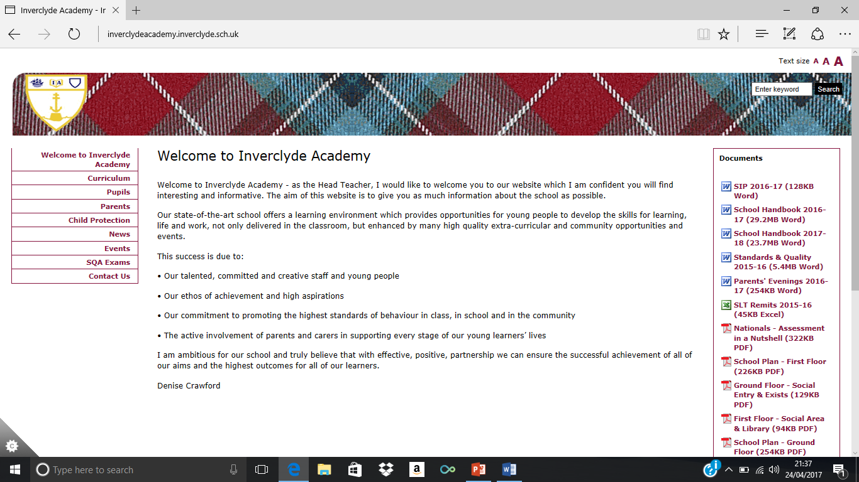
Inverclyde Academy: Higher Education Info Evening
29th September 2022
Employment
Apprenticeship
Training
College
University
RESPECT RESPONSIBILITY EQUALITY SUCCESS

Slide 2
Schedule for the evening:
1 - Intro from Inverclyde Academy – Sabrina McCready, DHT
2 - HNC/HND pathways – WCS (Sabrina in absence)
3 – UCAS processes – Lynne Smith, PTPS
4 - Universities, Caitlin Houston, Strathclyde University
5 – Funding, Ben Galligan, SAAS
6 - Q&A with full panel
7 - Closing remarks from Inverclyde Academy – Denise Crawford, HT
RESPECT RESPONSIBILITY EQUALITY SUCCESS

Slide 3
Rationale:
In 2008, Education Scotland’s Building the Curriculum 3 described a curriculum where pupils are “entitled to experience a senior phase where he or she can continue to develop the four capacities and also achieve qualifications.” (p15)
But in June 2014, Sir Ian Wood’s report, Education Working for All! proposed improvements that highlighted several significant areas requiring improvements including the need for schools to design structures and programmes that deliver “the flexibility required to meet the needs of young people and employers” (2014, p.27) so that we can achieve the government’s vision of a Scotland that is a “fair and prosperous country” (DYW 2014, pi).
RESPECT RESPONSIBILITY EQUALITY SUCCESS
Notes:
Rationale:

Slide 4
Leavers’ Destinations 2020-21

Slide 5
IA’s Senior Phase Structure:
Senior Phase includes all of S4, S5 and S6 – all/any classes can contain pupils from any of these year groups.
Pupils studying all N3-5, study 6 subjects and attend core PSE, RMPS & PE in S4.
If doing at least one Higher, pupils study 5 subjects and attend core PSE and DYW each week.
If doing any Advanced Highers, pupils can drop one column for each AH e.g. if doing 1 AH, they only do 4 subjects, if doing 2 or more AH, you only do 3 subjects.
S6 are expected to use the free columns productively and are encouraged to do volunteering.
RESPECT RESPONSIBILITY EQUALITY SUCCESS

Slide 6
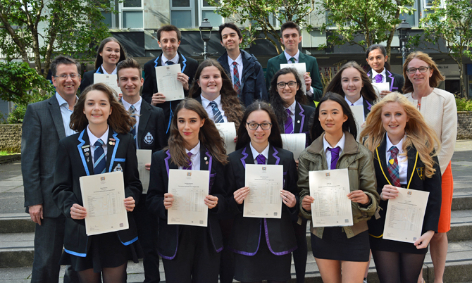
Consortium
In order to access the widest possible certification, we work with all our local secondaries:
Mostly S6 but some S5 if there are TT clashes
Mostly Advanced Highers but some
Higher and occasionally N5
RESPECT RESPONSIBILITY EQUALITY SUCCESS

Slide 7

West College Scotland
HNC/D Programmes
“[schools and colleges should have an] ambitious partnership… [with] high level vocational qualifications which have a strong currency in the labour market” (The Wood Report, 2014, p.20)

Slide 8
Curriculum Areas
Travel & Tourism
Applied Science
Electrical/
Mech/Eng Sys Engineering
Business/
Accounts
Photography
Fitness Health & Exercise
Professional Cookery
Sound Production
Computing/
Games Development
Coaching/
Developing Sport
Cyber Security
Automotive Engineering
Acting & Performance, Dance
Media & Television
Social Science
Construction Management
Make Up Artistry
Beauty/
Complimentary Therapy
Fine Art
Architectural Design
Childcare
Graphic Design
Interior Architecture & Design

Slide 9
What is an HNC/HND?
Higher National Certificate (HNC) is a Higher Education (HE) course starting at level 7.
Students complete between 12 and 15 different subjects per year on continuous assessment and complete a Graded Unit (A/B/C).
Higher National Diploma (HND) is a Higher Education (HE) course starting at level 8.
Completion of HND can allow students to access Year 2 in some degree courses.

Slide 10
What Qualifications Do I Need?
STEM area HNC/D level courses typically require at least two Highers including Maths and a science/ technical subject or have passed an NC course.
Non STEM areas typically require at least one Higher and possibly an audition (performing subjects).
If you don’t have the qualifications requested on the website come and talk to us to see if we can help. There are options.

Slide 11
What Next?
There are choices at the end of every course to either continue with the educational pathway or exit into the workplace.
Many of our HNC courses offer an HND level course for the following year.
Most universities accept HNC/Ds as alternatives to the school entry requirements (Highers).
HNC holders can gain entry to first year in most and second year in some university courses.
HND holders can gain entry to second year in most and third year in some university courses.

Slide 12
The UCAS Process

Slide 13
Our Role
Helping your young person to make the correct choices
Researching universities
Guiding them through their personal statement
Writing an academic reference
Supporting with additional programmes/scholarships

Slide 14
Young person’s role
Researching university courses taking grades into consideration, for example, that The University of Glasgow and Strathclyde University do not accept C passes.
Meeting personal statement deadlines and taking on-board teacher feedback
Sending application away on time
DO NOT APPLY AS AN INDEPENDENT – the school will give you a buzz word!

Slide 15
Cost
2023 entry
£22.50 for one choice
£27 for five choices
Five choices is the maximum you are allowed to make

Slide 16
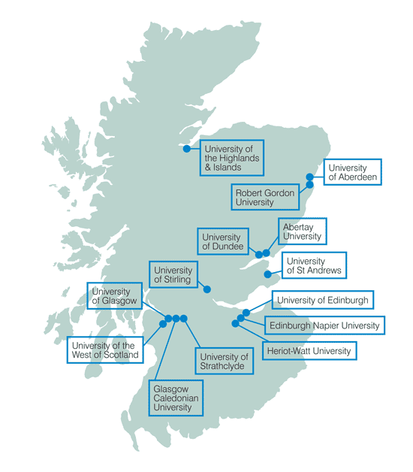
Universities:
We work with the following agencies to
support and encourage our young people
into Higher education.
Under the umbrella of Focus West, we have:
REACH
Access to a Career
Top Up
Routes for All
RESPECT RESPONSIBILITY EQUALITY SUCCESS
Notes:
Check with Catriona

Slide 17
University Support
REACH – Vet Medicine, Medicine, Dentistry and Law
ACCESS to a career – Teaching (Primary, Technological and Religious Moral and Philosophical studies, Engineering, Accountancy and Finance)
Top Up
Routes for All – 1-1 mentoring and career support for applying to Higher Education (college)
RESPECT RESPONSIBILITY EQUALITY SUCCESS
Notes:
Check with Catriona

Slide 18
Other School Support
SDS Careers Advisor – Larry Hansen
DYW Worker – Chloe MacKay
They can also help research college and universities
RESPECT RESPONSIBILITY EQUALITY SUCCESS
Notes:
Check with Catriona

