Slide 1
IA Fitness
Inverclyde Academy PE Department

Slide 2
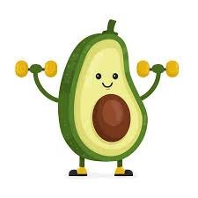
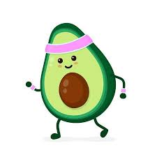
We bring you a selection of workouts to complete at home. Select a fitness type, then select your workout. #staystrong #stayhealthy

Slide 3
Things to remember…
Remember to warm up and stretch before completing any physical active. Examples of these can be seen in the links. – This helps to prepare the body for physical activity and helps avoid injury.
Know your limits – It’s important not to over do it and not to injure yourself!
Cool down after all active. Examples of these can be seen in the links. – this helps to remove lactic acid and help prevent muscle soreness.
Unsure of any activity ask your PE teacher. Remember we are here to help!
Stay hydrated before, during and after your workout!

Slide 4
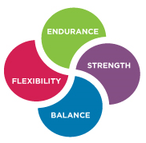
Click on the type of exercise you are looking for. This will take you to a link to access a number of workouts…
Warm Ups
Cool Downs
Stretches
The Body Coach
PE With Joe
HIiT
Just Dance
Zumba
Tabata
Cardio
Fat burners
Bootcamp
Seniors
Challenges
Legs, bums & Tums
Abs
Legs
Arms
Next
Kettlebell workouts
5 Minute moves
Yoga
Pilates
Meditation
Mindfulness

Slide 5
Click on the type of exercise you are looking for. This will take you to a link to access a number of workouts…
Back
Ladder Sets
Football Skills
Netball Skills
Basketball Skills
Crazy Catch

Slide 6
Warm Up
Click the picture to access the video…
5-minute warm up for at-home workouts
Zumba warm up routine for beginners
10-minute warm up for at-home workouts
Warm up by lessier Herrera – Zumba
How to warm up before a Hiit session – The body coach
Basic yoga warm up
5-minute warm up for at-home workouts
10 min pre workout yoga warm up

Slide 7
Cool Down
Click the picture to access the video…
Fast 5 minute cool down and stretching
Zumba fitness – cool down
How to cool down after a hiit session
5 minute follow along post run cool down
How to cool down after exercise
10 min cool down routine
Total body cool down
10 min basic yoga cool down

Slide 8
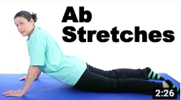
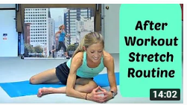
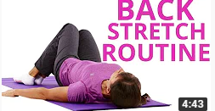
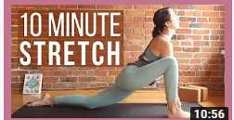
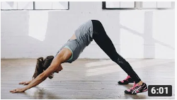
Stretches
Click the picture to access the video…
Post – workout stretching
Ab stretches
After workout stretch routine
Quad stretches
8 minute after workout stretching video
Lower back stretches
10 min morning yoga full body stretch
25 static stretches

Slide 9
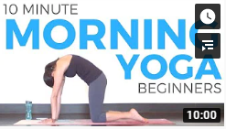
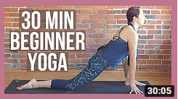
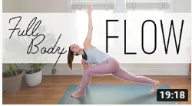
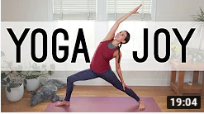
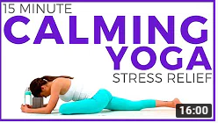
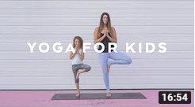
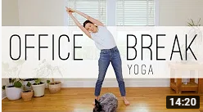
Yoga
Click the picture to access the video…
10 minute morning yoga for beginners
30 min beginner yoga
Full Body Flow
Yoga joy – full body vinyasa
20 min full body stretch/yoga for stress & anxiety
15 minute calming yoga for stress relief & anxiety
Yoga for kids with Alissa kepas
Office break yoga

Slide 10
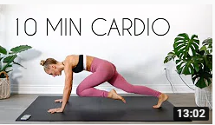
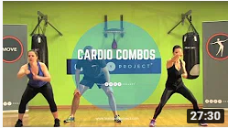
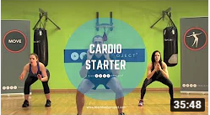
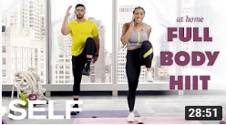
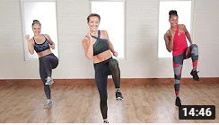
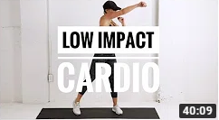
Cardio
Click the picture to access the video…
10 min cardio workout at home
25 minute interval cardio workout from home
30 minute standing cardio workout
Low impact 30 minute cardio workout - beginners
30 minute hiit cardio workout
At home cardio – No running
Killer hiit cardio workout
Low impact hiit cardio + legs workout

Slide 11
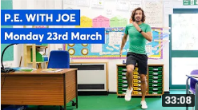
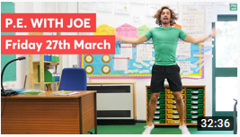
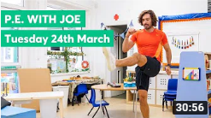
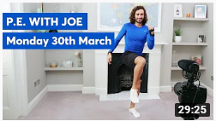
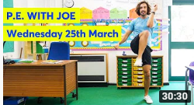
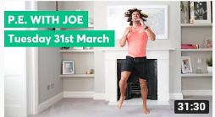
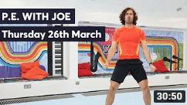
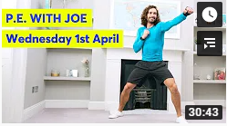
PE With Joe
Next
Click the picture to access the video…
Monday – 23rd March
Friday – 27th March
Tuesday – 24th March
Monday – 30th March
Wednesday – 25th March
Tuesday – 31st March
Thursday – 26th march
Wednesday – 1st April

Slide 12
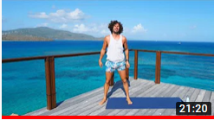
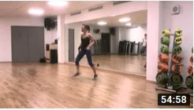
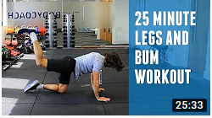
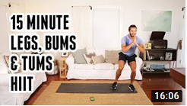
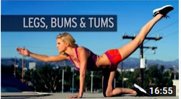
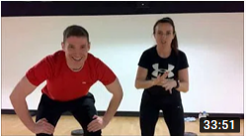
Lower Body
Click the picture to access the video…
20 minute legs & tums workout
Legs, bums & tums full class
25 minute legs workout
15 minute legs & tums HIIT workout
Legs & tums workout
Life leisure home workout – 30 mins legs & tums
Dance fitness workout – leGS
8 minute legs & tums workout

Slide 13
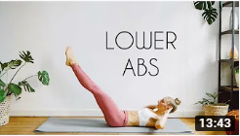
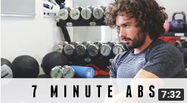
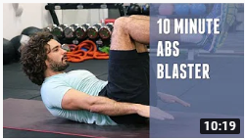
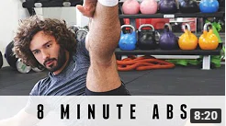
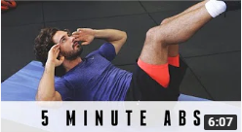
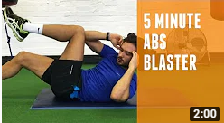
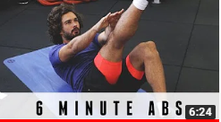
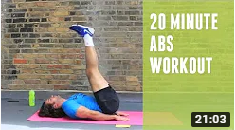
Abs
Click the picture to access the video…
10 min lower abs
7 minute abs workout
10 minute abs blaster
8 minute abs workout
5 minute abs
5 minute abs blaster
6 minute abs
20 minute abs workout

Slide 14
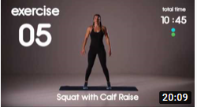
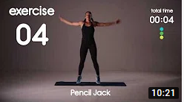
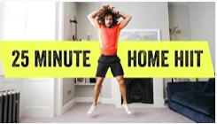
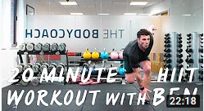
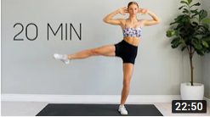
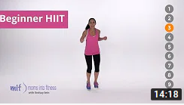
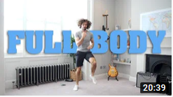
HIiT
Click the picture to access the video…
20 min full body beginner HIIT workout
10 min hit cardio workout from home
35 minute Full body home hiit
20 minute home hit workout with ben davie
Low impact Full body hit workout
Beginner Hiit – 10 minutes
20 minute full body home hiit
Full body fat burn hit

Slide 15
Meditation
Click the picture to access the video…
Meditation for inner peace
Daily calm – Be present
Meditation for anxiety
Daily calm – self soothing
7 min meditation to start your day
Daily calm – letting go
5 minute meditation
Daily calm – forgetting time

Slide 16
Pilates
Click the picture to access the video…
Total body Pilates
Level 1 Pilates mat class
Morning Pilates routine
Restful nights sleep pilates routine
Pilates full body workout 45 mins
8 min gentle pilates flow with isa-Welly
10 minute total body Pilates
10 min pilates workout with lottie murphy

Slide 17
Zumba
Click the picture to access the video…
Zumba kids (easy dance)
Zumba kids – old town road
Zumba fitness cardio workout
Home workout – 20 min zumba class
Zumba dance workout for beginners
20 minutes strong by Zumba
30 minute strong by Zumba
Strong by Zumba 30 min class

Slide 18
Tabata
Click the picture to access the video…
15 minutes fat burning Tabata workout
Tabata for beginners – low impact
30 minute Tabata session
10 minute Tabata workout to sweat away stress
12 minute full body tabata
Bodyweight Tabata workout
Beginner Tabata workout
Home Tabata workout – MMA workout

Slide 19
BootCamp
Click the picture to access the video…
30 minute no –equipment bodyweight bootcamp
8 minute bootcamp workout
15 minute beginner bootcamp
Military bootcamp
15 minute bootcamp style workout
45 minute nike bootcamp workout
15 minute bootcamp workout
15 minute total body bootcamp

Slide 20
Just Dance
Click the picture to access the video…
Just dance – waka waka this time for Africa
Just dance – uptown funk
Just dance – starships
Just dance – crazy in love
Just dance – eye of the tiger
Just dance – macarena
Just dance – despacito
Just dance – wanna be

Slide 21
Kettlebell workouts
Click the picture to access the video…
Beginners kettlebell workout
10 minute kettlebell workout
20 minute kettlebell workout
20 minute kettlebell workout
25 minute kettlebell workout
15 minute full body kettlebell fat burner
15 min Full body kettlebell workout
Kettlebell arm workout

Slide 22
The Body Coach
Next
Click the picture to access the video…
7 days of sweat – day 1
7 days of sweat – day 5
7 days of sweat - day 2
7 days of sweat – day 6
7 days of sweat – day 3
7 days of sweat – day 7
7 days of sweat – day 4
20 minute hit workout

Slide 23
Arms
Click the picture to access the video…
10 min toned arms workout
Arm toning & strength workout
Tone your arms workout
5 minute arm workout
5 minute arm workout
Barre arm workout
12 minute beginner arm workout
Barre fitness – arm workout

Slide 24
Legs
Click the picture to access the video…
20 min at home leg workout
At home leg day workout
Home leg workout – follow along
17 min home leg workout routine
10 minute leg workout
10 minute bodyweight leg routine
Leg workout without weights
Leg & glute workout

Slide 25
Seniors
Click the picture to access the video…
10 minute home workout for seniors
20 min exercise for seniors
10 minute chair workout for seniors
30 minute senior zumba
7 minute yoga for older adults
Daily stretches for seniors
15 minute senior workout
15 minute senior workout

Slide 26
Mindfulness
Click the picture to access the video…
Mindful breathing
Mindfulness meditation for kids
3 min mindful breathing
2 minute mindfulness
Quick stress & anxiety reduction
Simple mindfulness exercise
Mindful breathing
5 minute mindfulness breathing

Slide 27
challenges
Click the picture to access the video…
Baby shark abs challenge
Bring sally up – lunge challenge
Cha cha slide plank challenge
Bring sally up – leg raises challenge
Bring sally up – push up challenge
Bring sally up – abs challenge
Bring sally up - squat challenge
Bring sally up – glute bridge challenge

Slide 28
Ladder Sets
Click the picture to access the video…
Total body no equipment ladder circuit
HIIT workout game. Fat burning ladder
Brutal home Hiit workout ladder workout
25 minute ladder HIIT
20 minute ladder workout

Slide 29
Football Skills
Click the picture to access the video…
At home: ball control, footwork and passing drill
Close control drill
Small space drilling drills
Shooting drills
Freestyle skills
5 shooting drills
Fast feet drills
How to train on your own

Slide 30
Netball Skills
Click the picture to access the video…
Ball skills at home
Ball and wall Skills
Wall Skills
Shooting practice
Netball Drills
Changing direction and agility
Ball Skills
Get around a 3ft marker

Slide 31
Basketball Skills
Click the picture to access the video…
Handling, shooting and Footwork
Daily dribbling drills
Home basketball drills
Individual drills
Shooting drills
Shooting drills without a hoop
Dribbling drills
Improve your layups without a hoop

Slide 32
Crazy Catch
Click the picture to access the video…
Netball hand reactions & Speed drills
Netball drills
Cricket fielding drills
Hockey drills
Football goalkeeping drills
Football drills
Rugby drills
Vison & eye drills

