Slide 1
Clydeview academy
S4 Subject Choice Information Evening –
February 2025

Slide 2
Tonight we will be looking at:
S3 – The Journey So Far
Structure of the S3 and S4 Curriculum
S4 Pathways/Senior Phase Pathways Process
Our New Roadmaps
THE FORM
Support for young people with ASN
SQA information and support in S4
Universal and Targeted Support
Parental Engagement
Whats next?
Notes:
We understand that at this stage as they are still very young, but we want to be clear about the fact that this is where career planning really begins, and I will speak to you a little about the support that they will receive going forward.

Slide 3
The Journey of S3 so far
Students chose 9 subjects to study in S3 – allowed multiple choices in subject areas – e.g. science, social subjects, technical etc.
Each subject 3 periods a week.
3 tracking periods
Evidence of progress – attainment and achievement
Time to enter the transition phase of S3
Skills development, raising attainment and S4 readiness

Slide 4
S3 Reports
All pupils have a paper copy of their report
Work in PSE ahead of Pathways Interview
Looking at levels achieved so far
Another tracking period due in April
Behaviour Effort and Homework

Slide 5

S4 Subject choices timeline –the journey so far
S3 Reports issued –1 further tracking report issued in April
S3 Parents’ Meeting
S4 Parental Information evening
S4 Subject Choice Interviews
Deadline for Submission of Subject Choice forms
Notes:
However, if there is anything that you wish to discuss in more detail after tonight, the parents’ meeting next week then feel free to contact your son/daughter’s guidance teacher before this.

Slide 6
S1-6 Curriculum Overview and recent changes
S1/2 - 14 subjects
S3 - 12 subjects (5 compulsory (English, Maths, PSE, PE, RME, plus a language & 6 choice)
S4 - 7 subjects at National 3/4/5 (Eng, Maths & choose another 5 from your S3 subjects)
S5/6 - 5 subjects at National/Higher/Advanced Higher (choose from your 7 subjects in S4).
Further options for wider achievements, college courses, work experience, and apprenticeships.
Notes:
S2 – Very similar to S1. Students have no choice with regards the subjects they take. New subjects have been introduced –Business, Enterprise and Finance. Skills based learning has allowed them to try some different electives this year and these do relate to subject content within the senior phase
S3 – Still a high number of subjects but obviously with students choosing 6 subjects in total. The five compulsory remain – English Maths, PE, RME, PSE
S4 – Significant reduction to 6 subjects – I should mention here the consultation that the local authority have undertaken regarding the proposed move to 7 subjects in S4
S5/6 - 5 subjects
Personalisation – as much as possible we tailor the curriculum for our young people and within the senior phase (S4-6) students can have flexible timetables with time spent at college, work placement, apprenticeships - this will be mentioned again later on.
PLPs – allow students to remain on the school roll but to experience much of their education off-site.
As a school we are striving to introduce new courses at various SCQF levels – in last few years we have introduced lab skills and Travel and Tourism for example.

Slide 7
 | S3 | S4 | S5 | S6
English | 4 | 4 | 6 | 6
Maths | 4 | 4 | 6 | 6
French or Spanish | 2 | - | - | -
PE | 2 | 2 | - | -
6 Subjects (x3) | 18 | - | - | -
5 Subjects (x4) | - | 20 | - | -
3 Subjects (x6) | - | - | 18 | 18
RE | 1 | 1 | - | -
PSE/ Leadership/ Enrichment | 1 | 1 | 2 | 2
REG | 1 | 1 | 1 | 1
Notes:
And a further 3 periods of 6 subjects.

Slide 8
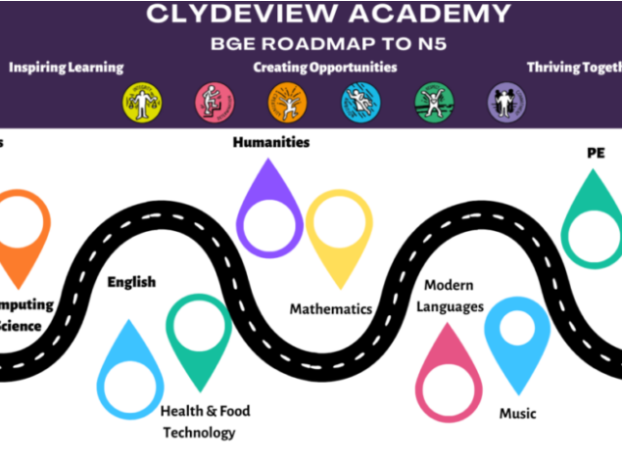
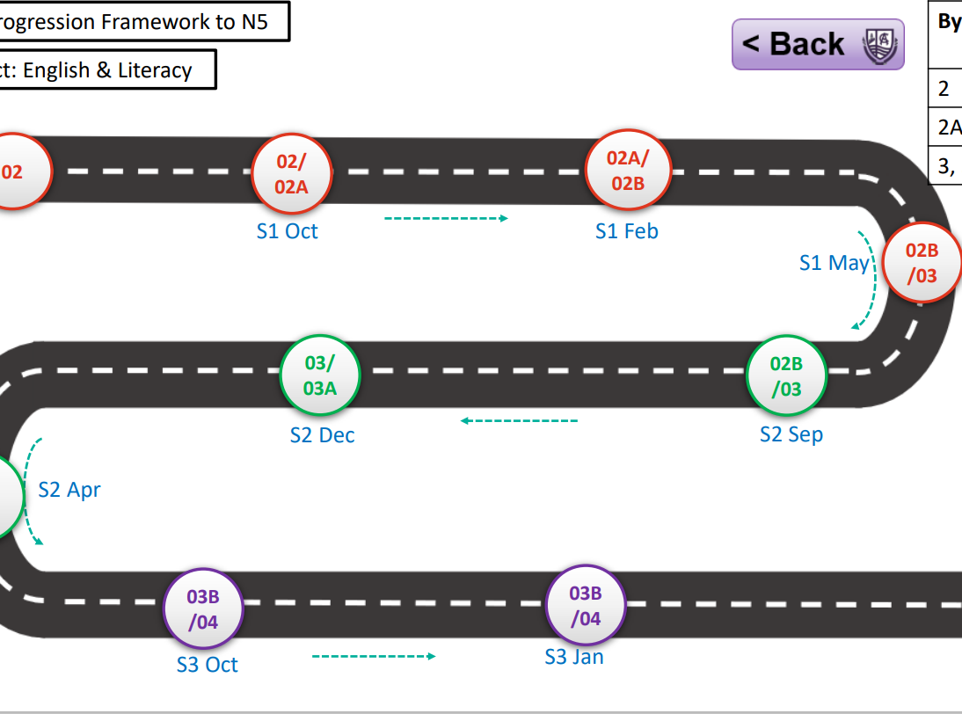
Our New roadmaps
Notes:
Excited and this is the bit where I switch to a website demonstration so I am excited to see that it works!

Slide 9
Why is this Roadmap Important? How You Can Support Your Child:
Clarity: It helps you and your child understand how each stage of learning prepares them for their Senior Phase from S4 to S6.
Support: It identifies areas where your child may need additional support or challenge and ensures timely interventions.
Reassurance: The roadmap ensures that the transition from BGE to the Senior Phase is a natural progression and not a sudden leap.
Engage with Their Learning: Regularly discuss their progress in different curricular areas and celebrate achievements.
Encourage Skills Development: Support activities like reading, problem-solving games, or hands-on experiments at home to reinforce school learning.
Partner with Us: Stay in touch with teachers, attend parent-teacher evenings, and ask questions about your child’s progress

Slide 10




Slide 11
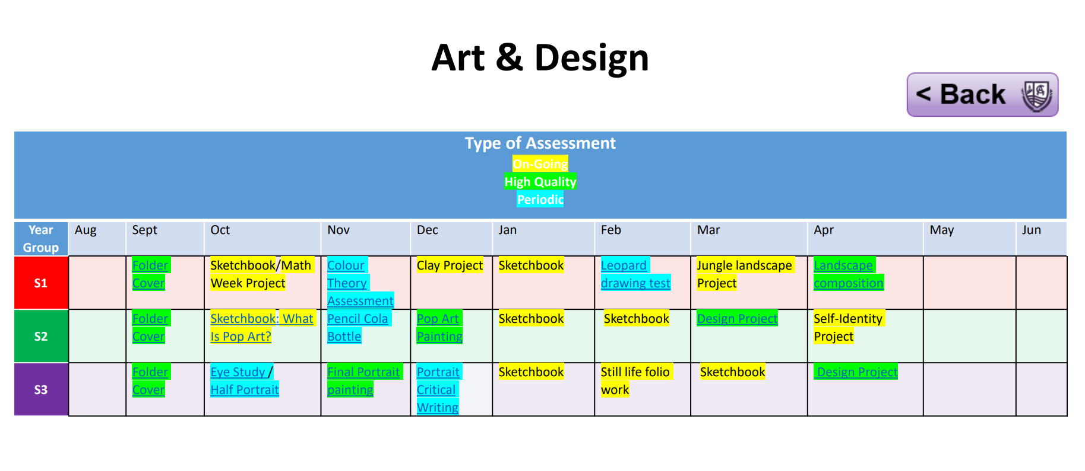
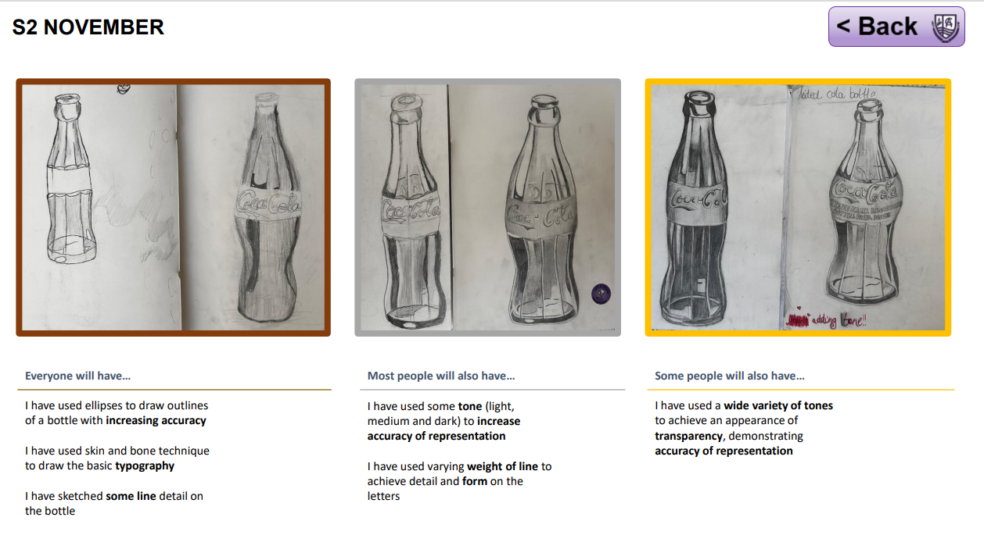
Our New roadmaps

Slide 12


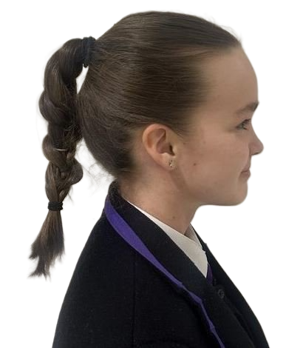

By April S3 | Pathway
2 | N3
2A, 2B | N4
3, 3A, 3B, 4 | N5
02
02/
02A
02A/02B
S1
S1 Oct
S1 Feb
02B/03
S1 May
03/
03A
02B/03
S2 Dec
S2 Sep
03A/
03B
S2 Apr
03B/04
03B/04
03 - 04
S3
S3 Oct
S3 Jan
S3 May

Slide 13
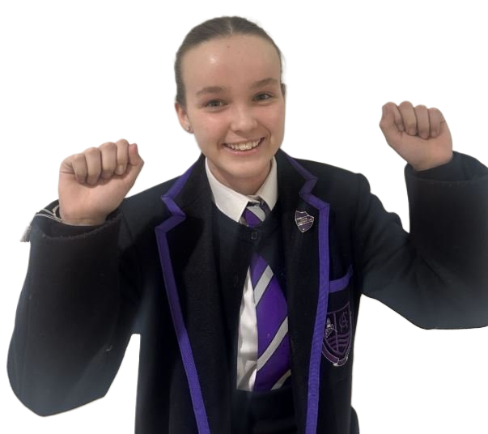
By April S3 | Pathway
2 | N3
2A, 2B | N4
3, 3A, 3B, 4 | N5
02
02/
02A
02A/02B
S1
S1 Oct
S1 Feb
02B/03
S1 May
03/
03A
02B/03
S2 Dec
S2 Sep
03A/
03B
S2 Apr
03B/04
03B/04
03 - 04
S3
S3 Oct
S3 Jan
S3 May

Slide 14


By April S3 | Pathway
2 | N3
2A, 2B | N4
3, 3A, 3B, 4 | N5
02
02/
02A
02A/02B
S1
S1 Oct
S1 Feb
02B/03
S1 May
03/
03A
02B/03
S2 Dec
S2 Sep
03A/
03B
S2 Apr
03B/04
03B/04
03 - 04
S3
S3 Oct
S3 Jan
S3 May

Slide 15

By April S3 | Pathway
2 | N3
2A, 2B | N4
3, 3A, 3B, 4 | N5
02
02/
02A
02A/02B
S1
S1 Oct
S1 Feb
02B/03
S1 May
03/
03A
02B/03
S2 Dec
S2 Sep
03A/
03B
S2 Apr
03B/04
03B/04
03 - 04
S3
S3 Oct
S3 Jan
S3 May

Slide 16
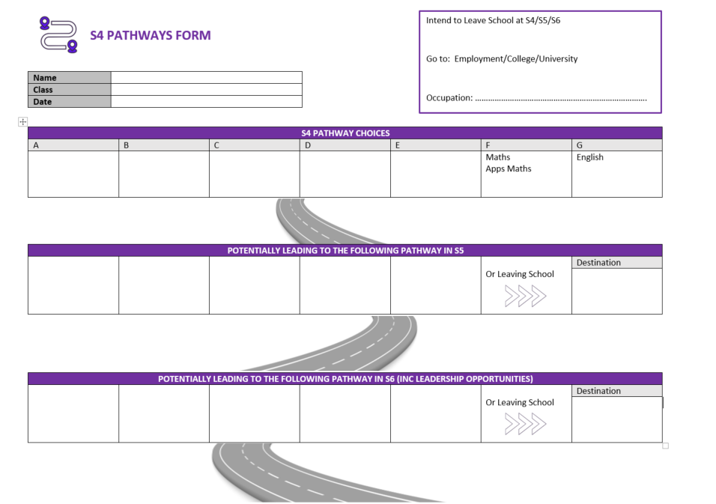

Slide 17
A – 4 periods | B – 4 periods | C – 4 periods | D – 4 periods | E – 4 periods | Maths – 4 periods | Other Subjects
Chemistry Computing Computing Tech (NPA) French PE Spanish | Biology Chemistry Dance History Lab Skills Physics Science (Level 3/4) | Admin & IT Business Management Geography History Modern Studies Travel and Tourism (NPA) | Accounts (Level 5 only) Admin & IT Art Computing Graphics Music Tech | Art Design and Man Music Performing Practical Cookery RMPS Spanish Woodworking | Apps Maths Maths | English – 4 periods PE – 2 periods RMPS – one period PSE – one period Registration – one period
Unless otherwise stated, all subjects are available at level 4 and level 5. Please note that students will make a choice from columns A to E and in addition everyone will get the subjects in the final column. A spreadsheet will be completed by the guidance staff with students’ choices at the interview. Subjects will only run if there is enough uptake and some may be oversubscribed in some columns.

Slide 18
Important Pathways information
For S4, courses are offered at various levels – Level 4 and 5 being the most common but there are some at Level 3.
The majority of Level 5 qualifications have exams at the end of the year except Lab Skills, Travel and Tourism, Computing Tech – Level 3 and 4 are continual assessment.
Some subjects stop at N5 level eg Practical Woodworking and Practical Cookery
Accounting only begins at N5

Slide 19
The pathways interview
Dedicated time set aside for a meeting with students' Guidance Teacher
Meeting takes into account:
S3 Reporting
Student pathways
Strengths and skills development
Referencing the Roadmaps

Slide 20
THINGS TO THINK ABOUT
What career is your child considering – does it require any specific subjects?
What subjects are they good at and that they enjoy?
What does the report tell you?
See S4-S6 as one pathway – consider what the subjects chosen in S4 will lead to in S5.
Keep options open – go for maximum success.
All S4 students have an individual interview with either Leigh Gavin or another SDS advisor.

Slide 21
What to avoid
Don’t choose subjects because they like the teacher.
Don’t choose the same as friends – everyone is an individual.
Don’t choose subjects because they look easy/don’t have much homework – that changes.

Slide 22
CAREER INFORMATION
My World of Work
https://www.myworldofwork.co.uk
Planit Plus
https://www.planitplus.net
UCAS
https://www.ucas.com

Slide 23





Pathway Map
Everyone is different and will want to do different things when they leave school.
There are lots of different pathways that will suit different people and their aspirations.
School
Graduate
Apprenticeship
University
College
Foundation/Modern Apprenticeship
Jobs
Notes:
We also know that there are many options for our young people today and this diagram illustrates some of the options or pathways.
Within the Senior phase we can build in study at college and foundation apprenticeships. These can lead to graduate apprenticeships/ further study at college or university.
Links to careers will be made within subject teaching and each subject area has developed individualised pathways showing the links to college courses/university courses or employment opportunities.

Slide 24


Slide 25
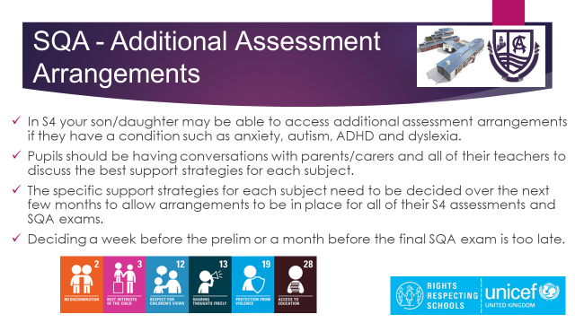

Slide 26
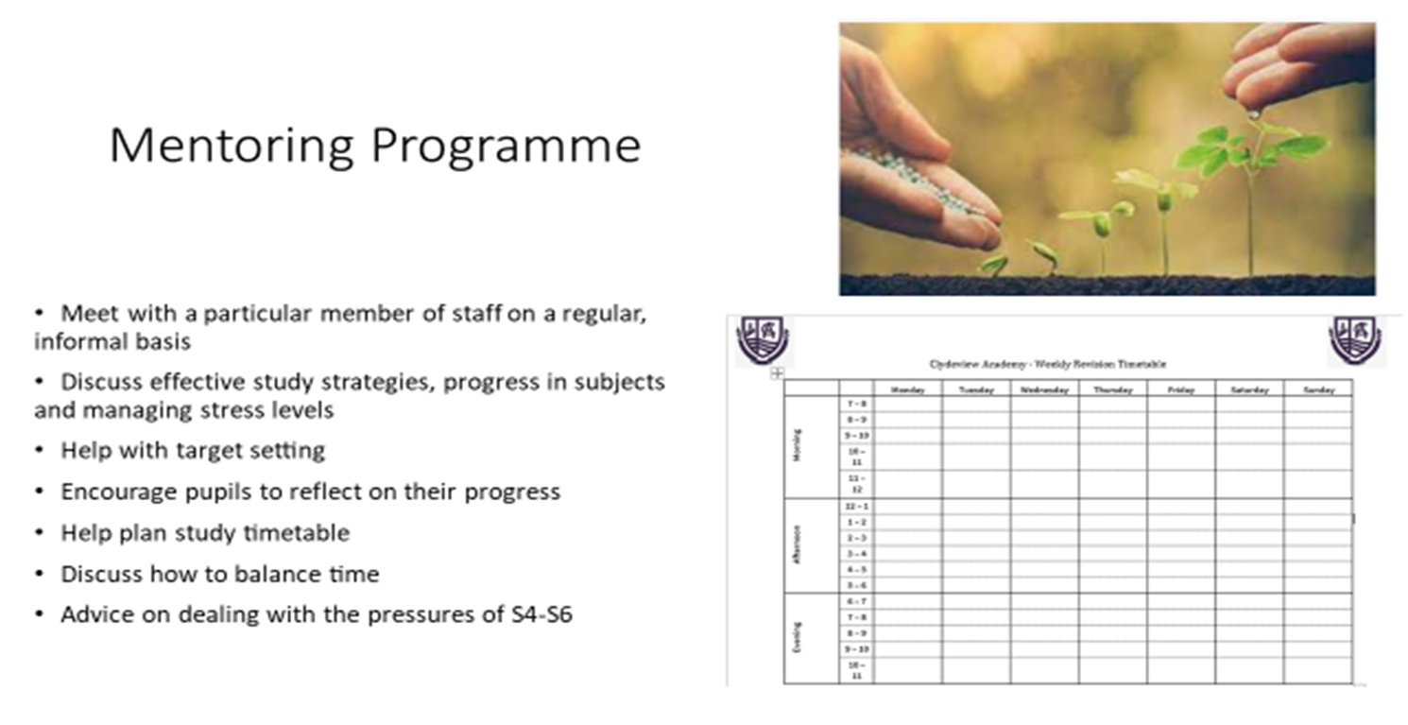
Universal and targeted support for pupils – supporting student achievement

Slide 27
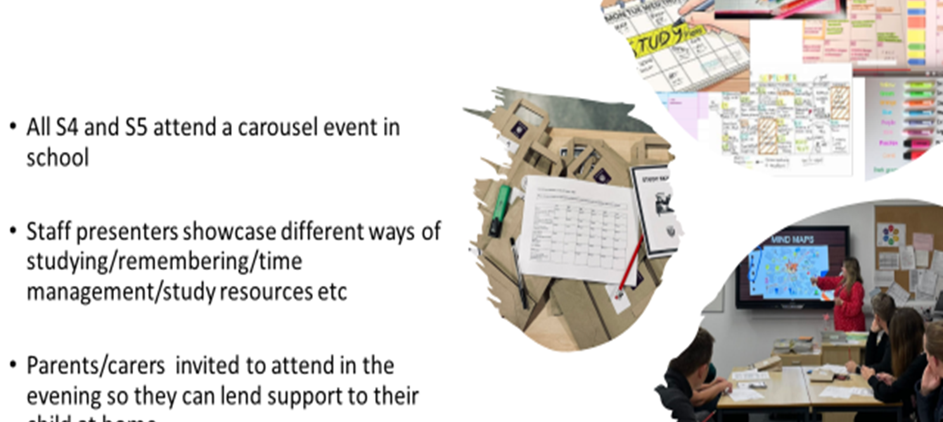
Study Skills Week

Slide 28
Other Supports
Supported Study
Easter School
Achievement Zone
Raising Attainment Meetings

Slide 29

Parental Engagement
Parental Toolkit
Your Voice Matters
Call to Action

Slide 30
What's Next?
Presentation and Subject Information Booklet published
Pathways interviews begin w/b Monday 24th February
Opportunity to dial into that meeting
Forms to be completed by March 10th

Slide 31
Your voice matters

