Slide 1
BGE Progression Framework to N5
By April S3 | Pathway
2B | N3
3A | N4
3B/4 | N5
Subject: Modern Languages
1B/2
2
2A
S1
S1 Oct
S1 Feb
2A
S1 May
2B
2B
S2
S2 Dec
S2 Sep
3
S2 Apr
3A
3A
3B/4
S3
S3 Oct
S3 Jan
S3 Apr

Slide 2
Year | Period | Course Overview
S1 | August - December | Talking about myself (French) Greetings & how I am Giving my & others’ name & age Talking about birthdays Using Sentence Builders Learning to learn (Blackout method) Using a correction code Sound patterns | Talking about my school (French) What subjects I study Giving opinions on my subjects Comparing school life in France to Scotland Basic dictionary use
 | January - May | Talking about my school (French) Giving reasons for my opinions Telling the time Talking about my timetable and the school day Saying what I do at break | Talking about myself (Spanish) Greetings & how I am Giving my & others’ name & age Talking about birthdays Talking about my and others’ appearance
S2 | August - December | Talking about myself (Spanish) Describing where I live Learning to learn (Flashcard chunks) | Talking about my free time (French) Saying what I do in my free time Describing my use of technology Talking about sports
 | January - May | Talking about where I live (French) Saying what there is in my town Giving opinions on where I live Asking for & giving directions | Talking about the weekend (French) Saying what I do at the weekend Making arrangements to go out Dictionary Use – intermediate
S3 | August - May | French Ordering food & drink in a café Giving opinions on television and cinema Describing technology use Talking about family – descriptions & relationships | Spanish Giving opinions on my subjects and timetable Describing my school’s facilities Discussing what I do at break Coco film project Ordering food & drink in a café

Slide 3
Assessment Calendar
Type of Assessment Ongoing High Quality Periodic
Year Group | May | Jun | Aug | Sept | Oct | Nov | Dec | Jan |  |  | Feb | Mar |  | Mar | Apr
S1 |  |  |  | Listening & Reading Check-in 1 (name & age, birthday) | Talking Check-in 1 (name, age & birthday) | Writing Check-in 1 (name, age & birthday) | “Wee book” (name & age, birthday, subjects) | Writing Check-in 2 (subjects & opinions) |  |  |  | Reading & Listening Check-in 2 (subjects, opinions, timetable, break) |  | Reading & Listening Check-in 2 (subjects, opinions, timetable, break)
S2 | Reading & Listening Check-in 3 (name, age & birthday) |  |  | “Wanted” poster (name, age, birthday, appearance) | Talking Check-in 2 (name, age, birthday, appearance, live) | Reading Check-in 4 (free time) |  | Listening Check-in 4 (free time) |  |  | Writing Check-in 3 (where I live) |  | Talking Check-in 3 (directions)
S3 Fre | Listening Check-in 5 (ordering food & drink) |  | Reading Check-in 5 (TV) |  |  | Talking Check-in 4 (TV/cinema) | Writing Check-in 4 (TV/cinema) |  |  |  | Reading Check-in 6 (Media) |  |  |  | “Wee book” (media & relationships)
S3 Spa | Listening Check-in 5 (favourite day) |  | Writing Check-in 4 (favourite day, subjects, opinions & reasons) |  | Reading Check-in 5 (favourite day, subjects, opinions & reasons, facilities) |  | Talking Check-in 4 (school – all) |  |  | Writing Check-in 5 (school – all) |  |  |  | Talking Check-in 5 (ordering food) | Coco film project

Slide 4
S1 French: Talking Check-in 1
SOME
When Talking, using what I know about pronunciation I can easily work out how to say most words without help. I can remember and say lots of chunks from memory, including some harder ones, without help.
I can give I can give information about my and someone else’s name, age and birthday accurately and fluently within minimal or no pauses. I can ask a range of questions to find out personal information.
EVERYONE
When Talking, I note down the pronunciation of new words on my SB and this helps me say them. I use my SB to remember how to say most chunks.
I can give information about my and someone else’s name, age and birthday with enough accuracy that most of what I say can be understood, even if there are mistakes. I can do this even though I may pause and on occasion need prompting.
MOST
When Talking, using what I know about pronunciation I can work out how to say some words without help. I can remember and say short chunks from memory, and use my SB for harder ones.
I can give information about my and someone else’s name, age and birthday with enough accuracy that all of what I say can be understood, even if there are minor mistakes. I can do this mostly without pausing or prompting. I can ask a question to find out personal information.

Slide 5
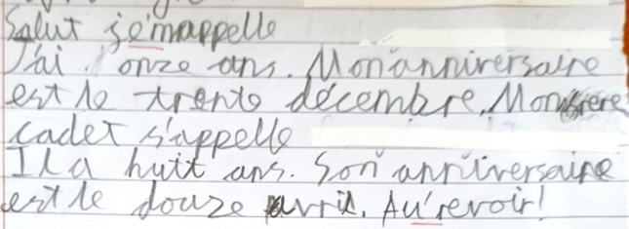
S1 French: Writing Check-in 1
EVERYONE
I can write some French words correctly on the topic I’m studying, in simple sentences. With help, I can use the Correction Code to fix mistakes in my writing.
MOST
I can write most French words correctly on the topic I’m studying using some simple and some longer sentences. I can link these together using ‘and’, ‘but’ or ‘also’ in French. I can use the Correction Code to fix mistakes in my writing.
SOME
I can write almost all the French words on the topic I am studying correctly, using longer sentences and linking these together with ‘and’, ‘but’ or ‘also’ in French. I can confidently use the Correction Code to fix mistakes in my writing.

Slide 6
S1 French: Wee Book
SOME
I can write personal information and details about my subjects, including a variety of opinions and reasons, in a highly accurate manner. I can present this very neatly and attractively and make good use of space and colour to create an engaging book.
EVERYONE
I can write some personal information and some details about my subjects with enough accuracy to be understood. I can present this neatly enough to be read.
MOST
I can write personal information and details about my subjects, including some opinions and reasons, with a good amount of accuracy. I can present this neatly and attractively.

Slide 7
S1 French: Reading & Listening Check-ins
EVERYONE
When Listening, with the support of my SB I can understand some short sentences that use chunks from my SB.
When Reading, I can read short texts and, with the support of my SB or teacher, can complete related activities. I sometimes need help finding key words in questions or in the text.
MOST
When Listening, I can understand most short and some longer sentences that use chunks from my SB. I can sometimes do this without referring back to my SB.
When Reading, I can read a longer text and complete activities, at times with the support of my SB or teacher. I can mostly find key words in questions and in the text.
SOME
When Listening, I can understand longer sentences that use chunks from my SB and some new words. I can often do this without referring back to my SB.
When Reading, I can easily read a harder text and complete activities with a little or no help from my SB or teacher. I know how find key words in questions and in the text by myself.

Slide 8
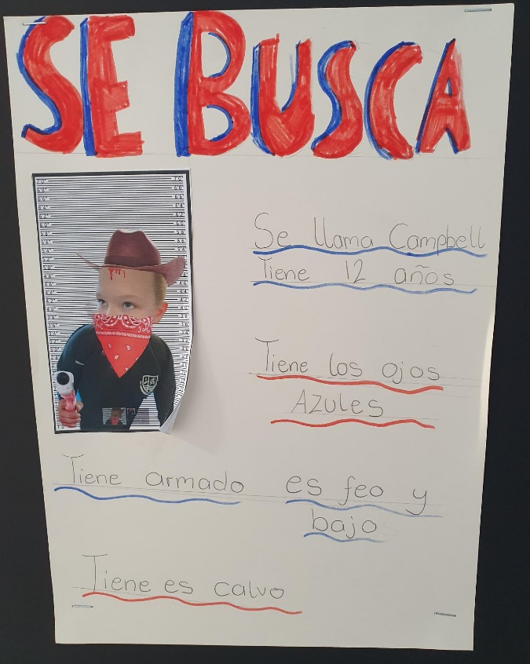
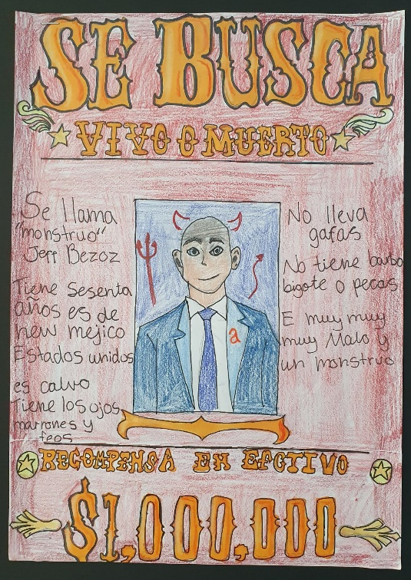
S2 Spanish: Wanted poster
SOME
I can write personal information (name, age, birthday & appearance) about another person, including a range of additional details such as personality and accessories, in a highly accurate manner. I can present this very neatly and attractively and make good use of space and colour to create an engaging poster.
EVERYONE
I can write some personal information (name, age, birthday & appearance) about another person with enough accuracy to be understood. I can present this neatly enough to be read.
MOST
I can write personal information (name, age, birthday & appearance) about another person, including some additional details such as personality, with a good amount of accuracy. I can present this neatly and attractively.

Slide 9
S2 Spanish: Talking Check-in
MOST
Using what I know about pronunciation I can work out how to say some words without help.
I can remember and say short chunks from memory, and use my SB for harder or longer ones, or to help me link these together to make longer sentences.
I can give information about my name, age, birthday, appearance and where I live with enough accuracy that all of what I say can be understood, even if there are minor mistakes. I can do this mostly without pausing or prompting.
EVERYONE
I note down the pronunciation of new words on my SB and this helps me say them.
I use my SB to remember how to say most chunks.
I can give information about my name, age, birthday, appearance and where I live with enough accuracy that most of it is understood, even though I may pause and/or require prompting on occasion.
SOME
Using what I know about pronunciation I can confidently work out how to say most words without help.
I can remember and say lots of chunks from memory, including some harder ones, without help, and link these together to make longer sentences.
I can give information about my name, age, birthday, appearance and where I live with a high level of accuracy and fluency. I give extra detail where possible and use more challenging vocabulary.

Slide 10
S2 Spanish: Reading & Listening Check-ins
EVERYONE
When Listening, with the support of my SB I can understand some short sentences that use chunks from my SB.
When Reading, I can read short texts and, with the support of my SB or teacher, can complete related activities. I sometimes need help finding key words in questions or in the text.
MOST
When Listening, I can understand most short and some longer sentences that use chunks from my SB. I can sometimes do this without referring back to my SB.
When Reading, I can read a longer text and complete activities, at times with the support of my SB or teacher. I can mostly find key words in questions and in the text.
SOME
When Listening, I can understand longer sentences that use chunks from my SB and some new words. I can often do this without referring back to my SB.
When Reading, I can easily read a harder text and complete activities with a little or no help from my SB or teacher. I know how find key words in questions and in the text by myself.

Slide 11
S2 Spanish: Writing Check-in
SOME
I can write almost all Spanish words on the topic I am studying correctly, using longer sentences and linking these together using a variety of connectors in Spanish. I can provide additional detail in several areas and use more challenging vocabulary where appropriate. I can confidently use the Correction Code to fix mistakes in my writing.
MOST
I can write most Spanish words correctly on the topic I’m studying using some simple and some longer sentences. I can link these together using some basic connectives in Spanish. I can use the Correction Code to fix mistakes in my writing.
EVERYONE
I can write some Spanish words correctly on the topic I’m studying, in simple sentences. With help, I can use the Correction Code to fix mistakes in my writing.

Slide 12
S3 Spanish Talking
EVERYONE
I note down the pronunciation of new words on my SB and this helps me say them.
I use my SB to remember how to say most chunks.
I can give information about my favourite day, subjects, school facilities and break time with enough accuracy that most of it is understood, even though I may pause and/or require prompting on occasion.
MOST
Using what I know about pronunciation I can work out how to say some words without help.
I can remember and say short chunks from memory, and use my SB for harder or longer ones, or to help me link these together to make longer sentences.
I can give information about my favourite day, subjects, school facilities and break time with enough accuracy that all of what I say can be understood, even if there are minor mistakes. I can do this mostly without pausing or prompting.
SOME
Using what I know about pronunciation I can confidently work out how to say most words without help.
I can remember and say lots of chunks from memory, including some harder ones, without help, and link these together to make longer sentences.
I can give information about my favourite day, subjects, school facilities and break time with a high level of accuracy and fluency. I give extra detail where possible and use more challenging vocabulary.

Slide 13
S3 Spanish: Writing Check-in
EVERYONE
I can write some Spanish words correctly on the topic I’m studying. With some help, I can use the Correction Code to fix mistakes in my writing.
I can write information about my favourite day, subjects, school facilities and break time with enough accuracy that most of it is understood, even though there may be errors throughout with word order, spelling, accents, gender or adjective agreement.
MOST
I can write most Spanish words correctly on the topic I’m studying using sentences of increasing length. I can use the Correction Code to fix mistakes in my writing.
I can write information about my favourite day, subjects, school facilities and break time that is mostly accurate, even though there may be some errors with word order, spelling, accents, gender or adjective agreement.
SOME
I can write almost all Spanish words on the topic I am studying correctly, using longer sentences. . I can confidently use the Correction Code to fix mistakes in my writing.
I can write information about my favourite day, subjects, school facilities and break time that is almost completely accurate, even though there may be occasional errors with word order, spelling, accents, gender or adjective agreement. I can provide additional detail in several areas and use more challenging vocabulary where appropriate.

Slide 14
S3 Spanish: Coco Film Project
EVERYONE
I am aware of certain differences in some aspects of life between Scotland and Spanish-speaking countries. I know some facts about Day of the Dead and recognise some specialist vocabulary related to this to describe what people do for this festival and why. With support, I can partially understand straightforward texts with some less predictable language.
MOST
I can talk about certain differences in some aspects of life between Scotland and Spanish-speaking countries. I can explain the cultural understanding behind Day of the Dead and recognise specialist vocabulary related to this to describe what people do for this festival and why. I can partially understand straightforward texts with some less predictable language.
SOME
I can talk confidently about differences in some aspects of life between Scotland and Spanish-speaking countries. I can explain the cultural understanding behind Day of the Dead and use specialist vocabulary related to this to describe what people do for this festival and why. I can understand straightforward texts with some less predictable language.

