Slide 1
Clydeview academy
Parent Council Meeting
22 January 2023

Slide 2
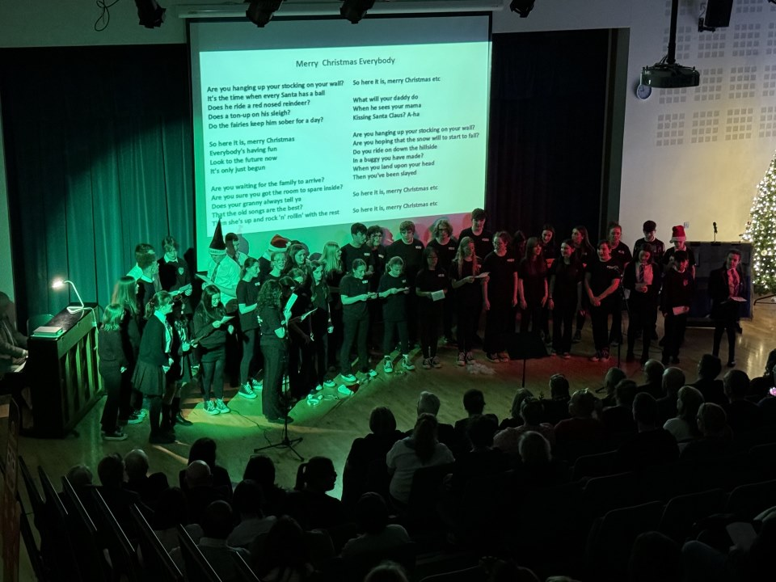
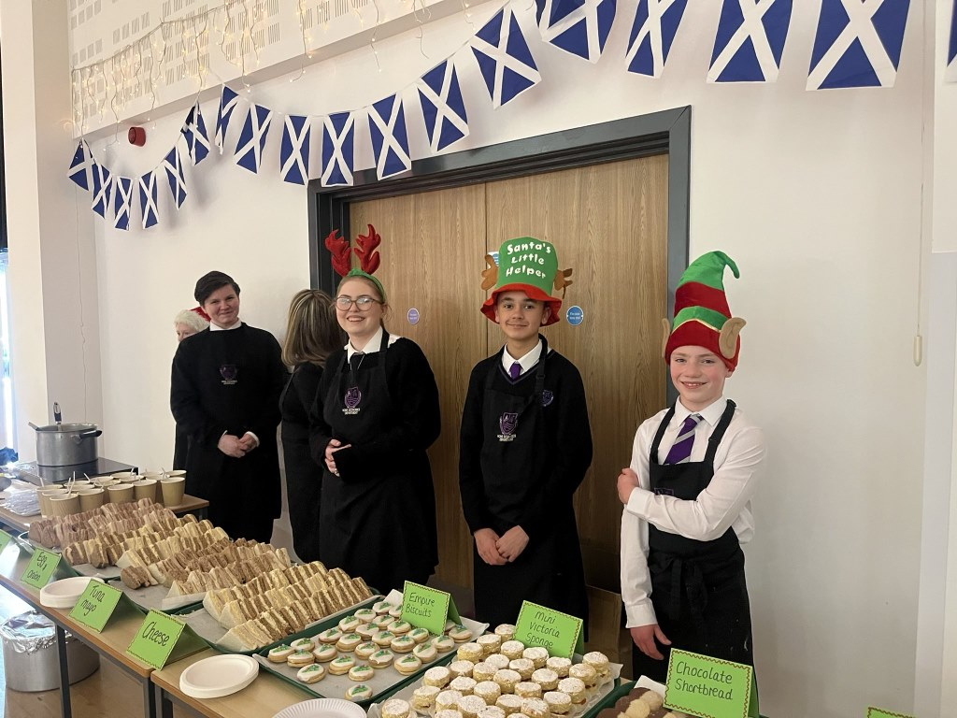
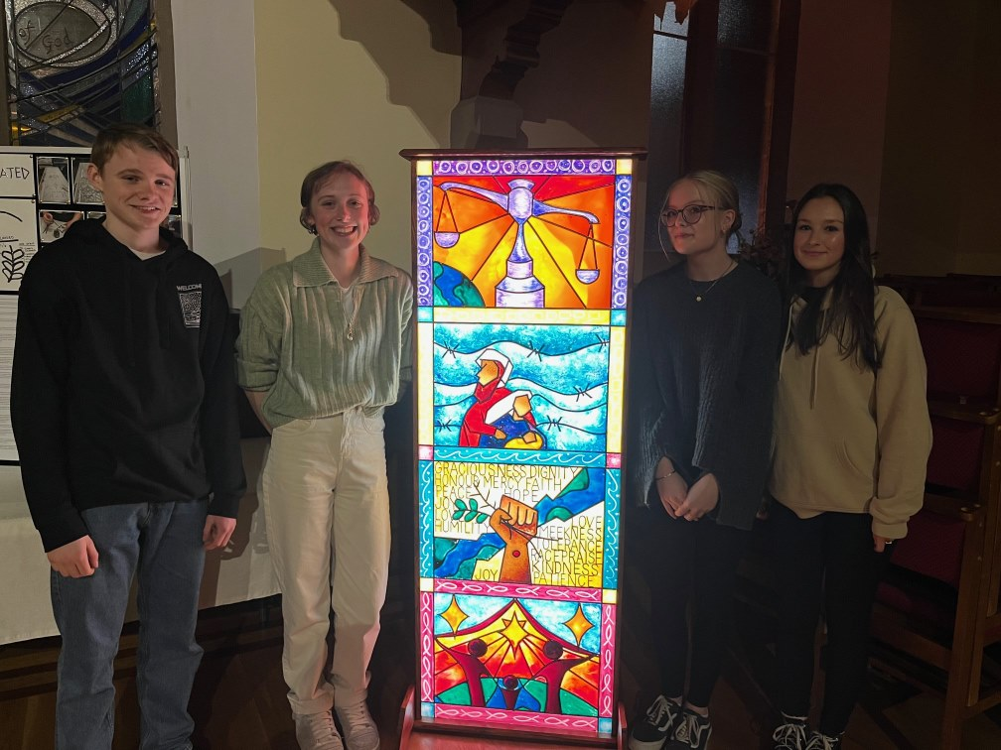
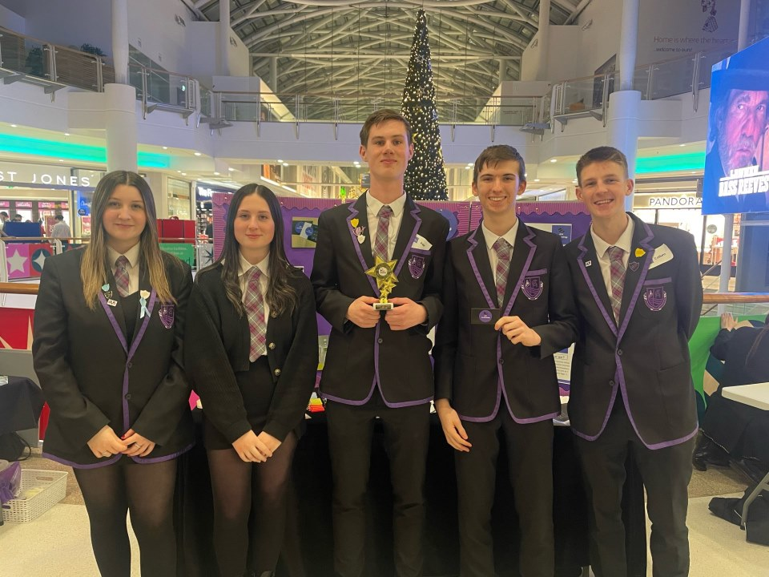
updates
N5/N6/N7 Prelims
Analysis & Targeted interventions
Christmas Events
Concerts, Tour, Cracker, S5/6 Dance, Community Event
Celebrating Achievement Ceremony
Trips:
Barcelona Trip
Jupiter Artland
Newton Flight Academy
Successes:
Gourock Rotary Event
Young Enterprise
Stained Acrylic Window Project
Sports Coaching Courses
S1 Netball – last 16 Scottish Cup
Renfrewshire Schools Swimming Championships
Language Cinema/Filmmaking Club
Young Writer’s 2023 winner
Ice Climbing World Youth Championships 2024
Notes:
Young Musician – 3rd place
Young Photographer 2nd and 3rd place
Festival of Art and Spirituality in St John’s church - Lyle Kirk Families, Stigma, Refugees, and Social Justice
28 pupils in total participated over 4 courses in basketball, badminton, netball and volleyball delivered by tutors from their respective National Governing Body

Slide 3
Forthcoming events
Options Information Evenings
S2-S5 Options Process
INSET Day 15/2/23
BGE Parent Session 13/3/23
Spring Concert 25/3/23
Columba 1400 Leadership Academy WB 29/4/24

