Slide 1
Clydeview academy
S3 into S4 Parents’ Information Evening
15th February 2024

Slide 2
Values
Ambition – strive to be the best version of ourselves we can be.
Respect – positive relationships with others
Determination – have high expectations and have persevere and recognise hard work.
Creativity – should propel our desire to learn.
Integrity – take responsibility for and reflect on our actions.
Commitment – in class and beyond, wanting to achieve for the betterment of ourselves and others.

Slide 3
Tonight we will be looking at:
S3 – The Journey So Far
Structure of S4 Curriculum
S4 Pathways/Senior Phase Pathways Process
S4 College Offer - West College Scotland
Careers Information
Support for young people with ASN
SQA information and support in S4
Key Messages

Slide 4
S3:The journey so far
Students chose 9 subjects to study in S3 – allowed multiple choices in subject areas – eg science, social subjects, technical etc.
Each subject 3 periods a week.
Now time to focus on subjects taking forward for senior phase pathway

Slide 6
S3 Reports
All pupils have a paper copy of their report
Work in PSE ahead of Pathways Interview
Looking at levels achieved so far
Another tracking period due in April
Behaviour Effort and Homework

Slide 7
BGE Progression Framework to N4 and N5
1A/1B
1A-2
2/2A
S1
2/2A
S2
2A/ 2B
2A
S2
2B/3
2B-3
3-3B
3A- 4
S3
End of S3

Slide 8
Senior phase S4 Curriculum Structure
All courses will build on prior learning from Broad General Education (BGE)
English and Maths compulsory – 4 periods each
Health & Well-being - Reg, PSE, PE & RME
Choice of four subjects – 5 periods each

Slide 9
Progression in Mathematics
S3
February 24

Slide 10
What are the options?
Mathematics
Applications of Mathematics

Slide 11
What’s the difference?

Slide 12
Applications of mathematics
Areas and Volumes
Finance
Probability
Data, graphs, charts
Statistics

Slide 13
mathematics
Factorising
Quadratics
Trigonometry
Surds and Indices
Straight lines
Algebraic fractions

Slide 14
Which one should I choose?
What topics do I enjoy?
What am I good at?
What do I want to do next?
Higher? Advanced Higher?
What do I want to do when I leave?

Slide 15
What am I good at?
Maths and Applications topics in S3
Both assessed
Tracked and reported on separately

Slide 16
What do I want to do when I leave?
STEM?
Entry requirements?
Employment
Skills

Slide 17
Which one is better?
French/Spanish?
Biology/Chemistry?
Music/Music Technology?
They're just different!

Slide 18
What levels?
Level 5 Mathematics
Level 5 Applications of Mathematics
Level 5 Numeracy
Level 4 Applications of Mathematics
Level 4 Numeracy
Level 3 Applications of Mathematics

Slide 19
What’s the right level?

Slide 20
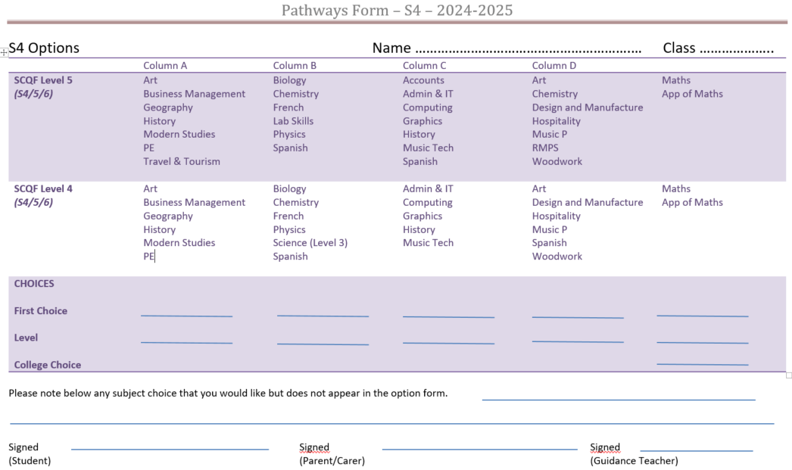
S4 Pathways Form

Slide 21
The pathways interview
Dedicated time set aside for a meeting with students' Guidance Teacher
Meeting takes into account:
S3 Reporting
Student pathways
Strengths and skills development

Slide 22
DESTINATIONs
65% go to university
83% of our leavers go to Higher Education at either college or university
Modern Apprenticeships
Graduate Apprenticeships
College Courses

Slide 23
SKILLS
Not just qualifications. Although new qualifications always being added.
Linking with students/parents/college/employers and are developing a Clydeview Academy skills framework which will be launched in June.
Consider the breadth of skills being developed for learning, life and work.

Slide 24
Skills Framework
Referenced in Lessons
Reflected upon in PSE
Gen+

Slide 25
Pathways PROCESS
For S4, courses are offered at various levels – Level 4 and 5 being the most common but there are some at Level 3.
The majority of Level 5 qualifications have exams at the end of the year except Lab Skills, Travel and Tourism – Level 3 and 4 are continual assessment.
Some subjects stop at N5 level eg Practical Woodworking and Practical Cookery
Accounting only begins at N5

Slide 37
THINGS TO THINK ABOUT
What career is your child considering – does it require any specific subjects?
What subjects are they good at and that they enjoy?
What does the report say – can be a good guide.
See S4-S6 as one pathway – consider what the subjects chosen in S4 will lead to in S5.
Keep options open – go for maximum success.
All S4 students have an individual interview with either Leigh Gavin or another SDS advisor.

Slide 38
What to avoid
Don’t choose subjects because they like the teacher.
Don’t choose the same as friends – everyone is an individual.
Don’t choose subjects because they look easy/don’t have much homework – that changes.

Slide 39
CAREER INFORMATION
My World of Work
https://www.myworldofwork.co.uk
Planit Plus
https://www.planitplus.net
UCAS
https://www.ucas.com

Slide 40
TARGETED SUPPORT FOR PUPILS –ADDITIONAL SUPPORT NEEDS
Confidential Register – Support Profiles – these will continue into S4
Parental contact to discuss ASN
Parents' Meetings
Subject Choice Meetings
Transition Meetings
Literacy Consultation Meetings

Slide 41
Targeted SUPPORT FOR PUPILS –Additional support needs
Alternative Assessment Arrangements (AAA)
Classroom assessments
Unit Assessments
Prelims
SQA exams – April/May 2025

Slide 42
Universal and targeted support for pupils – supporting student achievement

Slide 49
Clydeview academy
SQA – What it all means

Slide 51
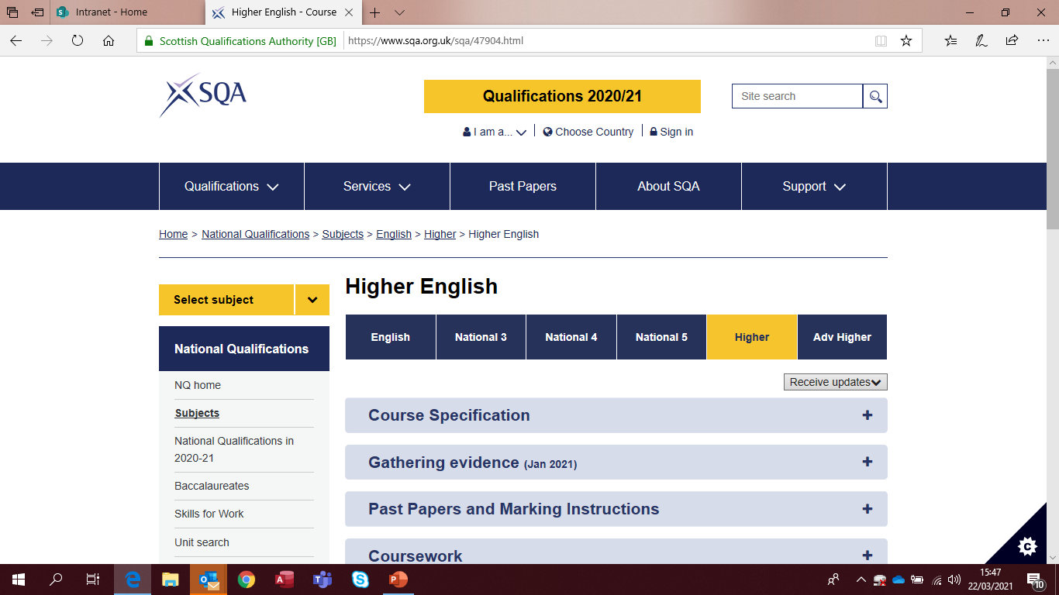
SQA website: www.sqa.org.uk/47904.html for Subject Specific assessment information:

Slide 52
Study support
SQA has study tools that are free for your child to use:
Past papers
Study planner and timetable apps
They can visit www.sqa.org.uk/learners for more information

Slide 53
S4: the successful Approach
Attendance and timekeeping
Uniform
Ambition, Determination and Commitment
Home Learning
Study Skills and Planning
Approach to assessments

Slide 54
S4: The Supports available
Class Teachers
Principal Teachers
Guidance Teachers
Support for Learning Teachers
PT Supporting Student Achievement
Year Head
DYW Coordinator
Careers Advisors
Mentors
Parental Engagement

Slide 55
KEY MESSAGES
Every National Subject is equal
Subjects are open to all students
College takes place in core time – Wed pm
Choose subjects that you will do well in
Choose subjects which are right for your pathway
Consider a broad range of subjects as you may change your mind about your pathway
Write down any subject choice that you would like, but doesn’t allow on the form

Slide 56
What next?
Reports have been issued. Check websites etc. regarding requirements if known career pathway.
Option interviews will take place with Guidance Teacher – calls can be made so that you are able to join the conversation. They begin 24 February.
Form and subject booklet will be available on the school website.
Choices will be recorded by the Guidance Teacher. An option form may be submitted.

