Slide 1
Clydeview academy
S3 Course Choice Information Evening –
11/01/24

Slide 2
Tonight we will be looking at:
S2 Subject Choices Timeline
S1-6 Curriculum Overview
S3 Curriculum Model and Broad General Education
Next Steps

Slide 3
S2 Subject choices timeline
Thursday 11th January
Reports issued
period 5 and 6 – S2 Subject Fayre
6pm-7pm – parental information evening and subject fayre
Next week – PSE – more input with Guidance staff
Wednesday 17th January – S2 Parents Meeting – 3.30pm-5.30pm
Between Thursday 18th January & Friday 2nd February– Options Interviews
Deadline for submission of forms – Friday 2nd February

Slide 4
S1-6 Curriculum Overview
S1/2 - 14 subjects
S3 - 12 subjects (5 compulsory (English, Maths, PSE, PE, RME, plus a language & 6 choice)
S4 - 6 subjects at National 3/4/5 (Eng, Maths & choose another 4 from your S3 subjects)
S5/6 - 5 subjects at National/Higher/Advanced Higher (choose from your 6 subjects in S4).
Further options for wider achievements, college courses, work experience, and apprenticeships.

Slide 5
 | S3 | S4 | S5 | S6
English | 4 | 4 | 6 | 6
Maths | 4 | 4 | 6 | 6
French or Spanish | 2 | - | - | -
PE | 2 | 2 | 1 | -
6 Subjects (x3) | 18 | - | - | -
4 Subjects (x5) | - | 20 | - | -
5 Subjects (x6) | - | - | 30 | 30
RE | 1 | 1 | - | -
PSE | 1 | 1 | 1 | 2
REG | 1 | 1 | 1 | 1

Slide 6
S3 curriculum model
Allows completion of the Broad General Education in S3.
Provides opportunities for specialism and depth of study while providing a broad general education
Supports a more informed and mature choice for national qualifications

Slide 7
English – 4 periods
Maths – 4 periods
Column C | Column D | Column E | Column F | Column G | Column H | Column I
French Spanish | Biology Chemistry Physics Science | Business Geography History Modern Studies | Accounts Admin & IT Computing Graphics Music Tech | Art Music Perf Design & Manu Hospitality Woodwork | Art History PE Spanish | Admin & IT Computing Chemistry Dance
PE – 2 periods PSE – 1 period
RE – 1 period Reg – 1 period

Slide 8
What will S3 look like?
Depth of learning whilst maintaining personalisation and choice
Continued development of literacy and numeracy through carefully moderated and planned coursework and assessment
Skills development through all subjects, preparing students for learning, life and work.
Deeper engagement in future pathways through PSE, Assemblies, My WOW, course work and Careers Education

Slide 9
senior phase
Supports increased depth of study
S4 students study 6 subjects for 5 periods.
Allows S5/6 students to do 5 subjects for 6 periods.
Increases the choice of subjects and the combination of subjects on offer.
Allows for efficiency when timetabling.
More flexible progression routes.
Maintains Inverclyde’s consortium arrangements.

Slide 10
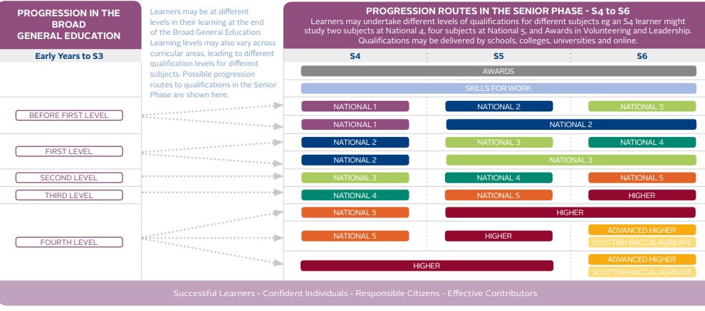

Slide 11
Pathway Map
Everyone is different and will want to do different things when they leave school.
There are lots of different pathways that will suit different people and their aspirations.
School
Graduate
Apprenticeship
University
College
Foundation/Modern Apprenticeship
Jobs

Slide 12
ART & DESIGN PATHWAY
YEAR
SCQF
Course
School College Partnerships
Future Pathways
SENIOR PHASE
Level 7
Advanced Higher Art & Design
Courses
Employment
S5/6
BA (Hons) Art & Design
BA (Hons) Graphic Design
Glasgow School of Art
HNC/D Art & Design
HNC/D Visual Communications
Architect
Level 6
Higher Art & Design
FA Creative & Digital Media
Fashion Designer
Level 5
National 5 Art & Design
S4
NC Art & Design
NC Graphic & Digital Design
Games Designer
Level 4
National 4 Art & Design
NQ Art & Design Portfolio
NQ Introduction to the Creative Industries
Art Therapist
BGE PHASE
S3
CFE LEVEL 3/4
Art & Design
S1/2
CFE LEVEL 3/4
Art & Design

Slide 13
COMPUTING SCIENCE PATHWAY
YEAR
SCQF
Course
School College Partnerships
Future Pathways
SENIOR PHASE
Employment
Level 7
Advanced Higher Computing Science
Courses
FA Information Tech (Software Development)
NPA Computer Games
S5/6
BSc (Hons) Computing Science
BSc (Hons) Data Science
HNC/D Computer Software Development
Software Developer
Level 6
Higher Computing Science
Online Intro to Raspberry Pi
Network Architect
S4
Level 5
National 5 Computing Science
NPA Cyber Security
Games Prgorammer
Level 4
National 4 Computing Science
NC Computing
IT Helpdesk Analyst
BGE PHASE
S3
CFE LEVEL 3/4
Computing
S1/2
CFE LEVEL 3/4
Computing

Slide 14
HISTORY PATHWAY
YEAR
SCQF
Course
School College Partnerships
Future Pathways
SENIOR PHASE
Level 7
Advanced Higher History
Courses
Employment
S5/6
Level 6
Higher History
Higher Politics in S6
BA (Hons) History
HNC/D Social Sciences
Archeologist
S4
Level 5
National 5 History
Parliamentary Assistant
NC Pathway to Social Sciences
Archivist
Level 4
National 4 History
Museum Assistant
Tour Guide
BGE PHASE
S3
CFE LEVEL 3/4
History
S1/2
CFE LEVEL 3/4
History

Slide 15
PHYSICAL EDUCATION PATHWAY
YEAR
SCQF
Course
School College Partnerships
Future Pathways
SENIOR PHASE
Level 6
Higher Physical Education
Higher Dance
Sports Leaders
Courses
Employment
S5/6
Level 5
National 5 Physical Education
National 5 Dance
Dance SCQF Level 5
MA (Hons) Physical Education
BEd Sports Science
BA Physiotherapy
BA Hons Dance Performance
HNC/D Fitness, Health & Exercise
HNC/D Sports Coaching & Development
Physiotherapist
S4
Choreographer
Level 4
National 4 Physical Education
Sports Coach
Personal Trainer
NC Sports & Fitness
NC Football Studies
NQ Sports & Fitness
Dancer
BGE PHASE
S3
CFE LEVEL 3/4
Physical Education
Dance
S1/2
CFE LEVEL 3/4
Physical Education

Slide 16
PHYSICS PATHWAY
YEAR
SCQF
Course
School College Partnerships
Future Pathways
SENIOR PHASE
Level 7
Advanced Higher Physics
HNC Applied Science
Courses
Employment
S5/6
Level 6
Higher Physics
BSc Physics
BSc Electronics and Electrical Engineering
BSc Physics with Astrophysics
Mechanical Engineer
Level 5
National 5 Physics
National 5 Lab Skills
Geophysicist
S4
HND Mechanical Engineering
NC Applied Sciences
Electronics Engineer
Level 4
National 4 Physics/
Science
Sound Technician
BGE PHASE
S3
CFE LEVEL 3/4
Physics
Structural Engineering Technician
S1/2
CFE LEVEL 3/4
Science

Slide 17
Alternative School College Partnerships

Slide 18
SCQF Ambassadors
11 January 2024

Slide 19
WELCOME!
Ava and Nathan
OUR AIMS
Increase your knowledge of what the SCQF is
Understand the role of an SCQF Ambassador
Look at some of the new wider qualifications available for learners at Clydeview Academy

Slide 20
video
An introduction to the SCQF - YouTube

Slide 21
What is the scqf?
The Scottish Credit and Qualifications Framework
The national learning framework in Scotland
Qualifications are measured by 12 levels:
1 is the simplest (National 1 award)
12 is the most complex (doctoral degree)
Over 10,000 qualifications sit on the framework
school, college, uni, apprenticeship, workplace, youth work and more!
Helps everyone understand the value of different qualifications

Slide 22
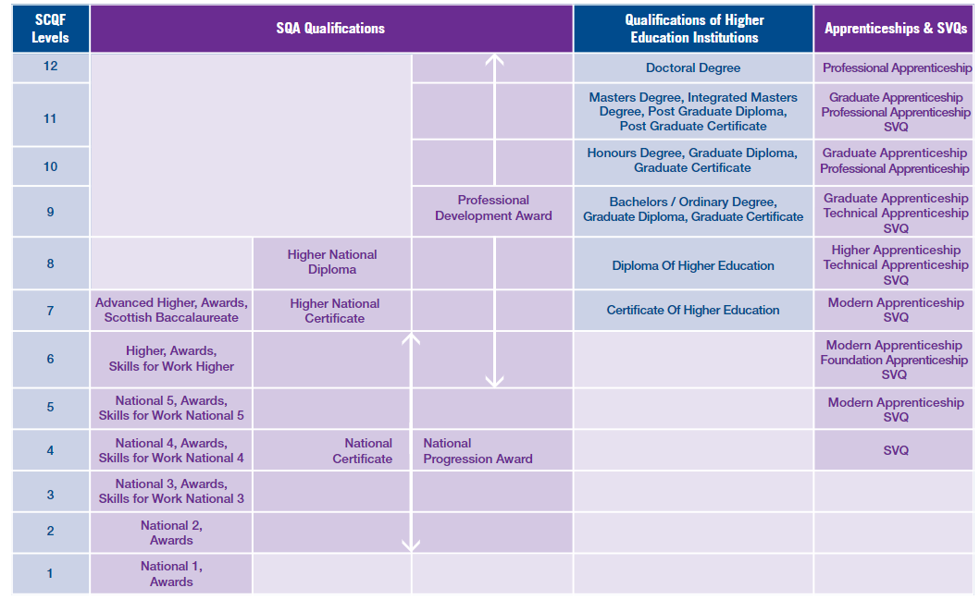

Slide 23
SCQF in Schools
SQA qualifications up to SCQF Level 7 are offered in schools:
Nat 4 = SCQF Level 4
Nat 5 = SCQF Level 5
Higher = SCQF Level 6
Adv Higher = SCQF Level 7
There are also many other qualifications available including Skills for Work, NPAs, Apprenticeships etc

Slide 24
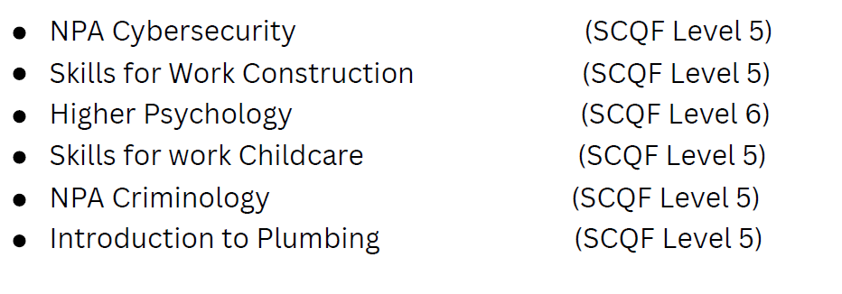
NEW OPTIONS AT Clydeview (and beyond!)
Did you know we offer qualifications such as:
Barista (L5)
Travel and Tourism (L5)
Lab Skills (L5)
Business & IT (L5)
Practical Cookery (L5)
And have a partnership with West College Scotland?
E.g.
And Foundation Apprenticeships/ HNC

Slide 25
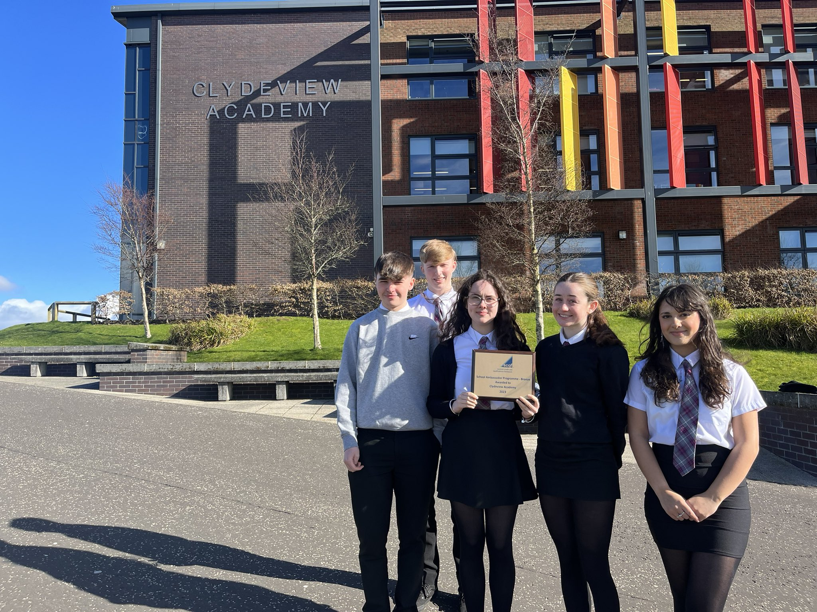
Our role as scqf ambassadors
200+ schools are involved in the SCQF Ambassador programme in Scotland
We want to help learners make better informed decisions on what qualifications are right for them
Parents Night stall,
BGE nights, Options nights,
Assemblies
Bronze = Awarded in 2023
Silver = Aim for 2024

Slide 26
Help your child plan their future - Information for parents
LEIGH GAVIN
CAREERS ADVISER – CLYDEVIEW ACADEMY

Slide 27
The Big Five
1
How do I like to learn?
For example, you may enjoy languages because you get to talk and listen, or art and design or science because you get to be creative.
Where could these options take me?
You may need to have studied certain options to get into a job. Think about what types of jobs might suit you.
What options do I enjoy?
If you are interested in something, learning more about it can be fun. You are also more likely to do well if you’re doing something you love.
What options am I good at?
Think about options you’ve done well in, but remember this is also an opportunity to study options you’ve never done before.
What do other people think?
Ask people you trust what they think you’re good at and could do well in. The answers may surprise you. But remember, in the end you have to make the choices that are right for YOU.
2
3
4
It’s really important when you choosing your options that you’re making the best decisions for you.
Take a bit of time to think about the following five questions.
5

Slide 28
My World of Work is Scotland’s careers information and advice web service
it can support you as a parent / carer for careers advice and information, as well as helping you help your child
your child will be introduced to My World of Work in school and will be supported to set up their individual user account. This will give them access to a wealth of career information, resources and tools.
myworldofwork.co.uk

Slide 29
Have a look on My World of Work – myworldofwork.co.uk

Slide 30
Helping you to help your child
Online:
www.myworldofwork.co.uk
www.planitplus.net
Face-to-face:
Visit your school careers adviser for further information.
Telephone:
Call us and speak to an Adviser on 0800 917 8000

Slide 31
S2 Reports v S3 Options
What have you done well in?
What are you really pleased about?
Where do your strengths lie?
Are there any surprises?
What subjects suits my talents?
What subjects do I enjoy the most?
What skills will I need in each subject?
Am I rethinking my options since my report?

Slide 32
S2 Subject choices timeline
Thursday 11th January
Reports issued
period 5 and 6 – S2 Subject Fayre
6pm-7pm – parental information evening and subject fayre
Next week – PSE – more input with Guidance staff
Wednesday 17th January – S2 Parents Meeting – 3.30pm-5.30pm
Between Thursday 18th January & Friday 2nd February– Options Interviews
Deadline for submission of forms – Friday 2nd February

