Slide 1
Clydeview academy
Parent Council Meeting
16 March 2023
Notes:
School Concert – thank our PC members for their support – great end to the term

Slide 2
updates
Prelim examinations N5-N7
Support:
Supported Study (targeted approach)
Saturday School
Achievement Zone
Parental Meetings
Study Weekend
Information/Options Evenings S2-S5
Options Process for S2-S5
Blood Donation 17/2
SCQF Bronze Award
Parent Council Quiz Night
Dive Cornwall Fundraiser

Slide 3
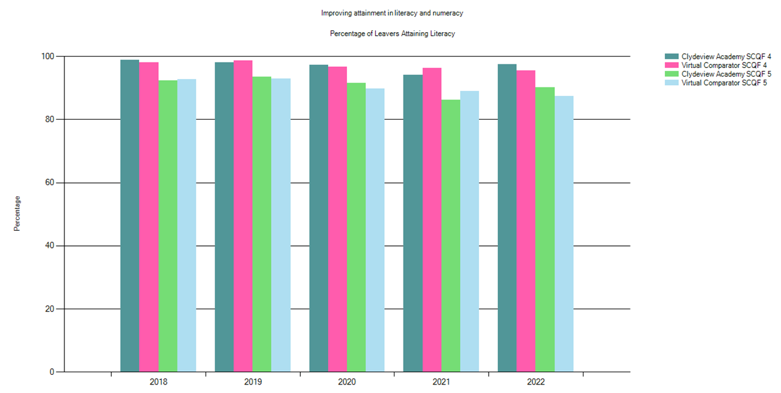
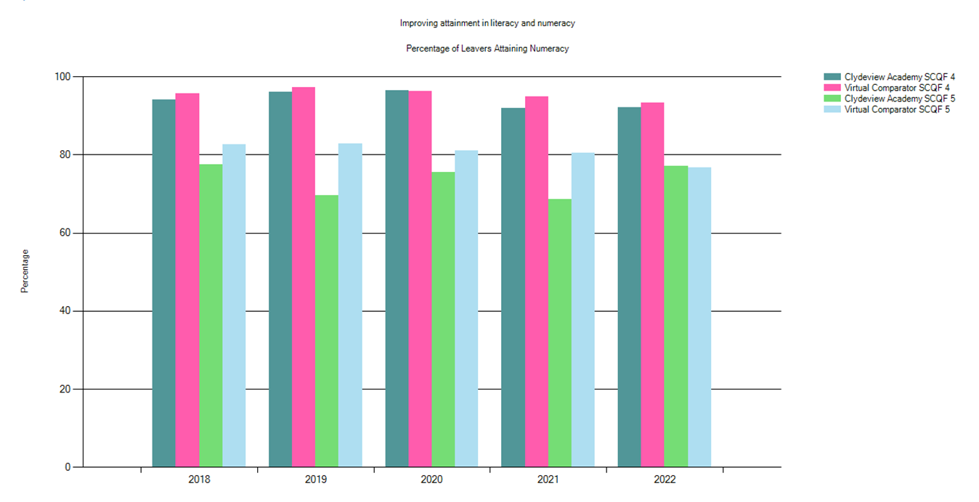
Notes:
Literacy/Numeracy

Slide 4
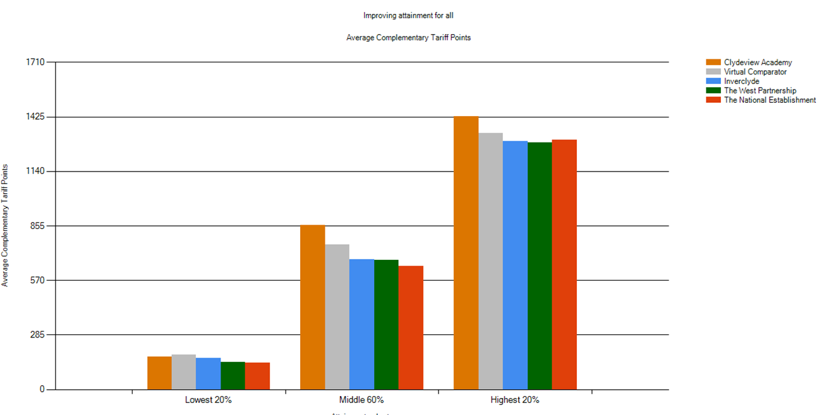
Notes:
Improving Attainment for All
Positive Trend Middle/Highest Attaining Group
Lowest Attaining – negative over last 2 years – accreditation offer

Slide 5
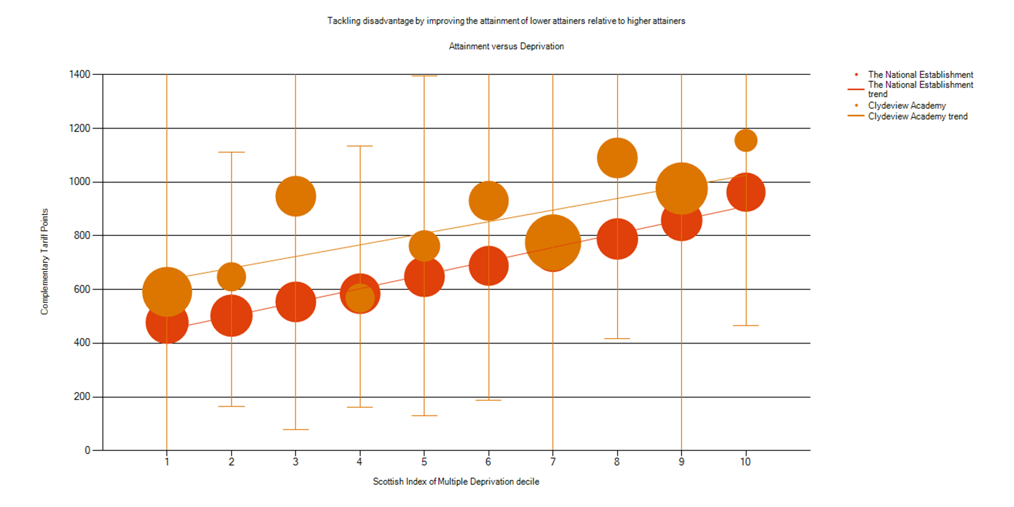
Notes:
Attainment V Deprivation
Positive trends compared to the national establishment

Slide 6
Notes:
Destinations
Average 79% entering further/higher education
Average 60% Higher Education
Average 19 % Further Education

Slide 7
Forthcoming events
Parental Engagement
BGE HWB/Family Cooking/P7 Numeracy Workshop
International Women's Day
Science Fayre (P7/S1)
Questionnaire
STEM CPD sessions – Primary Staff
Easter School
SQA Exams/Study Leave
Columba 1400
Leavers Celebration 20/04
Presentation of the Royal Honours of Scotland

Slide 8
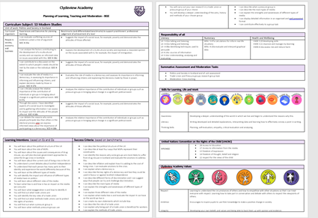
SIP Update
Planning of Learning, Teaching and Moderation
Notes:
BGE Courses
S3 completed – QA processes
S2 by end of May
Incorporates
Es and Os
Benchmarks
Literacy, Numeracy, HWB
Summative assessments
Planned Moderation Tasks
Skills development
UNCRC Articles
Values
This work will lead to
Decluttering the curriculum
Increased opportunity for IDL
Assessment Frameworks – student friendly understanding of level and stages within a level

Slide 9
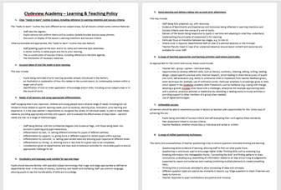
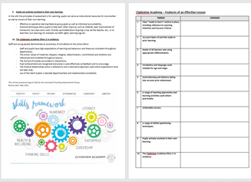
New Learning and Teaching Policy
Notes:
Launched with staff and Self-evaluation framework created
10 points with examples listed below.
Focus of Departmental Discussion
Learning Visits – Part 2 Learning Review
Staff visiting other departments and using Features of an Effective Lesson to Feedback

Slide 10
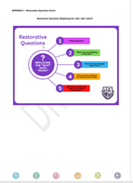
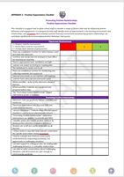
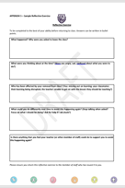
Relationships Policy
Notes:
Summary of our Rational
“In order to develop trust with others, it is important to hold them in unconditional positive regard. This requires a basic acceptance of, and respect for, who that person is regardless of what they say or do”
Carl Rodgers
Approaches to Nurture
Trauma-Informed Practice
Restorative Approaches
Positive Expectations
Recognising Achievement and Rewarding Success – Merits
Positive Relationships Strategies
Empowering classroom Teachers
Role for Principal Teachers/Faculty Heads
PT Pupil Support – Requests for Support Wellbeing Indicators
Consultation Phase
Staff – this Wednesday and completed by the end of the month.
Student Consultation – By end of March
Paret Consultation – By end of May.

Slide 11
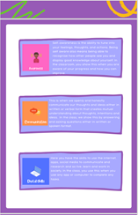
Skills Framework
Notes:
Skills that you were consulted on last year
How young people use the framework
3 Tracking points throughout the year across all subjects
Held centrally and part of learner conversations in PSE with Guidance Teacher
Departments reflect skills in course planning and regularly review with students
Hopefully lead to students being able to identify their skills and speak with confidence.

Slide 12
National Priorities | Session 2023-2024
Placing the human rights and needs of every child and young person at the centre of education | Achieve Gold Rights Respecting School Award Anti-racist Education – S2 Curriculum roll-out
Improvements in attainment, particularly in literacy and numeracy | Planning and Moderation Templates completed for S1 Assessment Frameworks completed for S1
Closing the attainment gap between the most and least disadvantaged children | Embedding tracking and monitoring of key measures Development of options pathways
Improvement in children and young people's health and wellbeing | Whole school approach to Growth Mindset established
Improvement in employability skills and sustained positive school leaver destinations for all young people | Further develop Senior Phase work experience programme Skills framework embedded across all curricular areas
Notes:
Where we were in establishing next year’s priorities in June 2022.
What else?
Where next?

