Slide 1
Clydeview academy
Parent Council Meeting
23 January 2023
Notes:
School Concert – thank our PC members for their support – great end to the term

Slide 2
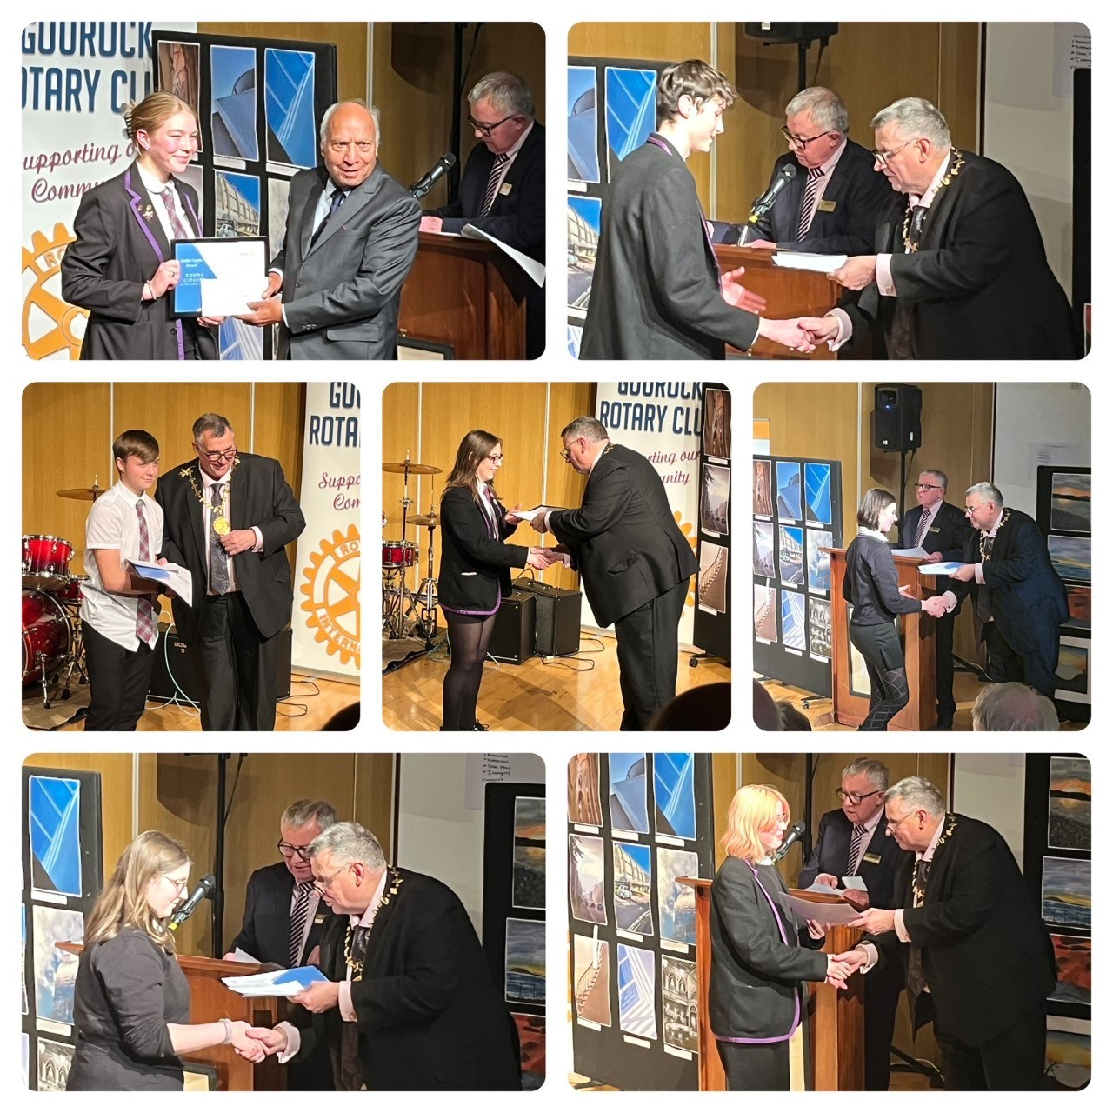
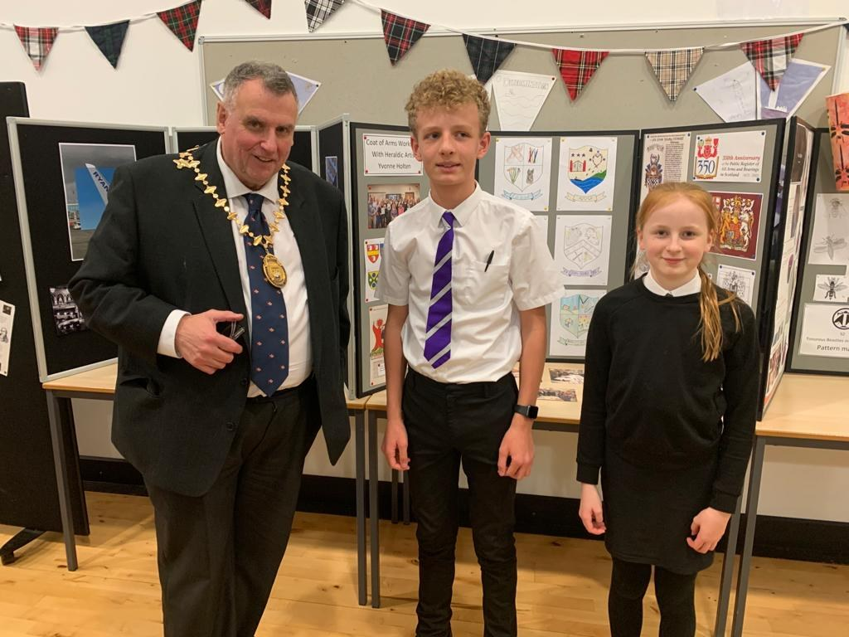
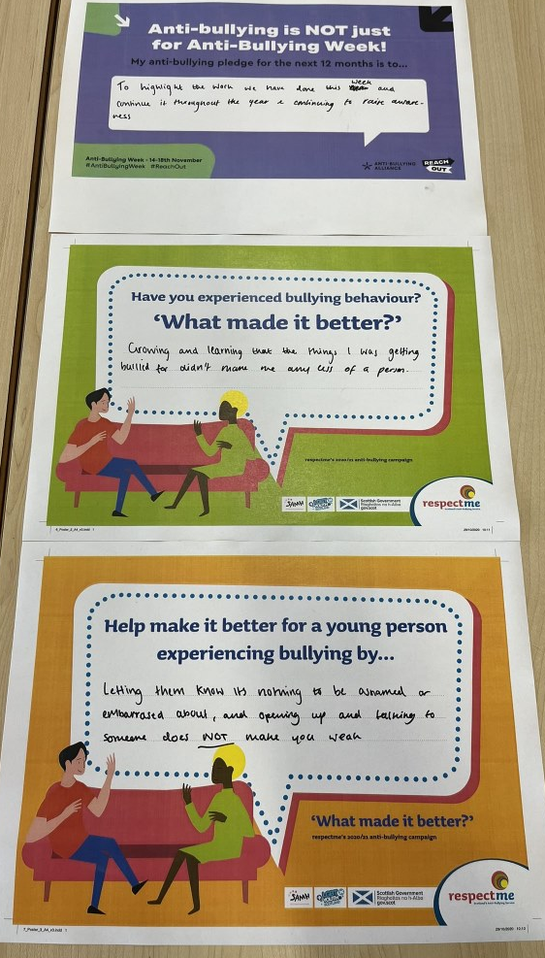
updates
S4 N5 Prelims
Christmas Events
Merit Award Ceremony
Supported Study provision
Rotary Young Musician and Youth Competitions Award Ceremony
Barcelona Trip
Celebrating Scottish Heroes
Anti Bullying Week

Slide 3
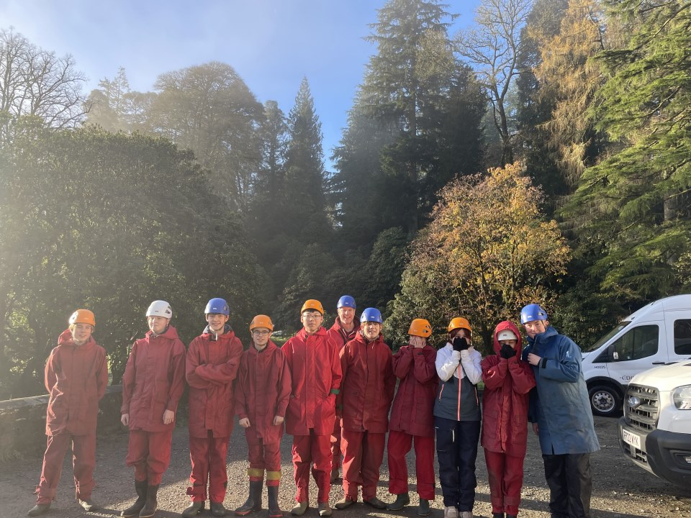
Updates
Rights Respecting School Award
No Discrimination
Respect for children’s views
Freedom of thought and religion
Aims of Education
Everyone must know children’s rights
Focus on High Quality Learning, Teaching & Assessment
Supported Study provision
Benmore Study Weekend
MVP Programme
Notes:
Pupil/School council agreed on rights they want to focus on
Learning review part 2 – agreed features of an effective lesson – chosen by staff and pupils
MVP training Nov 22 – next step is to work with S1 classes

Slide 4
Forthcoming events
S5/6 Tracking Report 8/02/23
S5/6 Parents’ Meeting 9/2/23
INSET Day 15/2/23
S4 Written Reports Issued 20/02/23
S3 Options Information Evening 16/2/23
S4/5 Options Information Evening 27/2/23
S2-S5 Options Process
BGE Parent Session 8/3/23
Spring Concert 27/3/23
Columba 1400 Leadership Academy WB 17/4/23

