Slide 1
SENIOR PHASE STUDY SKILLS

Slide 2
Welcome
Introduction and SQA Update
Ross McFadzean (DHT)
Supported Study and Mentoring Programme
Sandra McAdam (PT Supporting Student Achievement)
Study Skills, Planning and Expectations
Chantelle Murdoch (PT Health and Wellbeing)

Slide 3
SQA Update
The Scottish Government announced on the 18th August 2021 that SQA Exams will take place – if safe to do so – in the Spring of 2022
The examination timetable was published September 2021 and the exam diet will run from Tues 26th April 2022 until Wed 1st June 2022.
The latest advice detailed 2 scenarios:
If there is an increased level of disruption then exams will still run but with modifications to the content of the exam paper.
2. If public health advice leads to the cancellation of exams then teachers will determine provisional results.
Under this approach SQA have made it clear that there is no requirement for schools to run additional assessments to gather evidence that will inform provisional results.

Slide 4
Supported Study S4-S6
Thorough revision and consolidation of course content/exam style questions and past papers.
Sessions commence - week beginning 25th October and run until the end of January.
Sessions run for one hour at the end of the school day.
Students have been issued with a calendar showing the sessions available and will sign up using Forms.

Slide 5
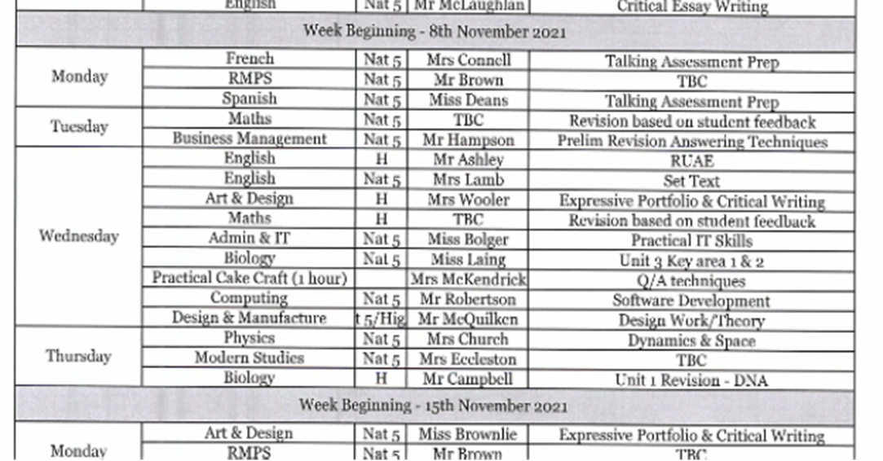
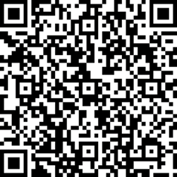
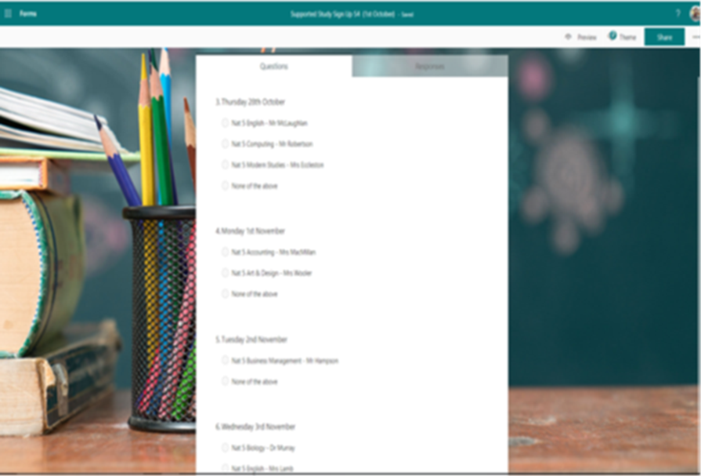
Students should return their Form by Thursday 7th October.
Timetables showing sessions chosen will be issued after the October break (a copy will be emailed home to you).

Slide 6
Mentoring
Student Worries……..
Who Can Help?
Volume of homework
Intensity/pace of coursework
Balancing workload with social life/family/work
Double periods
Pressure of assessments
Getting the results required
Guidance Teacher
Year Head
PT Supporting Student Achievement
Class Teacher
Principal Teacher of Subject
Parents/Carers
Friends
Mentor

Slide 7
A Mentor can…
Meet with the student on a regular basis usually at lunchtime or break.
Informal
Help with target setting
Study tips/how to study effectively
Help plan study timetable
Discuss how to balance time
Advice on dealing with the pressures of school
An extra helping hand and listening ear

Slide 8
Targeted Mentoring
Initially target our mentoring programme after reviewing our latest tracking and monitoring data.
Opening up later to all students who feel they would benefit from having a mentor to help.
Students self-refer.

Slide 9
We will be using menti.com
If possible, please access menti.com on your phone or another tab.

Slide 10
Studying
A word that brings many young people a feeling of dread!
Going beyond completing homework tasks and proactively revising previous work
No magic formula or quick fix

Slide 11
Study Methods
https://www.mentimeter.com/s/b049b93d792f753e78a88d7ce8e7720a/80493b69bee8

Slide 12
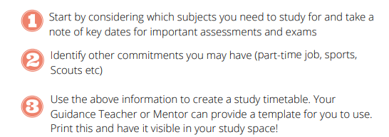
Creating a Study Routine
The first step – planning!

Slide 13
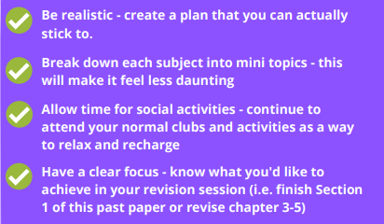
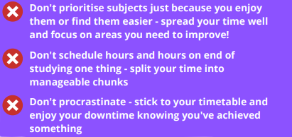
Tips for Effective Studying

Slide 14
Study Expectations
https://www.mentimeter.com/s/b049b93d792f753e78a88d7ce8e7720a/80493b69bee8

Slide 15
Study Expectations
Expectations will differ per subject and level (e.g. N5 or Higher)
Key points in the year (e.g. Prelim time) will increase study expectation
Some departmental examples (HW and Study):
Modern Languages
N5 – Around 1 hour per week
H – Around 2 hours per week
Business Studies
N5 – Around 2 hours per week
H – Around 3 hours per week

Slide 16
Study Skills Booklet
Study Skills Week
4th-8th October

Slide 17
Useful Digital Resources (1/5)
MySQA App
Create personalised study timetable based on subjects and exam dates

Slide 18
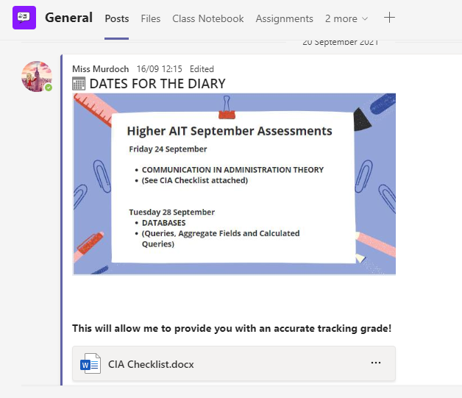
Useful Digital Resources (2/5)
Class Teams pages
Access to teaching presentations, course notes and “Ask the Teacher” channel

Slide 19
Useful Digital Resources (3/5)
E-Sgoil and WestOS
National study support providing webinars, video lessons and study guides

Slide 20
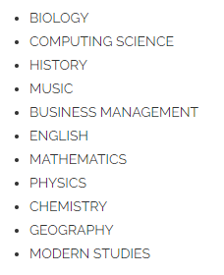
Useful Digital Resources (4/5)
Achieve
Access to interactive study checklists and associated study resources per topic

Slide 21
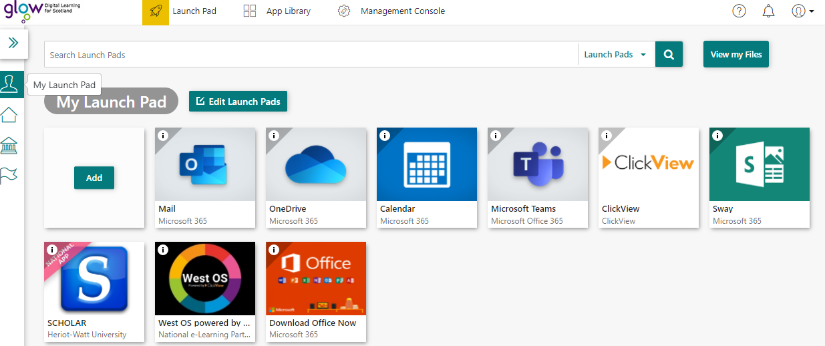
Useful Digital Resources (5/5)
Glow

Slide 22
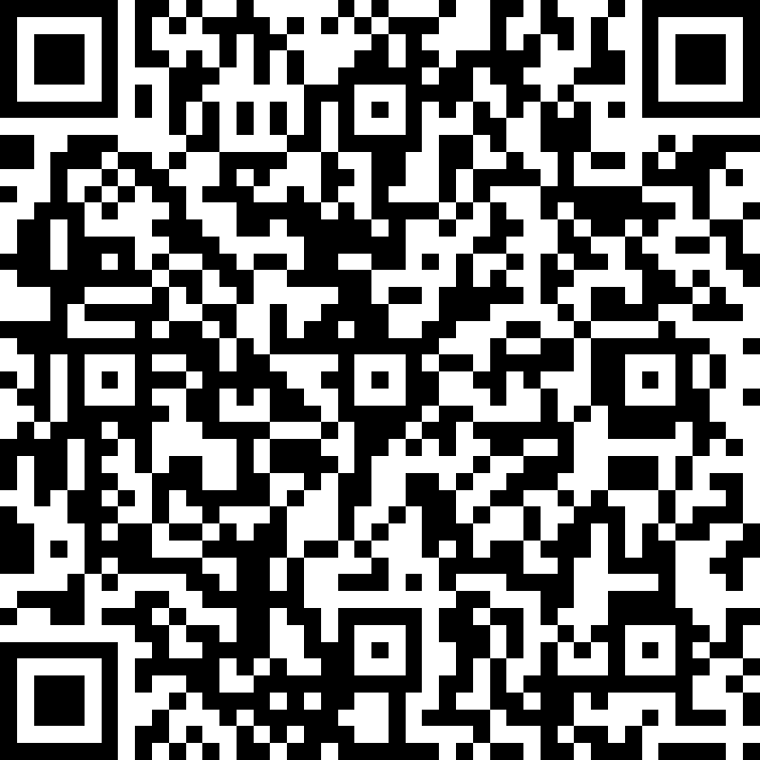
Thank You
Please take time to complete a short evaluation form to enable us to take on board feedback ahead of future events.
https://forms.office.com/Pages/ResponsePage.aspx?id=oyzTzM4Wj0KVQTctawUZKVKczbn7d2tAjZWdtP44xx1URExXUkg4SkRGODU5SDU4U1JNR1BJMU9DRS4u

