Slide 1

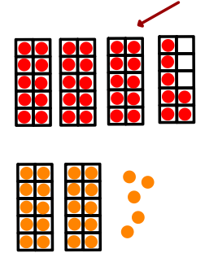
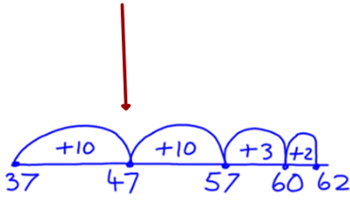
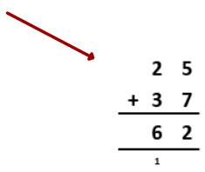
37 + 25
Inverclyde Secondary Attainment Challenge Team (Numeracy)

Slide 2

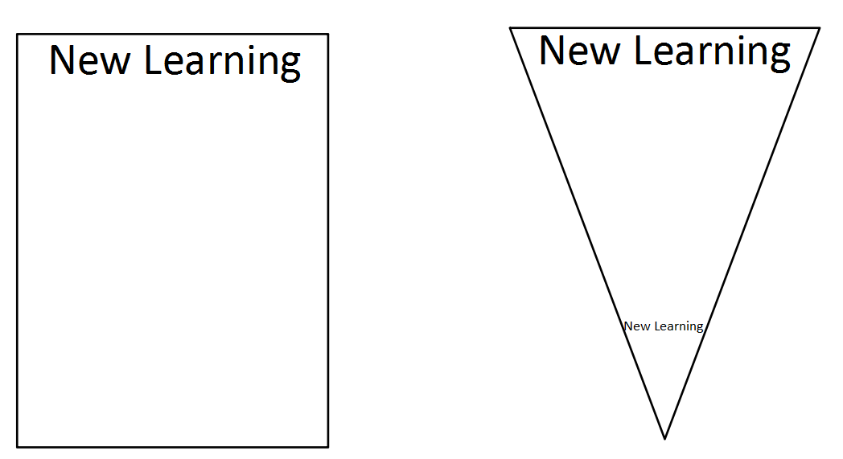
Inverclyde Secondary Attainment Challenge Team (Numeracy)
Notes:
If the top line represents amount of memory space for learning then if you memorise the steps it will always take that amount of memory space.
Triangle shows that if you understand then the memory space can be compressed and you can fit more new learning in.

Slide 3
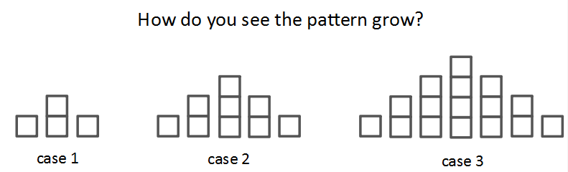
Inverclyde Secondary Attainment Challenge Team (Numeracy)

Slide 4
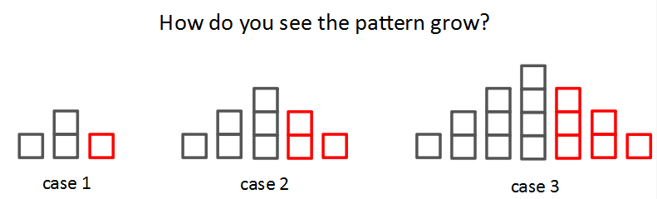
Inverclyde Secondary Attainment Challenge Team (Numeracy)

Slide 5
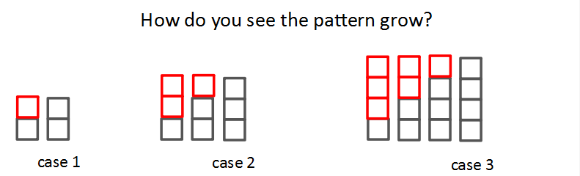
Inverclyde Secondary Attainment Challenge Team (Numeracy)

Slide 6
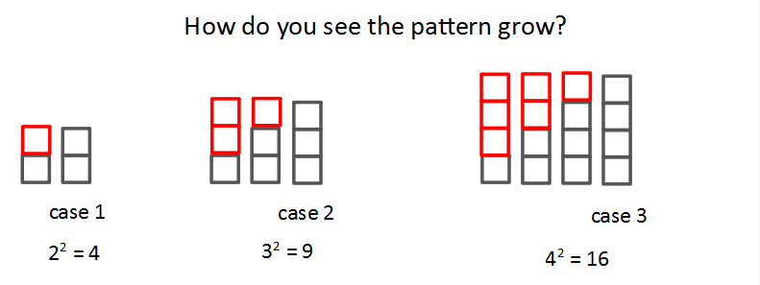
Inverclyde Secondary Attainment Challenge Team (Numeracy)

Slide 7
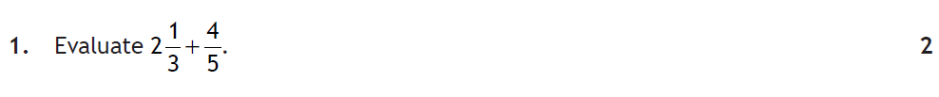
Inverclyde Secondary Attainment Challenge Team (Numeracy)
Notes:
Using bar models to introduce topics and promote understanding rather than memorising processes – pupils come up with the process for themselves moving from concrete (fraction tiles) to visual (bar models) to abstract (the rule used for exam working).

Slide 8
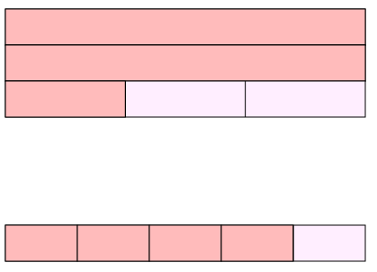
Inverclyde Secondary Attainment Challenge Team (Numeracy)

Slide 9
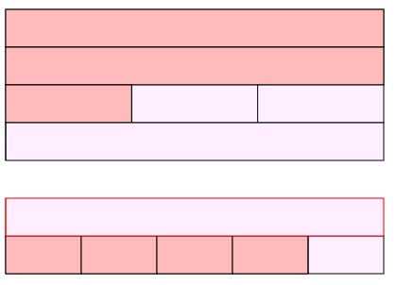
Add extra bars for
illustrations
Inverclyde Secondary Attainment Challenge Team (Numeracy)

Slide 10
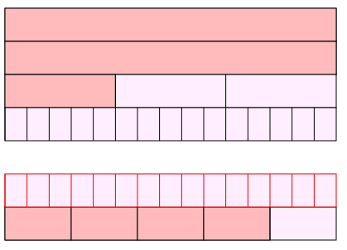
Cut the new bars
until the lines on the black bar
match thirds and the lines on
the red bar match fifths.
Inverclyde Secondary Attainment Challenge Team (Numeracy)

Slide 11
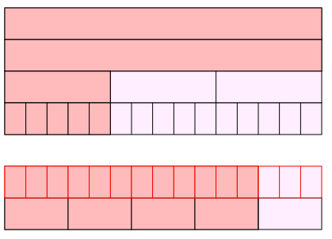
Colour in until they are
same sizes
Inverclyde Secondary Attainment Challenge Team (Numeracy)

Slide 12
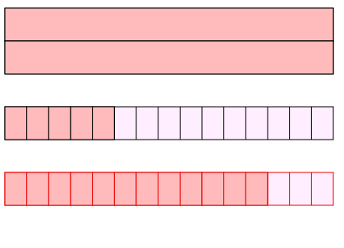
Remove the origninals
Inverclyde Secondary Attainment Challenge Team (Numeracy)

Slide 13
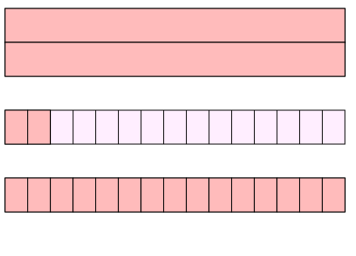
Use 3 to fill up one whole
Inverclyde Secondary Attainment Challenge Team (Numeracy)

Slide 14
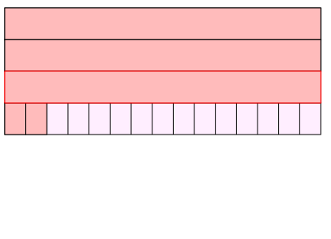
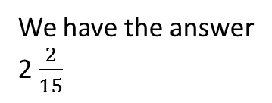
We have the answer
2 $\frac{2}{15}$
Inverclyde Secondary Attainment Challenge Team (Numeracy)

Slide 15



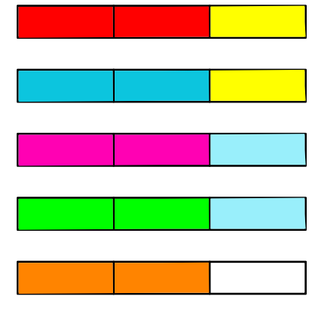
Inverclyde Secondary Attainment Challenge Team (Numeracy)
Notes:
Five bars cut into thirds and how many 2/3 chunks can we fit into to 15/3s? 7 and a half.

Slide 16
2.5% of £9000
Inverclyde Secondary Attainment Challenge Team (Numeracy)

Slide 17
2.5% of £9000
10% of £9000 = £900
Inverclyde Secondary Attainment Challenge Team (Numeracy)

Slide 18

2.5% of £9000
10% of £9000 = £900
£900
Inverclyde Secondary Attainment Challenge Team (Numeracy)

Slide 19

2.5% of £9000
So... 5% of £9000 =
£450
£450
£450
Inverclyde Secondary Attainment Challenge Team (Numeracy)

Slide 20

2.5% of £9000
£225
So...2.5% of £9000 =
£225
£225
£225
£225
Inverclyde Secondary Attainment Challenge Team (Numeracy)

Slide 21
Research shows…. explanation 1 -> 5% explanation 1b -> 20% explanation 2 -> 30% explanation 3 -> 20% explanation 4,5… -> 25% need you
Inverclyde Secondary Attainment Challenge Team (Numeracy)
Notes:
1 – first explanation 5% of kids
1b – same explanation just repeated 20% of kids
Now have to change how you explain it to get more kids to understand.
25% of kids need your help to find out misunderstandings and help set them on course with feedback for them

Slide 22
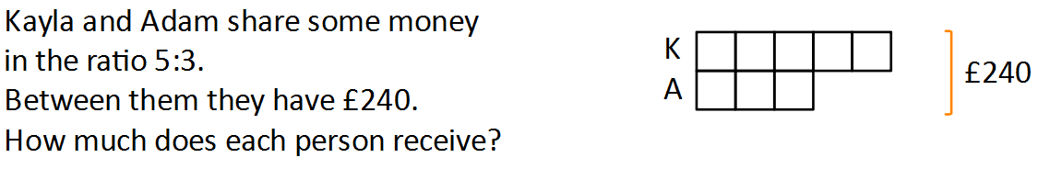
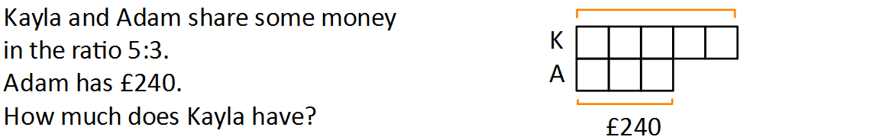
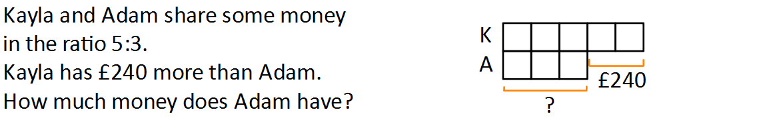
Inverclyde Secondary Attainment Challenge Team (Numeracy)
Notes:
Difficult question to think on right away so let us go back a step first and use bar models

Slide 23
Ratios
Inverclyde Secondary Attainment Challenge Team (Numeracy)
Notes:
240 divided into 8 boxes gives £30 a box. K gets £150 and A gets £90

Slide 24
Ratios
Inverclyde Secondary Attainment Challenge Team (Numeracy)
Notes:
240 divided into 3 boxes gives £80 a box. K gets £400

Slide 25
Ratios
Inverclyde Secondary Attainment Challenge Team (Numeracy)
Notes:
240 divided into the 2 extra boxes gives £120 a box. A gets £360.

Slide 26
- 2 - 5
Two negatives make a positive sir!!
Answer . . .
7
Inverclyde Secondary Attainment Challenge Team (Numeracy)
Notes:
Rules can be correct but also dangerous!

Slide 27
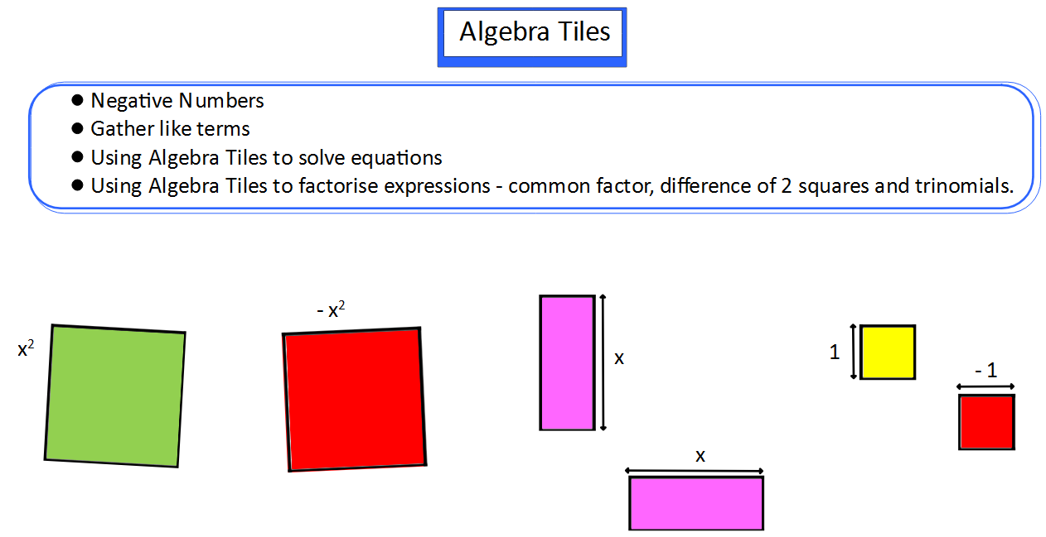
Inverclyde Secondary Attainment Challenge Team (Numeracy)

Slide 28
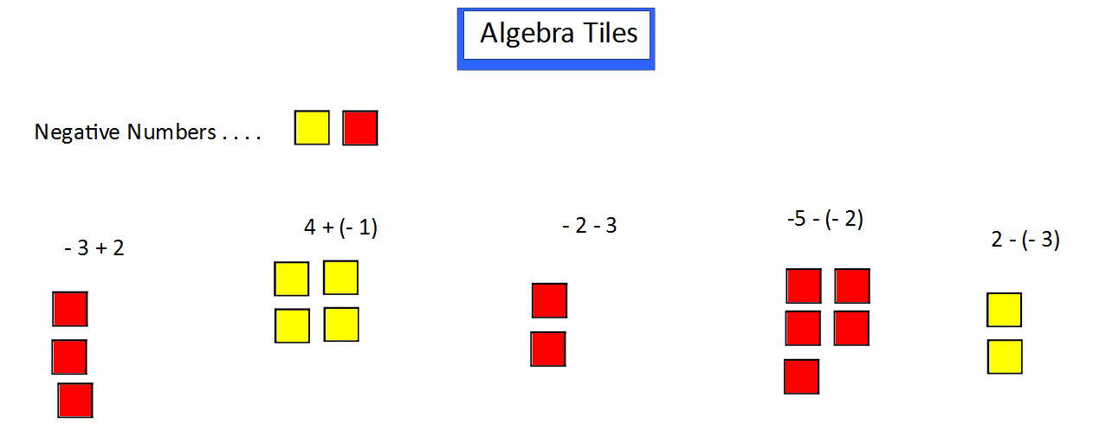



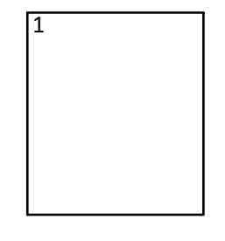

No reds to take
3 Y/R pairs appear
Take 3 reds away
Have 5 yellows so…
Answer = 5
Add 2 yellows,
Y/R pairs disappear
Answer = 1
Add 1 red
Y/R pairs disappear
Answer = 3
Add 3 reds
Got 5 reds so…
Answer = -5
Take away 2 reds
Got 3 reds so…
Answer = - 3
Inverclyde Secondary Attainment Challenge Team (Numeracy)
Notes:
Yellow means +1 and red -1 so a yellow and a red make 0 when added together.

Slide 29
34 x 9
Inverclyde Secondary Attainment Challenge Team (Numeracy)

Slide 30
34 x 9
30 4 9
270
36
306
Inverclyde Secondary Attainment Challenge Team (Numeracy)

Slide 31
25 x 17
Inverclyde Secondary Attainment Challenge Team (Numeracy)

Slide 32
25 x 17
20 5 10 7
200
50
250
140
35
175
425
Inverclyde Secondary Attainment Challenge Team (Numeracy)

Slide 33
2x (x + 7)
Inverclyde Secondary Attainment Challenge Team (Numeracy)

Slide 34
2x (x + 7)
x 7 2x
2x²
14x
2x² + 14x
Inverclyde Secondary Attainment Challenge Team (Numeracy)

Slide 35
5 (x - 6)
3x (2x + 3)
Inverclyde Secondary Attainment Challenge Team (Numeracy)
Notes:
You try

Slide 36
(x + 2)(x - 5)
Inverclyde Secondary Attainment Challenge Team (Numeracy)

Slide 37
(x + 2)(x - 5)
x - 5 x 2
x²
- 5x
2x
-10
x² - 3x - 10
Inverclyde Secondary Attainment Challenge Team (Numeracy)

Slide 38
(x + 3)(x + 4)
Inverclyde Secondary Attainment Challenge Team (Numeracy)
Notes:
You try

Slide 39
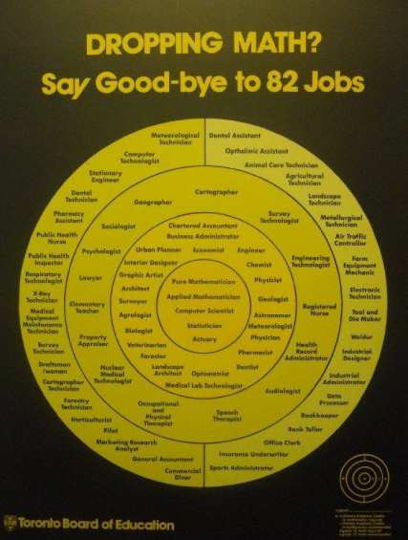
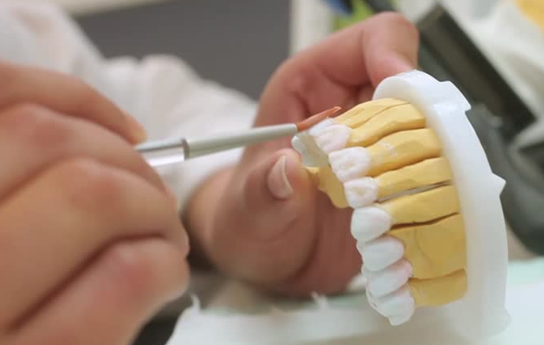

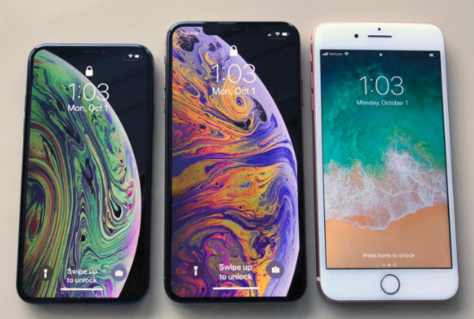


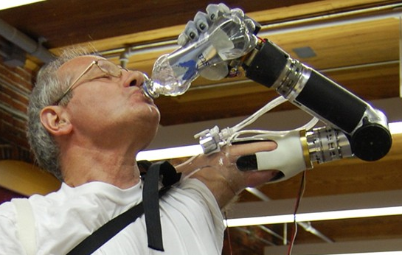

No such thing as a ‘Maths Brain’ –
we can all do Maths!
Making Maths Count
Transforming public attitudes to maths
Improving confidence and fluency in maths
Promoting the value of maths as an
essential skill for every career
Inverclyde Secondary Attainment Challenge Team (Numeracy)

Slide 40
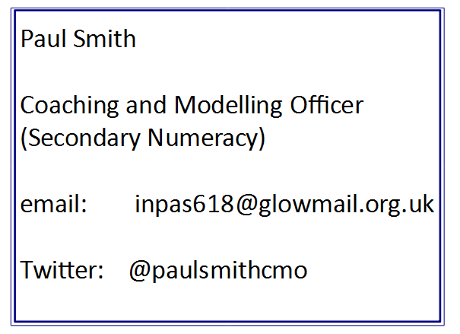
Inverclyde Secondary Attainment Challenge Team (Numeracy)

