Slide 1
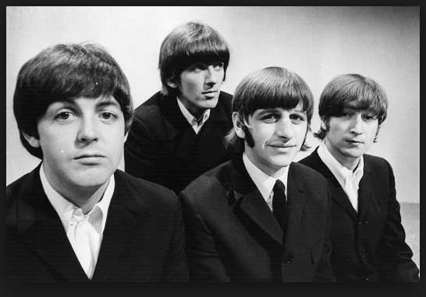
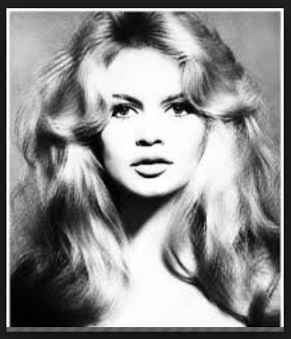
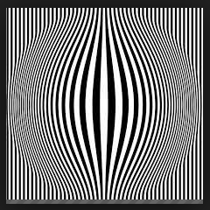
S3 Photography:
Photography Culture
1960’s

Slide 2
Photography Culture: 1960’s
The 1960’s was a really important decade for culture, including music, art and photography.
This topic is based on 1960’s photographers, artists and music.
Photographer: David Bailey/Richard Avedon
Artist: Pop Art
Music: Photography based on a 1960’s song
Graphics: A poster based on a 1960’s film

Slide 3
Photography Culture: 1960’s
Task One: Photography Culture: 1960’s-Mind Map.
Produce a Mind Map of Words which sum up 1960’s culture*
(*culture means social behaviour) in terms of Photography/Photographers, Artists and Music/Musicians.

Slide 4
Photography Culture: 1960’s
Task Two: Photography Culture: 1960’s-Mood Board.
Produce a Mood Board of Images which sum up 1960’s culture in terms of Photography/Photographers, Artists/Painters, Graphic Designers and Music/Musicians.

Slide 5
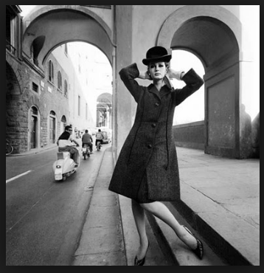
S3 Photography Culture: 1960’s
Topic One: Portrait Photography

Slide 6
1960’s Portrait Photography
Artist Research:
Choose a photographer whose work you like, who worked in the 1960’s.
Once you have chosen an appropriate photographer, please do the following tasks:
Fact File: Five facts about your photographer.
Examples of their work: choose five photographs from their body of work. Copy and paste them on to your PowerPoint.
‘I like this about their work…’ Looking at the photographs you have chosen, write down five things about their work which you like/you are inspired by.
Detailed Analysis: Choose one particular photograph, and use the pointers on the next slide to analyse it.

Slide 7
1960’s Portrait Photographer
Artist research: Detailed Analysis
Choose one of the photographs to analyse.
1. Describe the photograph as if you were talking about it to someone over the phone.
2. Explain how you think the photograph was taken. Discuss the composition, lighting etc.
3. How does the photograph make you feel? What do you like about it?

Slide 8
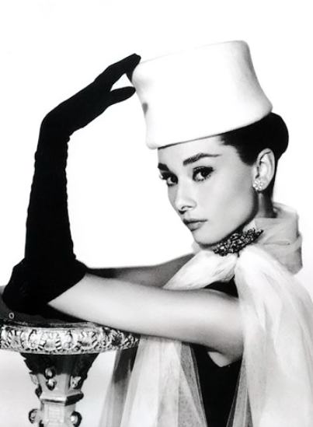
1960’s Portrait Photographer
Artist research: Detailed Analysis: Audrey Hepburn by Richard Avedon
Describe the photograph as if you were talking about it to someone over the phone.
The photograph is a black and white portrait of an actress called Audrey Hepburn. It is taken with a white background. She is facing the camera side on, and looking towards the photographer. She is wearing a plain white hat and black long gloves. Her hand is resting on an ornate vase holder. Her white scarf has a piece of jewellery holding it together, and her hair is tied in a bun.
Explain how you think the photograph was taken. Discuss the composition, lighting etc.
The Photograph was taken in a studio with artificial lighting. There were probably two lights as the lighting is quite balanced and soft. The hands are placed so that there is almost circle around the face, like a frame.

Slide 9
1960’s Portrait Photographer
Artist research: Detailed Analysis: Audrey Hepburn by Richard Avedon
How does the photograph make you feel? What do you like about it?
I like the fact that it is in black and white as it looks more classy. The photograph is quite simple, with a plain background and limited tones. The composition works well and using the long glove to frame the face is a good idea.

Slide 10
1960’s Portrait Photographer
Planning your 1960’s photographer response.
Now that you have looked at 1960’s portrait photography, I would like you to write down four things that you need to do in order to make your own 1960’s portrait.

Slide 11
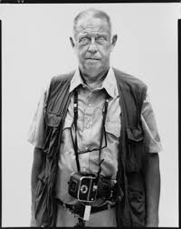
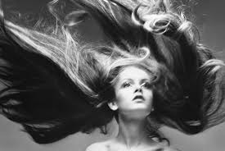
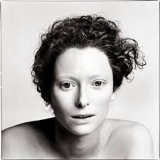
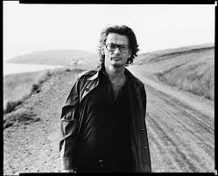
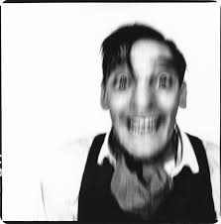
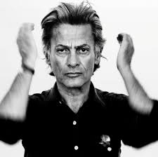
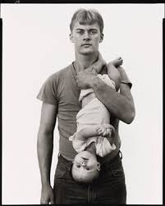
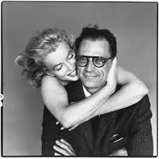
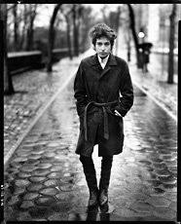
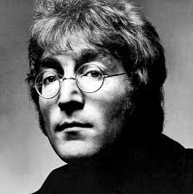
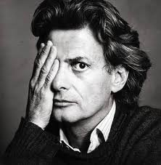
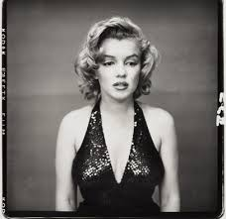
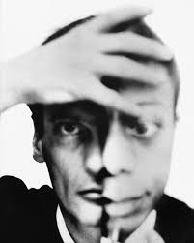
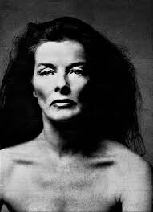
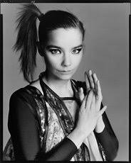

Slide 12
1960’s Portrait Photographer
Planning your response.
State four things that you need to do in order to make your own 1960’s portrait.
Black and white
Plain black or white background
Head and shoulders/whole body
Studio or outside
An emotion of the moment

Slide 13
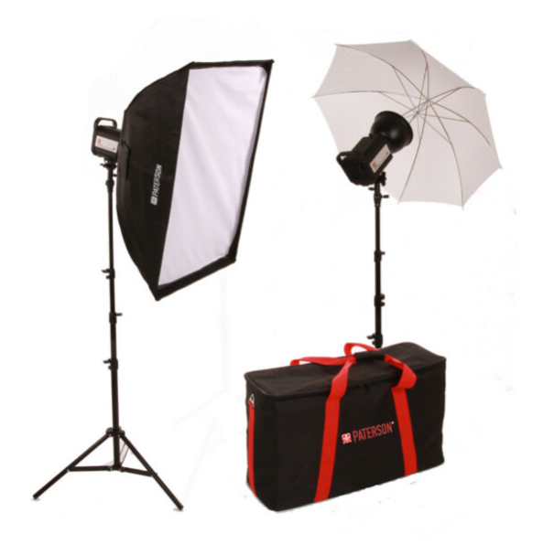
Studio Lighting: The Basics

Slide 14
Studio Lighting: The Basics
Studio Lighting is a form of artificial lighting. This means that the lighting is produced from bulbs rather than the sun, which is natural Lighting.
Artificial lights could be the flash on your camera, or a flashgun or larger studio lights.
Studio lights usually come in a kit with two lights and two stands. You will also need a background which is usually a roll of paper or fabric
There are several different types of lighting set ups.

Slide 15
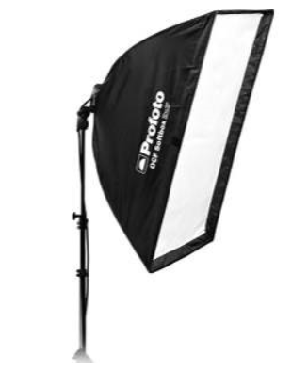
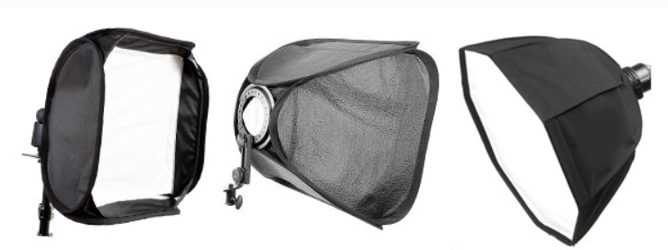
Studio Lighting: The Basics
There are several different types of lighting set ups.
1. Softbox: This provides a contained light which is not as harsh as a direct light. It has a translucent cover which softens the light, so is great for portraits. The light points towards the subject.

Slide 16
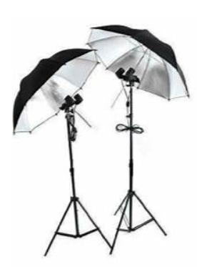
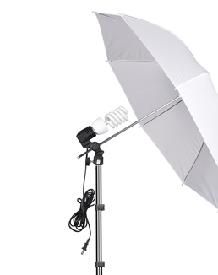
Studio Lighting: The Basics
There are several different types of lighting set ups.
2. Umbrella: This type of lighting spreads the light over a greater distance. The light points towards the subject or reflected in the umbrella.

Slide 17
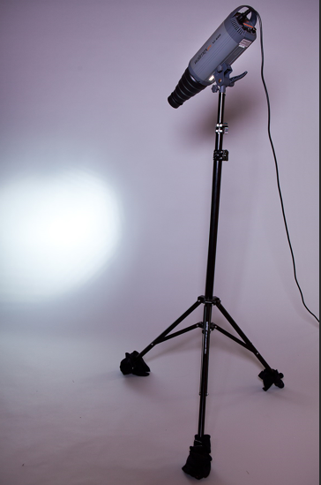
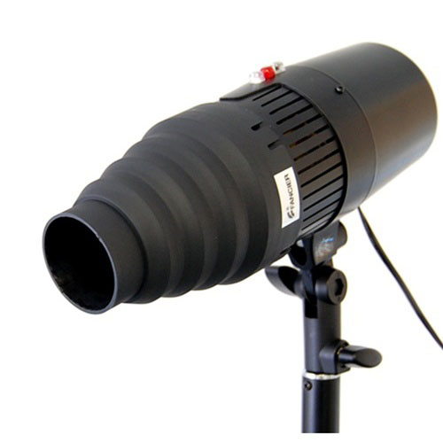
Studio Lighting: The Basics
There are several different types of lighting set ups.
3. Snoot: This type of lighting focuses the light over a specific area. The photographer controls the radius of the light. The light points towards the subject.

Slide 18
Studio Lighting: The Basics
Task One: Explain what studio lighting is, and what makes it different to natural lighting.
Task Two: List the three main types of studio lighting.
Task Three: Explain how each works, show as diagram/s and how the light is distributed.
Task Four: Find examples of portrait photographs taken using studio lighting/have a go at taking photographs using the set up and put on your PowerPoint.

Slide 19
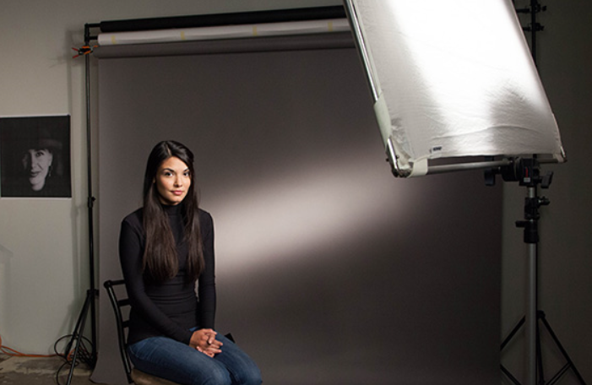
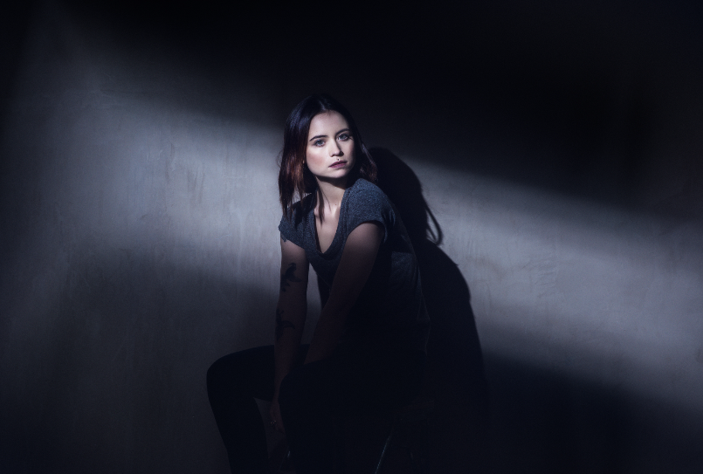
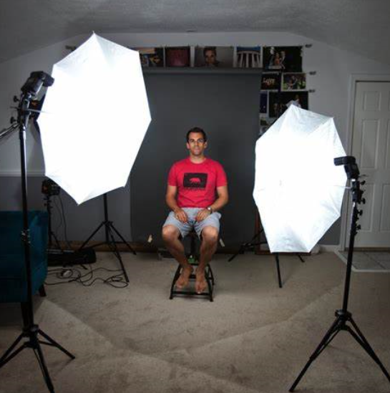
Studio Lighting: The Basics
Task Four: Find examples of portrait photographs taken using studio lighting/have a go at taking photographs using the set up and put on your PowerPoint.

Slide 20
1960’s Portrait Photographer
Planning your 1960’s portrait response.
This week you are going to take a set of head and shoulders portraits.
Research head and shoulders portrait poses for women and men.
Find eight different poses that you can try yourself when you photograph your 1960’s portrait response next week.

Slide 21
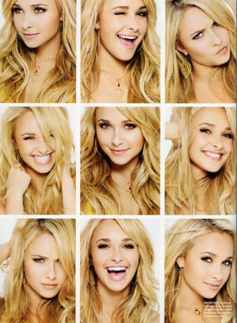
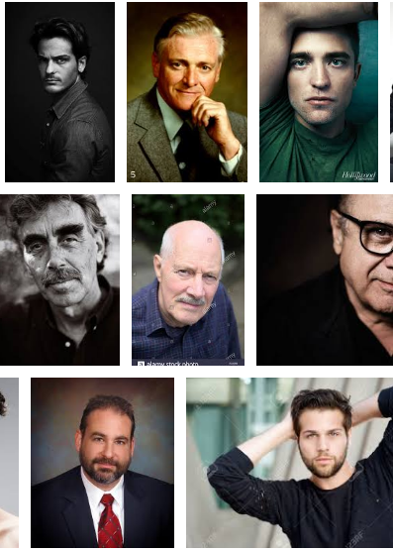

Slide 22
Checklist
Please ensure that all of the following are completed to a good standard.
Title Page: Photography Culture: 1960’s with appropriate imagery.
Detailed mind map and mood board relating to photography/music/art in the 1960’s with names and pictures of artists/relevant imagery.
1960’s portrait photographer research. Choose a photographer who worked in the 1960’s. Produce a fact file/examples of their work/what interests you/what you like about their work.
Detailed analysis of one of their photographs. Choose one photograph and copy it on to a new slide. Describe the photograph in detail. Highlight the key formal elements* by using arrows to identify. *Light/tone/shape/colour/texture/space/
Using the photograph as a Vogue/GQ cover. Research Vogue/GQ covers and use the photograph as a starting point to complete your own realistic cover, using the correct fonts/details etc.
Begin to plan your own set of 1960’s portrait photos by researching portrait poses. Find a range of poses as a starting point and copy them on to your PowerPoint.
Use one of the portraits from task 6 to design your own 1960’s Vogue or GQ cover

Slide 23
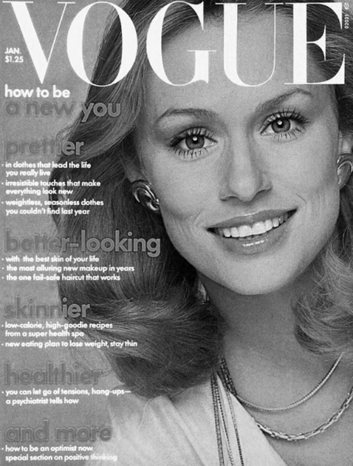
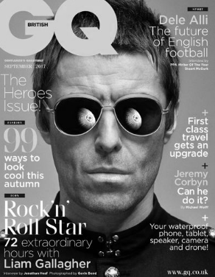

Slide 24
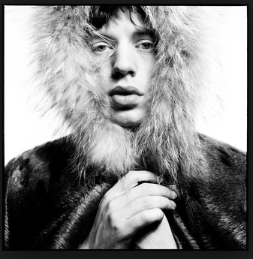
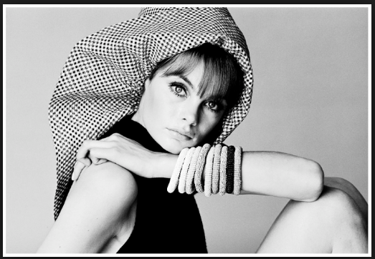
David Bailey Portrait Work
Task:
Below are two famous 1960’s photographs by David Bailey. Take photographs of both and try to make yours as close as possible to the real thing..

Slide 25
Portrait Work
Tasks:
1.Take a set of portraits of your someone in your household. They can be your parents or carers/brothers/sisters or even the family pet!
2. Upload the photographs on to your computer.
3. Select three and reject three, and explain why.
4. Using the editing package on your computer (most have Paint.net, or you could down load one, like GIMP), go through the stages of editing on the next few slides.

Slide 26
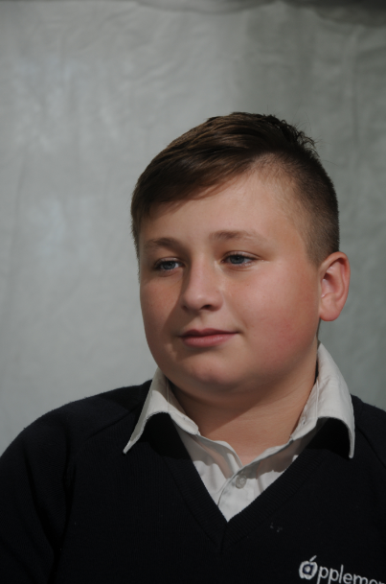
Editing the Portraits
Editing your portraits
Present a thumbnail set of photographs of your portraits.
Select and reject.
Choose three to edit.
Edit using Photoshop.
Think about:
Black and white transformation
Boost contrast
Adjust Levels for a balanced
Smooth out any skin blemishes
Tidy up background

Slide 27
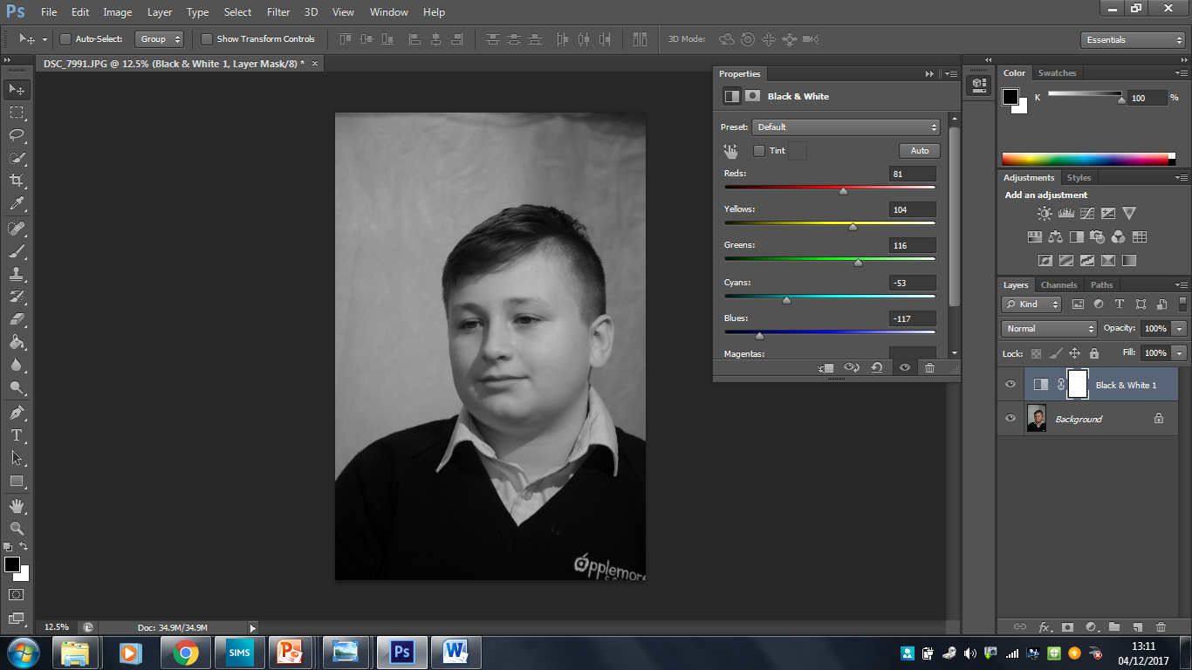
1. Make it Black and White

Slide 28
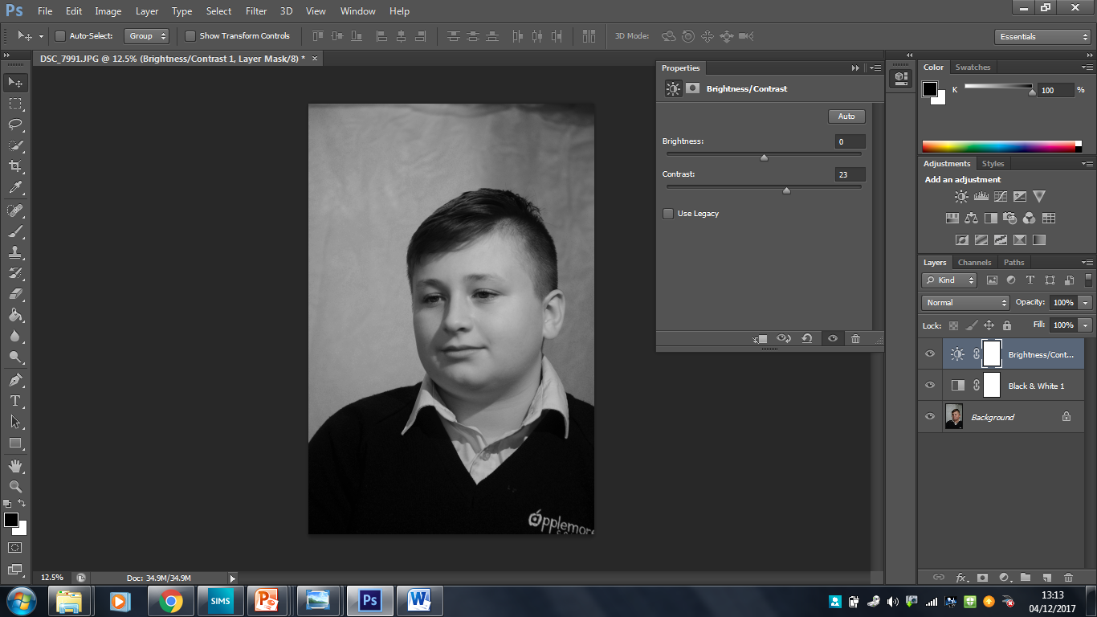
2. Boost the contrast

Slide 29
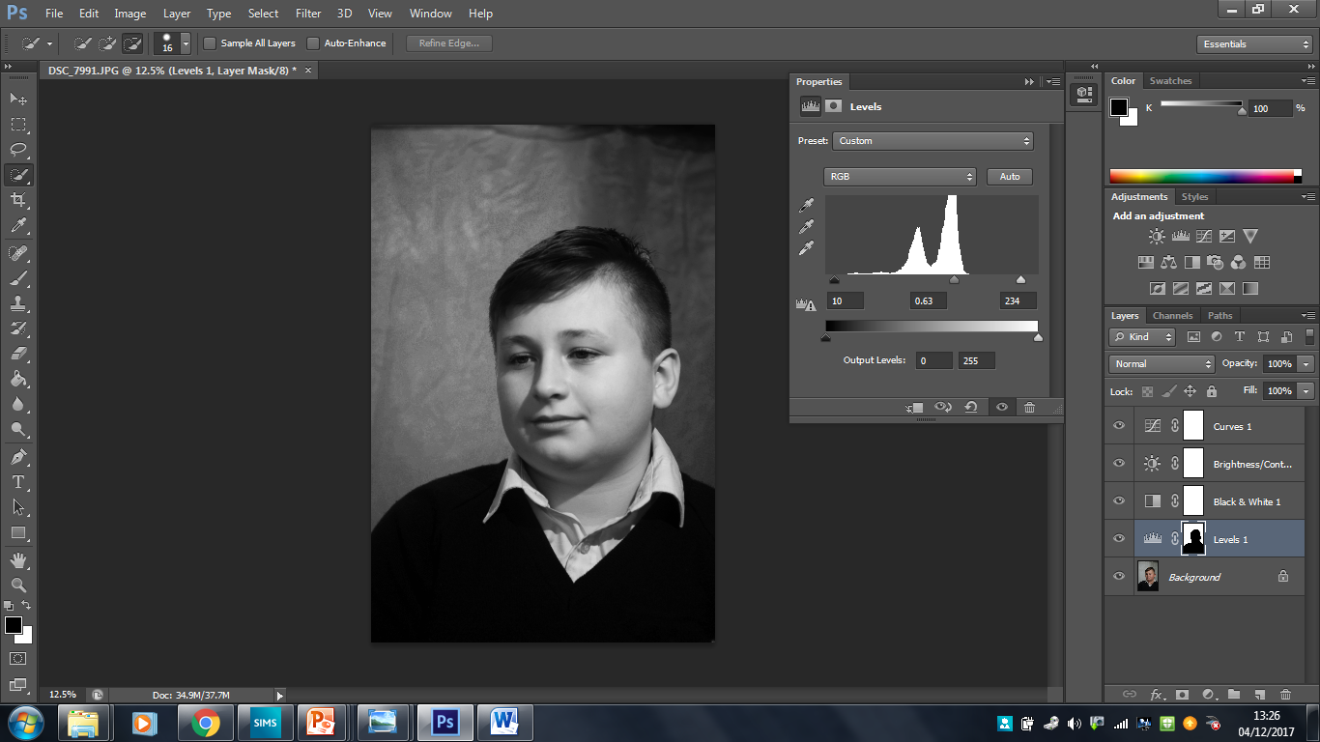
3. Adjust the Levels.

Slide 30
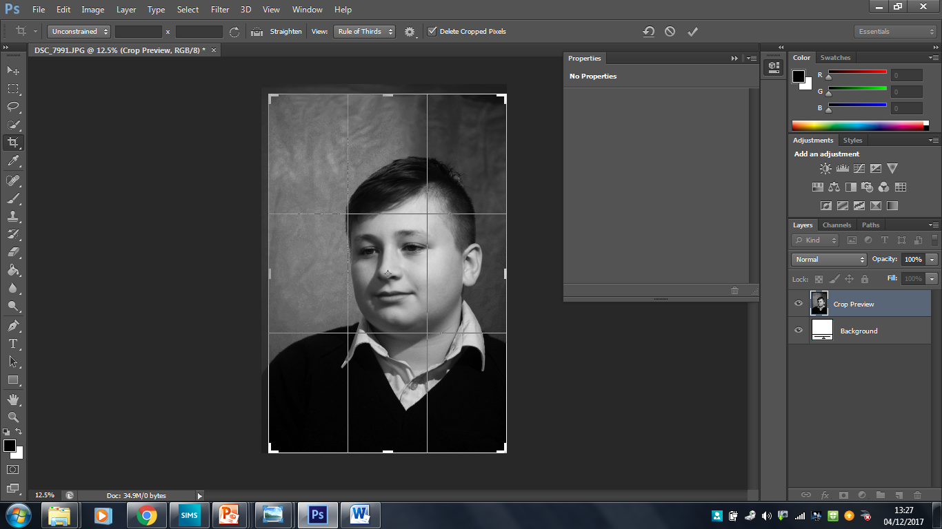
4. Crop to a 7’’x 5’’ format.

Slide 31
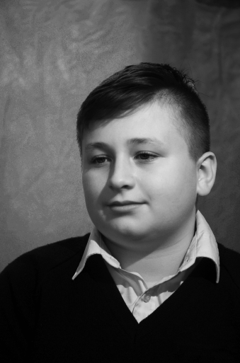
Original Edited.

Slide 32
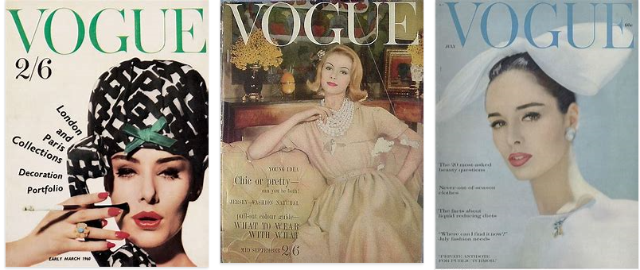
Richard Avedon: Work for Today
Magazine Research
Research the following and produce a mood board of 12 images:
Fashion Magazines from the 1960’s: For example- Vogue/Vanity Fair/Harpers and Queen.

Slide 33
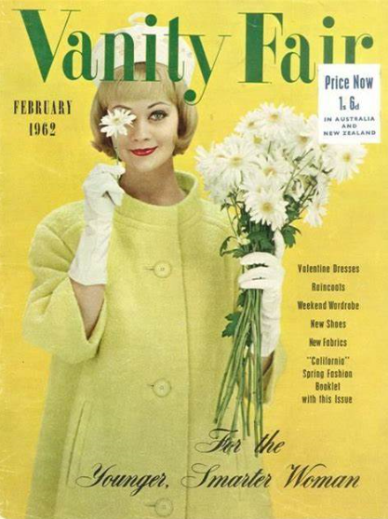
Richard Avedon: Work for Today
Magazine Research
Choose one magazine from your mood board. Copy and paste it on to a new slide. Label the different parts of the cover of the magazine.
Title of magazine
Price
Date of publication
Main Photo
List of contents
Tagline

Slide 34

Richard Avedon: Work for Today
Magazine
Create your own magazine cover.
Style Upgrade
Your 2018 Wardrobe Strategy
BECKHAM!
The Man and the Myth

Slide 35
Style Upgrade
Your 2018 Wardrobe Strategy
BECKHAM!
The Man and the Myth

Slide 36
Richard Avedon: Work for Today
Complete the editing of your portrait. Remember to do snips/print screens of each main edit.
Save your best/final edit as a jpeg. Copy and paste on to an A3 Publisher page. Print.
Snip your best/final edit on to your PowerPoint. Snip a Richard Avedon portrait next to as a comparison. How well do you think that you have responded to his work? What do you like about your work? What skills have you learnt? What have you enjoyed about this topic? What could you do to improve your work if you did it again?
Go back over your Richard Avedon PowerPoint and complete any unfinished elements.
Give yourself a pat on the back!

Slide 37

1960’s Culture: Pop Art
S3 Photography Culture:
Topic Two

Slide 38
Photography Mini-Tasks
During the time that you are studying from home, I will set you a series of weekly Mini-Tasks. Could you please complete at least one mini-task each week (feel free to do more!). The Mini Task work consists of the following:
Photographer or Artist Research. Find out about the photographer or artist and produce a fact file about them/a mind map of words which relate to their work/a mood board of images which show the kind of work they do, and some critical analysis of their work, using the Formal Elements words.
Each mini-task has at least one ‘Things I can do’ task. Either complete the photographic task by taking at least 15 photographs, or come up with a task of your own which relates to the artist’s work and take at least 15 photographs.
Upload the photographs as a thumbnail set.
Edit one or more of the photographs using whatever editing package you have on your computer. Paint.net is an example. Or you can download free ones, like GIMP.
Present your weekly ‘mini-task’ final piece.
Evaluate/analyse your work. Explain how you have responded to your artist’s work, how it links, but also how it has your own identity.

Slide 39
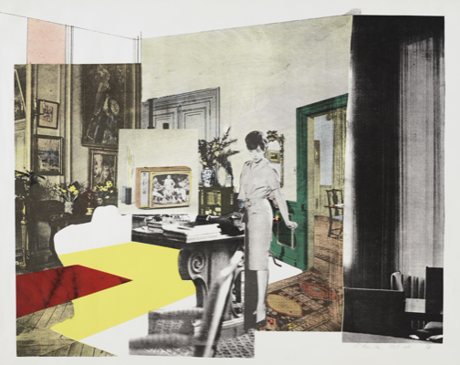
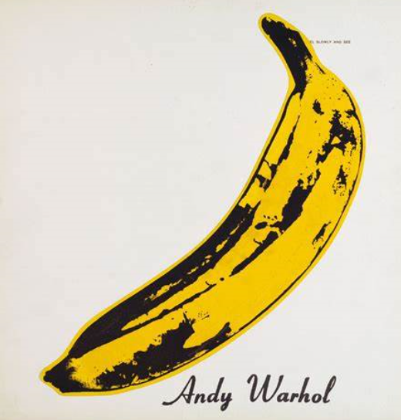
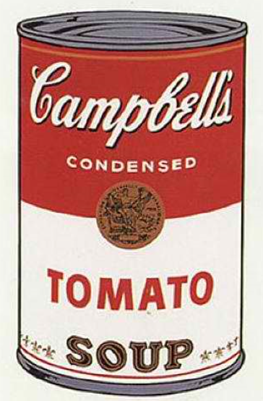
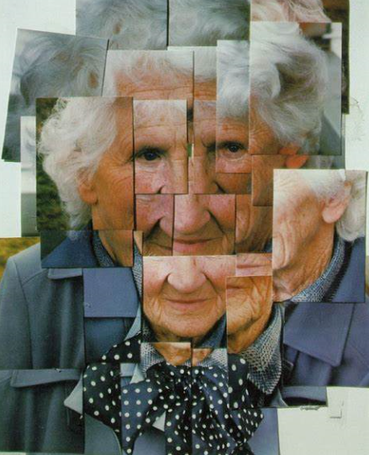
BGE Photography: 1960’s Culture: Mini-Tasks
23.02-27.03.20

Slide 40
BGE Photography: 1960’s Culture
PHOTOGRAPHY MINI TASKS: Richard Hamilton
Things I could do: Make a collage by cutting and gluing photographs from newspapers or magazines and make your own Richard Hamilton style pop art work.

Slide 41
BGE Photography: 1960’s Culture
PHOTOGRAPHY MINI TASKS:
Andy Warhol
Things I could do: Take photographs of fruit or vegetables against a white background. Then take photographs of stages of peeling/cutting the fruit.

Slide 42
BGE Photography: 1960’s Culture
PHOTOGRAPHY MINI TASKS:
Andy Warhol
Things I could do: Take photographs of tinned food around the home in unusual places. For example: in the bathroom, on your pillow, sitting on the sofa.

Slide 43
BGE: 1960’s Culture
PHOTOGRAPHY MINI TASKS:
David Hockney
Things I could do: Take close-up photographs of an object/person that combine to make the whole photograph when uploaded on to a computer and made into a collage. Cut up a portrait/s from a magazine and rearrange in a Hockney style.

