Slide 1
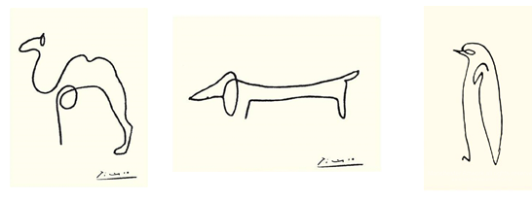
Line
Individual marks made on a surface
Observational Drawings | Drawing from Life. By looking continually from what you are drawing to the piece of paper and back again you will be able to draw far more accurate than if you are trying to imagine or remember your subject.
Continuous Line Drawing | Continuous contact between the drawing tool and the surface that is drawn on. This technique helps you concentrate on varying the weight of line produced by changing the pressure you apply while drawing.
Hatching | A drawing technique where shade or tone are created using closely-spaced lines. Cross Hatching is a drawing technique where shade or tone are created using crossing lines.
Picasso liked to create drawings of animals using continuous line drawings.
Exercise 2: Copy one of the Picasso animal drawings above.
Exercise 3: Create a continuous line drawing of objects from your pencil case. Remember do not take your pencil off the page!
Horizontal Line
Vertical Line
Curved Line
ZigZag Line
Cross Hatched

Slide 2
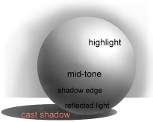
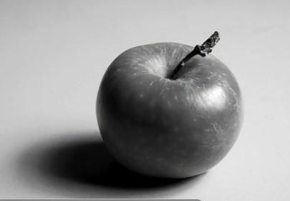
Tone
Tone describes the shades of light and dark. Tone is used to suggest the illusion of a three dimensional form.
Exercise 3: Choose two shapes from the image above. Draw and add shade to them in the boxes provided .
Exercise 4 : Draw an apple using form. Think about the direction of your lines, these should be curved, this is call contouring. Don’t forget your shadow so it doesn’t look like it’s floating.
Exercise 1: Shade in the boxes decreasing in tone.
Light Source
Exercise 2: Shade the circle above so it appears as a sphere.

Slide 3
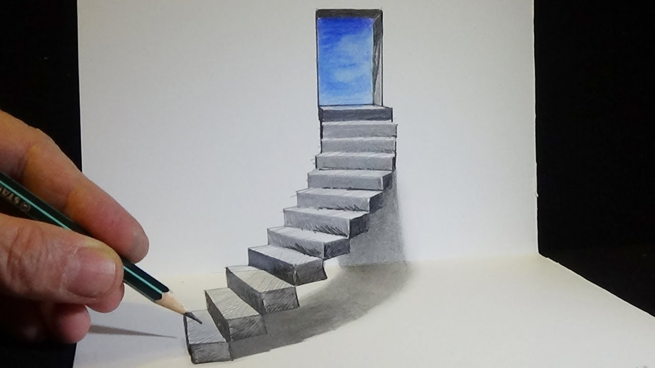
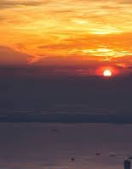
Form
Exercise 2 : Use the diagram to draw the letters of your name in 3D.
A 3D shape / to make something appear 3D
Exercise 2
Exercise 1 : Copy the steps below to make an shape look 3D. You can do the square or triangle or pick your own shape as a challenge.
Exercise 3
Exercise 1
Exercise 3 : Make the photo look like a door with some stairs leading up to it in 3D. Don’t forget your shaddows.

Slide 4
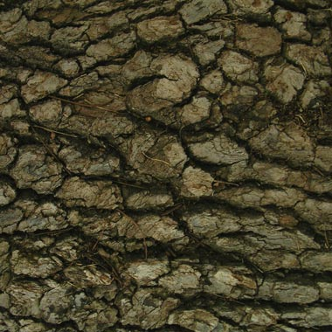
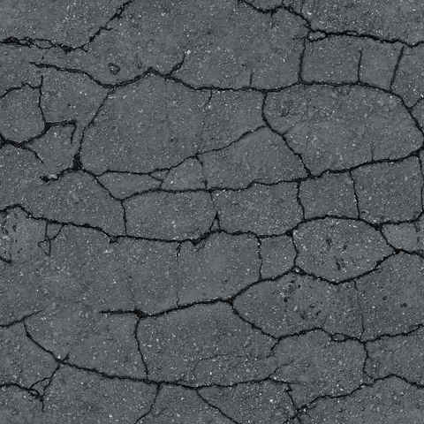
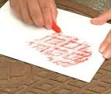
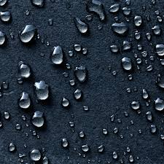
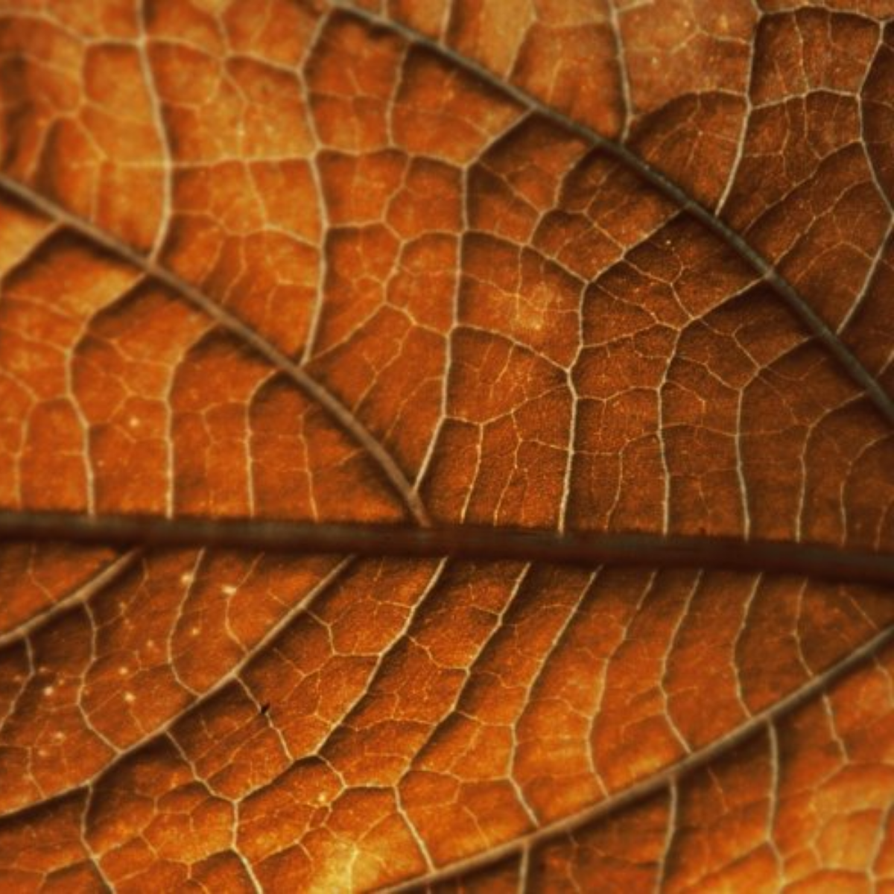
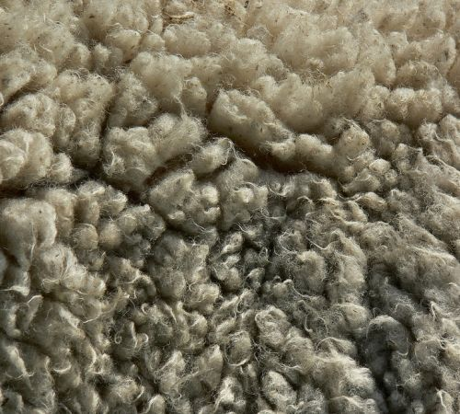
Texture
The appearance of the surface
Frottage is the technique or process of taking a rubbing from an uneven surface to form the basis of a work of art. It is created by placing a piece of paper surface and then rubbing the paper with something to deposit marks, most commonly graphite or wax crayon.
Exercise 1: Create a rubbing in the box above.
Exercise 2: Draw the textures above using pen or pencil.
Exercise 3: Write over the photo descriptive words that represent that texture.

Slide 5
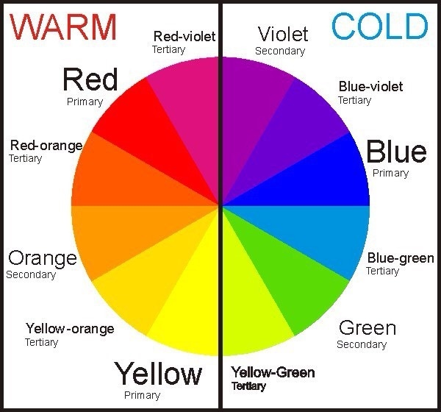
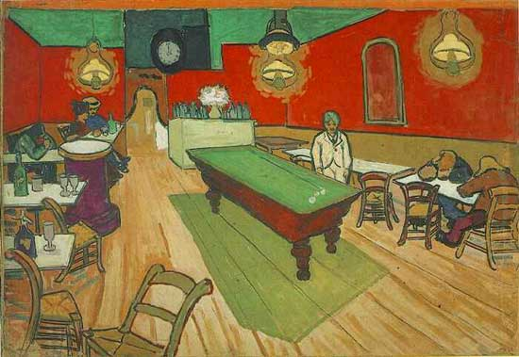
Colour
The hue, tint or shade
Exercise 2: Fill in the remaining complementary colour pairs.
Primary Colour | A colour that cannot be made by mixing other colours together.
Secondary Colour | Made by mixing two primary colours together.
Tertiary Colour | Made by mixing a primary and a secondary colour together.
Exercise 3: Fill in the remaining harmonious colour pairs.
Complementary Colour | They are opposite each other on the colour wheel. Appear brighter when placed next to each other.
Harmonious Colours | Colours that are next to each other on the colour wheel and are pleasing to the eye.
Warm Colours | Are shades of orange, yellow and red.
Cold Colours | Are shades of green, blue and purple.
Tint/Shade | A tonal range from light to dark.
Exercise 1: Using your favourite colour create a tonal gradient above. In the block below blend two colours from each end together in the middle.
Exercise 4:
Exercise 4: Describe Vincent Van Gogh’s The Night Café, Arles (1888) use of colour in his Marilyn Monroe screen prints.

Slide 6
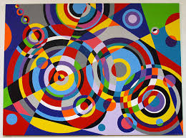
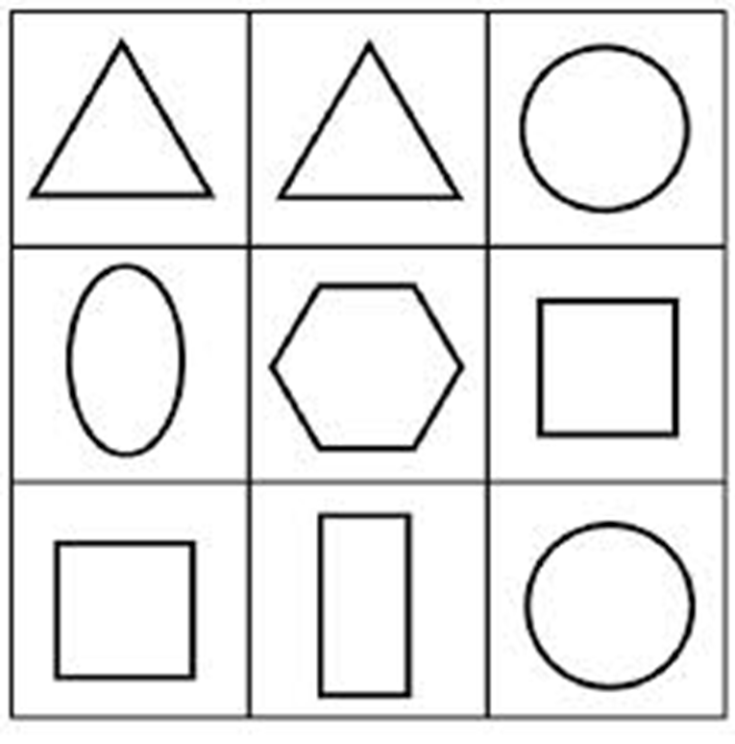
Shape
The outline of an object
Geometric | Geometric shapes describe regular shapes such as squares, triangle, circles etc.
Organic | Organic shapes are associated with things from the natural world like plants which have flowing shapes and lines.
Bruce Gray is an artist who makes his work using shapes.
Exercise 1: Draw all the shapes from the box to the left in the box above making sure they overlap.
Exercise 2: Create your own Bruce Gray inspired piece of work using geometric shapes. Colour your design using a colour theory choice.

Slide 7
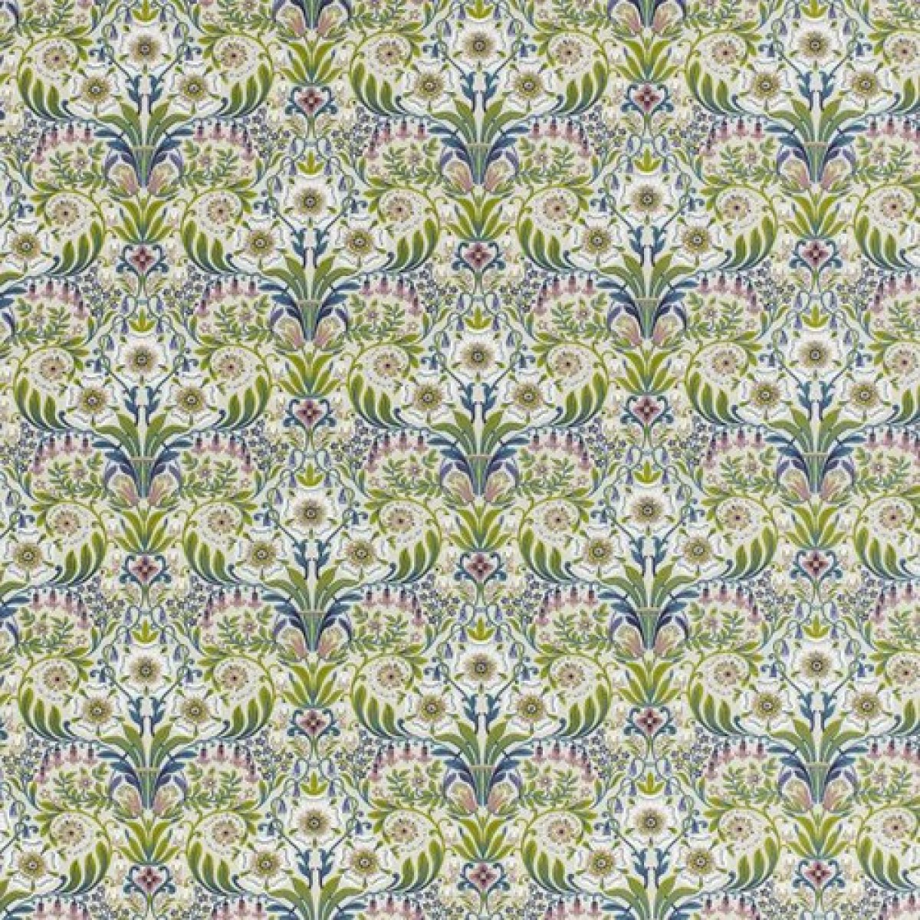
Pattern
William Morris is a famous British textile designer known for his nature inspired wall papers.
A repeated motif
A pattern is created by repeating one design element. This can be a mark, line, shape or a colour. This is called a motif. Motifs can be simple shapes or complex arrangements. Even the simplest motif can create infinite variations of patterns through tessellation. Tessellation is an arrangement of shapes closely fitted together, in a repeated pattern without gaps or overlapping. Patterns can be man-made, like a design on fabric, or natural, such as the markings on animal fur.
Task 2: Draw below your own repeating wallpaper.
Task 1: Draw an example of each of the types of repeat pattern in the boxes below.

