Slide 1
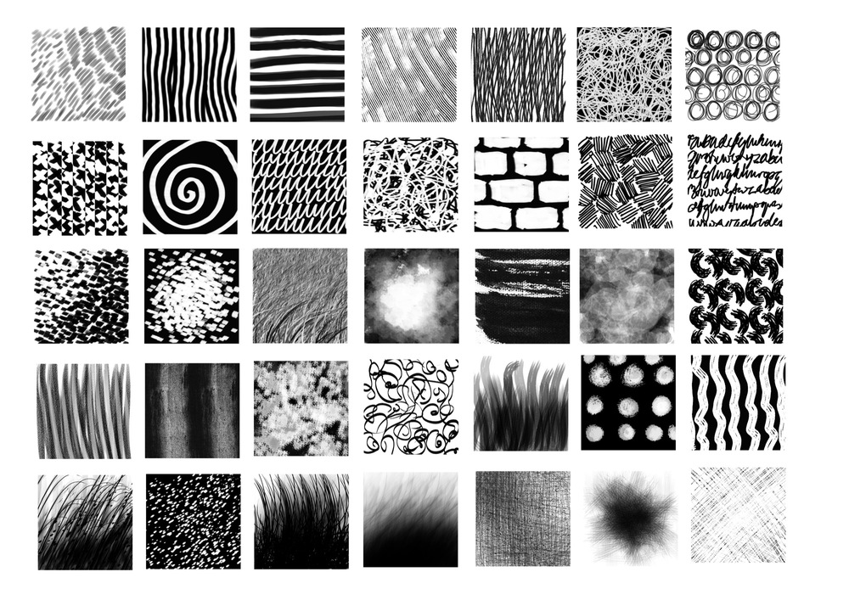
Clydeview Academy
Independent Learning Project
‘Thinking outside of the box and creative risks’

Slide 2
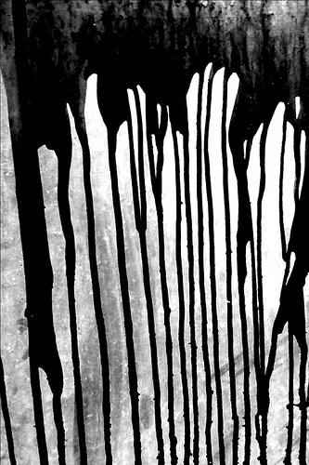
Task 1: Using liquids available to you (coffee, tea, paint), drip splash, splatter, fling and dribble them in this box.
HINT: See what patterns you can create intentionally and unintentionally.
Extension Challenge: Look at the work of Abstract Expressionist Artist Jackson Pollock. On a piece of paper/sketchbook page stick one of his pictures, and try to recreate it with your own splatter patterns. Annotate your work and his, outlining key themes and your opinions.

Slide 3
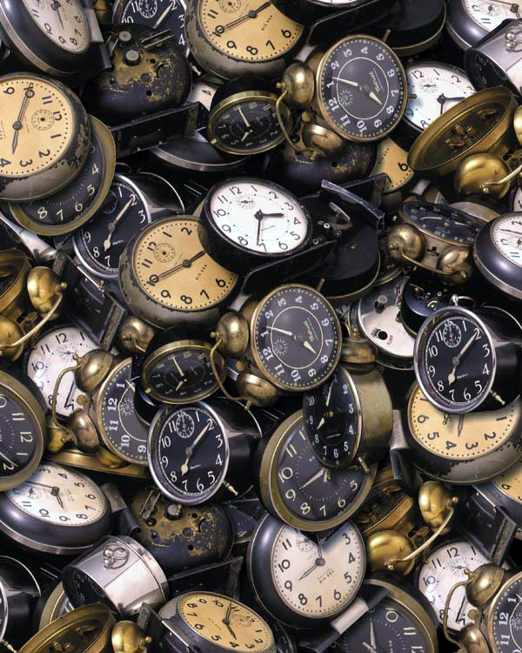
Task 2: The 10 second challenge. Chose 8 small objects. Time yourself. In 10 seconds draw the complete item. This quick recording tasks speeds up the connection between eyes and hands.
HINT: Small objects such as drawing pins, paper clips and pencil sharpeners work well.
Label each picture (just in case we can’t tell what it is).
Go to Task 3b.........

Slide 4
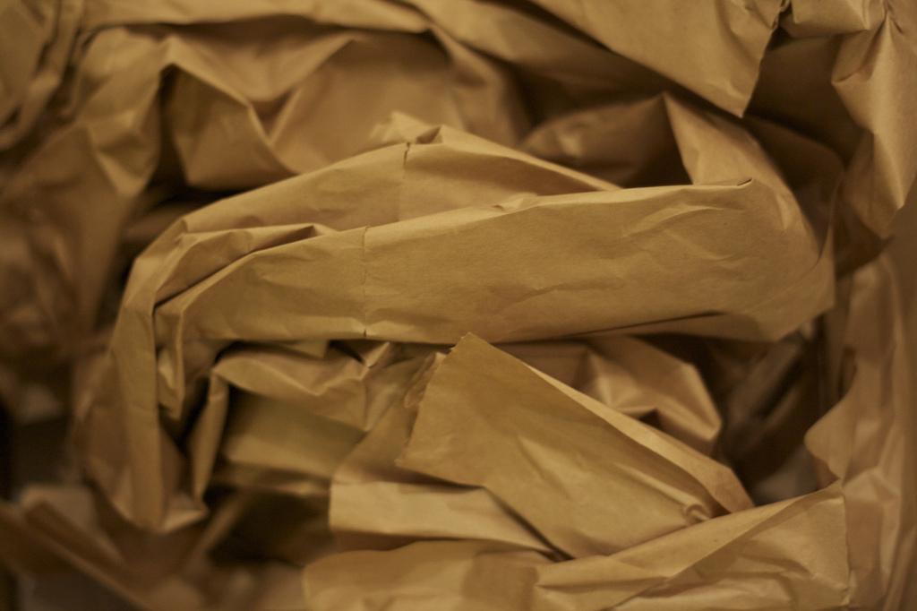
Task 3: Select the most successful object out of the 10 (from task 2). Using your left and right hand create 2 tonal studies of this object.
HINT: Remember the different methods of shading; block, linear, cross hatching, pointillist.
Right Hand
Left Hand

Slide 5
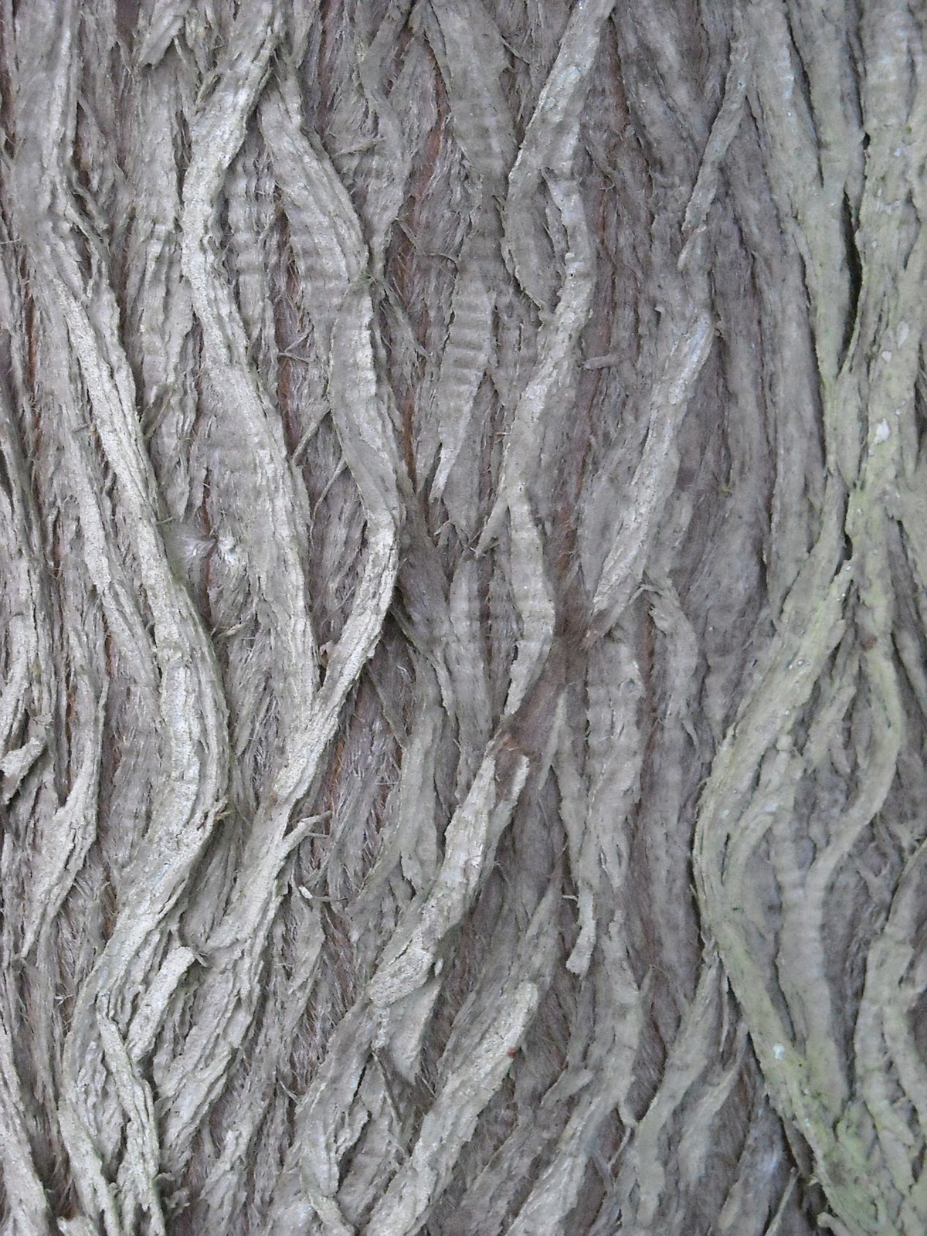
Task 4: Using pencil, crayon, chalk or charcoal, collect at least 5 texture rubbings. Vary the colour or keep it black and white. Try alternative papers to make it more interesting.
HINT: try different surfaces from bark to pavement slabs and brick.

Slide 6
Task 5: Cut small thin strips of text (newspapers, magazines, letters). Spread the box with glue and sprinkle the strips like confetti.
HINT: Avoiding pictures makes the arrangement more confusing to the eye. The smaller the strips the more effective the randomness.
Extention task: Do a detailed drawing from a small section of your random arrangement. Include a full tonal range.

Slide 7
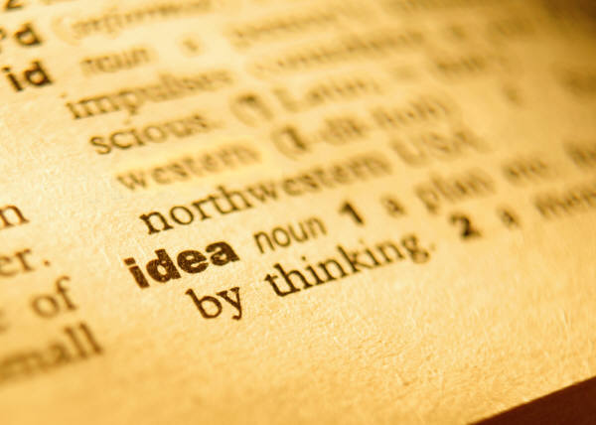
GLOSSARY
Task 6a: Complete the definitions of the following words.
Extension Challenge: There are 5 spaces for you to add in some of your own key words .
Risk | Intentional | Unintentional
Motion | Frantic | Smooth
Rough | Sporadic | Expressive
Abstract | Gestural | Observation
Texture | Collage | Layers
Repeat Pattern | Typography

Slide 8
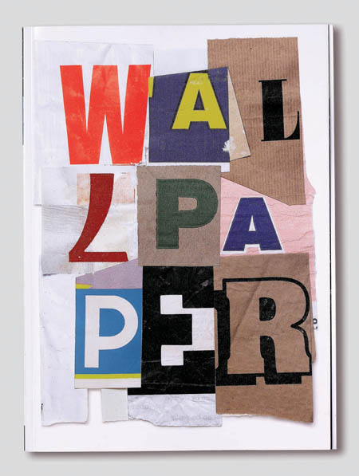
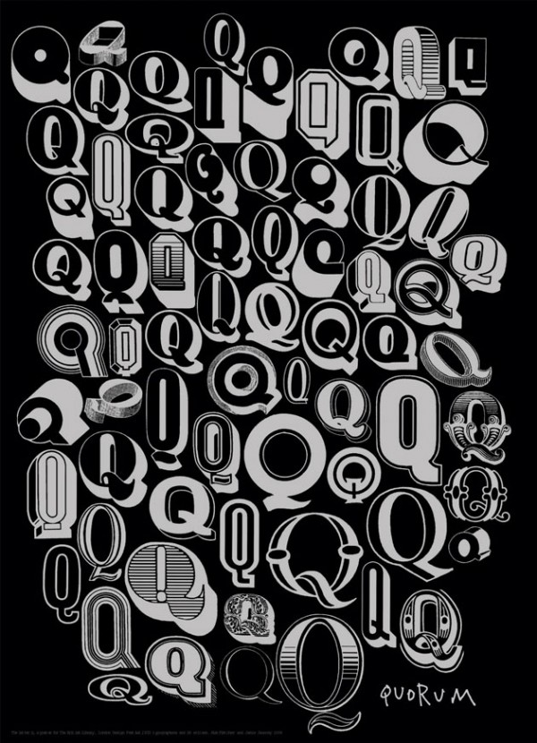
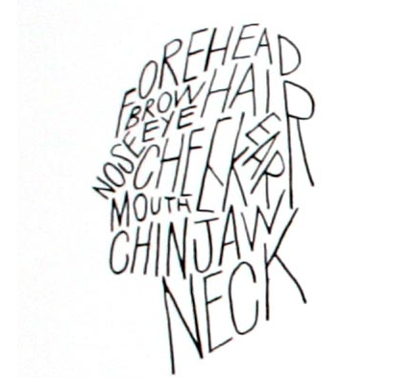
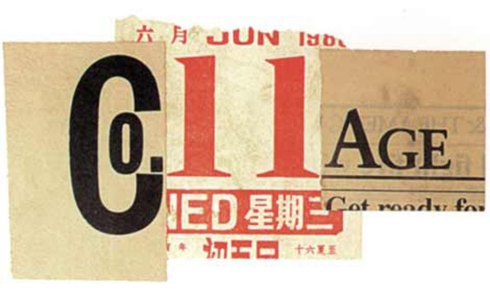
Task 6: Look at the typography work of Alan Fletcher. Using the key words from the Glossary (Task 6), create your own unique piece of word art.
HINT: Think about different shape letters, maybe look at fonts on the computer/phone/books to inspire you.

