Slide 1
PINEAPPLES
My favourite fruit…

Slide 2
Why are they good for you?
They’re yummy!
Packed with Vitamin C – they’ll help you when you get the cold!
Full of juicy flavour!

Slide 3
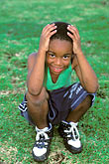
But why are they my favourite?
This is Martin →
Where do you think Martin lives?

Slide 4
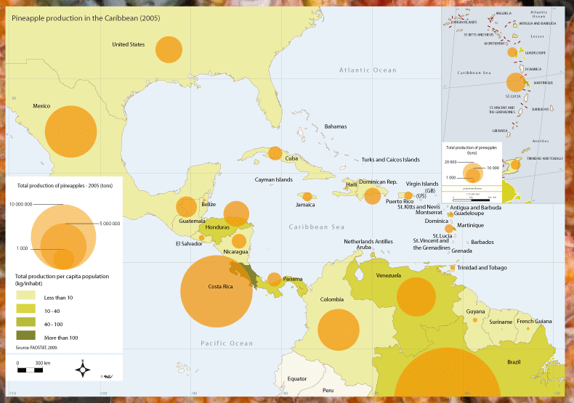
But why are they my favourite?
Martin is from Martinique

Slide 5
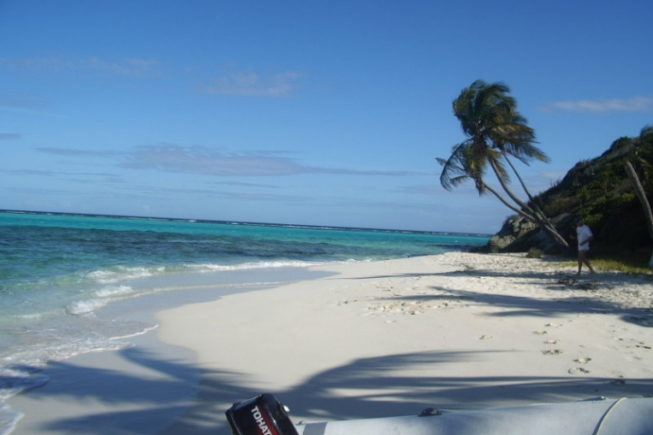
But why are they my favourite?
Martinique is a beautiful Caribbean island home to French speakers and spectacular beaches.
Martin would love to spend the weekend with his friends on the beach…

Slide 6
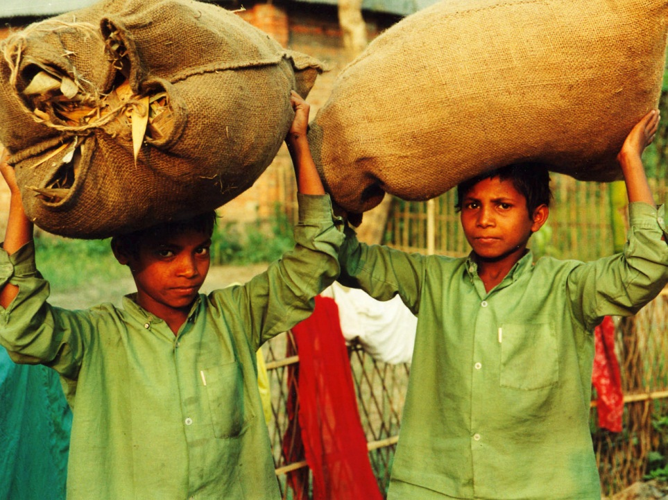
But why are they my favourite?
Unfortunately for Martin, he’ll spend the weekend working on his father’s farm.

Slide 7
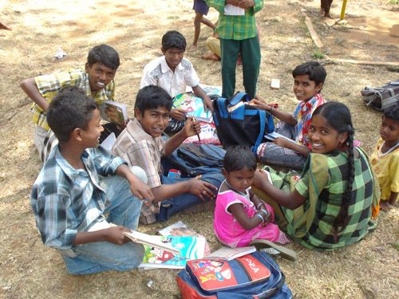
But why are they my favourite?
Even though Martin is only 11 he is forced to work. This is because his dad, a farmer, does not get enough money for his pineapples. For all of the family to eat, Martin must work at a young age for free, in extreme heat, and without protection for his hands.
His dad sells fairtrade pineapples, but does not make enough money as people are not willing to pay for fairtrade.

Slide 8
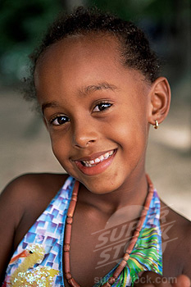
But why are they my favourite?
Martine on the other hand, Martin’s sister, will spend the weekend skipping in the sand with her friends. Martine is allowed to enjoy her weekends because she is a girl.

Slide 9
But why are they my favourite?
1. Do you think this is fair on Martin?
2. What could you do to make Martin smile?
3. What are the benefits for you?

Slide 10
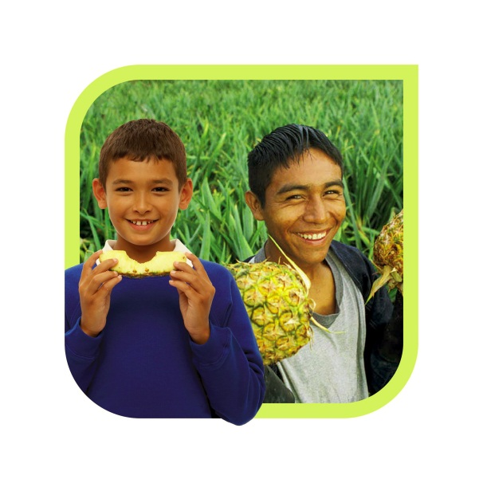
But why are they my favourite?

