Slide 1
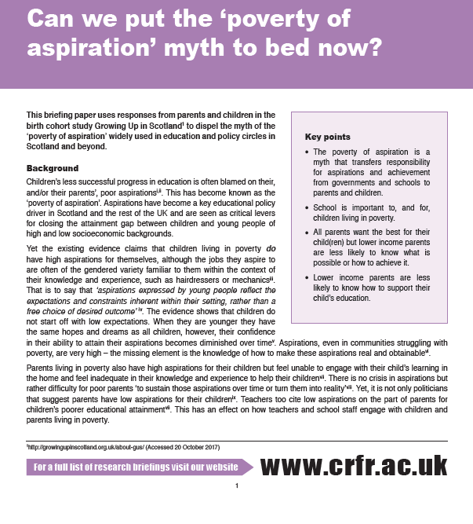
Can we put the ‘poverty of aspiration’ myth to bed now?
Dr Morag Treanor
University of Stirling
South East Improvement Collaborative
Murrayfield, Edinburgh
30 November 2018

Slide 3
Background
Aspirations have become a key educational policy driver in the UK and are seen as one of the critical levers for improving educational attainment and raising skills.
children and their parents are seen as lacking ambition
leads to a deficit view of aspirations, holding young people and their parents ‘responsible’ for their ‘lack of’ ambition.
but aspirations expressed by young people and their parents reflect the expectations and constraints inherent within their setting, rather than a free choice of desired outcome.
Ralf St Clair & Amanda Benjamin (2011) Performing desires: the dilemma of aspirations and educational attainment, British Educational Research Journal, 37:3, 501-517

Slide 4
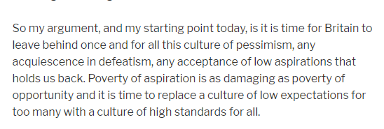
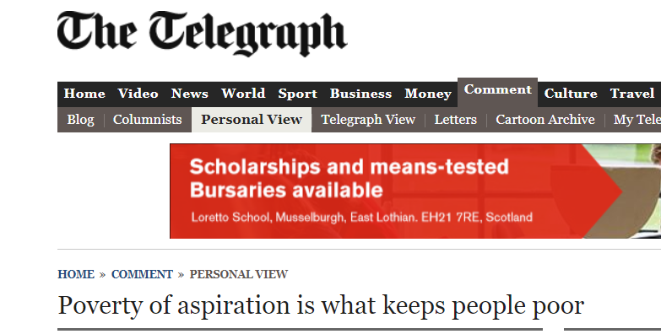
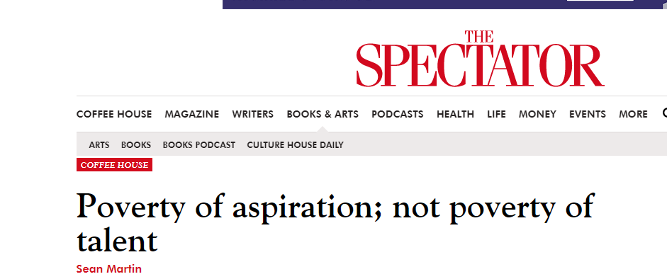
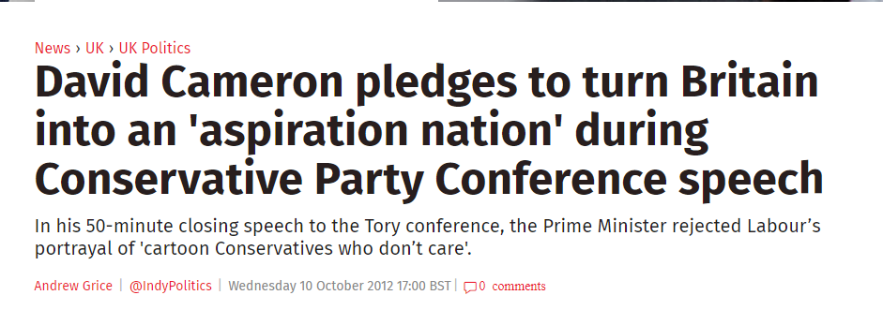
GORDON BROWN
THERESA MAY
TONY BLAIR

Slide 5
Despite excellent work on child poverty by the Scottish Government, myths persist…
Alex Cole-Hamilton (LD)
Michelle Ballantyne (C)
Ruth Maguire (SNP)
Scottish Parliament 8 November 2017. Official report of the Stage 3 debate on the Child Poverty (Scotland) Bill [Online]. Edinburgh: Scottish Parliament. Available: http://www.parliament.scot/parliamentarybusiness/report.aspx?r=11177&i=101890 [Accessed 6 December 2017].

Slide 6
Poverty of aspirations
Children living in poverty do have high aspirations for themselves, although the jobs they aspire to are often of the gendered variety familiar to them within the context of their knowledge and experience, such as hairdressers or mechanics.
That is to say that ‘aspirations expressed by young people reflect the expectations and constraints inherent within their setting, rather than a free choice of desired outcome’.
Children do not start off with low expectations. When they are younger they have the same hopes and dreams as all children, however, their confidence in their ability to attain their aspirations becomes diminished over time.
Aspirations, even in communities struggling with poverty, are very high—the missing element is the knowledge of how to make these aspirations real and obtainable.
Parents living in poverty also have high aspirations for their children but feel unable to engage with their child’s learning in the home and feel inadequate in their knowledge and experience to help their children.

Slide 7
Teachers and the poverty of aspiration
Teachers and student teachers often found to have little understanding of the link between child poverty and educational attainment, which lead to their falling back on negative stereotypes of children and parents living in poverty (Thompson et al, 2016: 220).
Often teachers do not understand enough about existential poverty to get beyond a pathologising discourse of families, parents and children as feckless and undeserving (Singh et al. 2013)
Negative stereotypes about impoverished children based on deficit assumptions can perpetuate inequality (Cummings et al., 2012).

Slide 8
Let’s look at child poverty in Scotland…
Notes:
24% child poverty rate after housing costs (14/15 - 16/17) - Up from 23% in the previous 3-year average 13/14 – 15/16
19% child poverty rate before housing costs (14/15 - 16/17) - Up from 17% in the previous 3-year average 13/14 – 15/16

Slide 9
Notes:
10% / 12% of children in combined low income and material deprivation

Slide 10
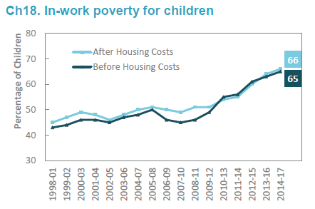
What these statistics do not convey…
Notes:
66% / 65% of children in poverty are in in-work poverty

Slide 11
Source: Growing Up in Scotland sweeps 1 – 7
Weighted by longitudinal weight from sweep 7

Slide 12
What’s the message?
Note that only 45% of children in Scotland have not experienced at least one year of poverty in all seven years of data.
Poverty is dynamic
There is not a fixed population of people living in poverty
Annual, cross-sectional snapshots can’t tell you that
But the new experimental statistics on persistent poverty that the Scottish Government are trialling are not cross-sectional so they could do more than they are.

Slide 13
Notes:
Of the four statements that children responded to there were no differences by the four categories of poverty over time.
This means that children at this age (7/8 years old) do not experience different enjoyment of school based on their socioeconomic background.
That is not to say that their ability to participate fully in school, or their ability to make equal use of what is available to them, or indeed their response to or conduct in school will be the same.
Rather it shows that in spite of differences perceived by teachers or felt by children in the classroom, children in poverty value school as much as their better off peers.

Slide 14
Notes:
There are differences in the types of aspirations parents hold for their children according to their experience of poverty.
However, there is no ‘lack’ of aspiration per se.
Parents living in any type of poverty are 1.6 times more likely to want their child to start a training course or undertake an apprenticeship on leaving school.
Parents living in any type of poverty are more likely to want their child to leave school to go onto further education college.
Parents living in any type of poverty are approximately half as likely to want their child to stay on at school beyond age 16.
This corresponds to the literature that poorer parents are more likely to aspire to apprenticeships/training/further education and less likely to aspire to higher education for their children.
Parents’ aspirations differ by poverty experience, but they are still ‘high’ aspirations, and are a construct of parents’ own knowledge, understanding and experience.

Slide 15
Parents’ experience of their children’s education
For every type of poverty, parents are less likely to believe that they can positively influence their child’s achievement at school compared to parents with no experience of poverty.
That is not to say that they believe they cannot, just that they are less likely to believe that they can. This corresponds to the literature that while poorer parents have aspirations for their children they are less confident in their ability to assist them.
All children are talking about the things they have learned at school with parents irrespective of their experience of poverty.

Slide 16
Poverty of aspirations
The problem with the ‘poverty of aspiration’ as a concept is not only that the research evidence does not support it, but also that it passes the responsibility for a presumed lack of aspirations onto parents and children.
In so doing it shifts responsibility away from local and central government, and schools, to children and parents from low socioeconomic backgrounds.
However, teachers are also disadvantaged by not understanding the causes of poverty, its effects on children and on their education, and by believing that the poverty of aspirations is a fact.
Teachers perpetuate the myth but are tasked with solving the problem as it is (wrongly) understood.

Slide 17
Coming at the problem from the wrong angle
Schools and policy-makers are putting effort into ‘raising aspirations’ to increase achievement among disadvantaged pupils.
Focusing on ‘raising’ aspirations unlikely to narrow the educational attainment gap
It is based on false assumptions about low aspirations.
The real challenge for disadvantaged young people is sustaining and achieving their aspirations.
The challenge for parents is how to understand and support their children’s aspirations.
The challenge for teachers is how to understand the causes and consequences of poverty, and then how to support and sustain aspirations.
It’s about knowledge, experiences, support and relationships.

Slide 18
Key messages
School is important to, and for, children living in poverty
Parents living in poverty value school and want to help
The ‘Poverty of Aspiration’ is a myth
Parents all want the best for their child
Parents living in poverty less likely to know what that looks like or how to achieve it
Parents living in poverty less likely to know how to help their child
Teachers on the whole would like to help but are trying to change the wrong thing, often through misunderstandings of poverty itself.

Slide 19
“Those of us with no experience of sailing in the Mediterranean do not aspire to yacht ownership on the Côte d’Azur. That does not make us deficient in aspiration; rather, we aspire to what we have experience of, what we know we can influence, and what we believe we can achieve. “

Slide 20
Recommendations
Policymakers having a more sophisticated understanding of how their own views of aspirations and those of others are shaped by their socio-economic circumstances.
It is important to promote policies which open up knowledge of the whole range of opportunities available to parents and children in poverty including routes into higher education.
Parents and children need knowledge of both the opportunities and the route to achieving their aspirations.
Support parents and children to understand the opportunities available to them and give them the knowledge necessary to achieve them
Focus on the mechanisms by which aspirations can diminish over time for young people
Focus on keeping young people’s aspirations on track rather than just ‘inspiring’ them
Dismantle the local and structural barriers to high aspirations.

Slide 21
‘Flipping the thinking’ JFK-style
“And so, my fellow Americans: ask not what your country can do for you—ask what you can do for your country.”
John F. Kennedy Inauguration speech, 20 January 1961

Slide 22
A teacher once asked me:
“how do I teach those children (living in poverty) to value their education?”
and I asked her:
“what do you do to show those children you value them so that they want to take up your offer of an education?”
Instead of expecting stressed children to understand the long-term value of education how do we flip the thinking so that educators understand and value all children in their classroom irrespective…?
Question 1 - what do you do to show those children you value them so that they want to take up your offer of an education (or other service)?

Slide 23
Work is being done in schools (and elsewhere) to reduce and eliminate poverty-related stigma and shame. I think of this as the cessation of a negative behaviour; in other words, it’s a neutral act.
How do we flip this to turn it into the presence of a positive; in other words, a positive act?
Rather than reduce or eliminate stigma, how do we actively promote dignity and respect for those who manage to come to school each day despite the barriers that poverty puts in their way?
Question 2 - How can you promote dignity and respect for those who manage to come to school each day despite the barriers that poverty puts in their way?

Slide 24
Evaluation feedback from event in March…
Morag Treanor - well received although group discussion went on tangent from presentation and questions posed… the focus of the conversation was parental controls, parental values etc.

