Slide 2
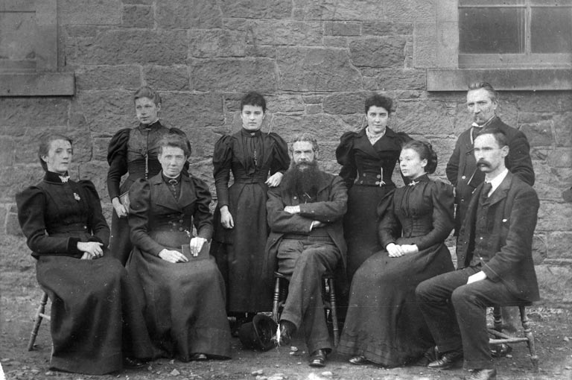
Hello again Law Primary School
School Teachers, North Berwick Public School, c.1890 & CPD via Gillian Baillie 2010

Slide 3
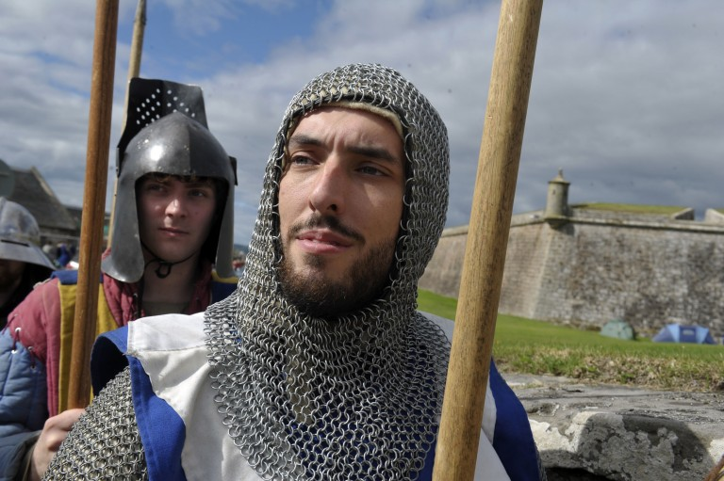
Background - March 2014

Slide 4
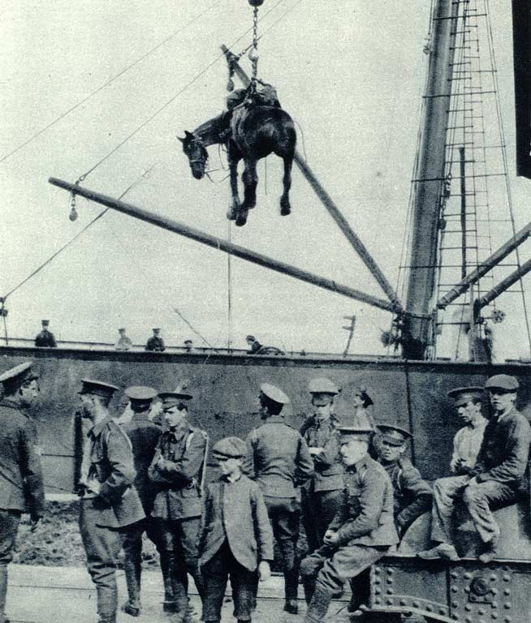
World War One Presentation
Education Scotland
Social Subjects Saturday
Created
Pathfinder: War Horses

Slide 5
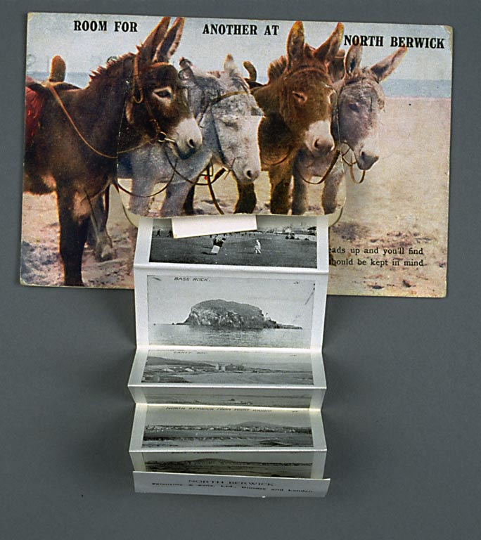
Background
Proposal April
Planning Meeting May
Preparations June-Sept
Classroom Activity Sept-Oct
Staff InSET Showcase Oct
Staff CLPL 12th Nov 2015

Slide 6
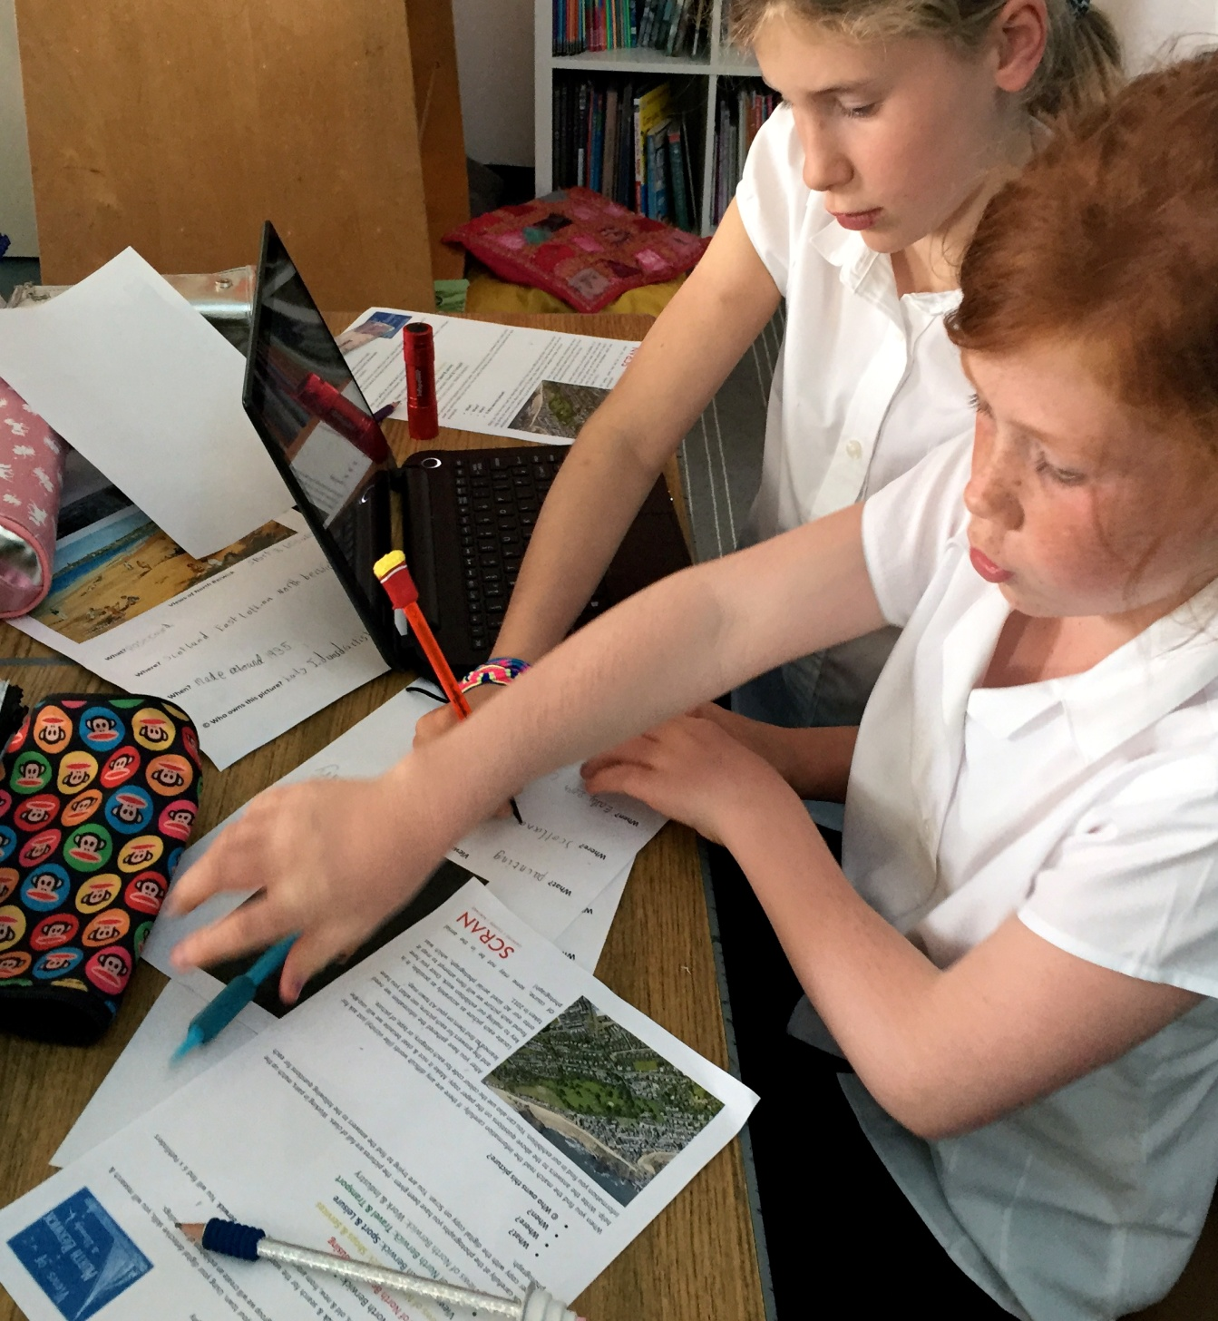
Classroom Activity
P5 Classroom Activity Sept-Oct
Context - Social Subjects Planner
Views of North Berwick
Specific Scran Pathfinders x 6
3 x afternoon visits
Kite Aerial Photography

Slide 7
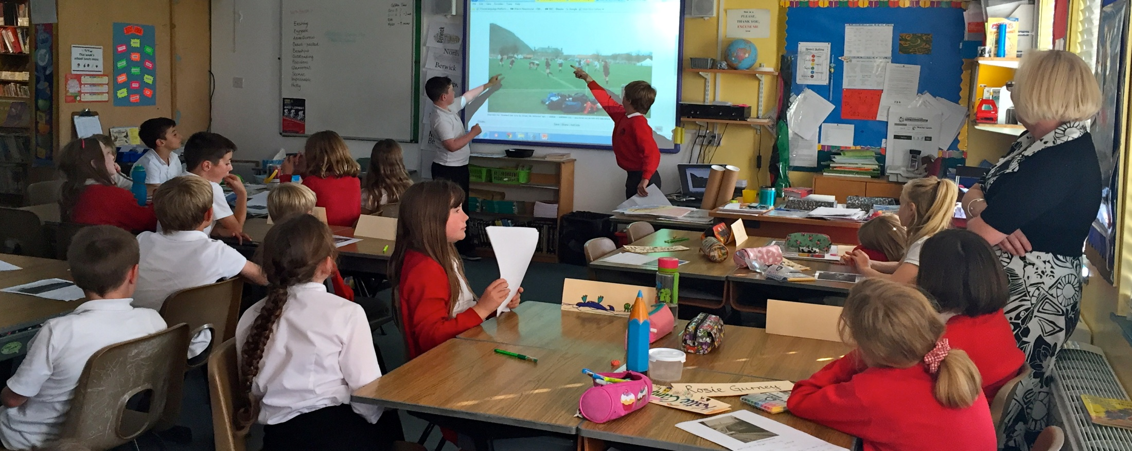
Context - Social Subjects Planner
ICT Digital Research & Investigation Skills
Creative Writing - local heroes & biopoems
Mapping Skills
Sense of Place
IDL
Active Outdoor Learning
Partnership working with Scran
Co-operative & collaborative learning
Celebration of work in exhibition
GlowBlog – Scranalogue posts
Edubuzz feed
Tweets @Scranlife

Slide 8
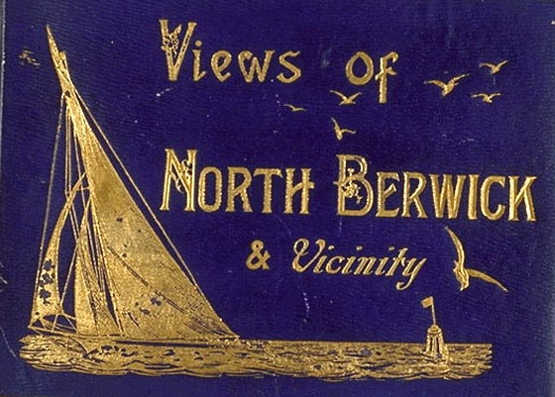

Slide 9
©

Slide 10
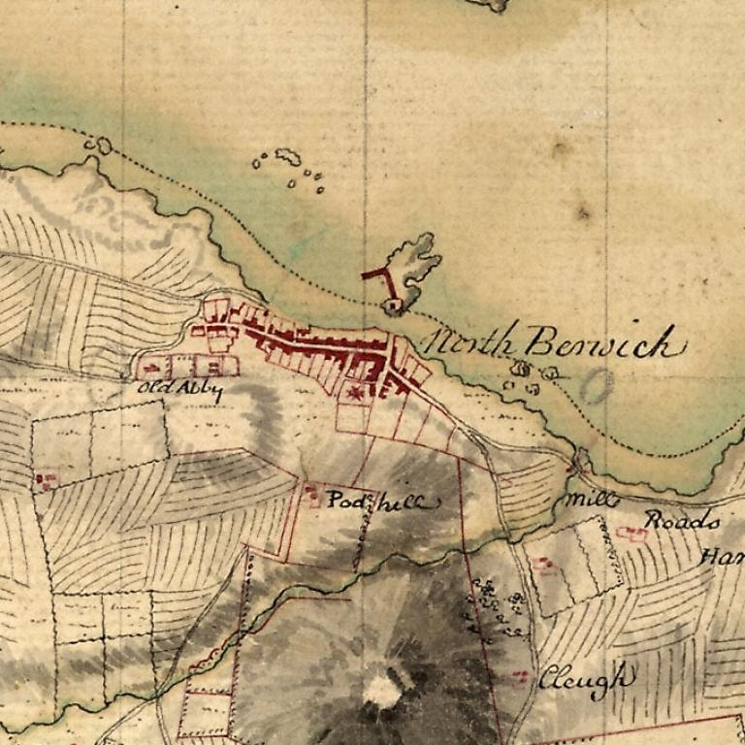

Slide 11
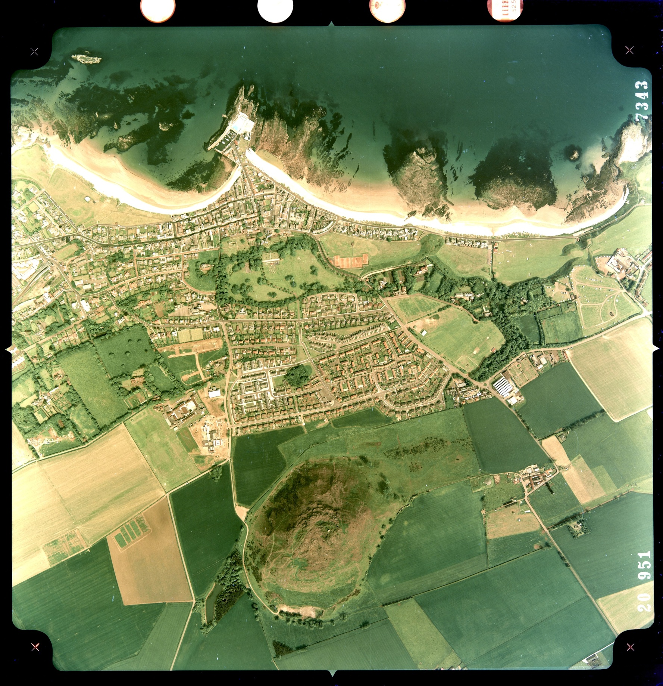

Slide 14
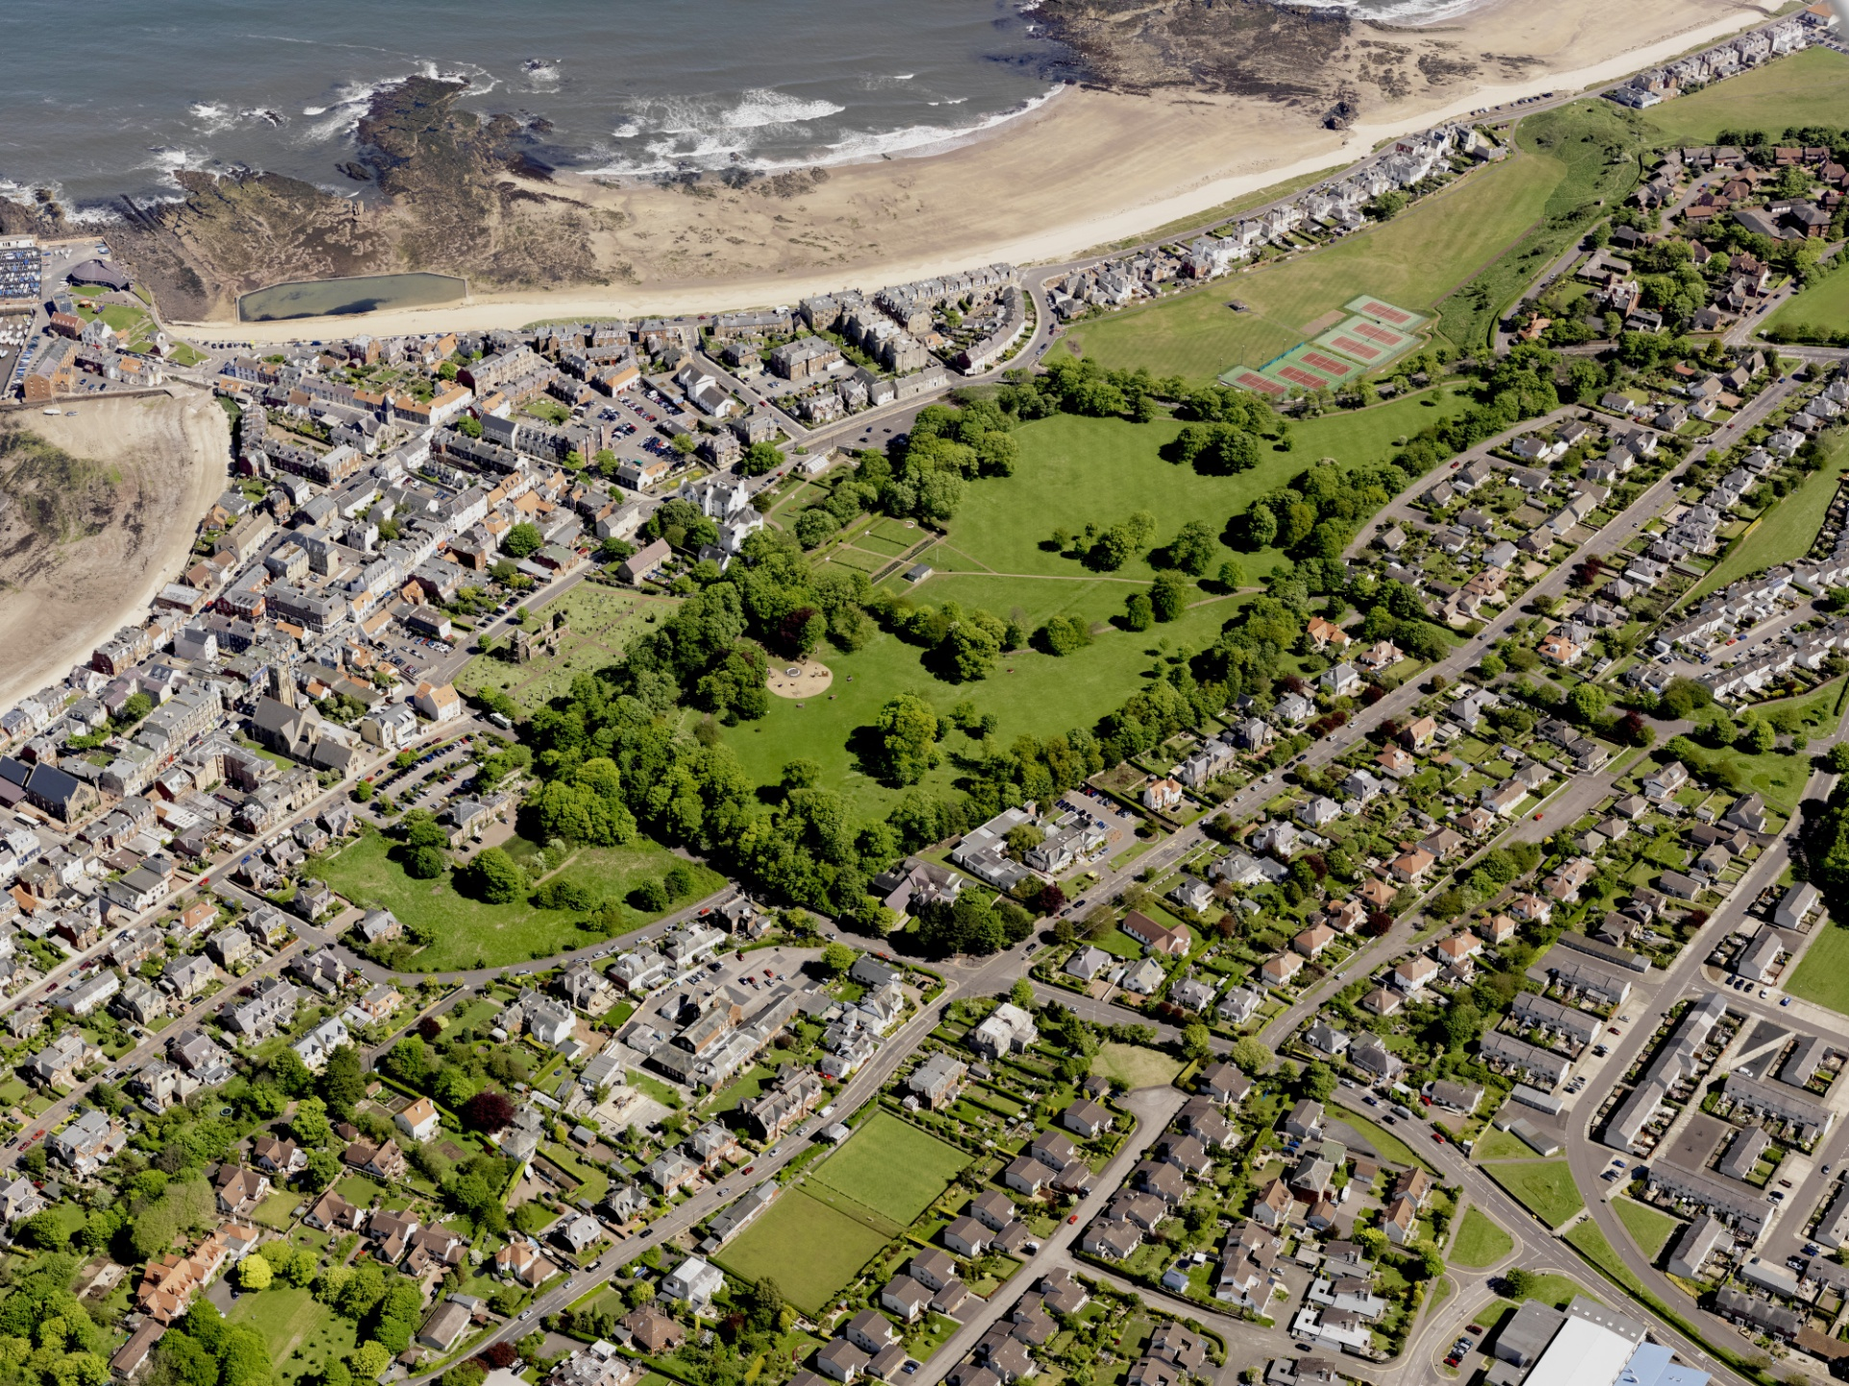
Aerial Photographs

Slide 15
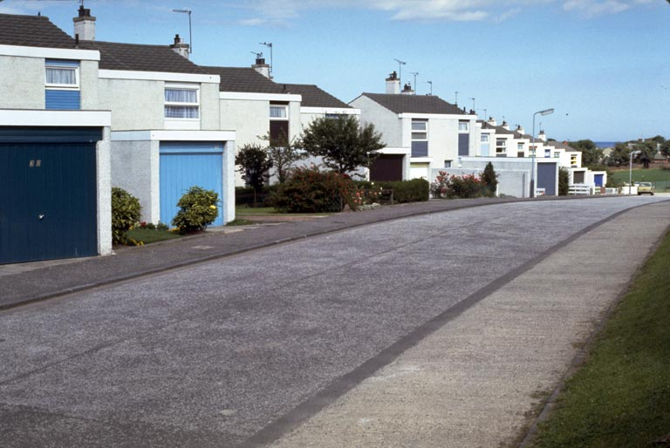
Housing

Slide 16
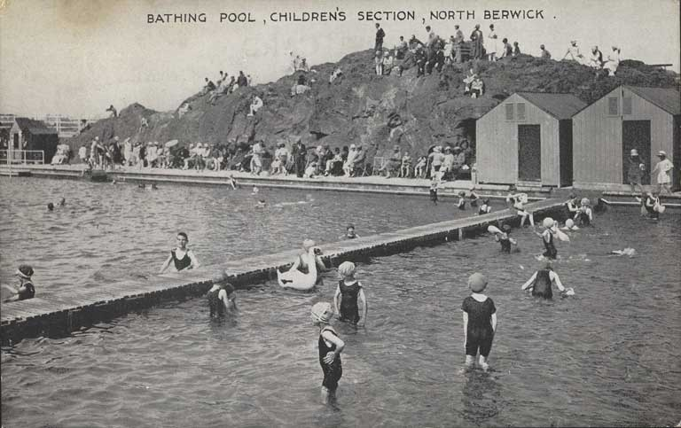
Sport & Leisure

Slide 17
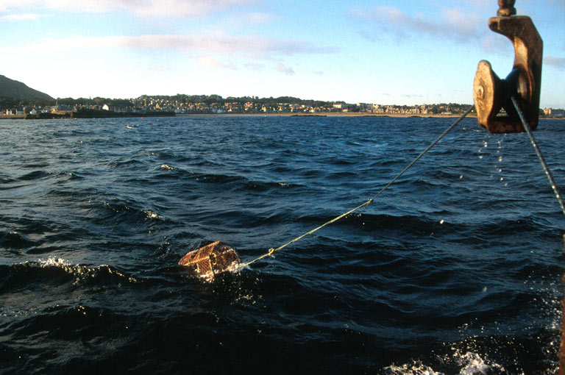
Work & Industry

Slide 18
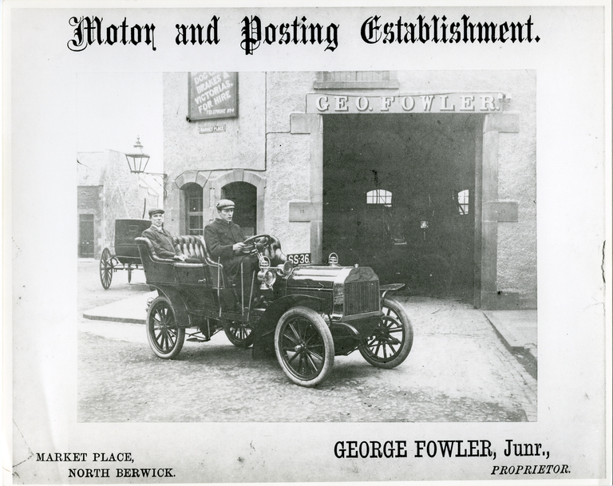
Travel & Transport

Slide 19
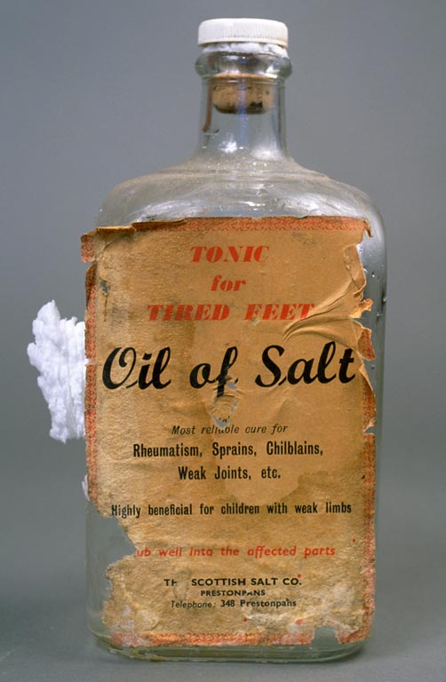
In-School Access
Teacher at Home Access
ELC Library Card Access
Glow Access

Slide 20
SCRANALOGUE
Culture
Heritage
Learning

Slide 21
P5 Classroom Activity - Day 1
Tuesday 29th September

Slide 22
Day 1 Digital Detective Work
Working in pairs
Searching
Reading & Recording
Visual Literacy & Looking
Categorisation

Slide 23
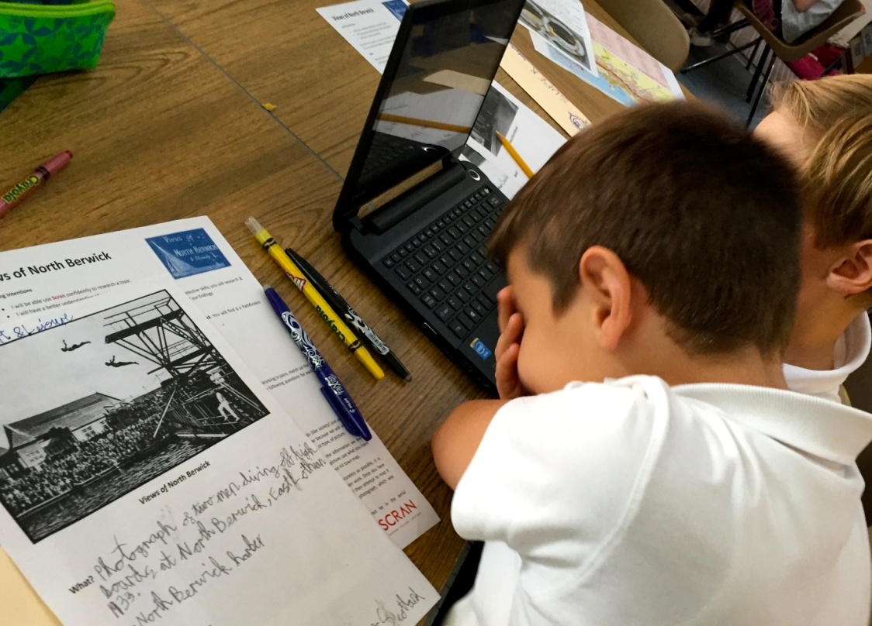
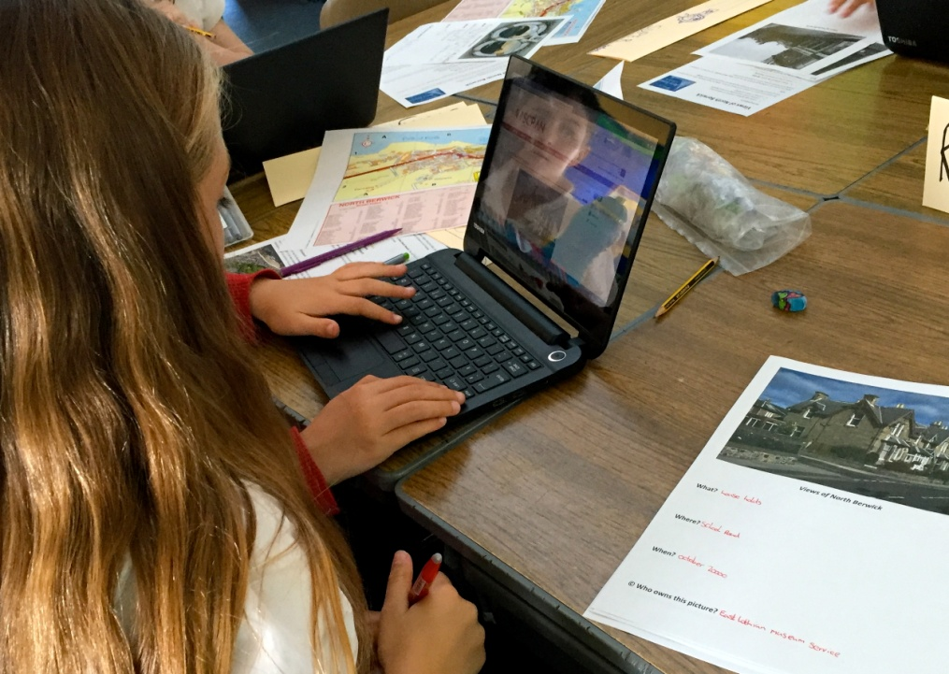
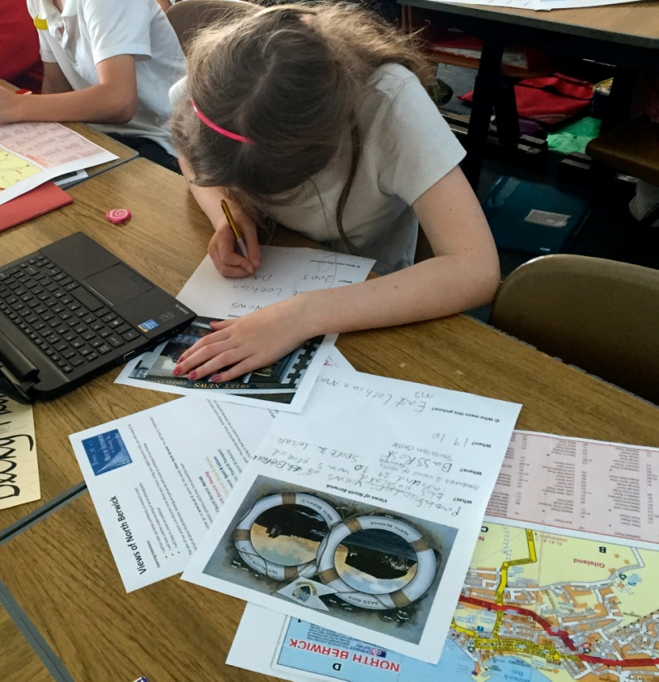
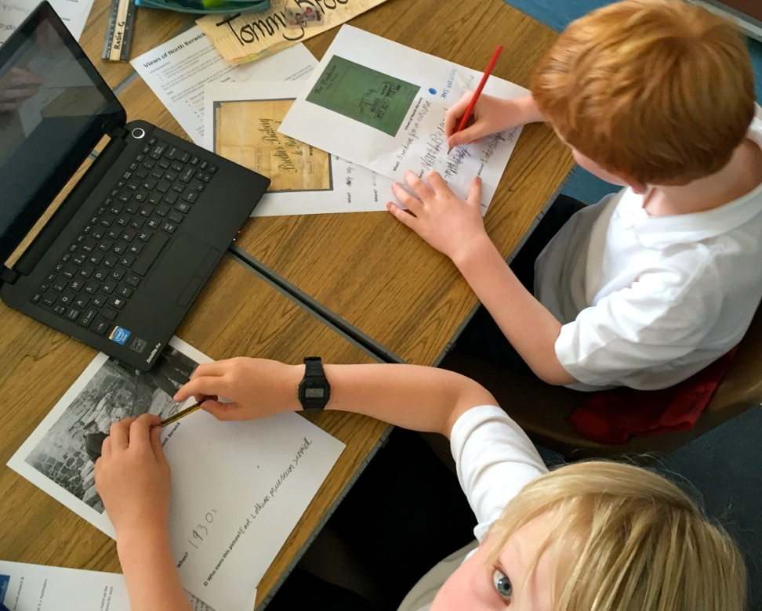

Slide 24
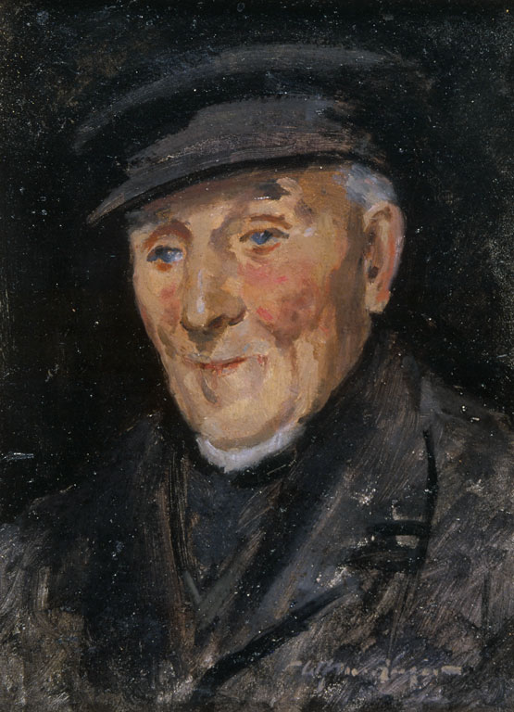
P5 Classroom Activity – Day 2
Wednesday 30th September

Slide 25
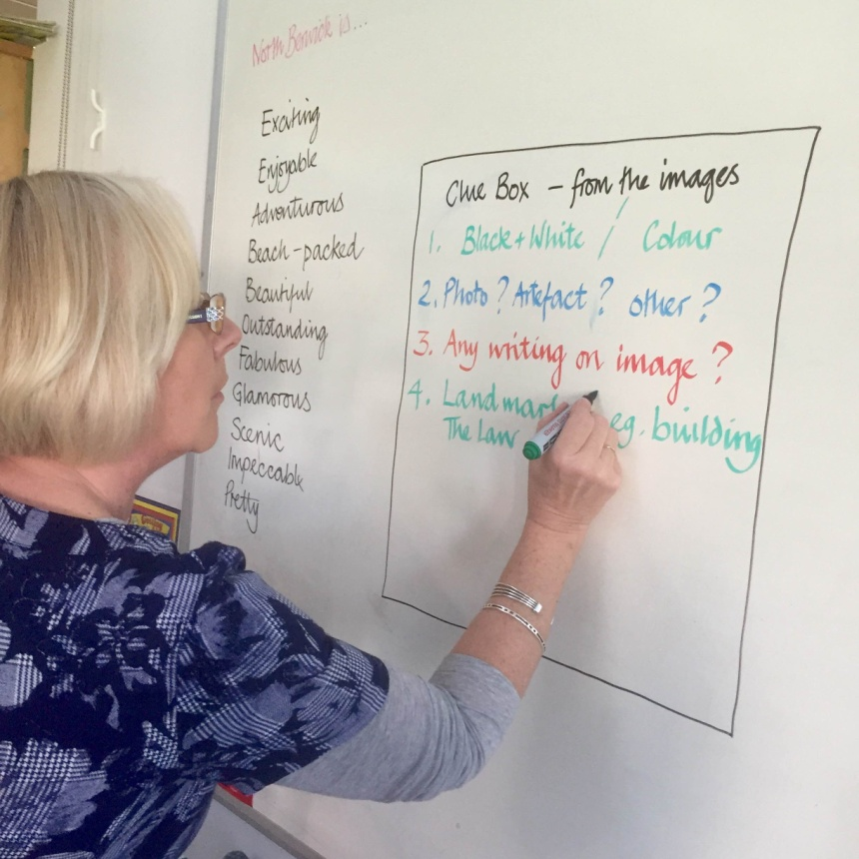
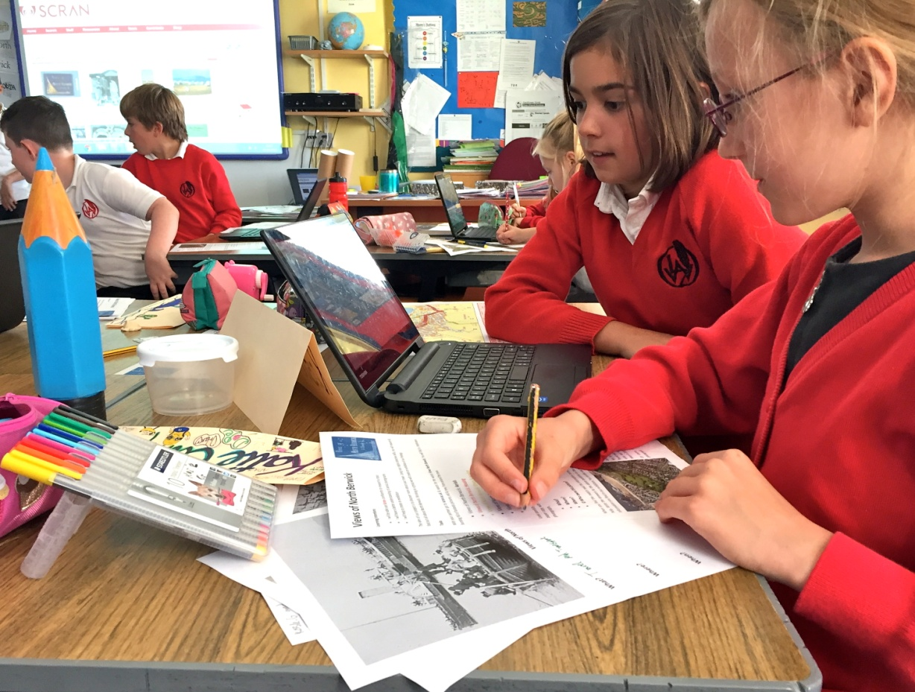

Slide 26
P5 Classroom Activity – Day 2
Working individually
Reading Examples
Language
Visual Literacy & Looking
Creative Writing
Biopoems

Slide 27
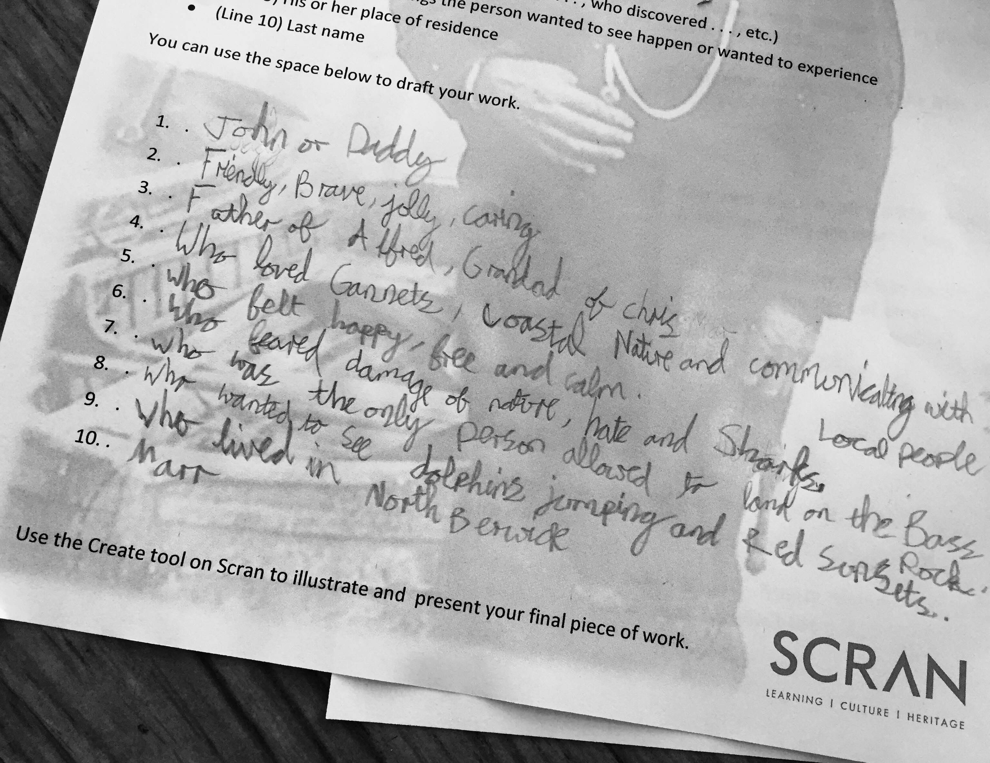

Slide 28
Comment
John Johnston October 5, 2015 at 11:27 am
“I love how you have combined old photos and poetry.
Great job Rosie. It is always exciting to see gannets.”

Slide 29
P5 Classroom Activity – Day 3
Thursday 1st October

Slide 30
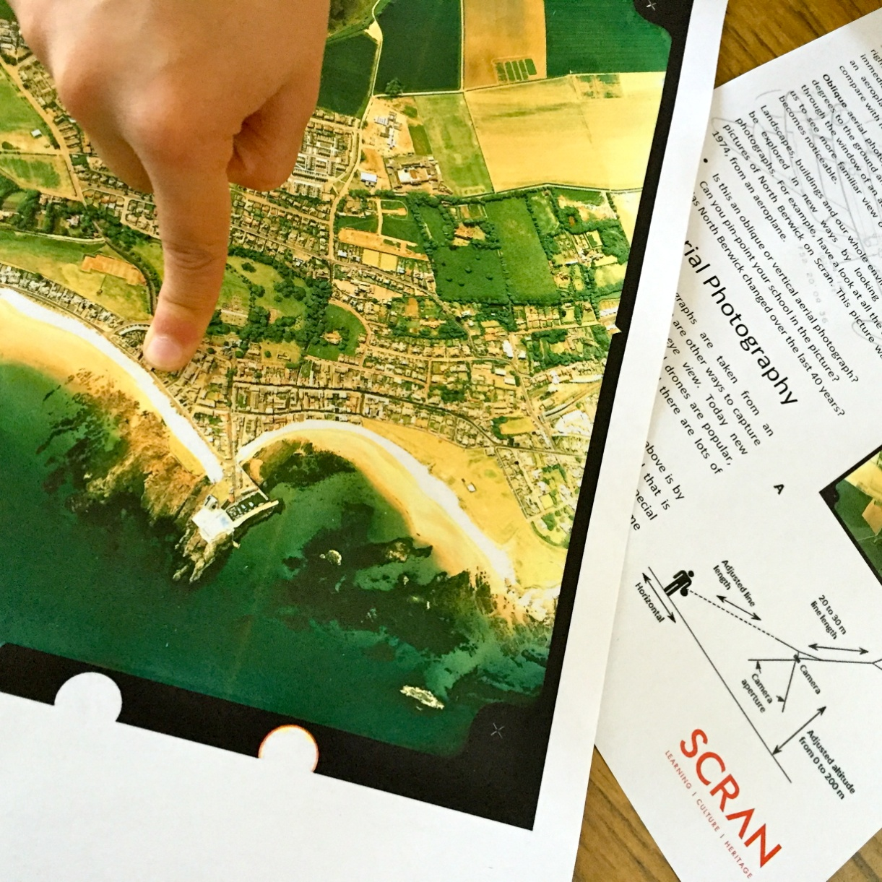
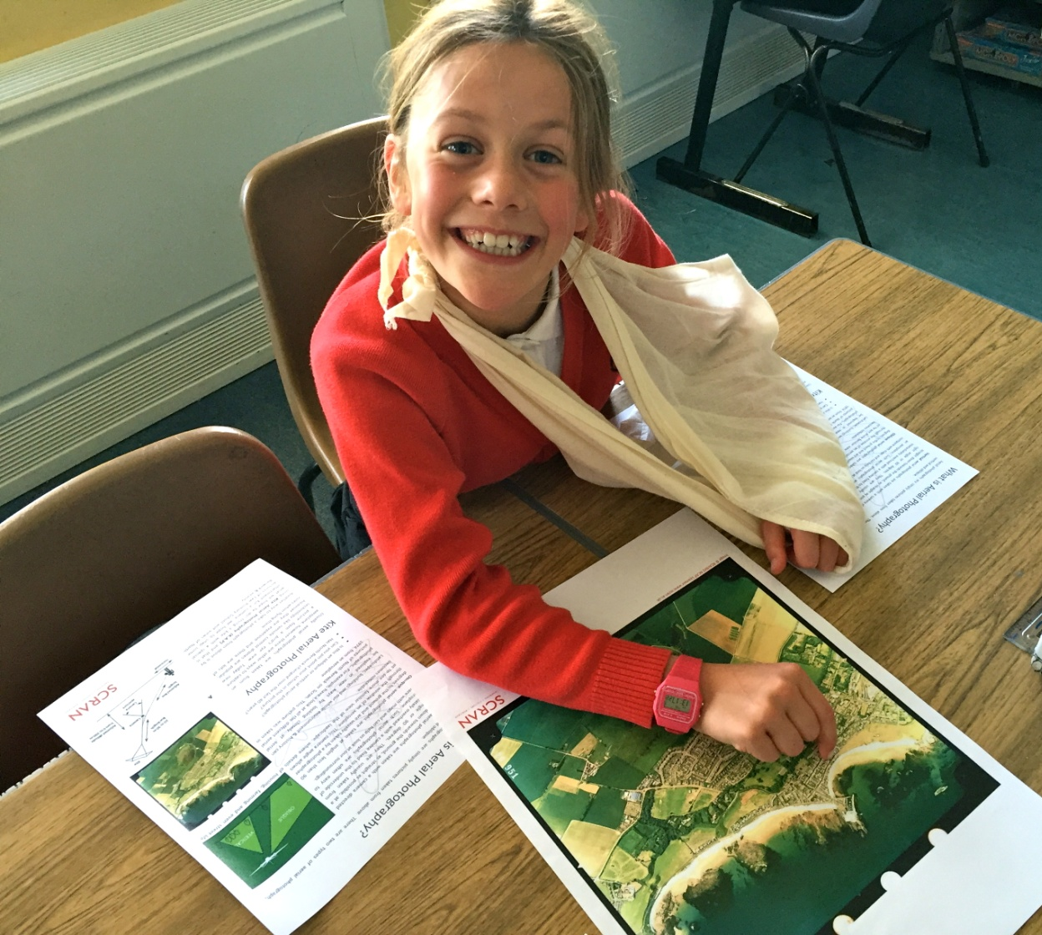

Slide 31
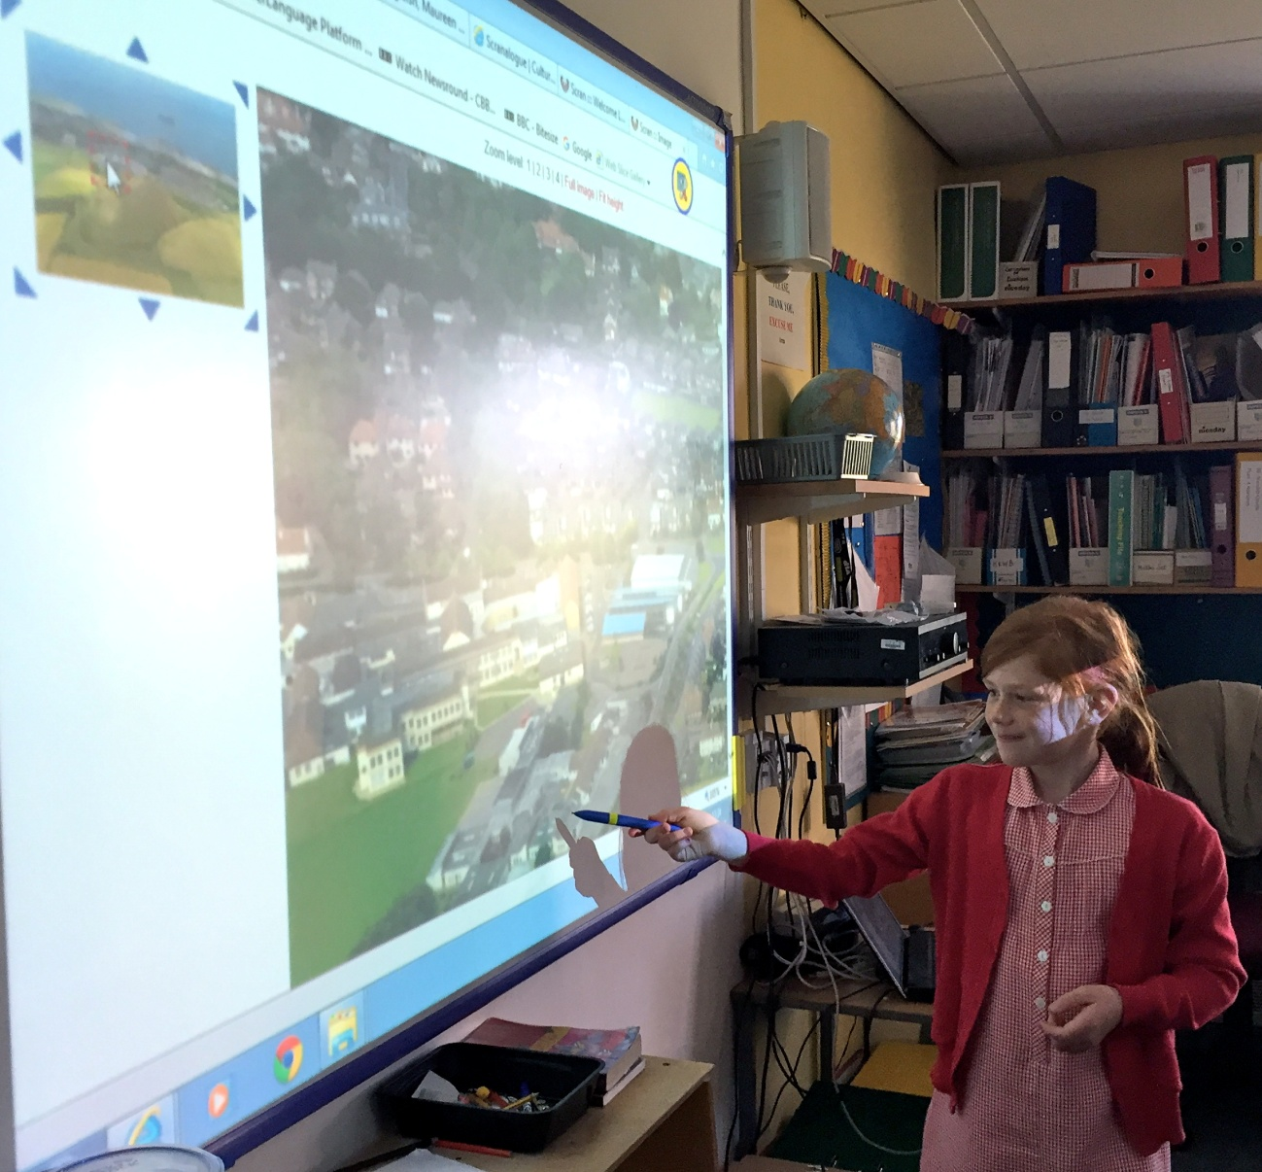
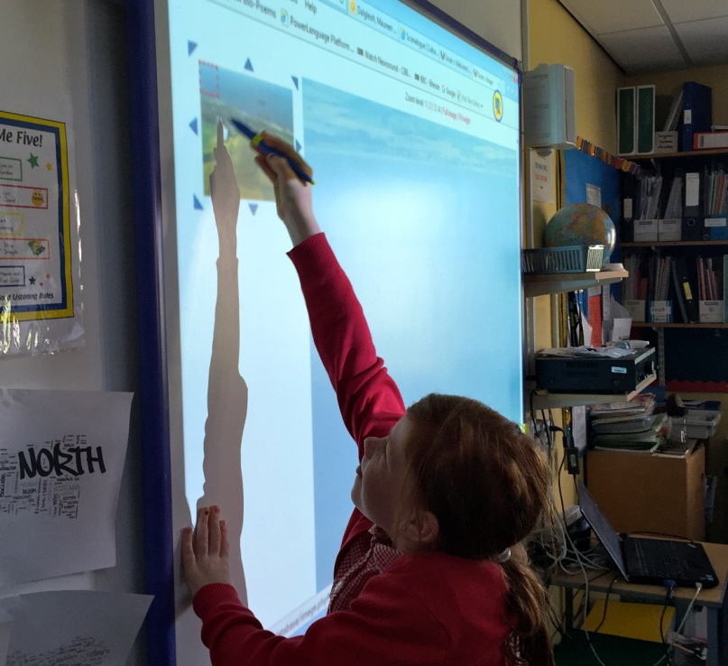

Slide 32
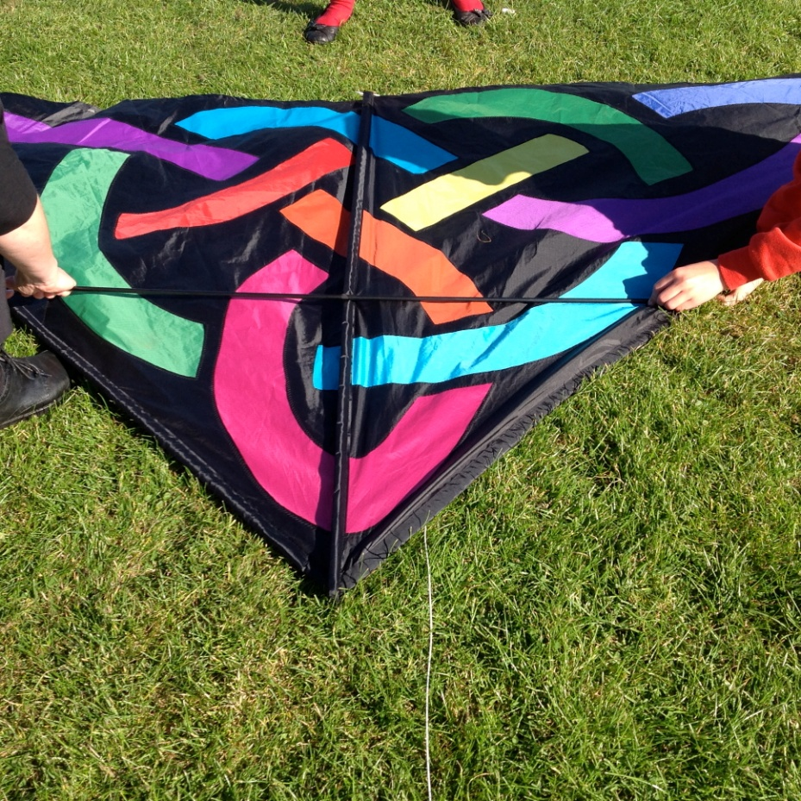
P5 Classroom Activity – Day 3

Slide 33
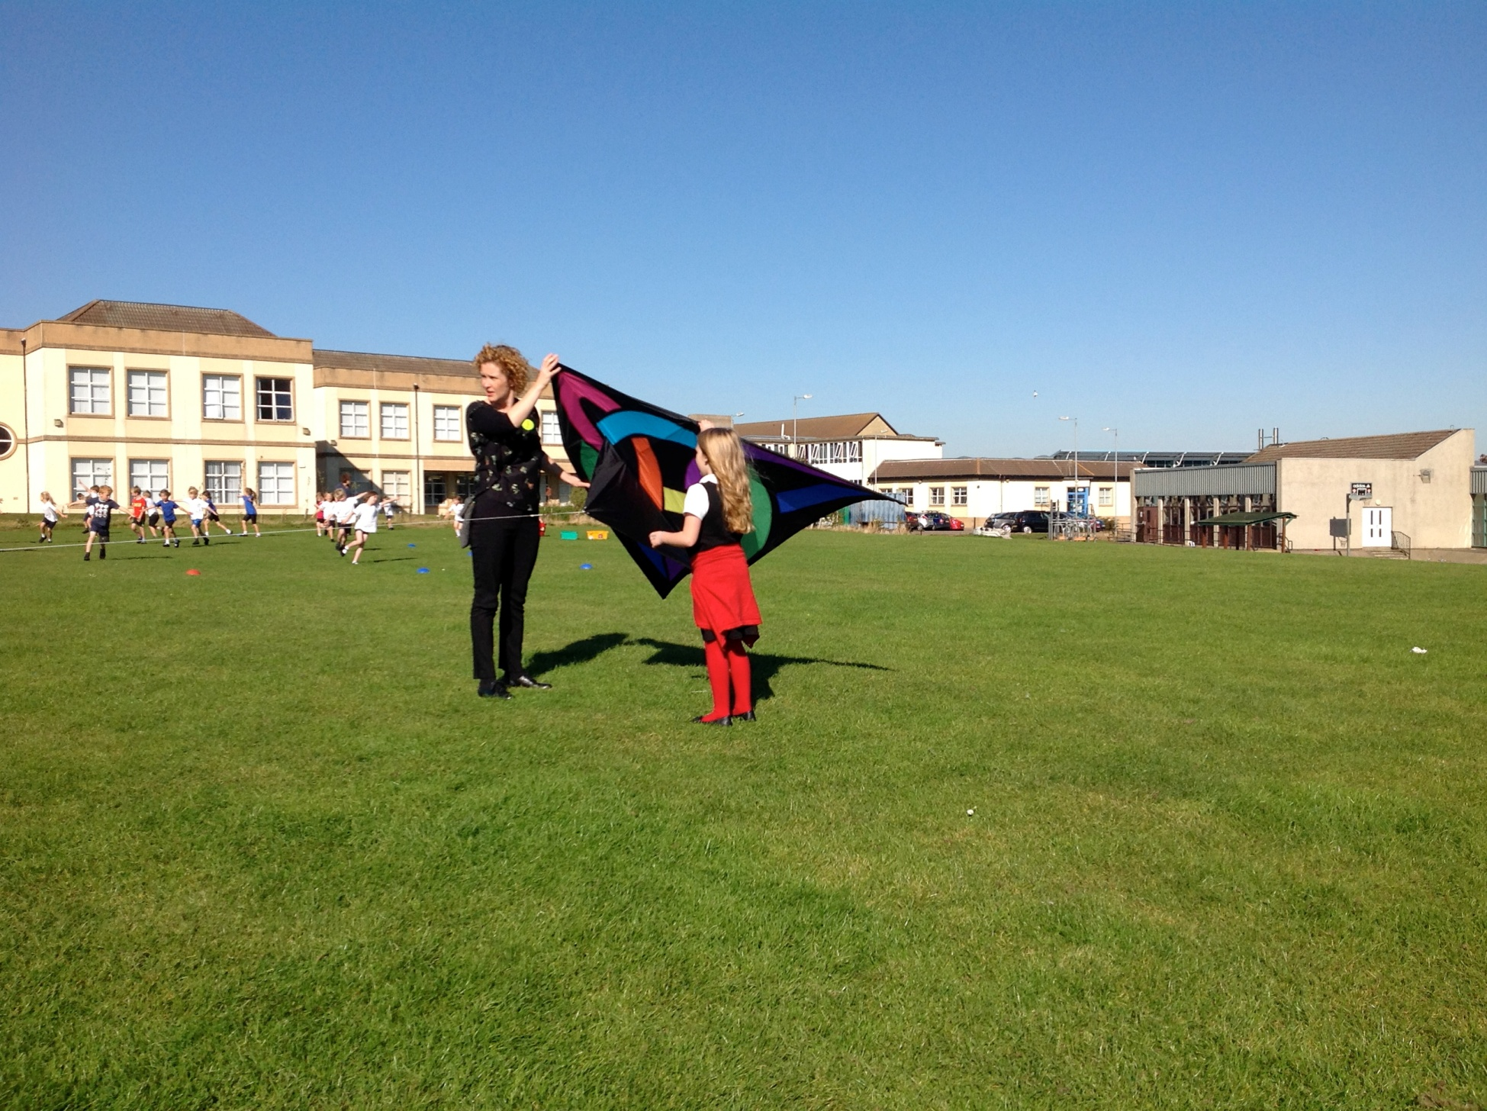
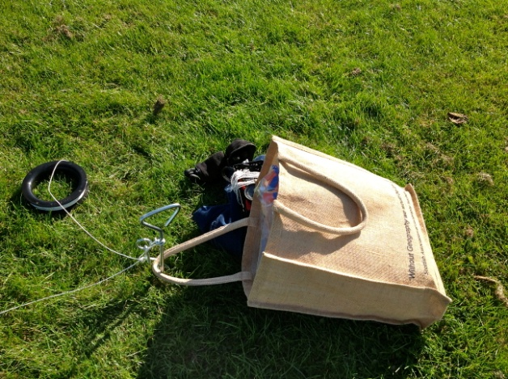

Slide 34
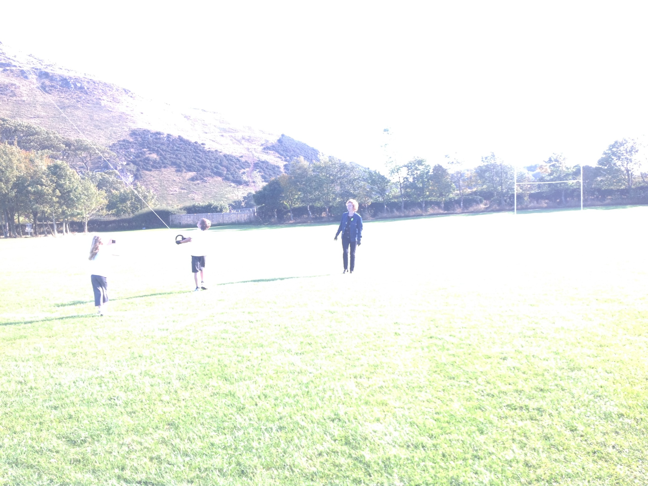

Slide 35
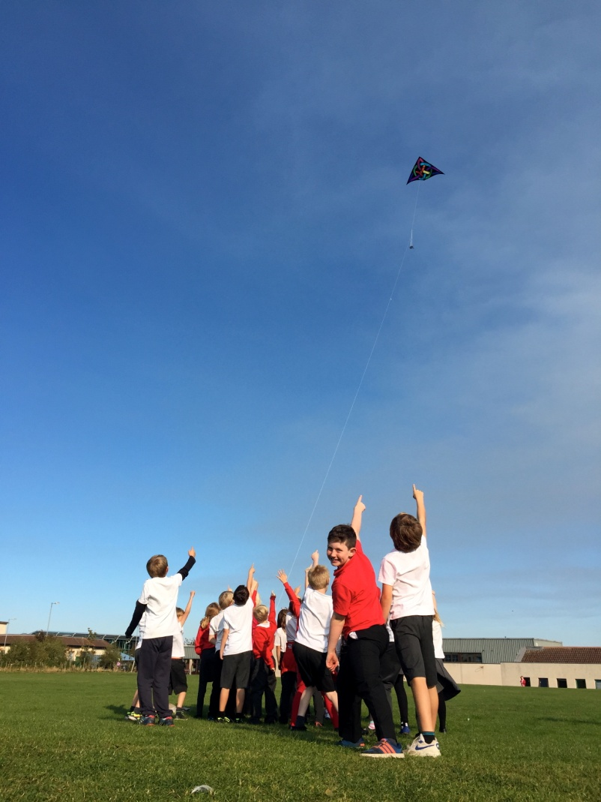
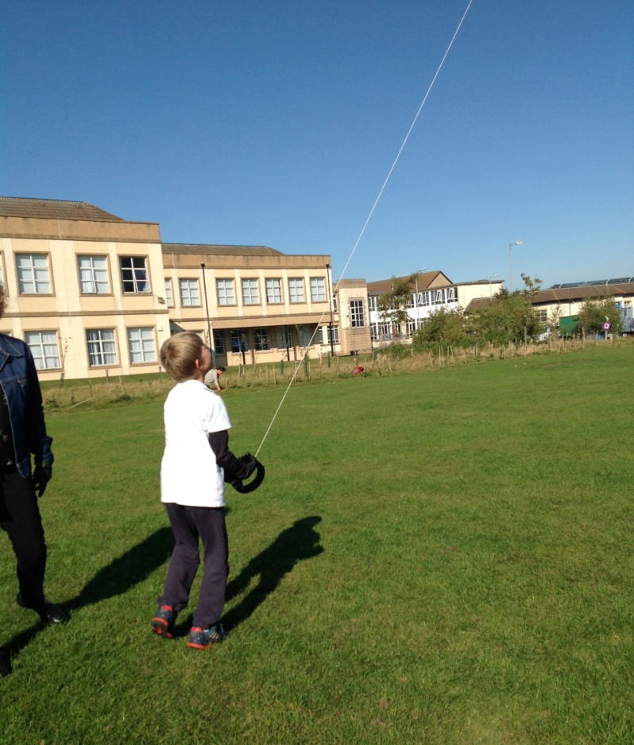

Slide 36
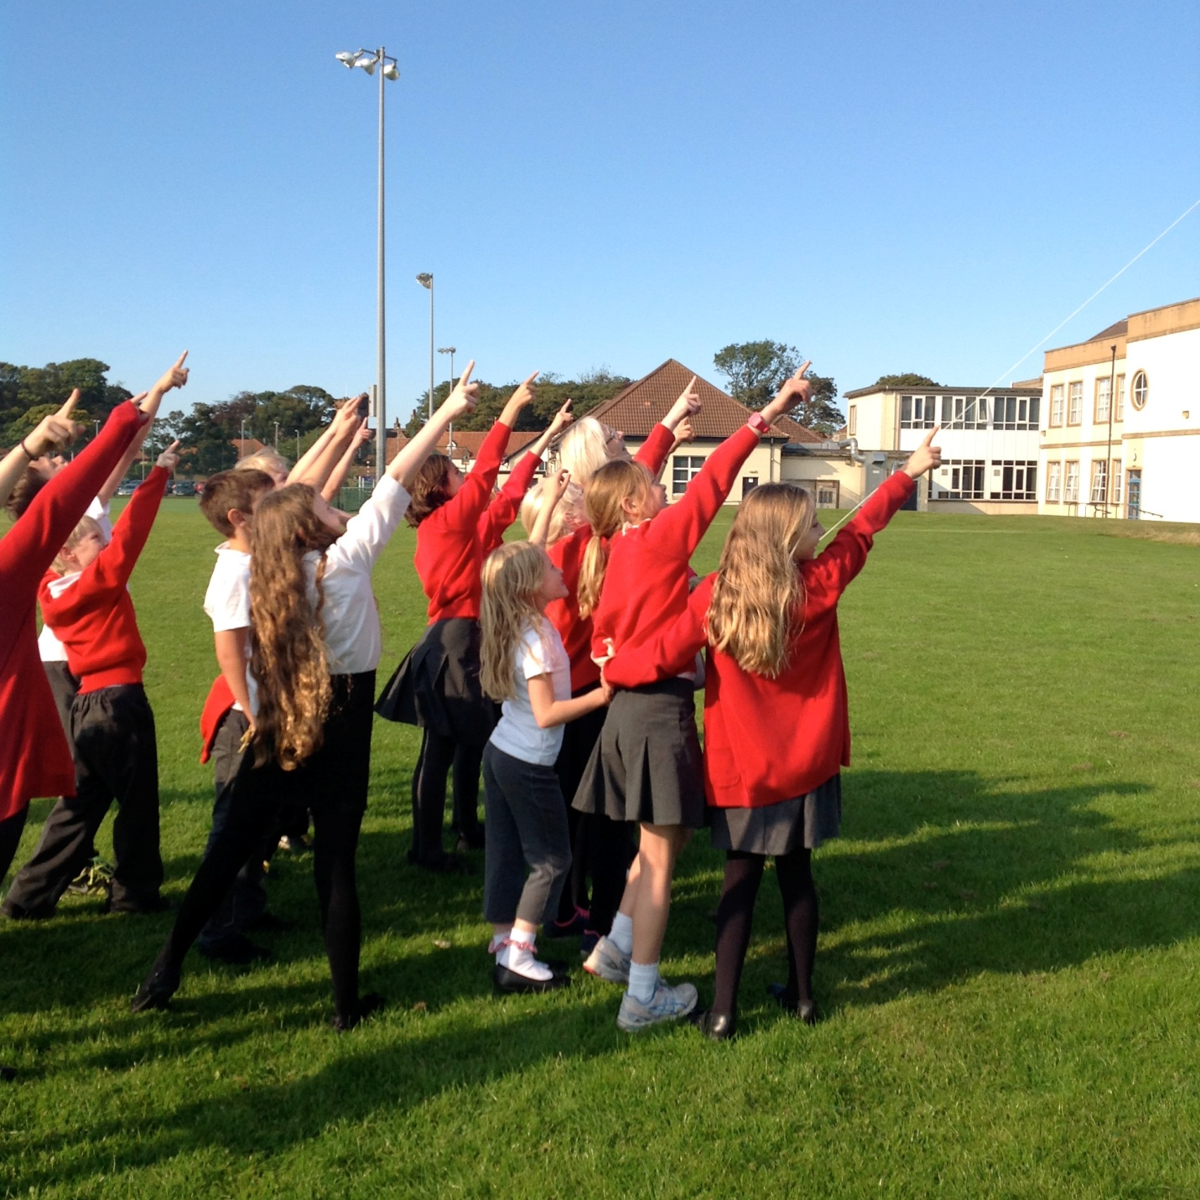

Slide 37
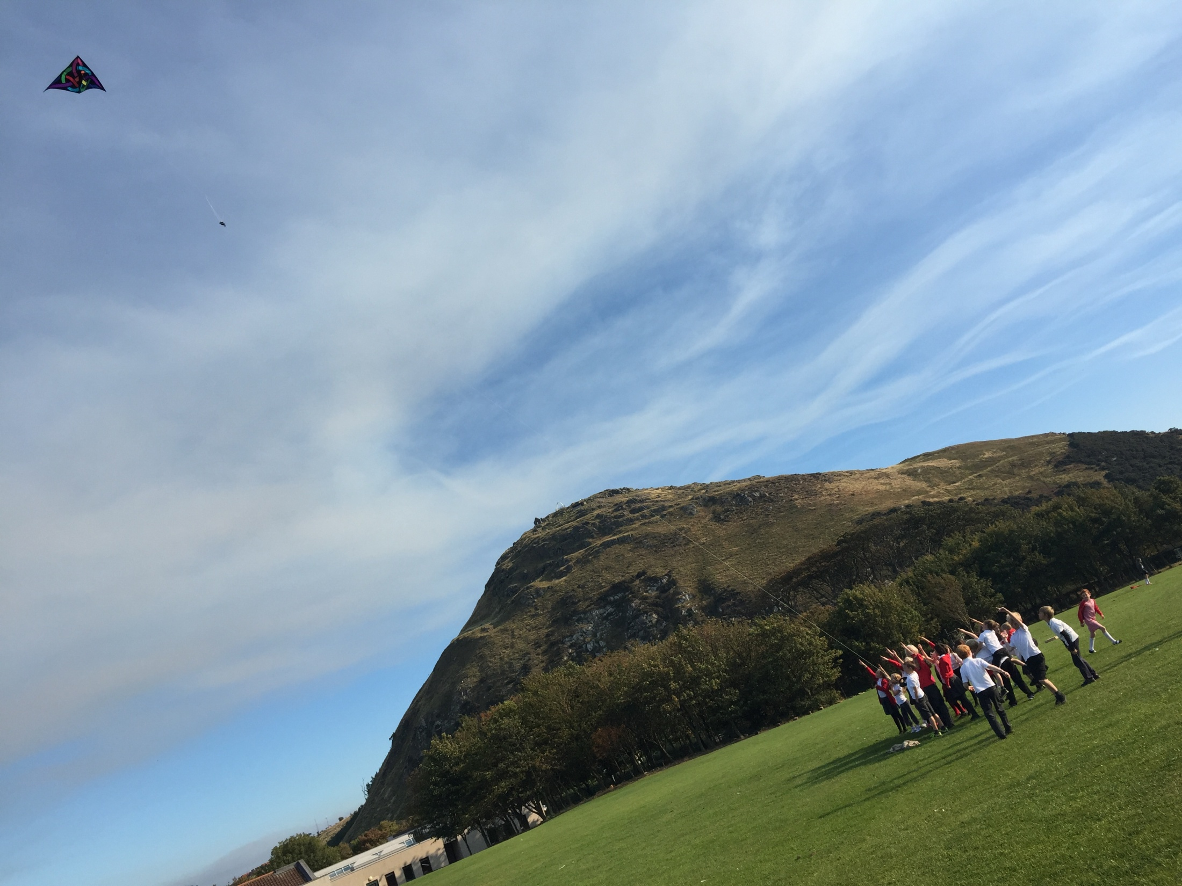

Slide 38
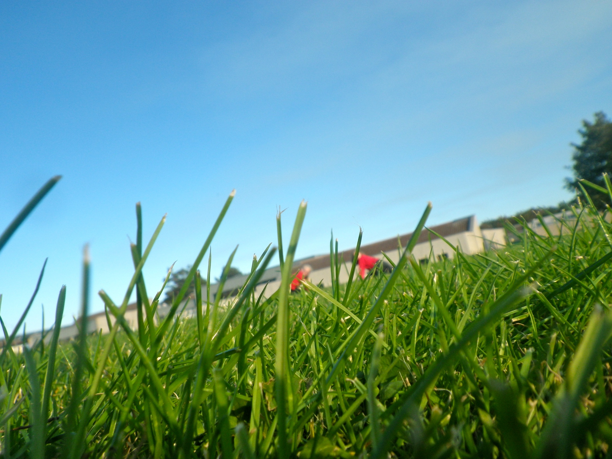

Slide 39
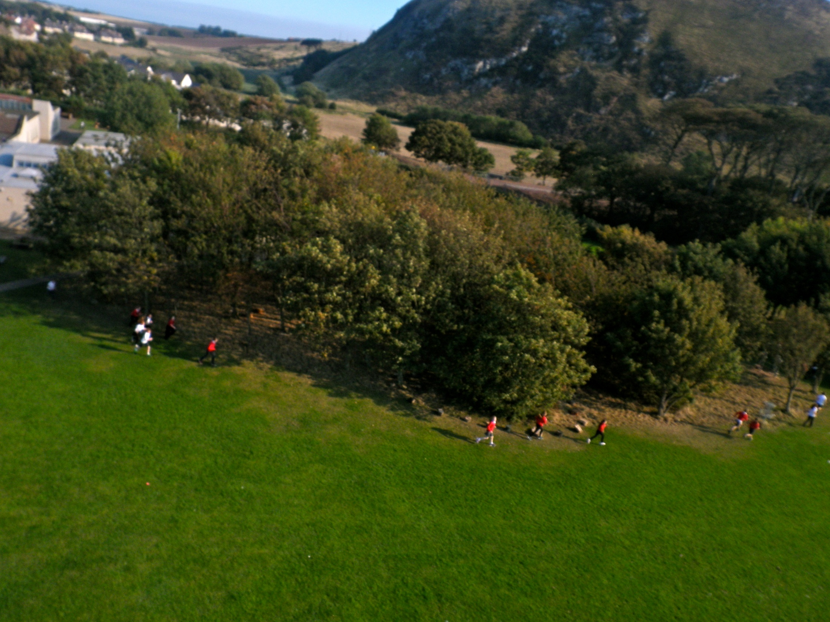

Slide 40
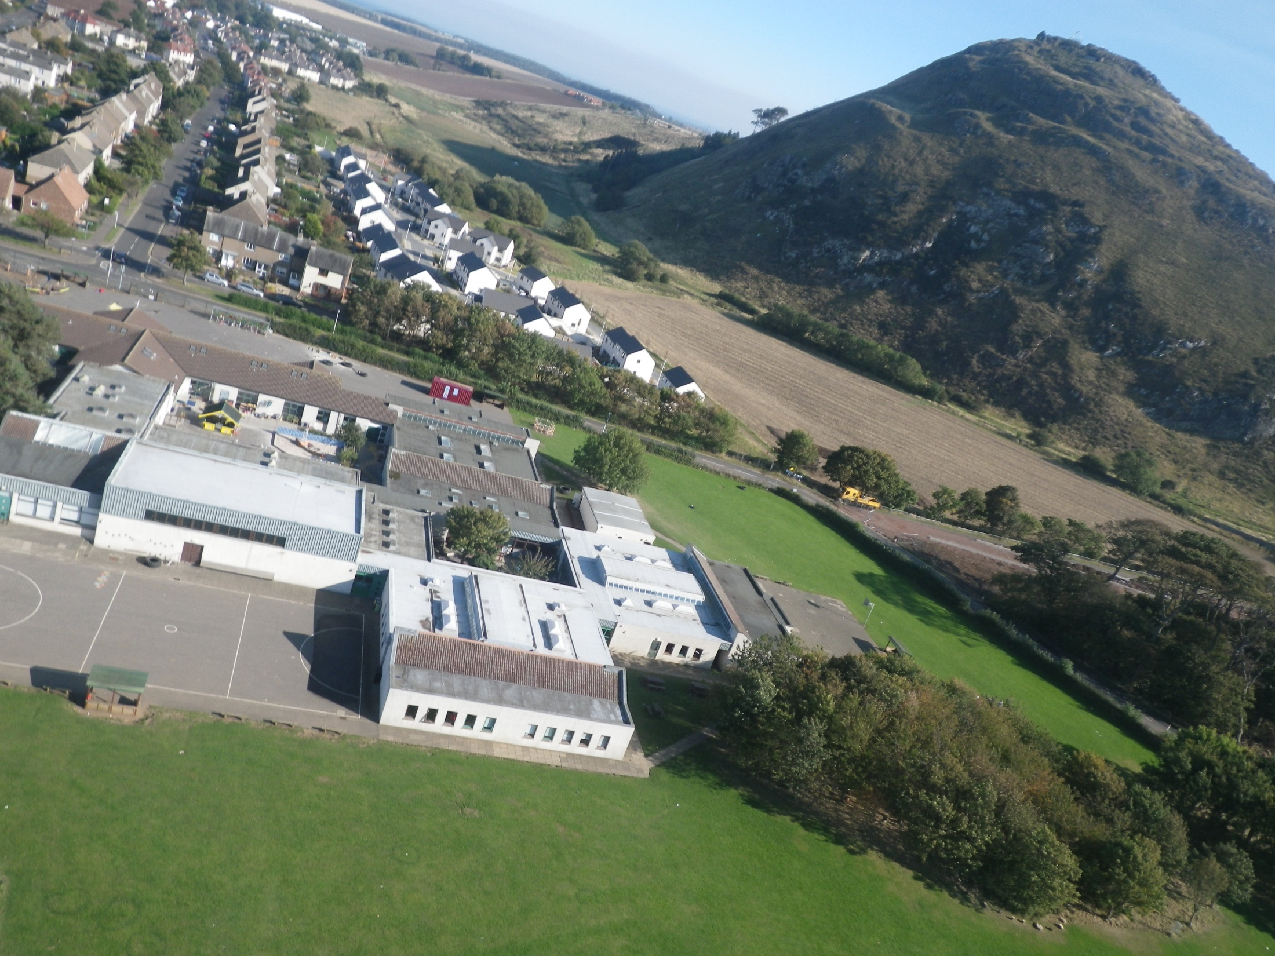

Slide 41
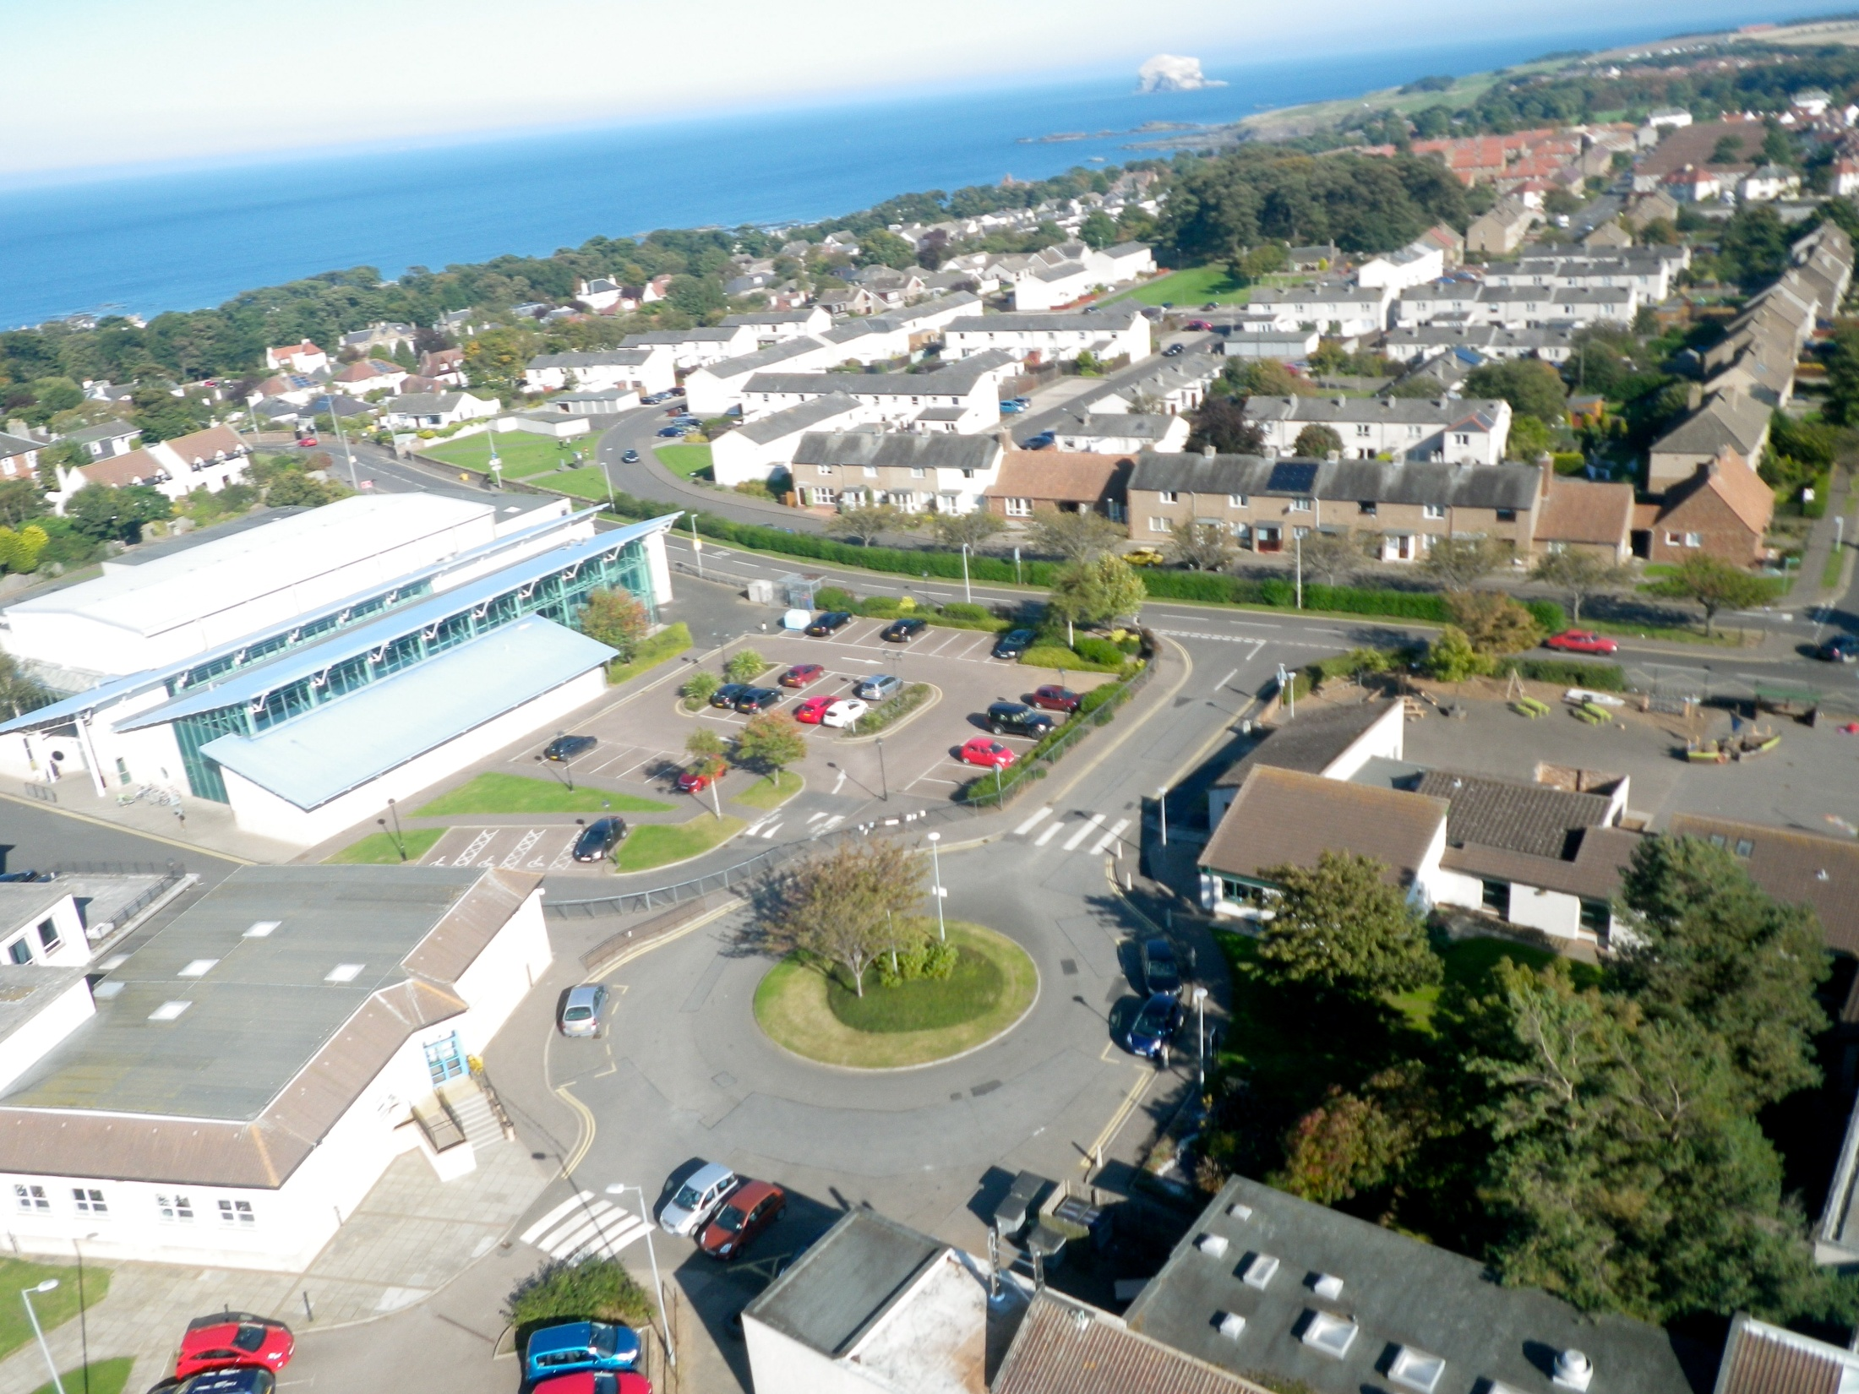

Slide 42
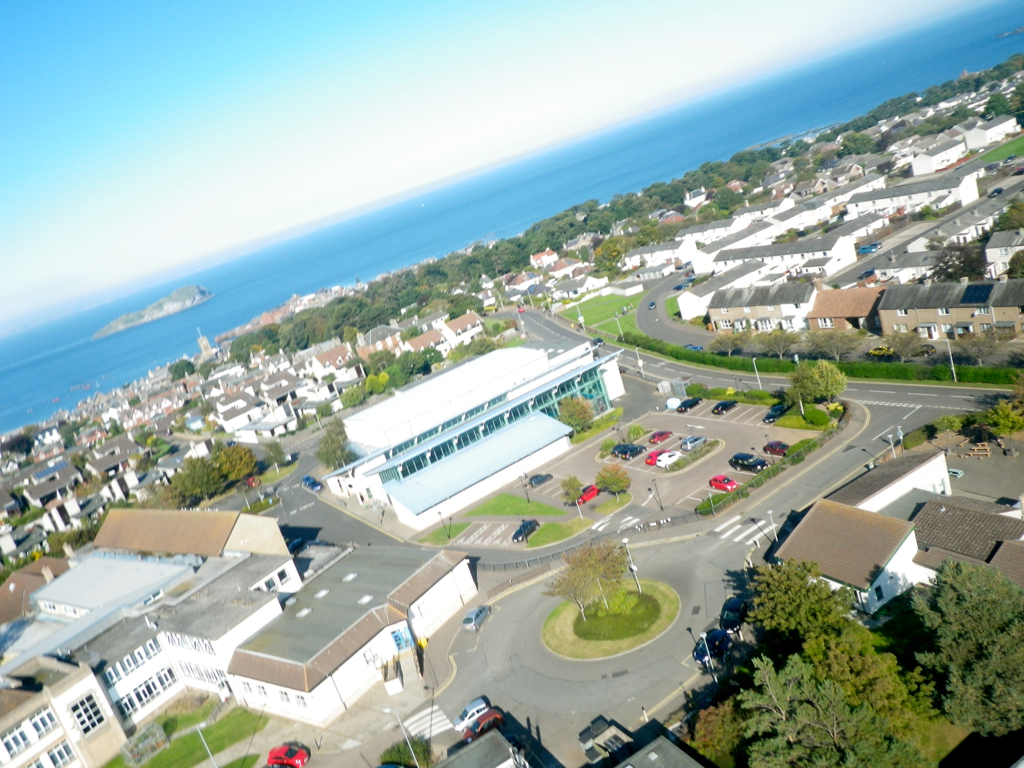

Slide 43
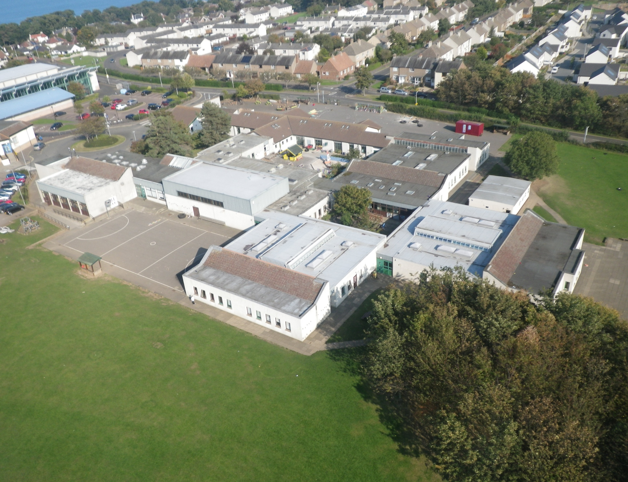

Slide 44
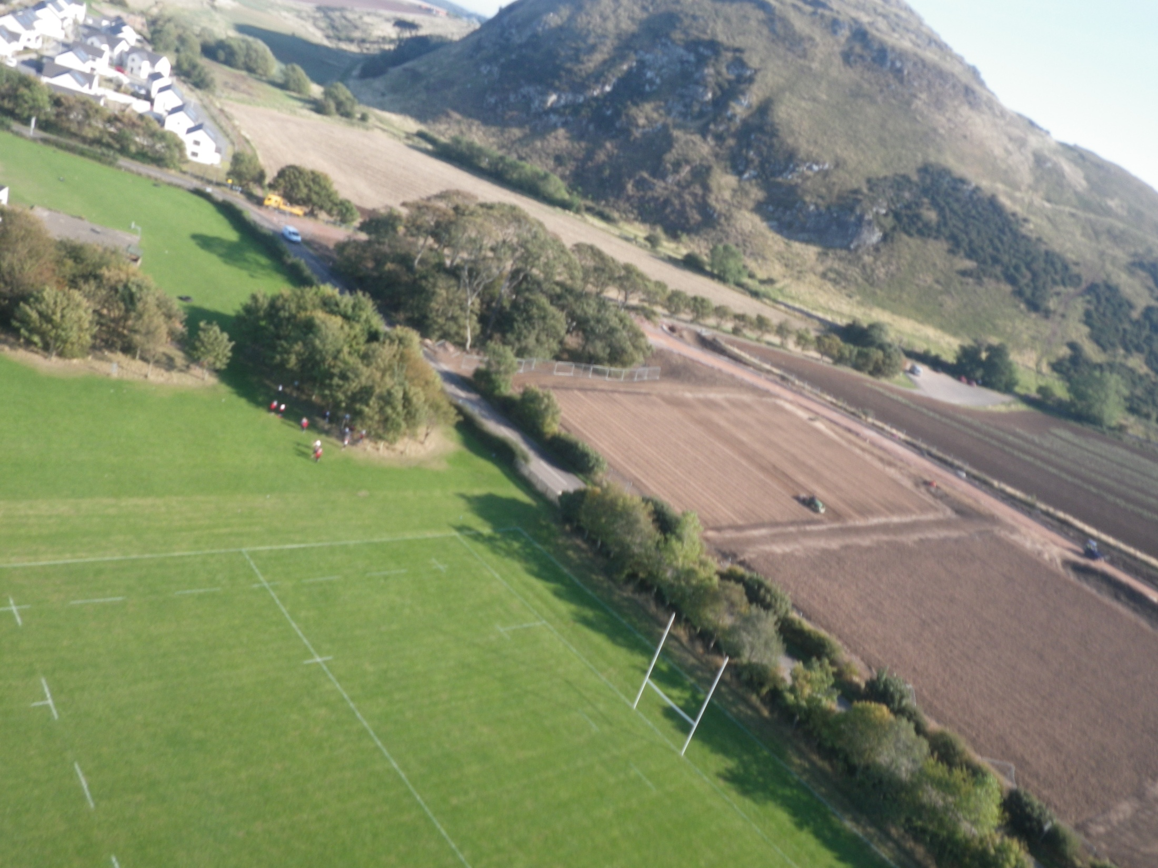

Slide 45
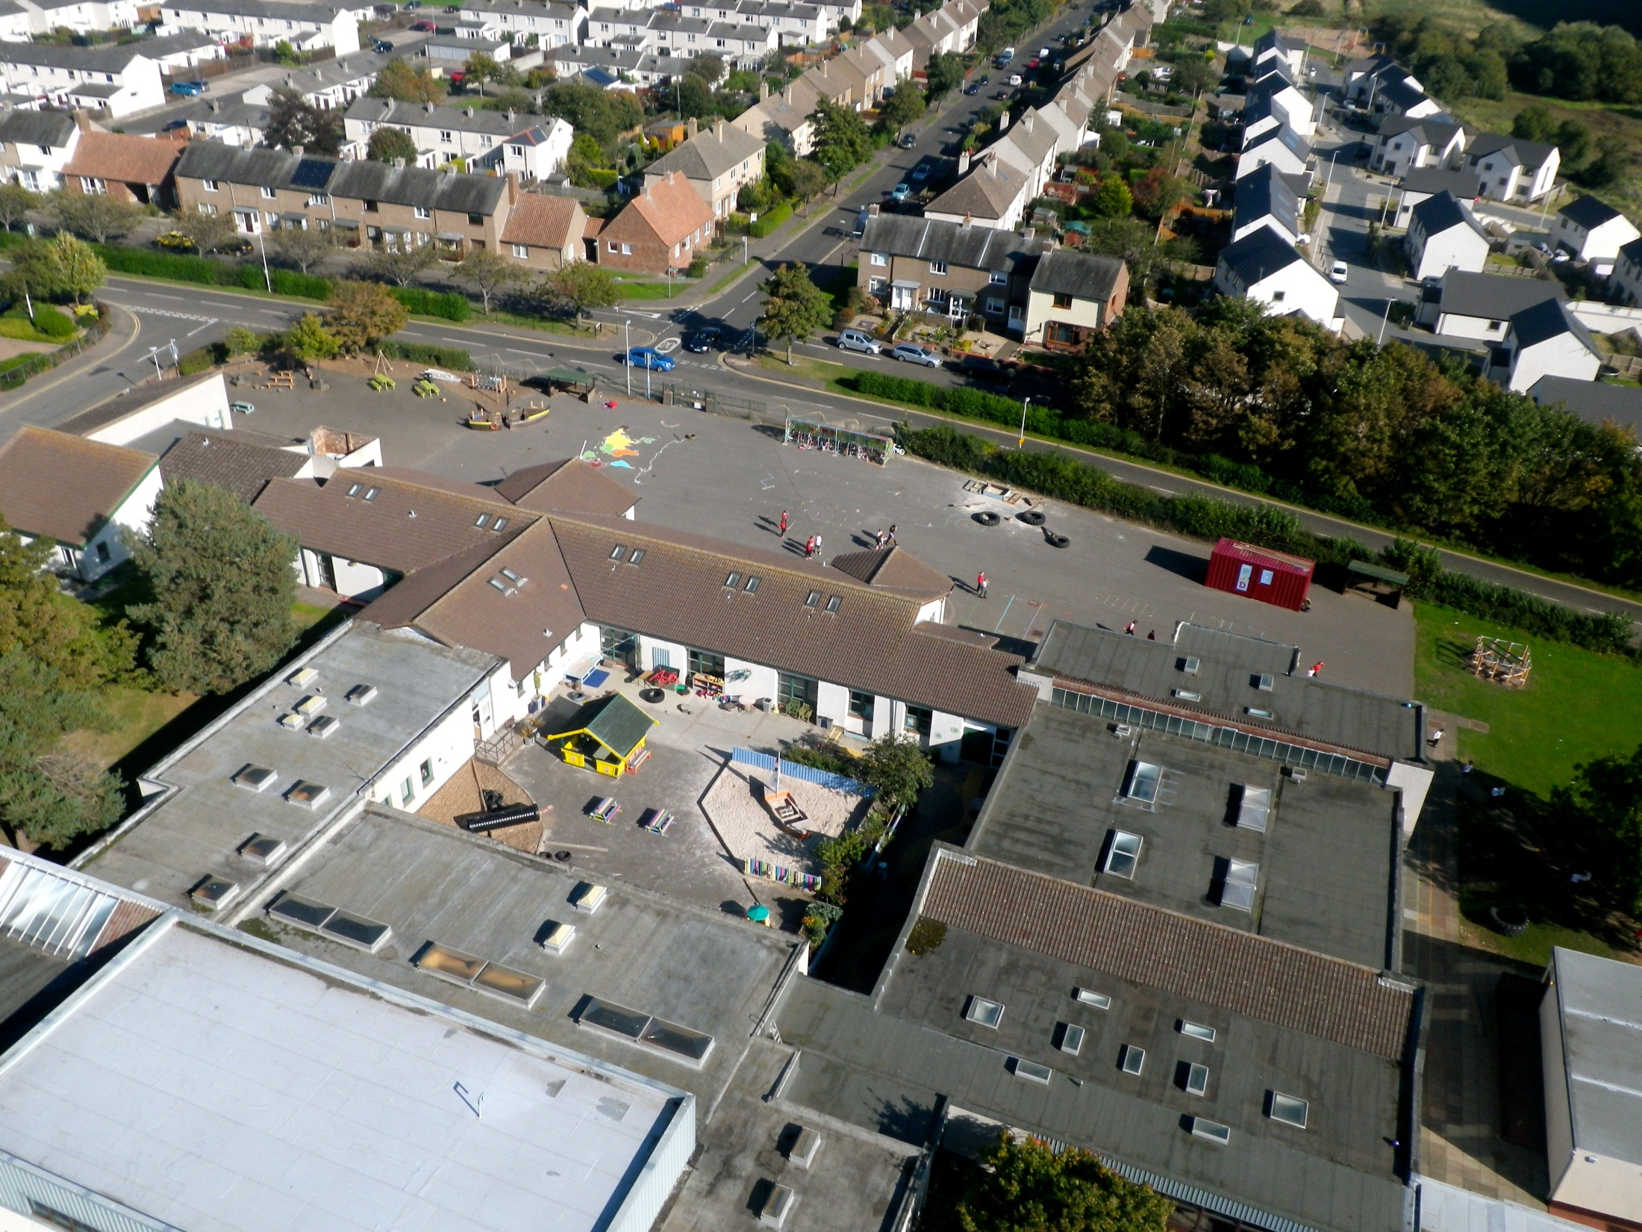

Slide 46
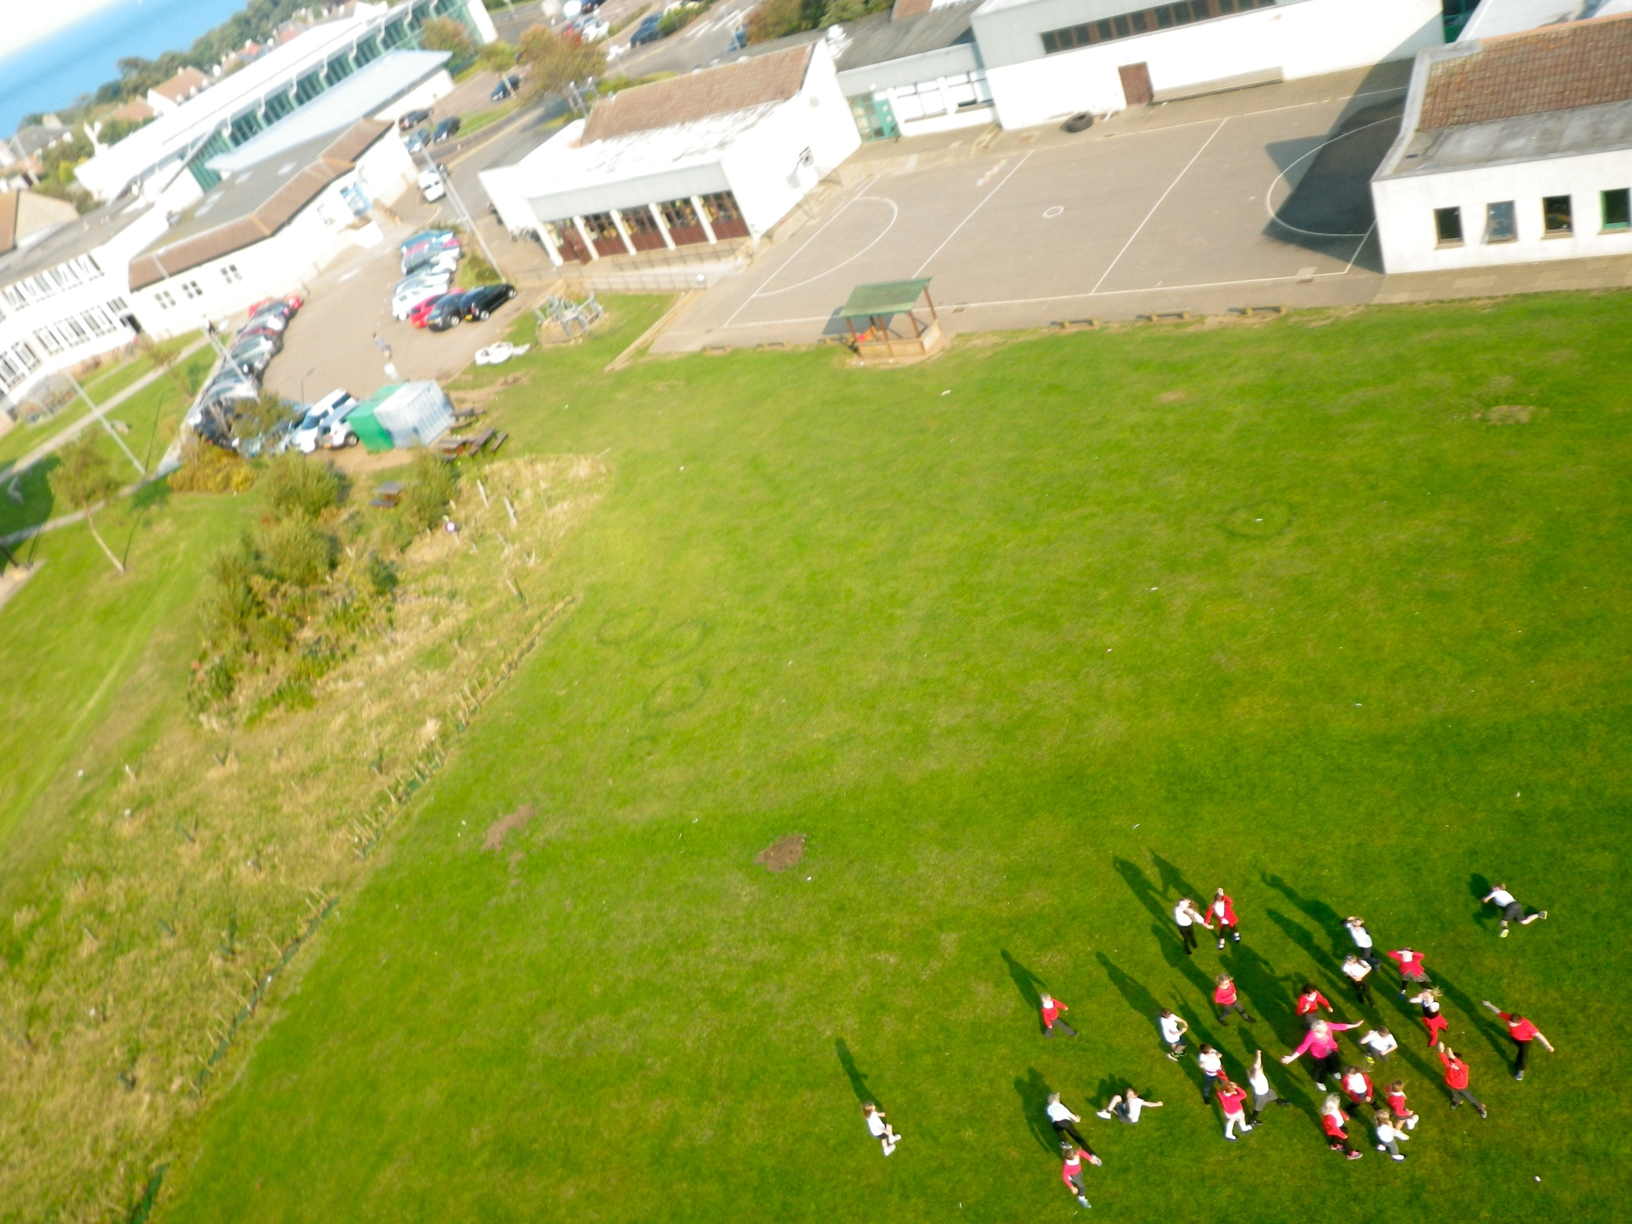

Slide 47
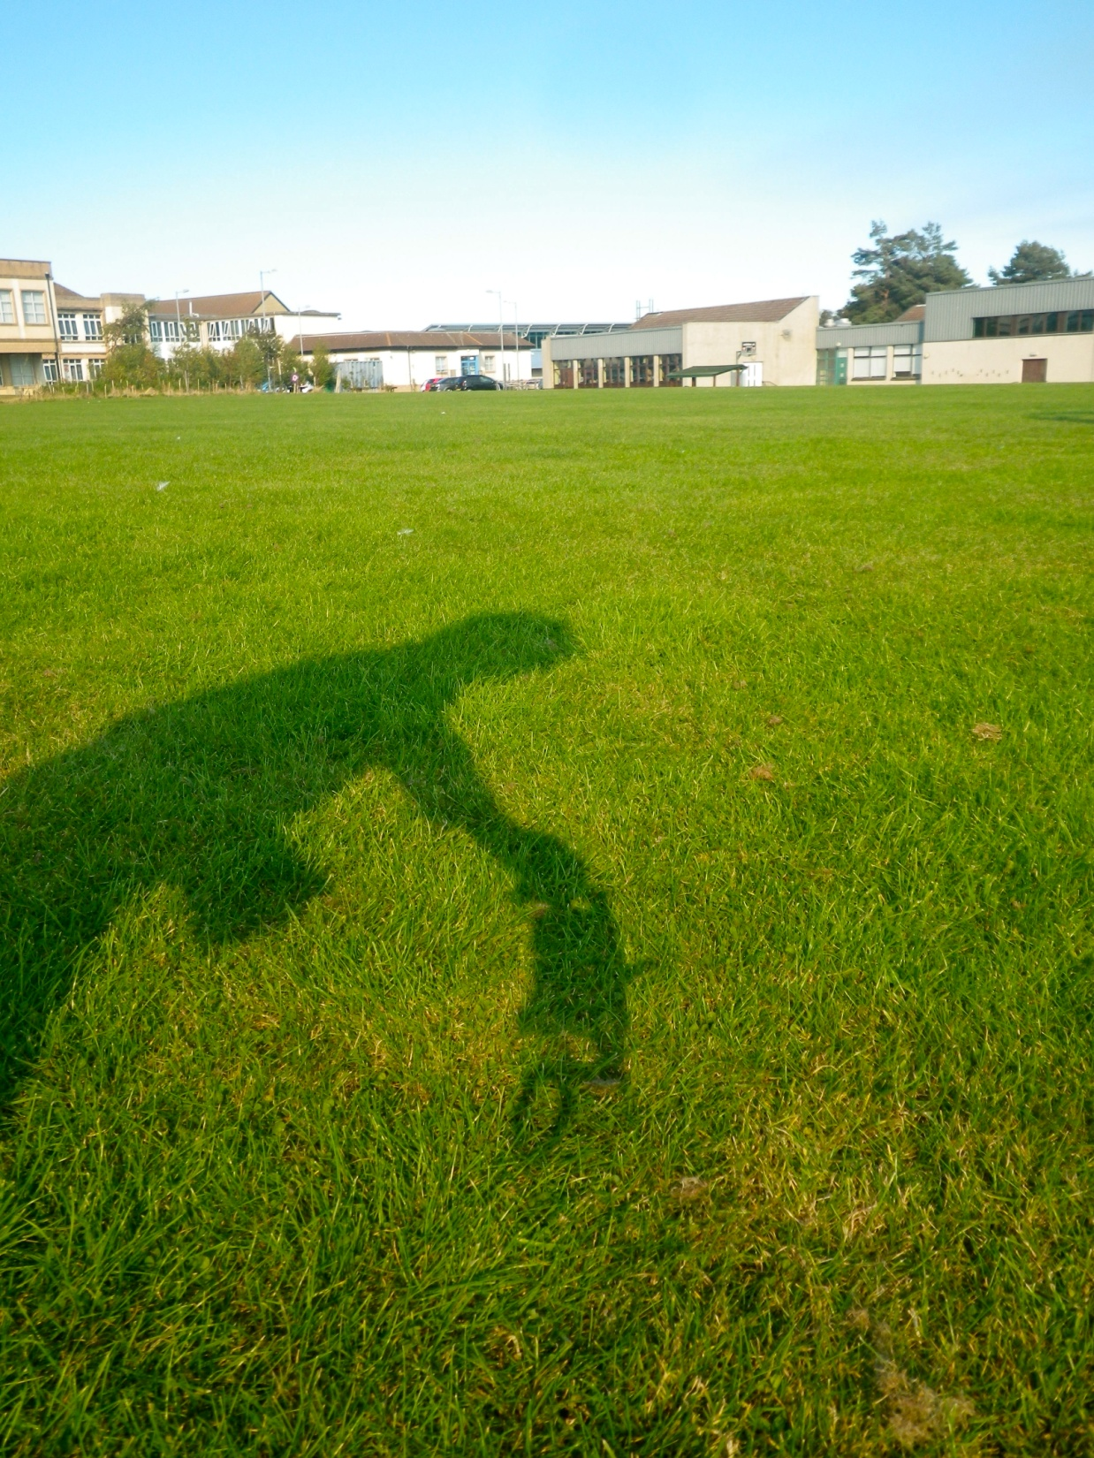
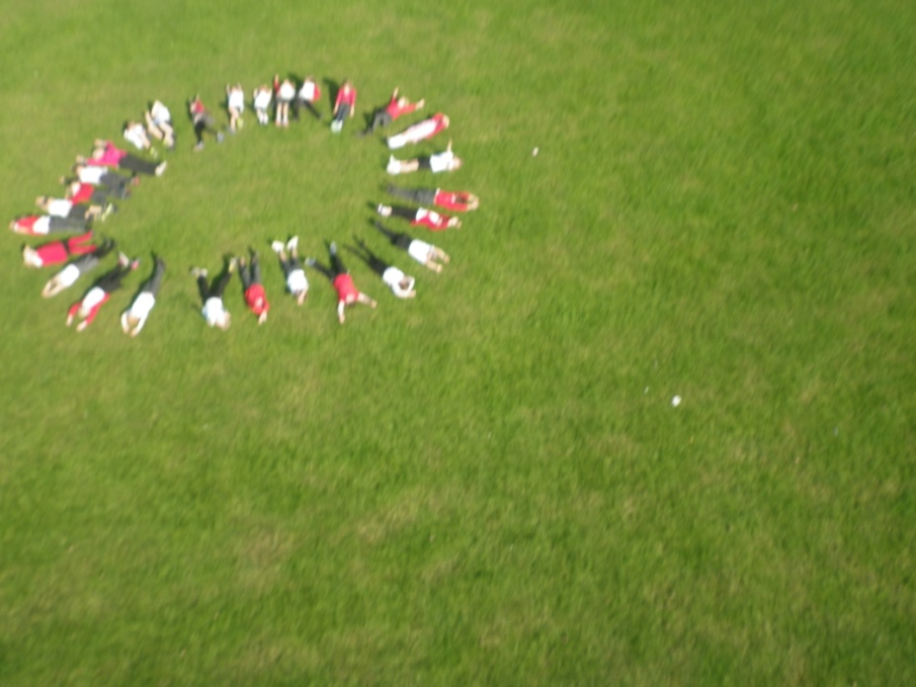

Slide 48
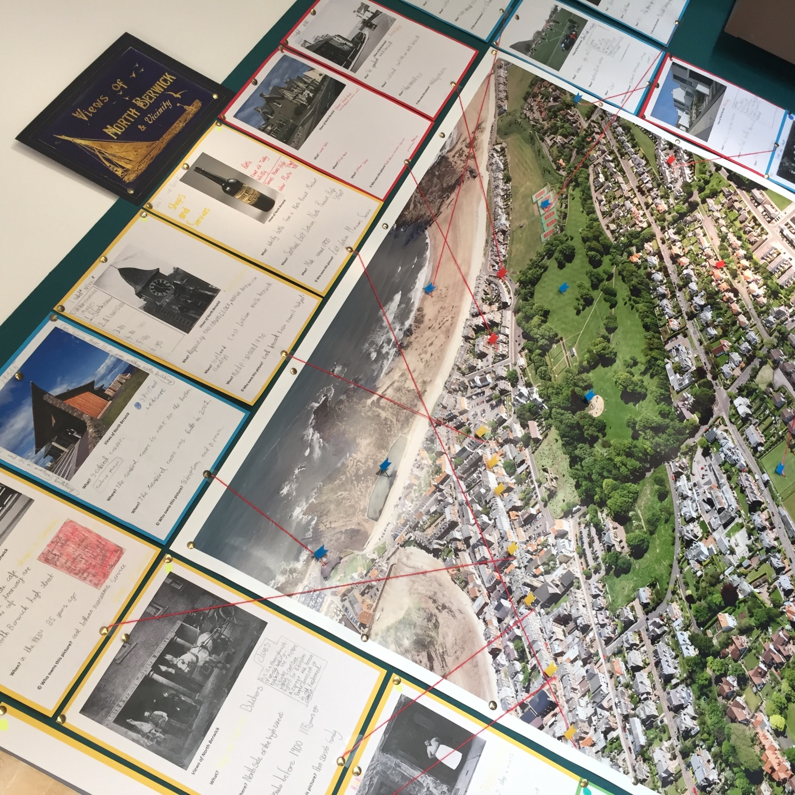
P5 Learning Intentions

Slide 49
I will be able to use Scran confidently to research a topic

Slide 50
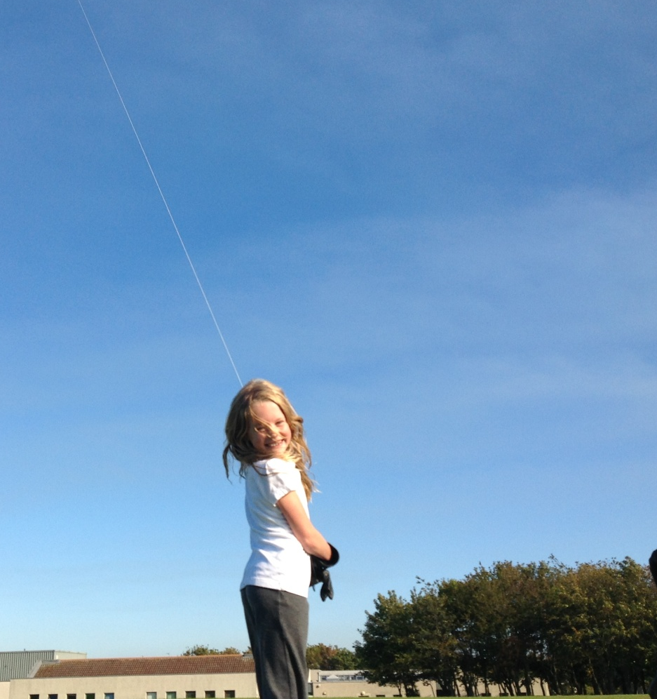
I will have a better understanding of aerial photography

Slide 51
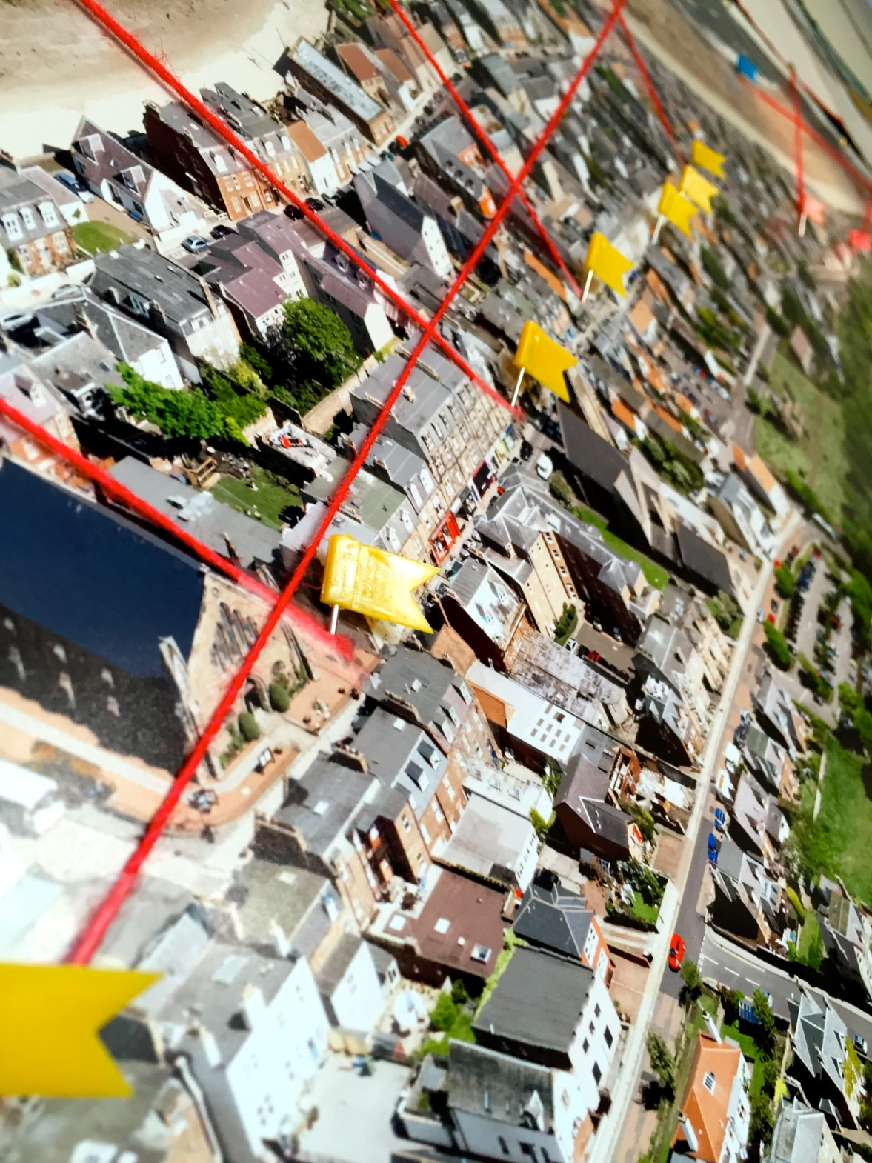
I will help to create an exhibition

Slide 52
Second Level Experiences & Outcomes

Slide 53
Let’s go explore

Slide 54
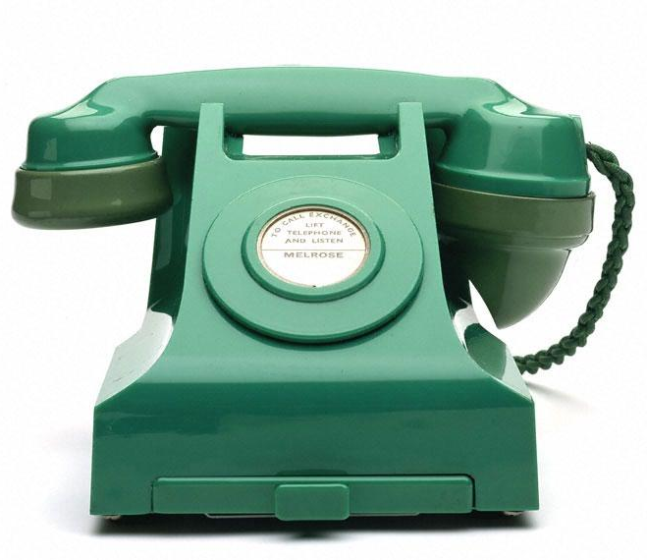
help & contact
0131 662 6817
jackie.sangster@rcahms.gov.uk

