Slide 1
Fire Microteaching PPT

Slide 2
Fire as A Natural Hazard
“A large destructive fire that spreads quickly over woodland or bush” (Oxford Dictionary)
Start in rural – migrate to rural urban fringes = effect on buildings, people and environment.
Causes of fire
high temp + drought + lightning/arson = uncontrolled fire
Everywhere except Antarctica
Australia most prone to fire – average 2000 wildfires a year

Slide 3
Scientific B/G
Some places in the world are extremely prone to fire, some countries live within the ring of fire. (See picture)​
We are better at preparing for natural fires such as a forest fire due to concise weather exports that indicates if it is to be too warm which could cause a fire.​
The equipment we have is now more advanced meaning if a fire was to break out we have better chance of putting it out quickly​
Although fire still devastates millions each year, we have decreased significantly from the 1900 were equipment and technology was not as advanced as it is today causing more widespread disruption and more loss of lives.

Slide 4
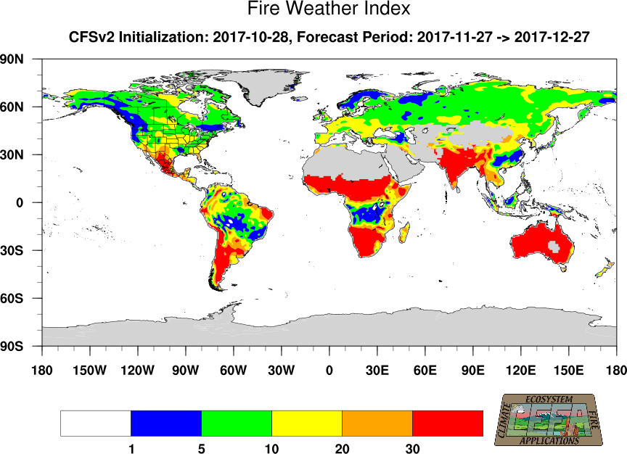
Scientific Background

Slide 5
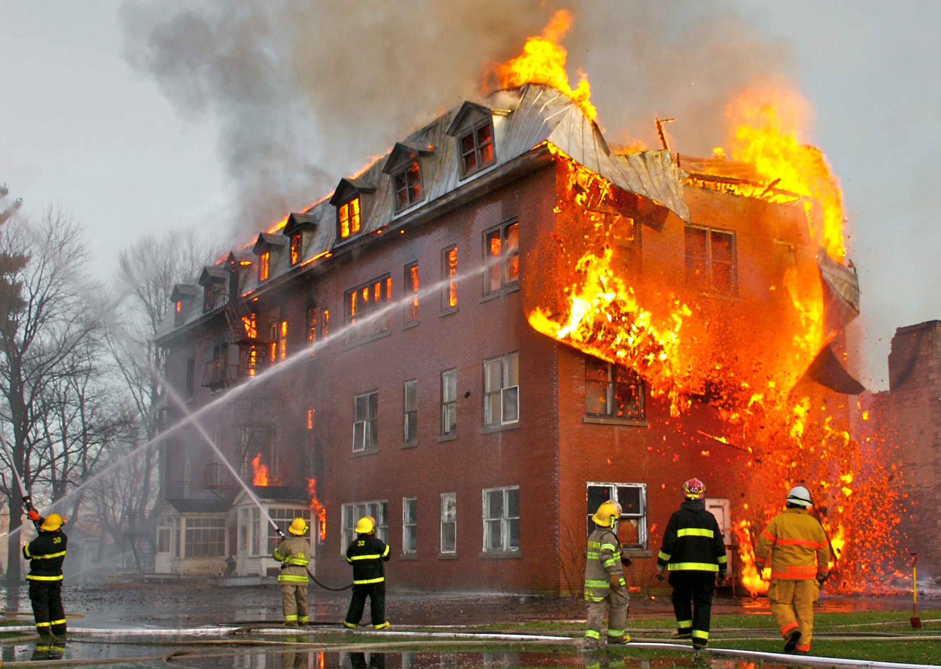
Humans can cause fires too!
Human factors can also determine the nature of if a fire is to start.
This is due to:
Wealth
Education
(Petra Tschakert et al, 2017)

Slide 6
Facts and Figures
US - 5.6 million acres of land has burned this year, or 1.8 million acres more than the ten year average of 3.8 million acres burned by this time across the US. 2017 is the worst fire season in 15 years
https://www.youtube.com/watch?v=Et8seg5aSjI (AJ+, 2015)
CANADA - record breaking 94 degrees in summer of 2017 when the average is 74 degrees
EUROPE – 60 people died over one weekend due to a wildfire in Portugal in 2017
(Kendra Pierre-Louis, 2017)

Slide 7
Mitigation
Common in areas where agriculture is a main source of income - farming and ranching land.
More than 50% of agricultural fires involve bushes or grass
1/3 are equipment fires that involve vehicles, processing equipment, fixed wiring, heaters and torches.
The US Fire Administration created a basic fire prevention preparation in order to make
dealing with fires a little easier.
Identifying and minimising the risk of possible fire hazards in the operations and
residence while removing highly flammable and combustible materials and accelerants
where they are possible.
Facilitate fire services response by working closely with the fire department
to make sure that adequate responses are made in the case of a fire
providing a list of stored fire hazards and keeping the fire department up to date regularly.

Slide 8
Mitigation
The state of Colorado in the US is very vulnerable to fires as many parts of their land are in the wild land urban interface (WUI) which is any area in where man made improvements are built close to or within natural terrain. And flammable vegetation, where high potential for wildland fires exist.
The Colorado State Forest Service (CSFS) is the lead state agency that fuels in mitigation expertise in Colorado and they have many different resources that help people to gain more information and helps to decrease the threat of wildfire to different types of properties.
The CSFS develops many education materials and programs to assist homeowners, landowners and communities in order to try and decrease the risk of wildfires.

Slide 9
Mitigation
They also developed a Forest Action Plan which had the goal of protecting many forests from harm.
This includes encourage the creation of fire adapted communities where people have a bit more knowledge on forest management in order to increase forest resiliency and therefore lessening the amount of wildfires.
This effort is an ongoing process and requires participation, maintenance and a shared responsibility in order to reduce the amount of devastation caused by wildfires

Slide 10
Preparation
In areas vulnerable to fires, preparatory action needs to be taken.
Areas where the risk level is greater than low will require mandatory control measures:
one way to prepare for a fire is by having a fire plan/maps. This plan should have useful information to support fire fighters during the time of the incident.
A fire plan/maps should only include control measures (for example fire and fuel breaks) that are relevant to putting the fire out.
An effective fire map will make use of clear symbols and will avoid putting too much information.

Slide 11
Preparation
The following methods are also used to prepare for fires
Wildfire management plan
The aim of this is to reduce fuel loadings and identify critical issues. The plan will include identifying hazard areas and risk factors. It will help to find appropriate control measures to reduce risk.
Species selection
- Some trees such as oak, birch, ash and alder can increase wildfire resilience.
Training
- Those who are responsible for undertaking burning operations should have appropriate training and be able to use appropriate safety measures. If an appropriate training is provided to those who deal with these incidents then the likelihood of injurys is reduced.

Slide 12
Response
It is important for the fire service, government, the local community and other agencies to respond promptly when a natural fire breaks.​
The main objective is to contain and prevent the fire from spreading and causing further damage. ​
In the UK there is one potential serious wildfire each year, the fire service responds to on average 70,000 grassland each year in the UK.

Slide 13
Response
The UK response to natural fires- The Peak District Fire Operation Group, founded in 1997 and is used a model for natural fire response throughout the UK.​
Swinley Forest Fire response- Based on the Peak District Fire Operation Group model.​
Comparison to Bhutan response to natural fire. ​
Bhutan investment in the fire service and limited resources to respond to a natural fire.

Slide 14
Recovery
Maintain a ‘fire watch’ system after the fire for several hours
‘Check and re-check’ for smoke, sparks or hidden embers
utility restoration
Cleaning up spills of hazardous materials
Search and rescue
Relief efforts come from the Red Cross such as opening up shelters for victims
Serving meals to families affected by fires
Mental health and health services were pffered to victims if needed
Relief emergency items such as tooth brush and toothpaste

Slide 15
Recovery
an example would be that on a mountain in the distant east of cache creek the NGO government supplied £600 to the homes affected by the fire
Australian communities are sympathetic and willing to help, an example would be that during the Tasmanian fires within 24hours 2500 people had donated to the cause
Charities such as the Red Cross, Salvation Army, Vincent de Paul and RSPCA started appeals for the victims of the wildfires.
The community responded to wildfires through the help of volunteers such as local fireguard groups
The NSW National Parks and Wildlife Service and Victorian Department of Sustainability and Environment are such examples of service’s that the government have made in order to help with bushfires.

Slide 16
News Coverage
A wildfire that was recently covered by news outlets, was the mass wildfire of Los Angeles that took place October 2017.
The incident was covered globally by most major news outlets. It was the biggest wildfire in US history, with more than 40 fatalities and a loss of over 5% of homes.
The wildfire was reported about on a global scale.

Slide 17
News Coverage
On 8th June 2017, a wildfire broke out in South Africa, that killed 9 people and damaged hundreds of homes.
Around 8,000 people had to be evacuated from the town just outside of Cape Town.
Whilst this was reported on news outlets such as CNN and BBC, it wasn’t reported on as much of a global scale as the wildfire in LA.

Slide 18
Curriculum For Excellence :E’s & O’s
SOC 2-07b – I can describe the physical processes of a natural disaster and discuss its impact on people and the landscape.
SOC 2-12a – By comparing my local area with a contrasting area outwith Britain, I can investigate the main features of weather and climate, discussing the impact on living things.
2nd level – Primary 5-7 (Some appropriate resources available on sites such as Twinkl)
Could be taught through: research & reporting, appropriate videos, powerpoints, appropriate news coverage.
Can tie into literacy/numeracy through written activities and data handling.

Slide 19
Teaching Disasters: Considerations
Supervise research (providing appropriate sites)
Be aware of your class and what is appropriate for their level.
Consider aspects which children might find frightening or unsettling.
Try not to focus too much on human casualty aspects – acknowledge, but direct focus towards other aspects (i.e. cost, land impact, early warning systems etc)

Slide 20
References
AJ+. (2015). Wildfires Start Strong Thanks To Record-Breaking Heat. [Online Video]. 30 September 2015. Available from: https://www.youtube.com/watch?v=Et8seg5aSjI. [Accessed: 31 October 2017].
Chan, E. (2017) Public Health Humanitarians Response to Natural Disasters. [online] Available: https://books.google.co.uk/books?id=ECQlDwAAQBAJ&pg=PA224&dq=response+to+natural+disasters+fires&hl=en&sa=X&ved=0ahUKEwjL4tzX1ZvXAhVLY1AKHVjeC4UQ6AEIKDAA#v=onepage&q=response%20to%20natural%2
Education Scotland (2004). A Curriculum for Excellence. Edinburgh: Scottish Government
Gazzard, R. McMorrow, J. Alyen, J. (2016) Wildfires Policy and Management in England [online] Available: https://www.ncbi.nlm.nih.gov/pmc/articles/PMC4874416/ [accessed 31 October 2017]​
Kendra Pierre-Louis. 2017. This is how much of the world is currently on fire. [ONLINE] Available at: https://www.popsci.com/global-wildfire-maps. [Accessed 2 November 2017].

Slide 21
References
Natural Disasters Association (2017) Natural Hazards: Wildfire [Online] Available at: http://www.n-d-a.org/fire.php [Accessed: 31/10/2017]
Petra Tschakert et al. 2017. Penn State - College of Earth and Mineral Science. [ONLINE] Available at: https://www.e-education.psu.edu/geog30/node/379. [Accessed 2 November 2017].
Swinley Forest Fire ‘Largest in Berkshire’s history’. (n.d.) [online] Available: http://www.bbc.co.uk/news/uk-england-berkshire-13292400 [accessed 31 October 2017]​
Wildfires officially recognised as a major UK hazard. (n.d.) [online] Available: http://www.seed.manchester.ac.uk/research/research-with-impact/wildfire/ [accessed 31 October 2017]​

