Slide 1
Professional Standards & supporting EAL learners
General Teaching Council for Scotland

Slide 2
GTCS Professional Standards
All teachers employed in Scottish schools require to be registered with the General Teaching Council for Scotland (GTCS)
GTCS has a suite of Professional Standards
Standards for Registration
Standards for Career Long Professional Learning
Standards for Leadership and Management
All teachers are required to engage in professional learning which is recorded every 5 years through professional update
http://www.gtcs.org.uk/professional-standards/professional-standards.aspx

Slide 3
Professional Standards & EAL
Teachers who are interested in improving their support for EAL learners will be easily able to link activities undertaken to various aspects of the Professional Standards
The next few slides identify some of the aspects of the Professional Standards which are most relevant to supporting EAL learners
This is not comprehensive – you will find many others which also link to this area

Slide 4
From Professional Values – Social Justice
Improving your skills to support EAL learners demonstrates your commitment to equality, justice, inclusions, recognising protected characteristics, valuing diversity and engaging in real world issues.

Slide 5
Learning for sustainability
Very clear links here to social justice, equality & fairness and diversity
See here for more info http://www.gtcs.org.uk/professional-standards/learning-for-sustainability.aspx

Slide 6
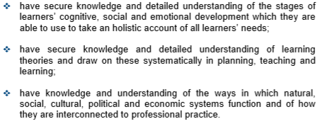
Understanding pedagogy (SFR 2.3.1)
Teachers who have a detailed understanding of the theory of how bilingualism develops and the cognitive benefits of bilingualism will be able to use this when planning teaching and learning.

Slide 7
Having high expectations (SFR 3.1.4)
Teachers who understand the strategies that support EAL development will be better able to provide varied, differentiated tasks to help learners to overcome barriers to learning

Slide 8
Pedagogy, learning & subject knowledge (SCLPL)
Teachers who develop a detailed understanding of EAL pedagogy will be able to use this to become more effective in their approaches, their relationships and their use of a range of technologies and environments to support learning.

Slide 9
Identifying learners’ needs (SLM 3.4.1)
Middle leaders who have a better understanding of strategies to assess and support EAL learners will be able to support their staff teams with assessment and with planning learning to ensure that learners’ needs are being addressed effectively.

Slide 10
Shared vision (SLM 4.4.1)
Head Teachers with a clear understanding of the needs of EAL learners will be able to ensure that these needs are included in the school’s vision and are addressed at all levels

Slide 11
Parental engagement (SLM 4.3.3)
Head Teachers who are aware of the needs of EAL families will be able to use this to ensure that EAL parents and carers are given appropriate and meaningful opportunities to engage with the school.

