Slide 1
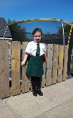
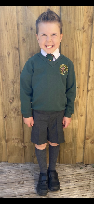
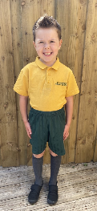
St Leonard’s Primary School Uniform
Blazer: Bottle Green
Trousers: Grey
Skirt/Pinafore: Grey or Bottle Green
Shirt/Blouse: White
Pullover/Cardigan/Sweatshirt: Bottle Green
Badges are available
P.E. Kit:
Bottle Green Shorts,
Gold Polo Shirt
White Socks
Black Plimsoles.
School uniforms can be purchased online via the following link:
https://www.border-embroideries.co.uk/schools
Please remember to label all of your children’s clothes and shoes. Clothes can often get mixed up.

