Slide 1
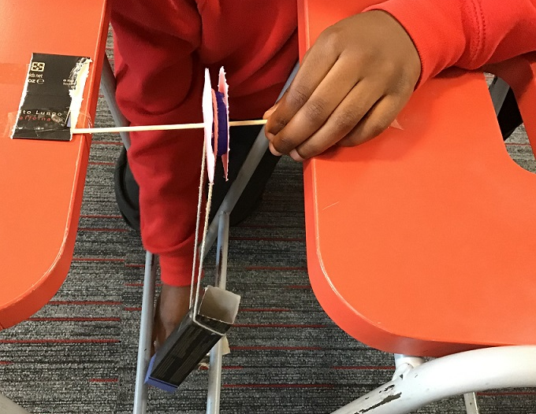
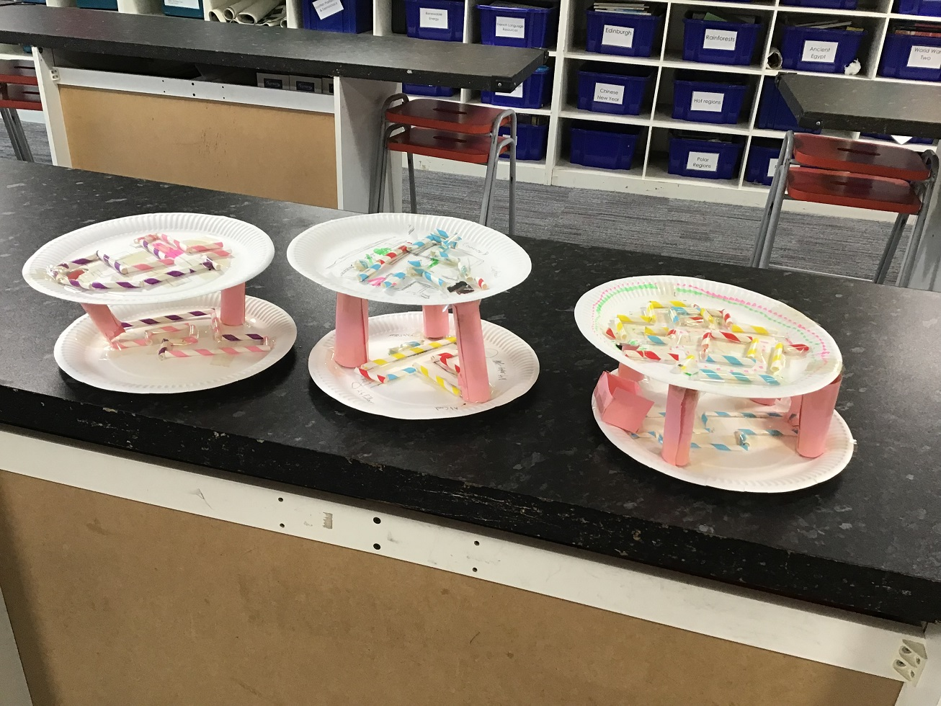
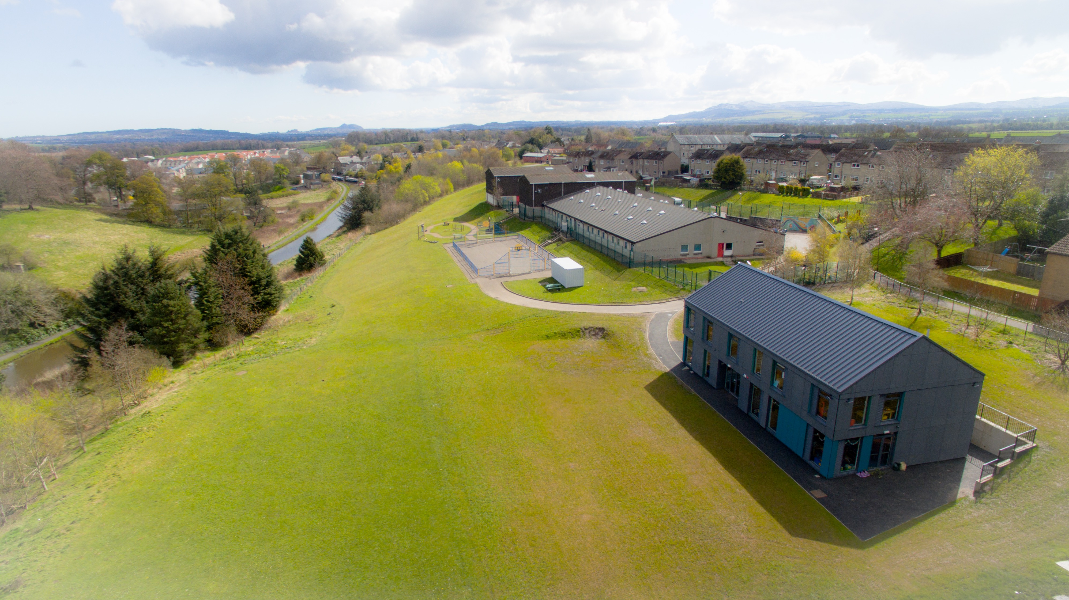
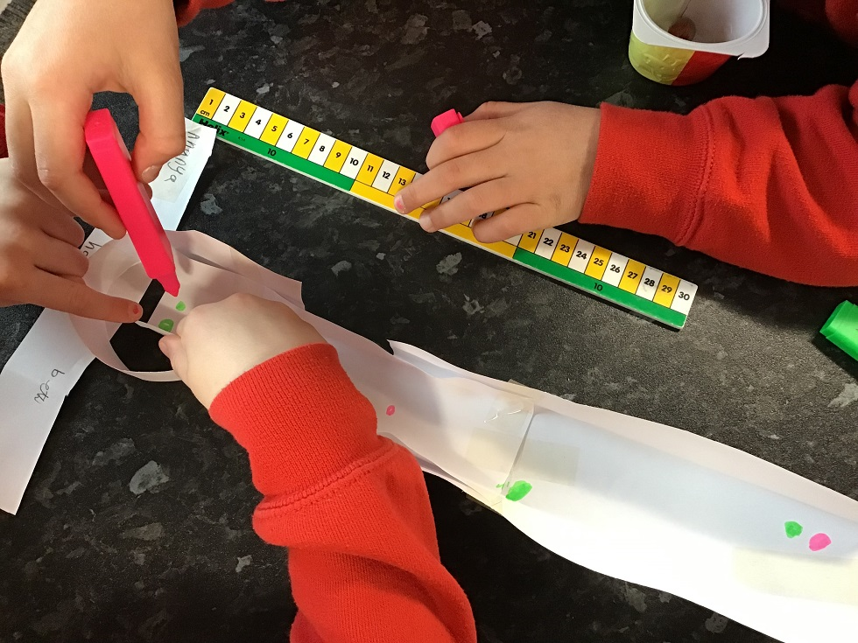
Creativity in STEM at Ratho Primary School
Morven Cooper and Olivia Parfery, P6 STEM Leaders
Amy Dixon, Science Specialist and STEM Teacher City of Edinburgh Council STEM Associate Development Officer

Slide 2
Ratho Primary School City of Edinburgh
A curious, creative community

Slide 3
Creativity in STEM Challenges
Creativity in

Slide 4
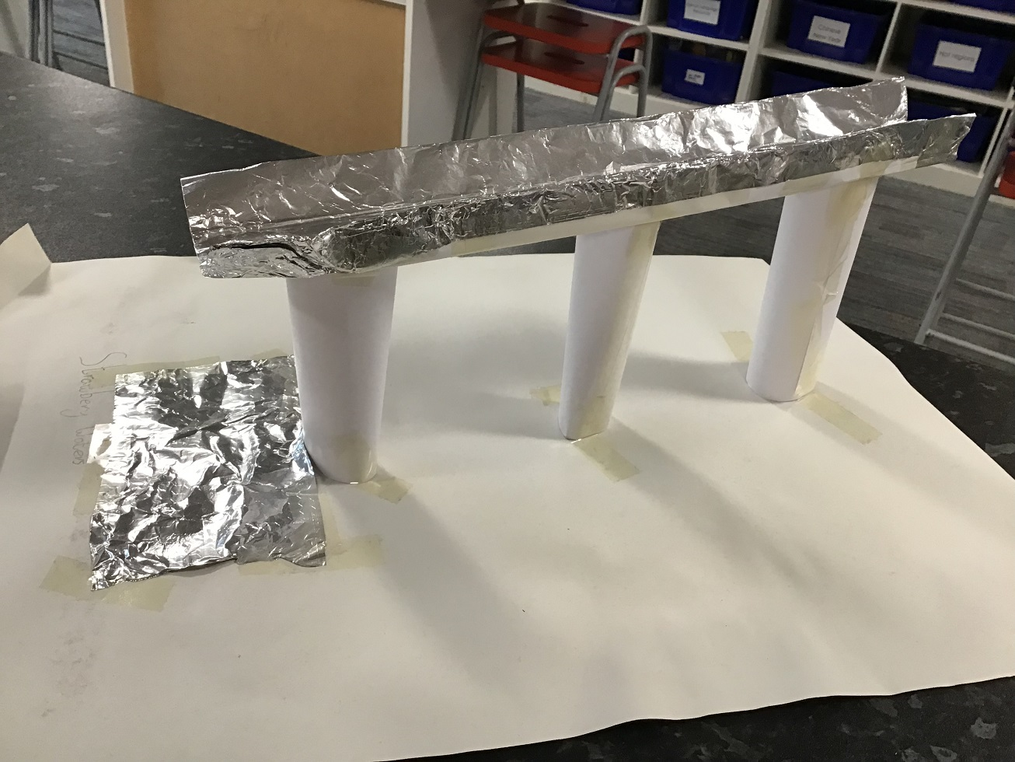
Problem solving

Slide 5
Imagination

Slide 6
Open-mindedness

Slide 7
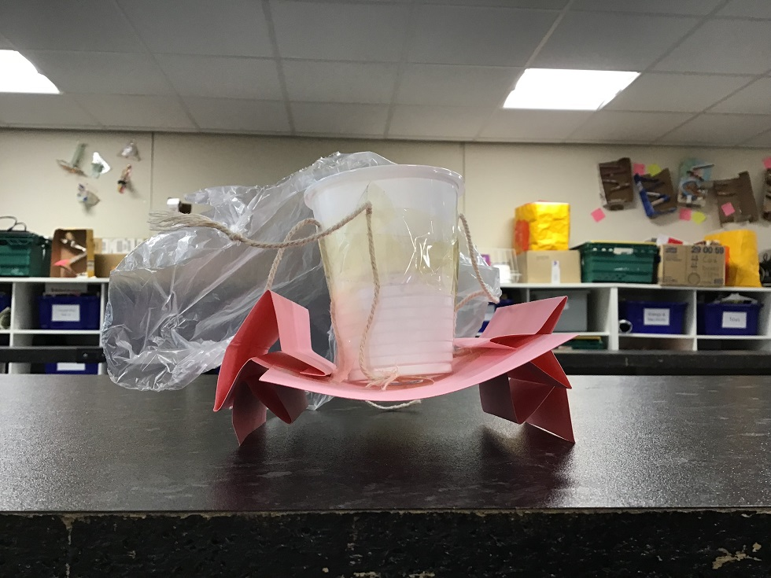
Innovation

Slide 8
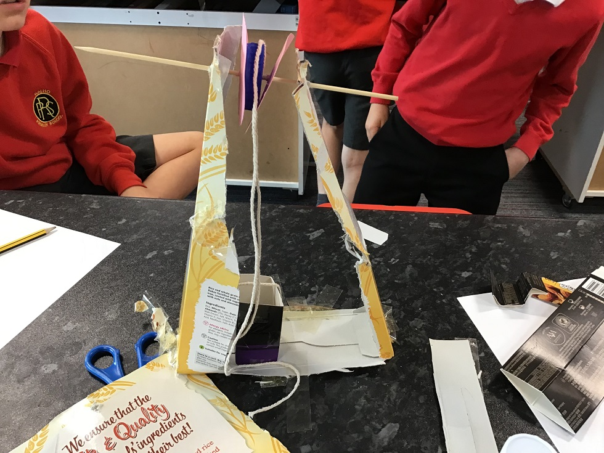
Risk-taking

Slide 9
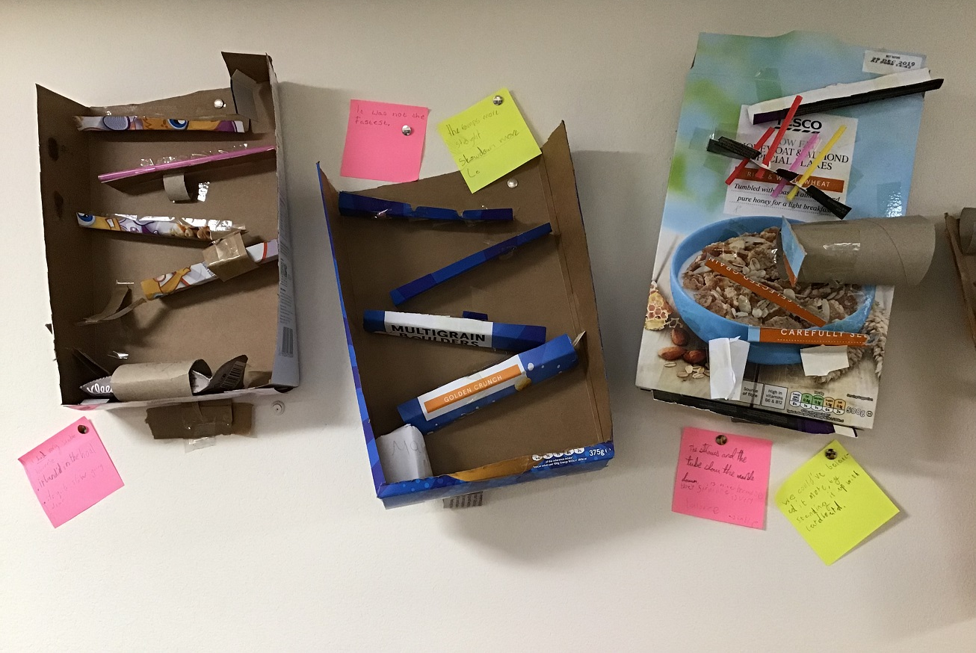
Initiative

Slide 10
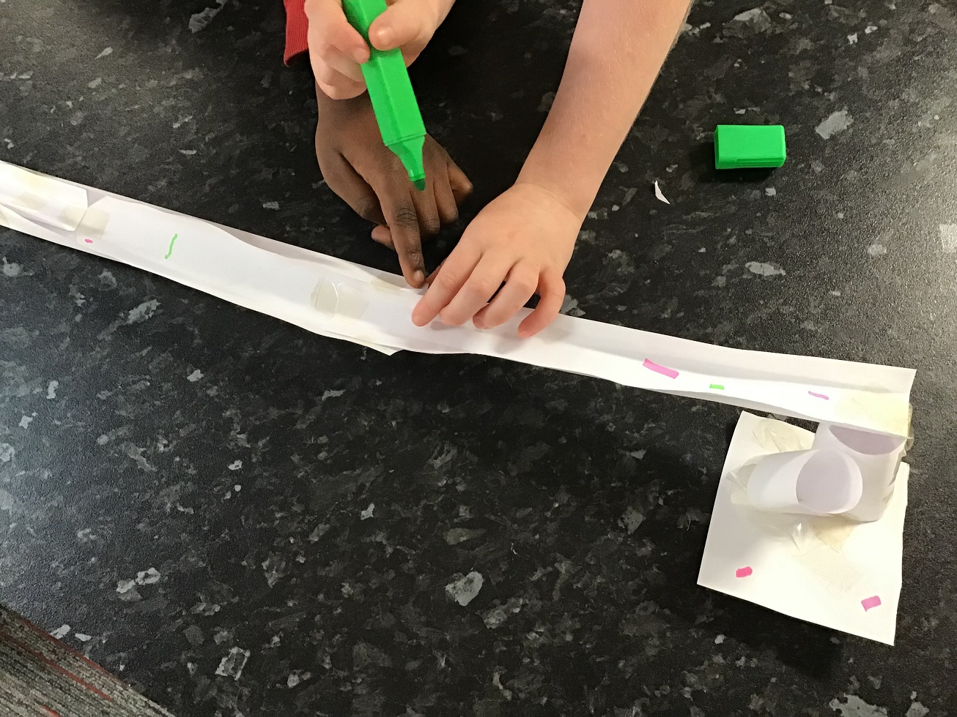
Critical thinking

Slide 11
Evaluating

Slide 12
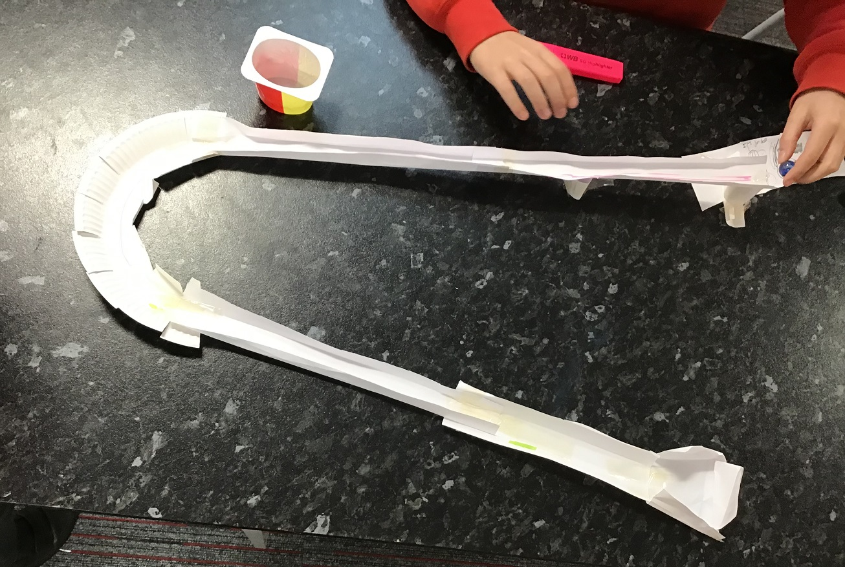
Curiosity

Slide 13
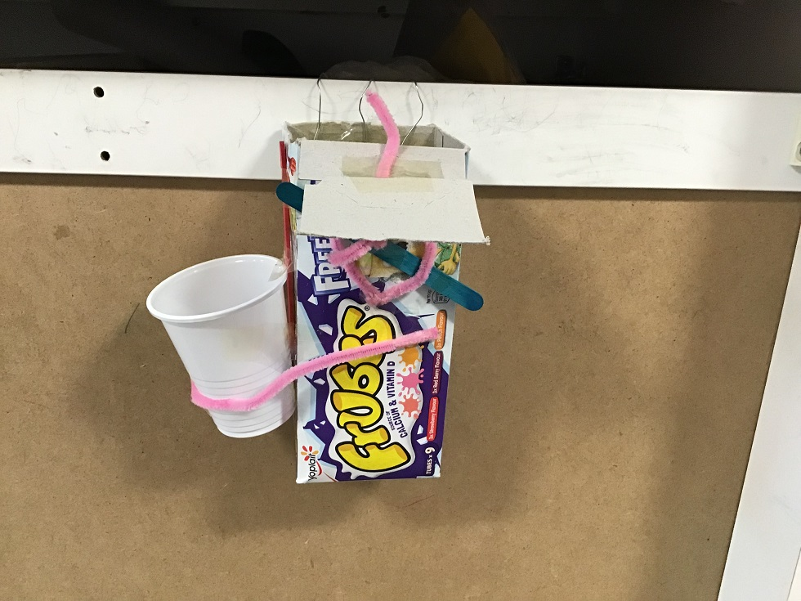
Making connections

Slide 14
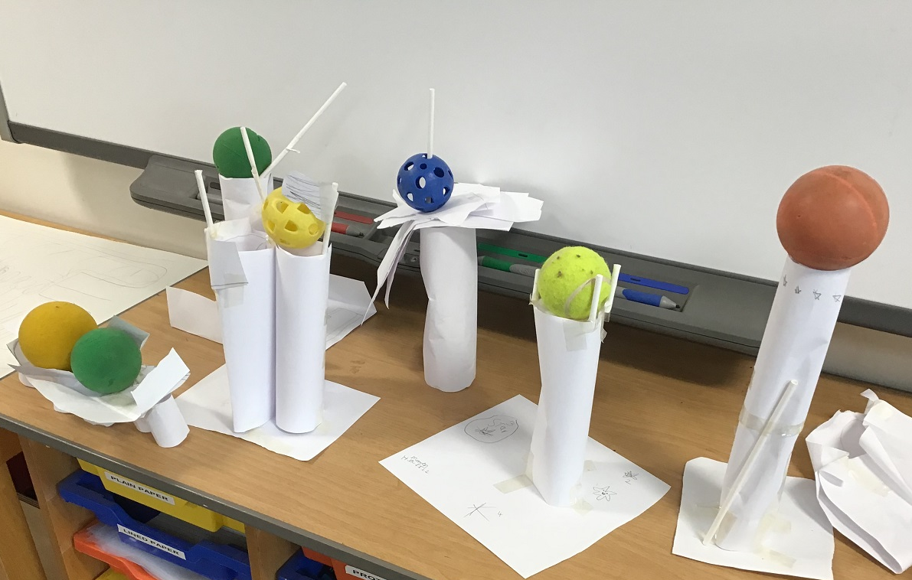
Learning from mistakes

Slide 15
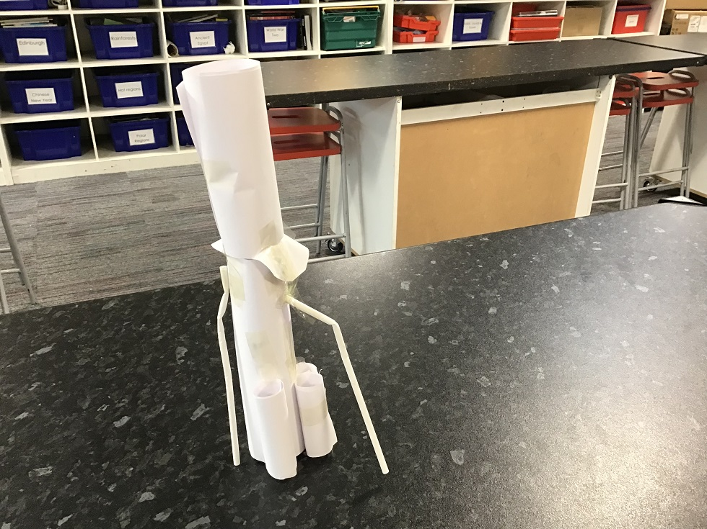
Motivation

Slide 16
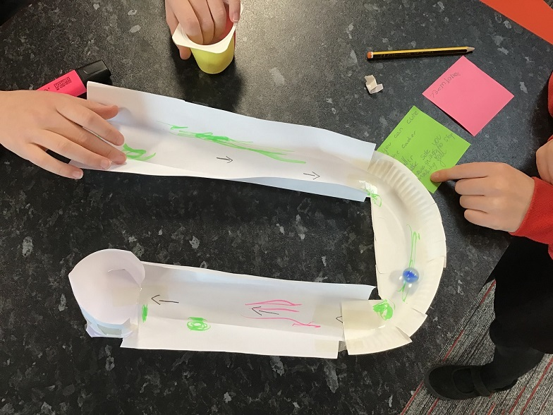
Create a U shaped marble run

Slide 17
Design a waterproof aqueduct to carry water

Slide 18
Young STEM Leader Award

Slide 19
Creativity in STEM Challenges
Challenge

Slide 20
STEM Challenge
As you carry out the STEM Challenge, consider and note down:
How are children using the key creativity skills during a STEM Challenge?
Imagination
Curiosity
Problem-solving
Open-mindedness
Which other skills linked to creativity are children developing?

Slide 21
STEM Challenge
Work in groups of 2 or 3 people
Design and create a structure which can be worn on your arm, between your wrist and elbow, to carry an item that belongs to you (such as a notepad or glasses case)
The item must be held at least 10 cm above your arm
You should be able to walk around your table with the item on the structure
You are not allowed to tape the item on, cover the item, or strap the item in
You are not allowed to tape anything to your skin or clothes
You have 10 minutes to plan and create your structure
You will be given 3 sheets of A4 paper, Sellotape and scissors
Test your structure and try to improve it

Slide 22
Group discussion
Discuss:
How are children using the key creativity skills during a STEM Challenge?
Imagination
Curiosity
Problem-solving
Open-mindedness
Which other skills linked to creativity are children developing?

Slide 23
How can STEM Challenges be used to develop Creativity skills?

Slide 24
What is a quality STEM Challenge?
Problem to solve
Interdisciplinary – making connections
Open-ended exploration but within constraints
Stimulates curiosity
Draws on prior learning
Staff facilitate but do not give ideas or answers
Child-led - learners take responsibility and make their own decisions
Learners confident to take risks and try new ideas

Slide 25
Common pitfalls
Too much direction – eg instructions or recipe for success
Showing videos or photos of end products of similar STEM Challenges
Not enough direction – task is too open-ended
Staff scared of letting children make mistakes and to experience “failure”
Giving children ideas
Giving answers instead of questions
Group size too big

Slide 26
A STEM Challenge should allow a variety of outcomes

Slide 27
Curiosity
Curiosity is stimulated
Learners want to investigate
Learners want to test out their ideas
Making use of prior learning

Slide 28
Imagination
Imagine what could go wrong
Generate ideas in groups to solve those problems
Rethinking when things don’t go to plan

Slide 29
Open-mindedness
The culture we have developed is that we all learn from each other
“Failure” is normalised since things often go wrong
Children are more confident about taking risks
Group discussions
Listening to each other
Selecting the best options from all possible ideas to create a team design
Flexibility
Many initial ideas don’t work as well when they are being tested
Children have to be adaptable – use their initiative to solve these problems

Slide 30
Problem-solving
Understand the problem
Using initiative to design and create solutions
Evaluate their solutions
Persistence and resilience
Children are exposed to a range of emotions
Coping strategies
Develop growth mindset
Motivation
Most children are highly engaged
Learn with and from others
Feed off each others’ ideas and creativity

Slide 31
Critical thinking
Evaluation skills
Peer-assessment
Learning Loop
Self-assessment of skills
Child-centred, personalised approach
Strategies for success
Success Criteria

Slide 32
Awareness of skills development
Making these skills explicit to children as they do STEM Challenges
Involving children in assessing and tracking their own skills development
Making sure children understand why these skills are important

Slide 33
Summary
STEM Challenges provide rich opportunities for creative learning and development of creativity skills
Staff need to consider how to facilitate STEM Challenges to maximise learning opportunities
STEM Challenges are adding value to our creative curriculum at Ratho Primary School

Slide 34
Creativity in STEM at Ratho Primary School
Thank you!

