Slide 1

Notes:
This is a front cover page and can only be used at the beginning of a PowerPoint presentation once. Do not add anything else to this screen if it is being used.

Slide 2


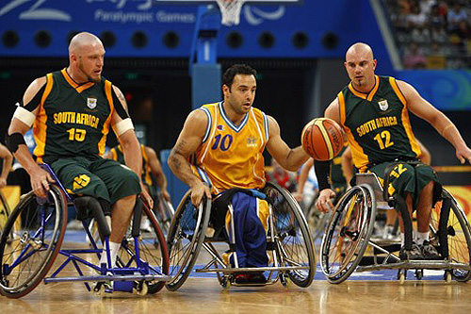
Ensuring Wellbeing,
Inclusion and Equality
Mary Berrill
Head of Inclusion, Wellbeing and Equality
Notes:
Introduction
Introduction to current inspection model
Evidence required to evaluate QI 3.1
Context of National Priorities for achieving Excellence and Equity:
Raising attainment
Closing the poverty related attainment gap
Improving health and wellbeing
Improving positive school leaver destinations

Slide 3
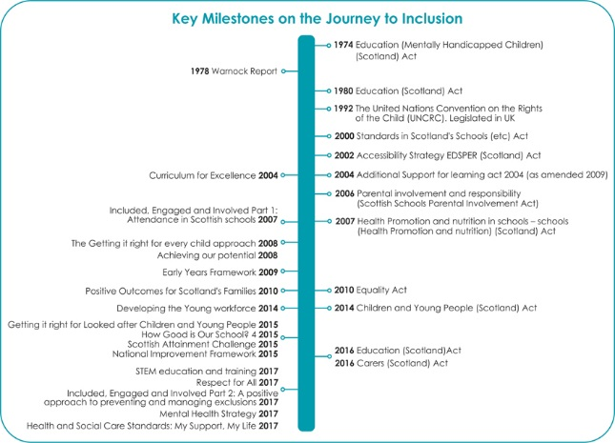

Slide 4
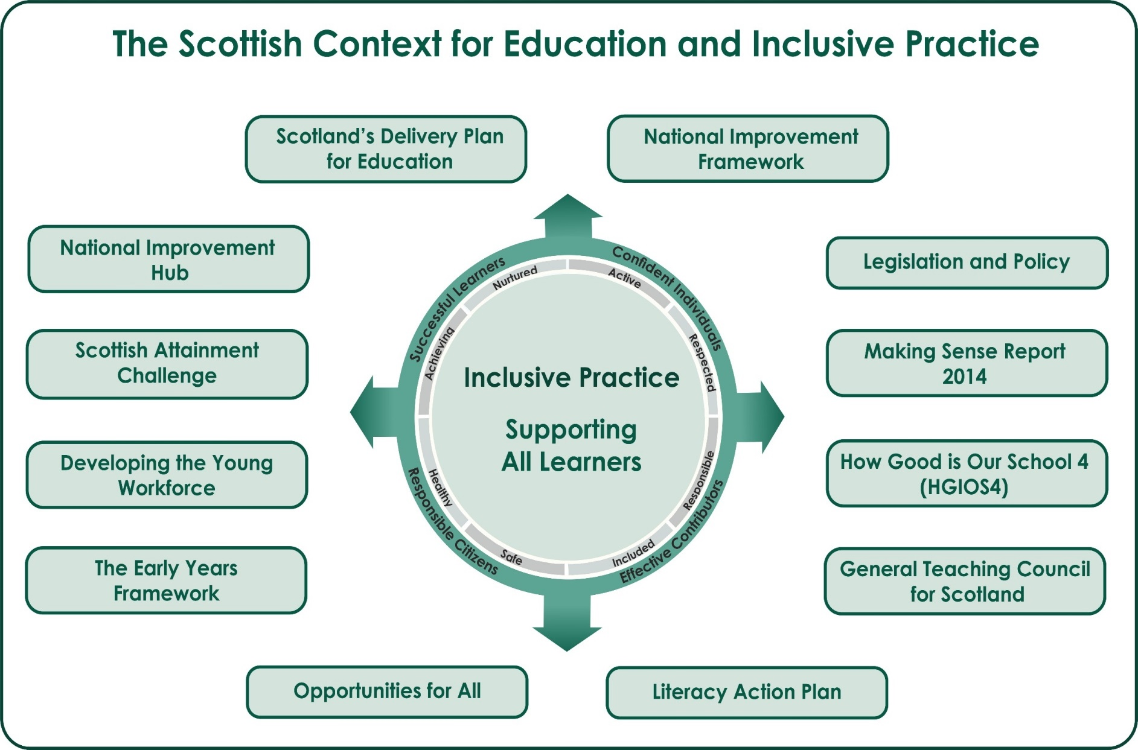

Slide 5
Standard Inspection Model
QI 1.3 Leadership of change
QI 2.3 Learning, teaching and assessment
QI 3.2 Raising attainment and achievement
QI 3.1 Ensuring wellbeing, equality and inclusion
QI chosen by school
Learning pathways
Parental engagement
Safeguarding
Notes:
During inspection schools have the opportunity to show that they know themselves well and that they are using self-evaluation to focus on improving outcomes for all young people. When a school's self-evaluation evidence is robust, we can use it as part of the inspection evidence. It can also help identify innovative practice that Education Scotland may wish to look at in more detail after the inspection has been completed.
Before the inspection, you are asked to complete a brief self-evaluation summary form and use this at the start of the inspection to brief the inspection team on the impact of your approaches to improvement through self-evaluation.
About one hour is set aside for this introductory meeting on the first day of the inspection. It is important that you focus on the outcomes for all learners who attend your establishment. This meeting will be the start of an ongoing dialogue with the inspection team about your establishment’s performance and approaches to improvement.
It would be helpful to the inspection team if you:
give a clear account of your establishment’s strengths and aspects for development
demonstrate where the school is improving and show us how you know
identify the key sources of evidence which underpin your knowledge of your school's performance and improvement, and make these available
show how you prioritise areas for improvement.

Slide 6
QI 3.1 Self-evaluation
How well are you doing? What is working well for your learners?
How do you know? What evidence do you have of positive impacts on learners?
What are you going to do now? What are your improvement priorities in this area?
How would you evaluate this QI using the HGIOS?4 six point scale?

Slide 7
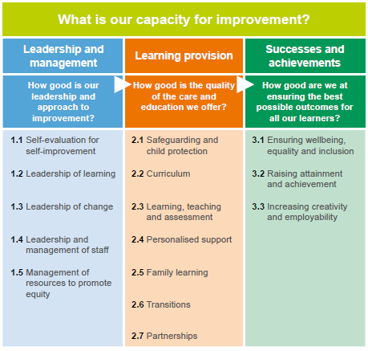
HGIOS 4
Notes:
Ensuring Wellbeing, Equality and Inclusion is located in the section of HGIOS?4 relating to ‘successes and achievements’.
It is one of the range of OUTCOME QIs which relate to the overall achievements of the school. So HMI will be looking for evidence of improving outcomes in wellbeing, inclusion and equalities.

Slide 8
Classroom observations
Relationships and levels of respect/fairness/behaviour?
Whether all pupils are included and have equal opportunities?
How well needs of learners known?
Effectiveness of support strategies, including IEPs and other plans?
Deployment of ASN staff?
HWB targets? Are learners aware of these? Progress?
Learners having a say about their learning?
Shared understanding of wellbeing, children’s rights, diversity etc.?
Notes:
In classrooms and around the school we expect to see an ethos committed to Children’s Rights and positive relationships where ch/yp are eager participants, fully engaged, highly motivated and interacting well with others.
How well do class teachers know the needs of all the learners in their class – how good are your systems for sharing that information? Are learners’ experiences matched to needs, interests and the wider world of work?
Genuine pupil voice - having a say, views and contributions being welcomed and encouraged. Opportunities to lead learning – examples of rich contexts with opportunities to celebrate diversity

Slide 9
Successes and Achievements
How good are we at ensuring the best possible outcomes for all our learners?
QI 3.1 Ensuring Wellbeing, equality and inclusion
GIRFEC and Wellbeing indicators
Evidence of progress in wellbeing
Statutory requirements and codes of practice
Impact of approaches to narrowing any gaps
Promoting equality and diversity
Challenging discrimination
Notes:
QI 3.1: ‘focuses on the impact of the school’s approach to wellbeing which underpins children and young people’s ability to achieve success.
It highlights the need for policies and practices to be well grounded in current legislation and a shared understanding of the value of every individual.
A clear focus on ensuring wellbeing entitlements and protected characteristics supports all learners to maximise their successes and achievements.’

Slide 10
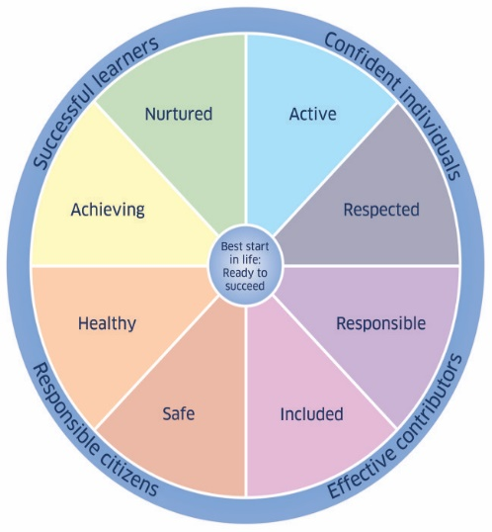

Wellbeing theme
Use of the wellbeing indicators. To what extent are young people safe, healthy, achieving, nurtured, active, respected, responsible, and included?
Learning pathways in HWB across the curriculum –progression, challenge, coherence, breadth, application? Quality of PSE?
What procedures do you have in place to track this and demonstrate progress in wellbeing, as well as their learning about health and wellbeing across the curriculum?
Notes:
Well planned learning pathways which have quality progression/challenge/coherence/breadth in HWB across the curriculum and in discreet curricular areas.
Giving ch/yp opportunities to apply their knowledge and skills, including real life contexts and the world of work.
PE often cited as a strength in developing physical wellbeing. PSE is highly variable.

Slide 11
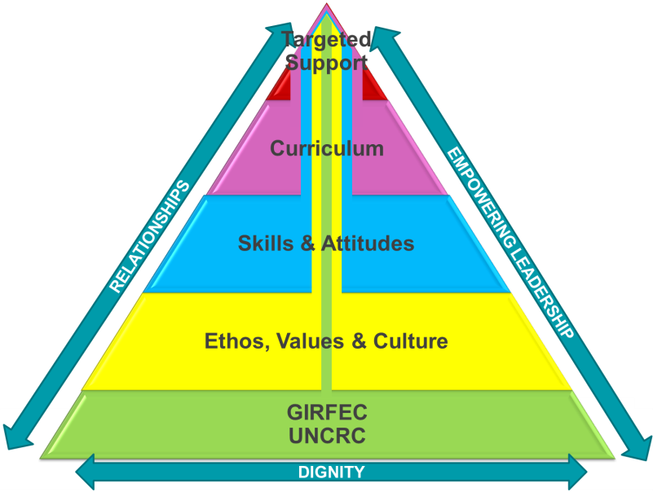
Links to other aspects of inspection
Leadership and management
Vision, values and aims
Ethos and culture
Strategic approaches to wellbeing, equality and inclusion
Safeguarding
Learning pathways
Monitoring and tracking
Attainment and achievement-ASN, LAC, protected characteristics
Notes:
What is your school all about? Is wellbeing, equality and inclusion at the heart of what you do? Is that vision shared and understood by all stakeholders? Does it take into account your social, economic and cultural context?
Are your shared values alive and evident in all that you do? What does that look like/feel like/sound like as visitors walk around your school? Does your school community have a shared understanding of the expectations about how people are treated? Is the dignity and worth of individuals respected? Is everyone treated in a fair and just manner? Is there a commitment to children’s rights and positive relationships. Is all of this reflected in your school policies and procedures?
How clear are your strategic approaches to wellbeing, inclusion and equality? How effectively do you plan improvements in wellbeing, equality and inclusion? Are you clear about your starting point and measures of success? Important to know your starting point/context – the school/setting in the community – so that you know what needs to improve.
Self-evaluation processes to drive change, use of data/wellbeing indicators.
High aspirations and expectations –is wellbeing ithe responsibility of all and does it underpins everything that you do.

Slide 12
Statutory requirements, guidance and codes of practice
Additional Support for Learning Act (ASL);
Children and Young People Act - including Getting it Right for Every Child, Children’s rights and participation;
IEI Parts 1 and 2-attendance and exclusions
Equality Act 2010;
Respect for All-National approach to anti-bullying
National guidance on child protection
Health Promotion and Nutrition Act
RE and RO
Gaelic Language (Scotland) Act 2005
Notes:
The second theme of the QI concerns how well the school complies with and engages in the wide range of legislation, guidance and codes of practice related to wellbeing, equality and inclusion of children and young people.
This slide provides the range of statutory requirements, guidance and codes of practice relevant to wellbeing, inclusion and equality that we focus on in inspection.

Slide 13
Fulfilment of statutory duties theme
Levels of awareness, knowledge and understanding of current legislation, guidance and codes of practice
The quality of key systems and processes which ensure the school complies with relevant legislation and statutory duties
How well staff adhere to these systems and processes in the course of providing services for children and young people
Evidence from evaluation, feedback and complaints processes
Notes:
Although this is an outcome QI, this theme requires us to look at systems and processes-
The focus needs to be on staff awareness and KU as well as how well they use systems and processes to support and promote wellbeing, inclusion and equality.
A key aspect of our work will be to explore the use of evidence from evaluation, feedback and complaints to bring about improvements in practices and to ensure that priorities focus on improving outcomes for young people.

Slide 14

Child protection and safeguarding
Child protection policy documents
Records or logs of incidents of bullying
Information related to complaints
Samples of files, eg those on CP register
Records of administration of medicines
Accidents and injuries log
Attendance, late coming and exclusion statistics
Complaints log
Notes:
Child protection and safeguarding self evaluation form
Schools are required to complete a record of information about safeguarding which is provided for the Managing Inspector (MI) on the first day of the inspection.
The MI and/or delegated team member will discuss the information provided with relevant staff during the inspection to add comments/evaluations as relevant.

Slide 15

Promoting inclusion: outcomes
Feel included in school
Are engaged in school
Have high levels of awareness of Children’s Rights with people’s dignity being respected
Are very well supported to overcome any barriers to learning which they face
Have their needs met well and are supported by appropriate plans
Participate fully in and influence decisions about their learning, levels of support and planning for their future through Children’s Rights being realised

Slide 16

Promoting equality and diversity and tackling discrimination: outcomes
Value diversity and challenge discrimination
Have equal opportunities to attain and achieve to the best of their ability
Are protected from harassment, bullying and discrimination
Feel they are treated fairly and have equal access to STEM subjects
Are confident that the school deals effectively with incidents and complaints relating to disability, gender and race equality
Have no significant variation in outcomes compared to other learners / groups of learners

Slide 17
Main messages from inspections - strengths
Importance of a clear strategic approach to wellbeing and Getting it right for every child
Positive relationships between learners and staff a prominent feature
Developing approaches to Children’s Rights and pupil voice
Commitment to inclusion
Effective partnership working

Slide 18
Main messages from inspections - next steps
Monitoring and tracking progress in wellbeing
Tracking groups/cohorts of learners - LAC
Continue to improve use of data/intelligence
Learning pathways in HWB
RME and/or religious observance
Strengthening approaches to equality and diversity

Slide 19


The module has been created for all practitioners especially those new to the profession, new to post or seeking to refresh their knowledge of a complex area of legislation, policy and practice
Notes:
This is an internal page and can be duplicated to create additional pages. Always keep the heading and footer as shown. To edit the document title in the footer, go to View and select Slide Master to edit in the ribbon menu.

Slide 20
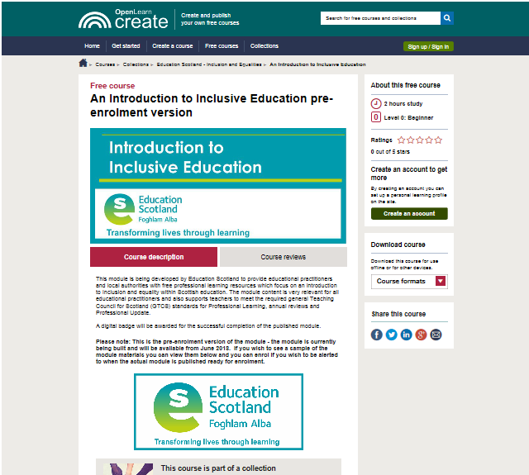
Access the module through the National Improvement Hub
Blended approaches to completion
Time taken to complete module
Badges

Slide 21
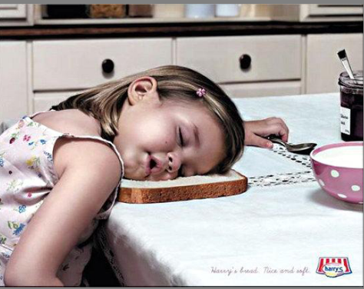
Questions?

Slide 22
Challenge Questions
Are we improving learners’ wellbeing? How do we know?
How well does our curriculum support wellbeing, inclusion and equality?
How effectively do we value and celebrate diversity and to what extent is discrimination challenged?
How do we ensure there are no significant gaps between learners and groups of learners?

Slide 23


Education Scotland
Denholm House
Almondvale Business Park
Almondvale Way
Livingston EH54 6GA
T +44 (0)131 244 5000
E enquiries@educationscotland.gsi.gov.uk
For Scotland's learners, with Scotland's educators
Notes:
This is a back cover page in green. You may edit the address if needed only. It can only be once and at the end of the PowerPoint presentation. Use the corresponding green front and internal pages if you are using this page.

