Slide 1
North Berwick High School
Collaborative Professional Learning

Slide 2
School Context
Co educational secondary school in North Berwick, East Lothian.
Current role of 925 pupils, set to grow significantly and school accommodation currently being extended.
Five primaries in the cluster: four of which located in small rural villages.
SIMD profile 6-10.

Slide 3
Our Professional Learning Journey – the story so far
Learning trios
Professional Learning Communities
Practitioner enquiry
Lots of talk, curiosity, thinking, reading and research around learning and teaching
Lots of collaborative working
Practice changing and improving as a result

Slide 4
“A professional learning culture is being developed across the school with staff working collaboratively to support their personal and collective professional development.”
Validated Self-evaluation Report, March 2016
“Take risks and be innovative in teaching and learning”

Slide 5
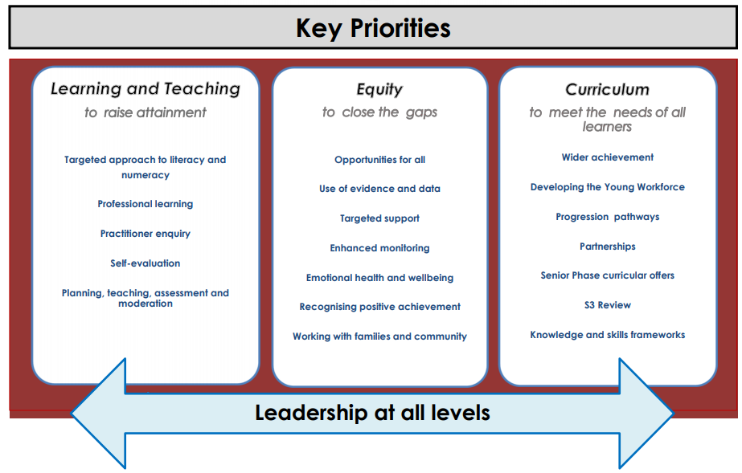
School Improvement Plan

Slide 6
Professional Learning Communities What are they?
“An inclusive and mutually supportive group of people with a collaborative, reflective, growth-orientated approach towards investigating and learning more about their practice in order to improve pupils’ learning”
Stoll, 2006

Slide 7
Why PLCs?

Slide 8
Why PLCs?
Increased professional autonomy
Potential for greater teacher agency
Transformative effect

Slide 9
PLCs 2017-18
Initial inset time on cognitive load theory and building long-term knowledge.
4 groups led by classroom teachers:
2 groups of 9 focusing on retrieval and spaced practice
1 group of 5 focusing on interleaving
1 group of 5 focusing on questioning

Slide 10
PLCs Focusing on Retrieval Practice
“Retrieval practice – recalling facts or concepts or events from memory – is a more effective learning strategy than review by rereading.”
Brown, Roediger & McDaniel (2014) Make it stick: The science of successful learning.

Slide 11
Example 1
N4/5/H Health & Food Technology class.
Pupils really lacked the background subject knowledge required for N5 & Higher.
Pupils were struggling to retain information.
Embedded answer structure is key to passing the final exam.
Note: no control class.

Slide 12
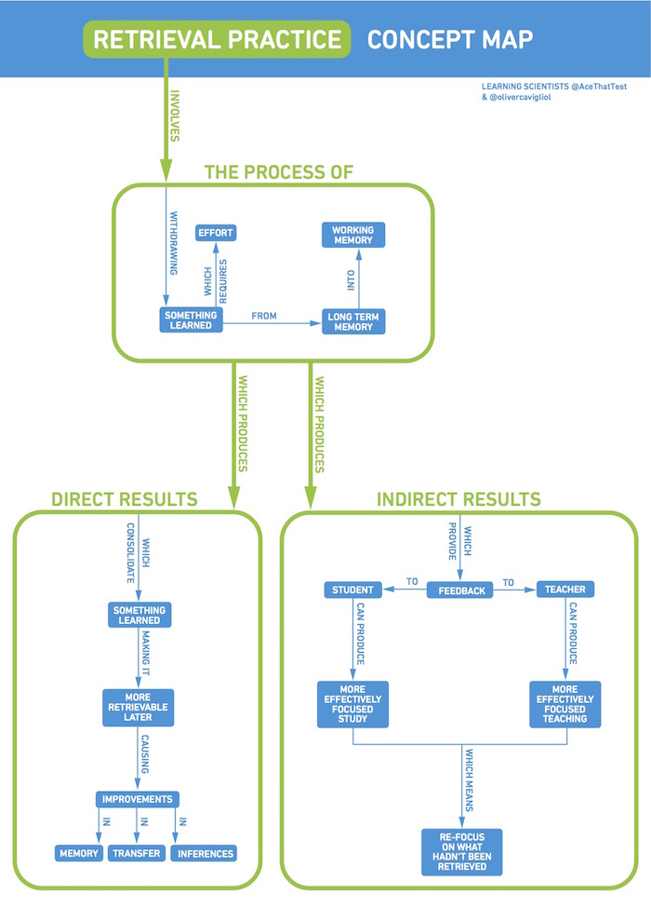
Using Retrieval Practice
Starter questions – exam style
Self, peer and teacher marked.
Class discussions.
Random topics.
Individual revision techniques
Class tasks/games

Slide 13
Results
Feedback reduced as answers became stronger.
Teacher observation – clear to see pupils’ confidence building.
Positive feedback during pupil interview.

Slide 14
Limitations
Benefits
One class – no control group.
Required pupil effort (this varied day to day).
Qualitative data.
New strategies to help pupils retrieve knowledge.
Good way to embed exam structure.
Built my own confidence in teaching the subject.
Built strong relationships with the individuals in my class.

Slide 15
Example 2
S3 Chemistry class.
Many learners were forgetting important concepts when moving into Senior Phase and time was being lost due to necessity to reteach core topics in S4.
Aim was to increase retention of skills and knowledge and improve attainment in S3 and beyond.

Slide 16
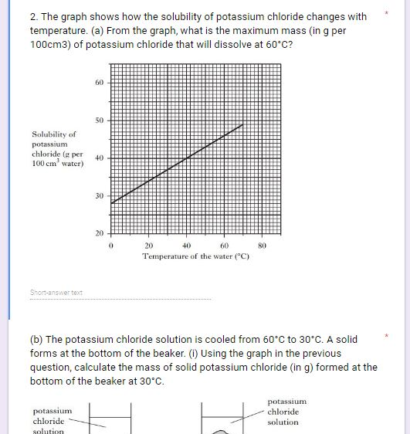
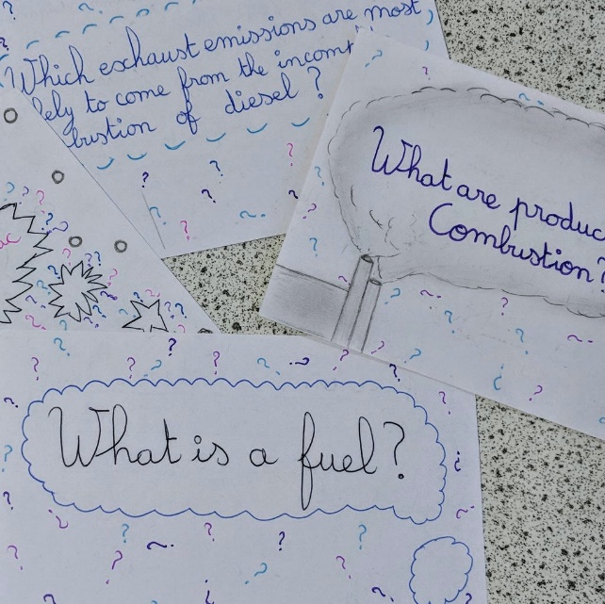
Using Retrieval Practice
Weekly low stakes quizzes – six questions made up of:
two from last lesson.
two from last week.
two from last month.
Tailored homework

Slide 17
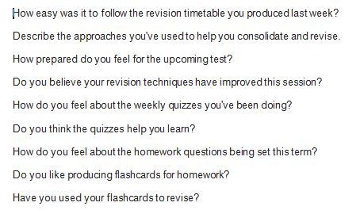
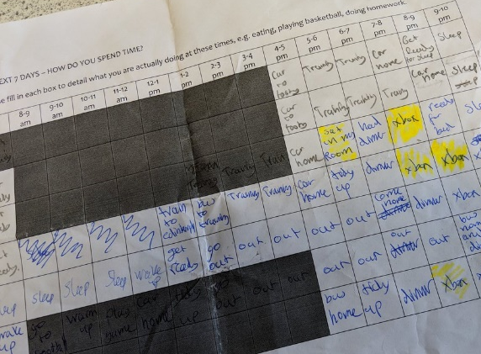
Collecting Further Data
Survey on personal revision techniques
Introduction to learning strategies
Survey on initial thoughts about these strategies
Planning for revision
Survey post-assessment
Individual interviews

Slide 18
Results
Attainment increased for the majority of learners from first assessment in August 2017 to one in March 2018:
Chemistry class | Average percentage increase (%)
Enquiry class | 15.3
Five other classes | 6.6

Slide 19
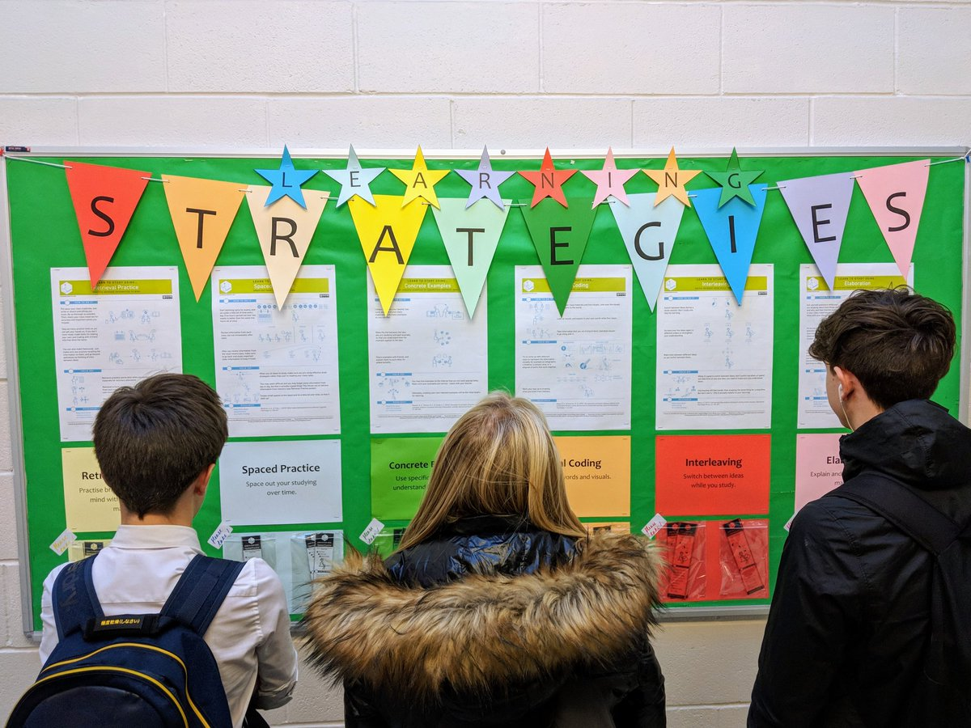
Results
Interview responses showed 3 out of 5 believed their personal learning and revision strategies had improved.
All 5 learners believed the weekly quizzes helped them to learn: “The quizzes are really helpful; if there’s stuff from a while ago you’ve forgotten it reminds you to go back.”

Slide 20
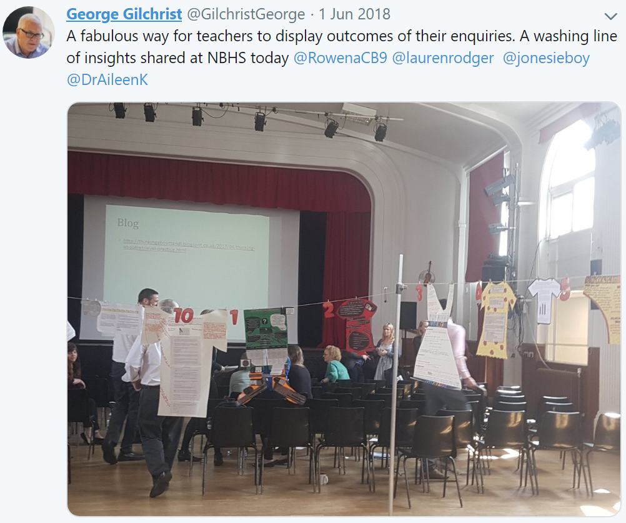
PLC Showcase
Attended by whole staff plus invited guests:
Dr Aileen Kennedy, Senior Lecturer in Education, UofE, Programme Director: MSc Transformative Learning and Teaching
George Gilchrist, former HT, author

Slide 21
Outcomes
Raising attainment: teachers continuously seeking to improve the positive impact on learners
Developing a reflective, enquiring learning culture; PLCs becoming embedded in the school
Strong collaborative links between teachers in different subject areas, establishing coaching partnerships
Taking risks, trying different strategies, developing culture of trust
Building motivation personally / professionally
Recognition for teaching staff from SLT and learners
Opportunities for leadership

Slide 22
Other Professional Learning 2017-18
SCEL Teacher Leadership Programme
First Steps into Leadership
Next Steps into Leadership
MSc Professional Education and Leadership
PGCE Leadership and Learning
Into Headship
GTCS Professional Recognition in Practitioner Enquiry / Teacher Leadership achieved by several teachers

Slide 23
Faculty-based PLCs 2018-19
Humanities
PE
22/3/19
Guidance
Business/Computing
Science
Design & Technology
Learning Support
Performing Arts
English
Modern Languages
Maths
8/3/19
All staff currently involved in a PLC as part of the working time agreement and undertaking small-scale practitioner enquiries; teachers leading CLPL activities which are open to all.

Slide 24
Strategy Groups 2018-19
Equity and attainment
NBHS Key Priority:
Equity to close the gaps
Developing Young Workforce
NBHS Key
Priority:
Curriculum to meet needs of learners
Mental Health
Literacy
NBHS Key Priority:
Equity to close the gaps
NBHS Key Priority:
Learning and Teaching to raise attainment
Numeracy
NBHS Key
Priority:
Learning and Teaching to raise attainment
Primary HGIOS QIs:
1.6, 2.2, 2.3, 2.4, 2.6, 3.2
Primary HGIOS QIs:
2.2, 1.2, 2.6
Primary HGIOS QIs:
2.2, 2.7, 3.2, 3.3
Primary HGIOS QIs:
1.2, 1.3, 2.2, 2.3, 3.2
Primary HGIOS QIs
3.1, 2.1, 2.3, 2.4 3.1

Slide 25
Looking Ahead
Fully-funded year-long initiative with Edinburgh University during 2019-20: Professional Learning as Critical Enquiry (PLaCE) for whole-school improvement.
Inset sessions in school on a L&T theme agreed between school and university lecturers.
Opportunity for some staff (DHT, middle leaders and aspiring leaders) to engage in further professional development at Edinburgh University (twilight and/or Saturdays).

Slide 26
East Lothian Review Visit, 5 – 7 March 2019. We have been nominated for a GTCS Excellence in Professional Learning Award. Panel visiting our school on 31 May 2019.
Looking Ahead

