Slide 1
Leading a Whole Establishment Enquiry Approach
Jill Lothian
HT Kelso High School

Slide 2
School Context
Facts
Pupil Roll: 610
Catchment: SIMD 4-10
FME: 9%, 54 pupils
HMRC Child Poverty: 23%, 140 pupils
Positive destinations consistently above Virtual Comparator, Scottish Borders Council and National.
Appointments (Dec 2015→)
11 from 52 teachers
1 Principal Teachers
1 DHT

Slide 3
National Documents
Practitioner enquiry was recognised by Graham Donaldson in 'Teaching Scotland’s Future', as an essential way to support educators to become more engaged with research to support their own learning and improve pupil experiences.
The GTCS Standards and Scottish education policy highlight the move towards teachers being and becoming enquiring practitioners as a fundamental ingredient to the future success of Scottish education.

Slide 4
Initial Steps
Before deciding on an approach towards practitioner enquiry, it is essential to think about where you are now through a variety of self-evaluation.
This will enable you to engage in evidence-based analysis of what is working well and what needs to improve or be in place for a whole establishment approach to be successful.

Slide 5
HGIOS 4 1.3 Leadership of Change
As a HT it was important to promote and support innovation, creativity and practitioner enquiry which leads to positive change. They work collaboratively to develop a clear rationale and choose appropriate approaches to effectively facilitate change..
Staff at all levels take responsibility for implementing change..

Slide 6
Involvement with SCEL
Leading a Whole Establishment Enquiry Approach within SCEL Framework:
a video was made to highlight the impact of a whole school approach to collaborative enquiry and offers some insight into the possible areas of impact that could be considered.

Slide 7
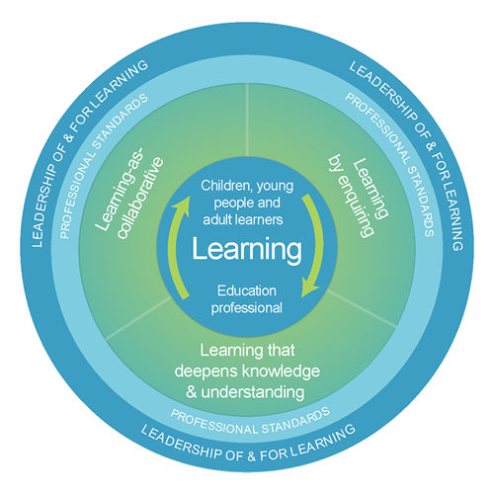
NATIONAL MODEL OF PROFESSIONAL LEARNING
Professional learning must focus on the education professional as a learner and how this is related to and impacts upon the learning of children, young people and adults.
Professional learning should be:
● Challenging, and develop thinking, knowledge, skills and understanding
● Underpinned by developing skills of enquiry and criticality
● Interactive, reflective and involve learning with and from others.

Slide 8
Involvement with GTCS
GTCS Excellence in Professional Learning Award - Sept 2018
Work with GTCS to support the creation of a campaign for enquiry
Member of staff highlighted within NIF 2019

Slide 9
Looking FORWARDS ‘exploring future possibilities’
Session 18/19 – Year 3
SCELEiH – Curriculum is – or should be – at the heart of school education (Professor Mark Priestley)

