Slide 1
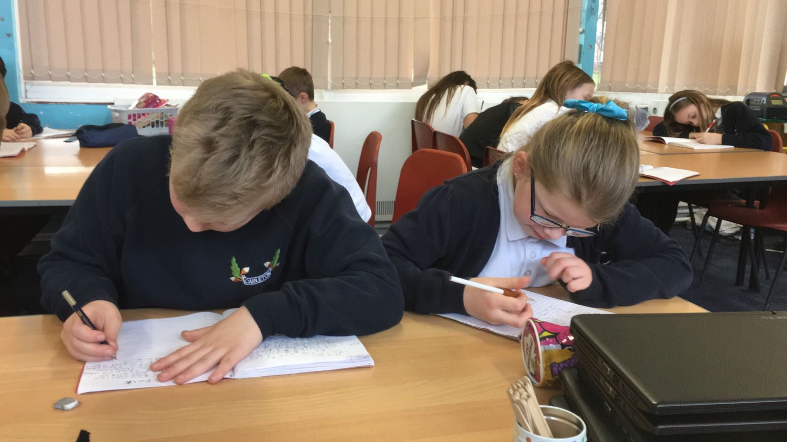
Lynne Courts
Class Teacher
Carleton Primary School
Improving Writing Outcomes Primary 5

Slide 2
Stretch Aim
By 22nd December 2017, 85% of pupils within class P5A will have achieved CfE first level writing outcomes
(baseline= 44%).

Slide 4
Refined my Aim
Aim 1: By 1st October 2017, 85% of class will be consistently writing three sentences with correct* punctuation within pieces of independent writing (baseline = 56%).
*Operational definition for punctuation: children can use basic sentence punctuation including full stops followed by capital letters. May be experimenting with other punctuation; use may not be accurate e.g. question marks, exclamation marks and commas.
Aim 2: By 22nd December 2017, 85% of class will be consistently exceeding 100 word count within pieces of independent writing (baseline = 61%).

Slide 5
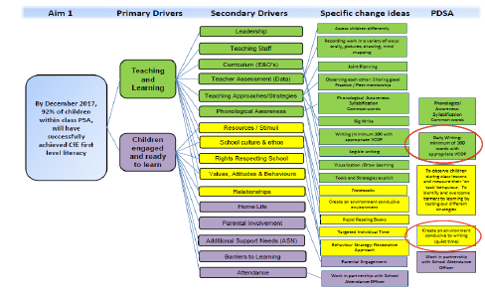

Slide 6
Change Ideas
Daily Writing (maximum of 15 minutes)
Teacher modelling correct / incorrect punctuation on whiteboard with class input
Reinforcement of learning intentions & success criteria
Children setting individual targets

Slide 9
Achievements
All aims were accomplished!
The number of pupils (P5A) who had achieved CfE first level writing outcomes increased from 44-85% from August- December 2017.
By 5th October 2017, 85% of children were consistently writing 3 sentences or more with correct* punctuation within pieces of independent writing.
By 24th October 2017, 85% of pupils (P5A) were consistently exceeding 100 words within pieces of independent writing.

Slide 10
Improving Writing Outcomes
Spreading Learning to
Primary 3
Leta Kelly, Rachel Stevenson, Katy Antropik

Slide 11
Stretch Aim
By June 2019 85% of P3 pupils will be on track for writing.
Baseline September 2018 (19%)

Slide 12
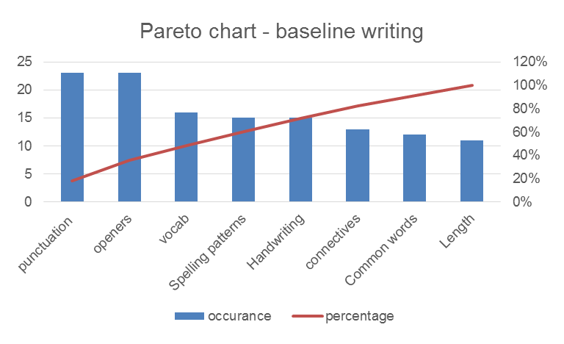

Slide 13
Aim 1
By December 2018 85% of all P3 pupils will correctly punctuate (using capital letters and full stops) at least 3 sentences (baseline 13%).

Slide 14
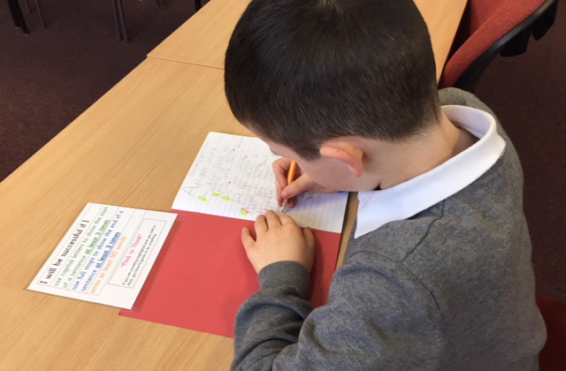
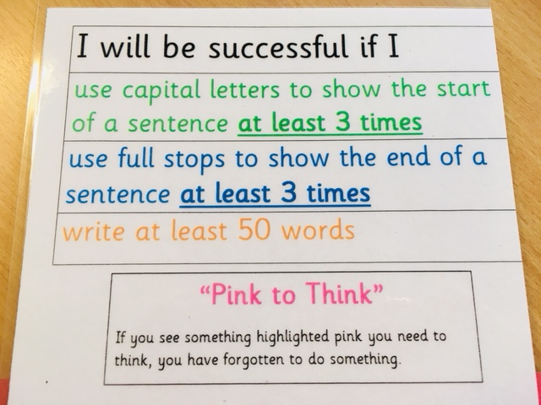
Change Ideas
Notes:
Daily writing (max 20 mins)
Reinforcement of Learning Intention and Success Criteria every day
Use of success criteria visual aid with colour code
Modelling with particular focus on pupil engagement
Peer/Self assessment

Slide 15
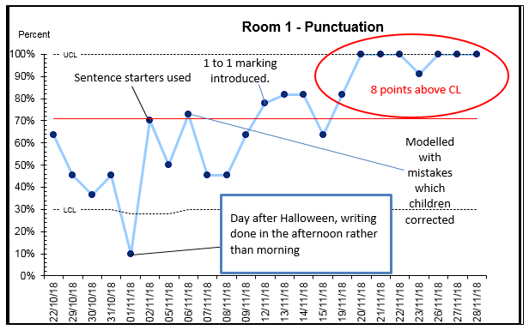

Slide 16
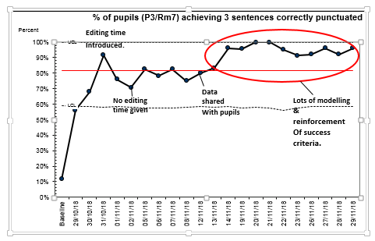

Slide 17
Key Learning
Children's’ engagement with success criteria improved their ability to achieve their learning intention.
Focusing on one area of writing at a time has accelerated children's’ ability to achieve.
Limiting daily writing to a maximum of 20 minutes has made the process manageable for the class teacher whilst also increasing pupil focus.
Tracking an assessing throughout the process has enabled class teachers to target support where needed and enhanced their knowledge and understanding of pupils’ abilities.
Sharing the data with the children created a culture of support and challenge.

Slide 18
Moving forward
September 2018 19% of P3 children were ‘on track’ for writing
January 2019 61% of P3 children are ‘on track’
I’ve got better at writing. I like it when it is quiet writing time because I can think more.” P3 pupil
“It has helped me to write better and use capital letters and full stops at the end of a sentence.” P3 pupil
“Using the data allowed me to see real progress in my class which was so encouraging and rewarding as a teacher.” Leta Kelly P3 teacher

Slide 19
Questions to consider
What is the difference between data for learning and data for judgement?
Within your context how are you currently using data to learn?
What strategies are you currently using to improve attainment for children in writing? How do you know they are working?

