Slide 1
Creating Magic Through Collaboration
Scottish Borders Council - Earlston Cluster
SEIC Event
5th March 2019

Slide 2
“Individually we are one drop; but together we are an ocean.”
– Ryunosoke Satoro
Notes:
Good morning / introduce myself
Fantastic to be here
Presenting in front of our colleagues from SEIC
Representing Cluster and Local Authority
To be talking about ‘magic’ – a story not often captured in a world of intelligent data and triangulation of evidence
Our story is one of collaboration
HTs of E C (8 primary, 1 HS) building on years of collaborating to combine their PEF funding to address a recognised need in numeracy
The creation of a dedicated team to plan and facilitate the project; PEF strategic lead; programme co-coordinator; Additional Needs Assistants
As well as collaboration within the team and HTs, there was also collaboration with Scottish Attainment Advisors, LA Attainment Officers – to plan and implement the project using the Quality Improvement Methodology
Ultimately, working together to have used the Quality Improvement Methodology to make a measurable difference for over 60 of the most vulnerable children in our cluster
Where is the magic?
1. In the impact for the learners
2. The empowerment of all staff
3. The empowerment of a class teacher.
Over to Kim

Slide 3
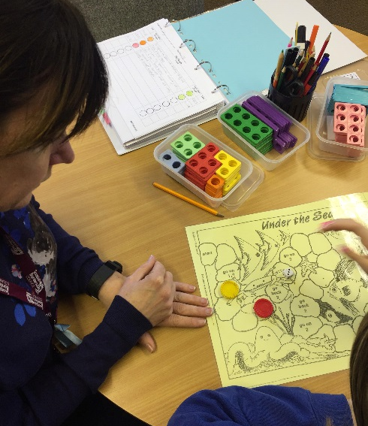
Collaboration
Research
Scale Up & Spread
Training
Moderation
Notes:
Class teacher background – 11 years of a school from a deprived area, skills and expertise working with support staff, different professionals centred around these children whom many were living in poverty. New challenge June 2017 as PEF prog coordinator in EC.
Successful intervention researched – Stow then Earlston. QI based. Consists of 15 min sessions 4x a week, 1:1, focussed on a target generated by CT, leaner tracks learning. Scale and spread to Earlston cluster.
Training – upskill, monitor and support. collaboration to share success, barriers, resources, learning rounds, feedback/updates
Moderation – school visits, quality assurance
Collaboration at different levels: ANAs, HTs, CTs

Slide 4
Successes
Pupil: I enjoy coming to do my numeracy. I am getting more questions right in class and it is making me feel happy and a lot more confident.
Class Teacher: I’m delighted to see the increase in (pupil’s) confidence and willingness to explain her thinking within numeracy. She is able to recall basic number facts much more readily.
Parent: I have noticed (pupil) is getting more confident and his maths is improving. He comes home telling me how well he is doing and how close he is to completing his target.
Notes:
Successes – pupil, parent etc quote

Slide 5
Cluster Final Assessment May 18
Below Average
Average
Above Average

Slide 6
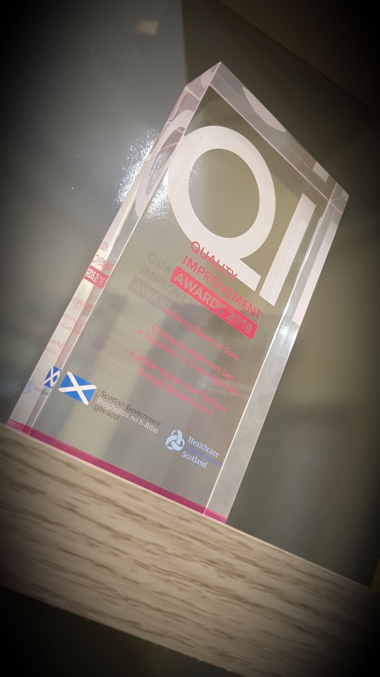
Quality Improvement Awards 2018
Notes:
Earlston Cluster approach spreading across our local authority

Slide 7
My Journey: August 2017-Now
What am I doing differently?
How do I feel?
Notes:
What am I doing differently?
Collaborating. Yes, prior to this new chapter I collaborated with colleagues at staff meetings but now it has been taken to a different level. I collaborate with JW, ANAs, SfLT, CTs, HTs, LA Attainment Officers. Working as part of a wider team and having these professional discussions has allowed ideas to be generated, feedback given and secure support network formed.
How do I feel?
In my practice, I feel more confident. This has happened through the trust and empowerment that I have been given. The ANAs who are working with some of our most vulnerable learners have gained in confidence as they too have been on a similar journey of empowerment and so there is high job satisfaction within the team. But at the heart, where the real magic is, is with the learners. Seeing their gains with numeracy and their beliefs within their own abilities grow, that’s the real magic. Thank you.

Slide 8
Creating Magic Through Collaboration
Scottish Borders Council - Earlston Cluster
SEIC Event
5th March 2019

