Slide 1
Teaching Refugee Issues Through Children’s Books

Slide 2
Why use children’s books to teach refugee issues?
Engaging way help children’s step into the shoes of others.
Good way to introduce issues that refugee children in the class might like to talk about, without the spotlight being on them and their specific personal story.
Opens up debate about refugee issues, which could lead to dispelling myths – the ‘my dad says that...’ syndrome.
Helps children understand ongoing and future refugee situations reported in the media.

Slide 3
Ways to introduce the issues:
Reading the book and discussing the issues raised as you go along.
Using novel study resources provided by the author or their publisher.
Engaging the pupils in other more general activities to teach an ‘empathy skillset’ that could be useful hen pupils encounter refugee issues in the media and through real life interaction.

Slide 4
Activity 1: Definitions Matching Game
Lay the cards face down so only the letters and numbers are showing.
Take it in turns to turn over two cards (a letter and a number). Read the word or phrase and the definition out to the group.
Do the cards match? If so, you get to keep them and win a point.
If not, lay them face down and continue till all the cards have been matched.

Slide 5
Did you get them right?
1. Refugee – (E) A person whose individual application for protection has been recognised under the 1951 UN Refugee Convention.
2. refugee – (B) A person who has made a claim to be considered for refugee status to a state which has signed the 1951 UN Refugee convention.
3. Asylum Seeker – (F) A person who seeks refuge, asylum or safety.

Slide 6
4. Illegal Immigrant – (D) Many refugees and asylum seekers do not have identity documents and are not committing a crime by seeking refuge in a safer country: this term denies innate dignity and human rights.
5. Migrant – (A) A person who moves from one region or country to another.
6. IDP – (C) A person who has been forced to flee their home but who has not crossed an internationally recognised state border.

Slide 7
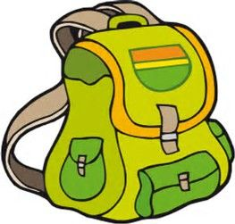
Activity 2: What would you bring? Choose 5 items for your rucksack.

Slide 8
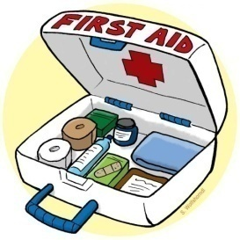
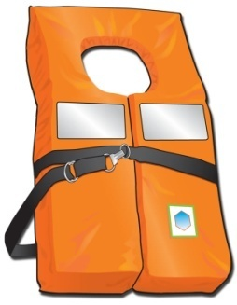
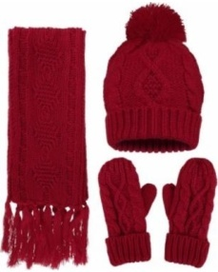
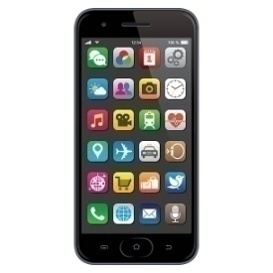
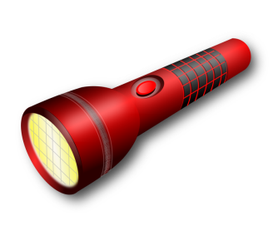
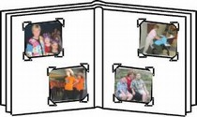
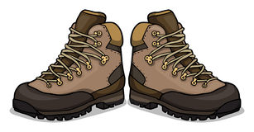
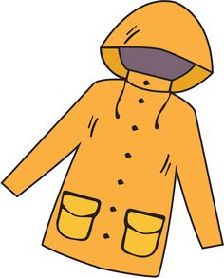
What would you bring? Choose 5 items for your rucksack.
Blanket
Books
Spare clothes
First aid kit
Hat and scarf
Laptop
Passport
Life jacket
Notebook
Mobile phone
Torch
Money
Tent
Photo album
Hiking boots
Water bottle
Food
Raincoat
Jewellery
Matches

Slide 9
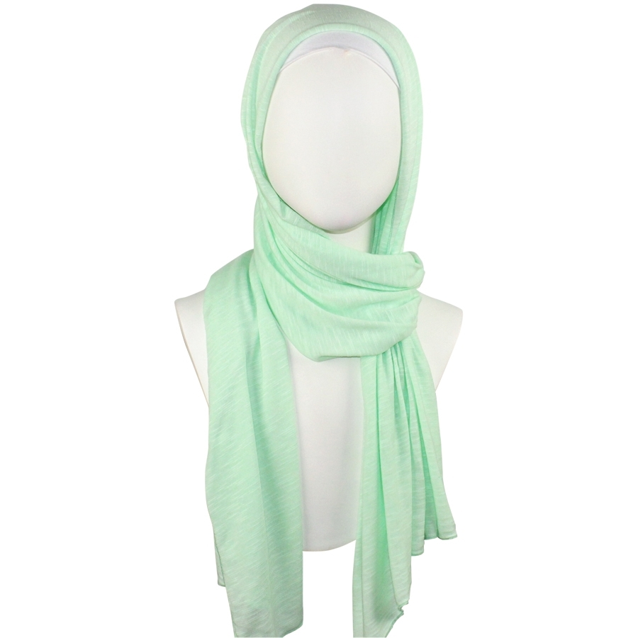
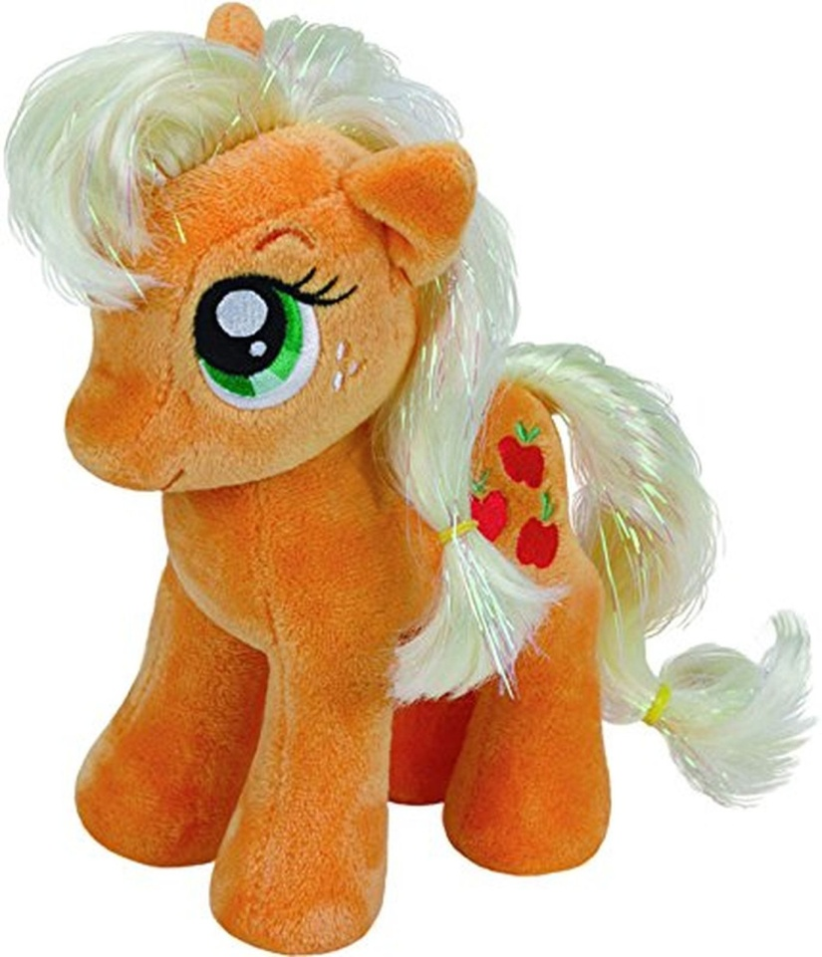

Slide 10
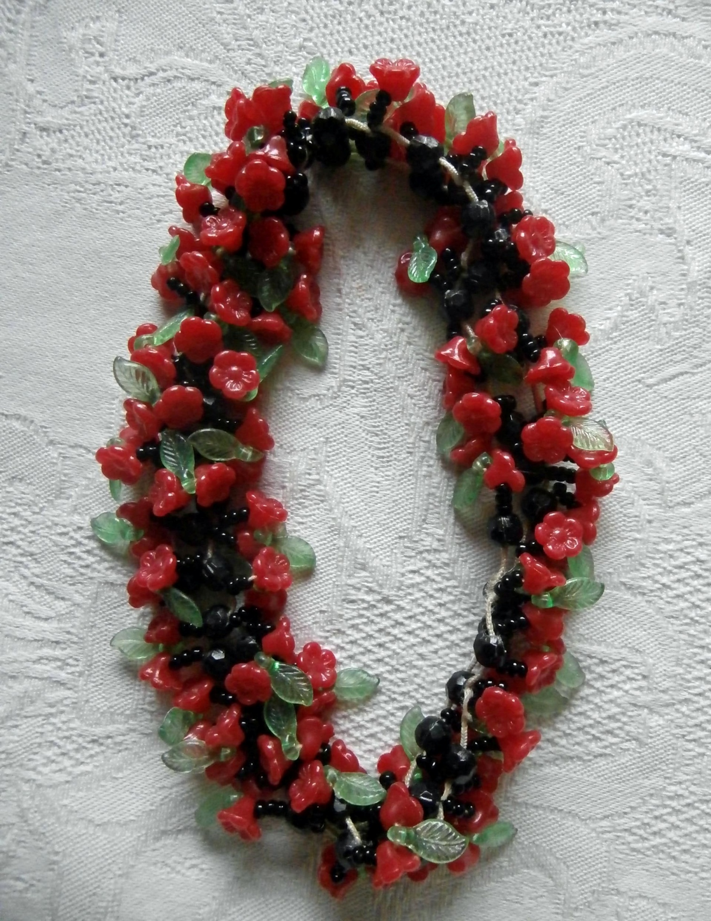

Slide 11
Activity 3: Who gets to tell the story? Points of view when lacking the full picture.
Look at the pictures – whose point of view are the stories in these pictures being told from?
Can you work out what the missing part of each picture might be, and who might be telling that part of the story?

Slide 13
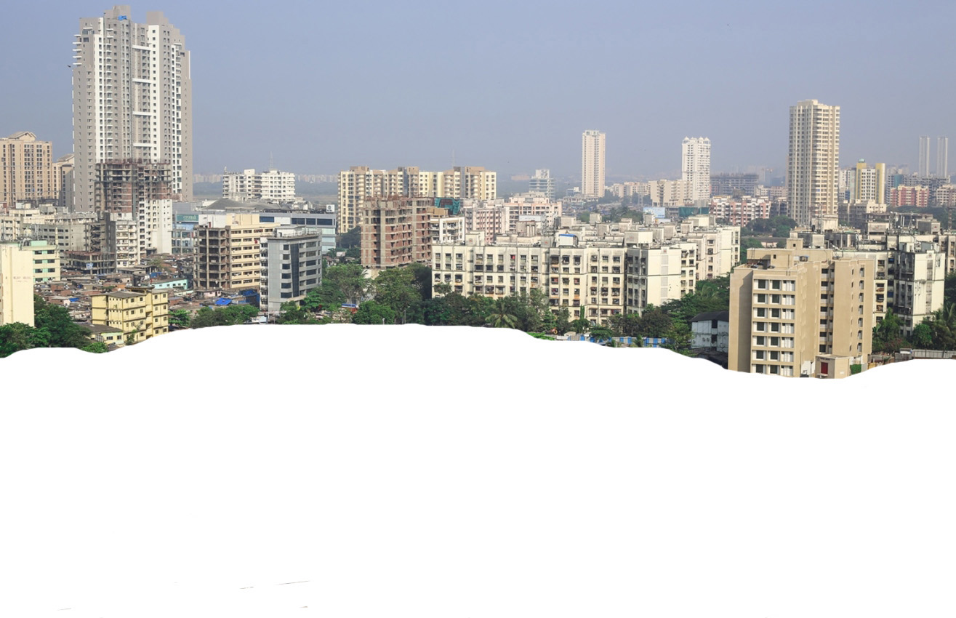
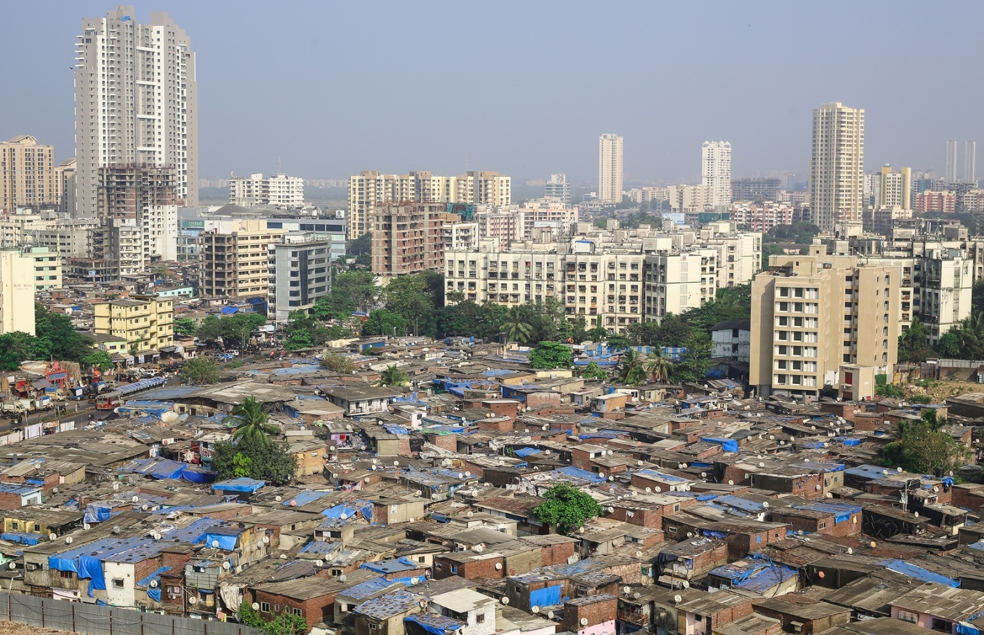

Slide 14
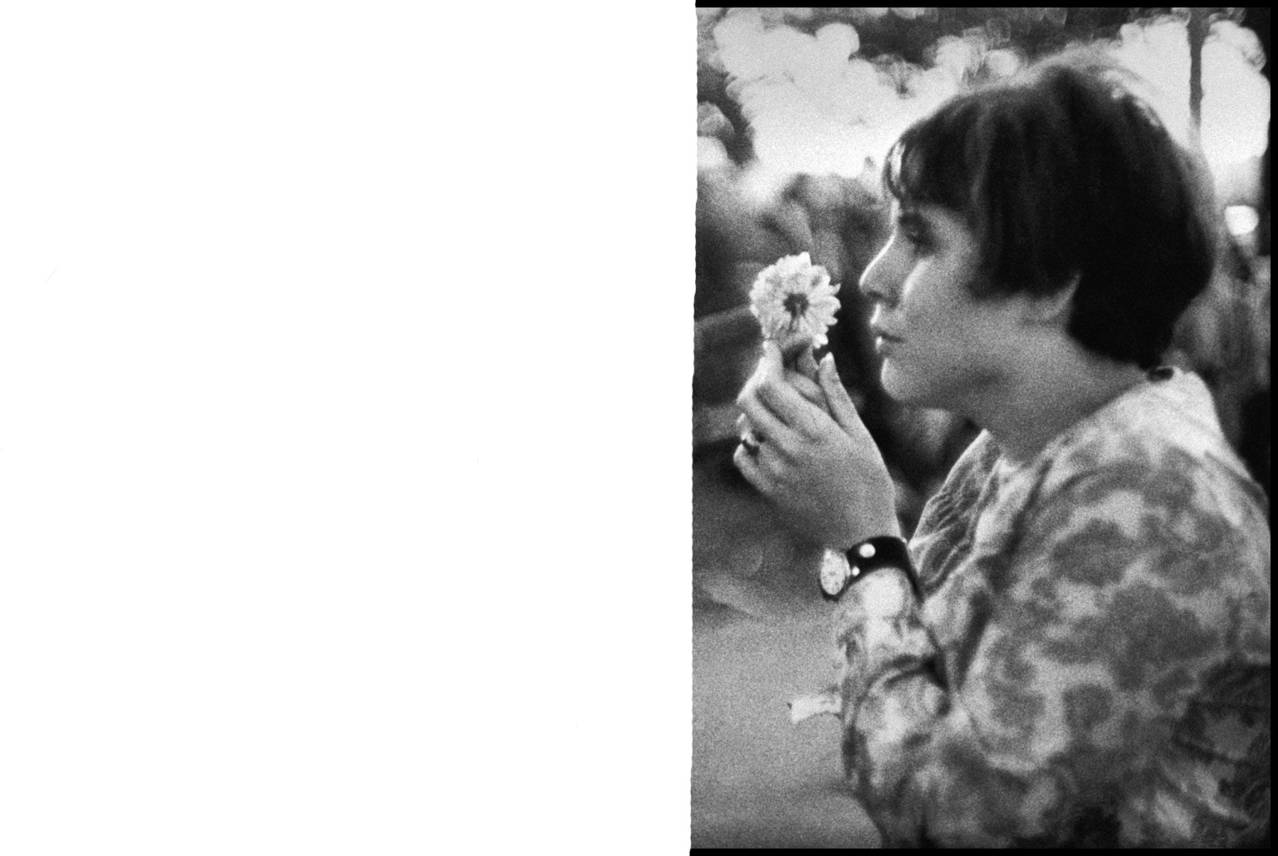
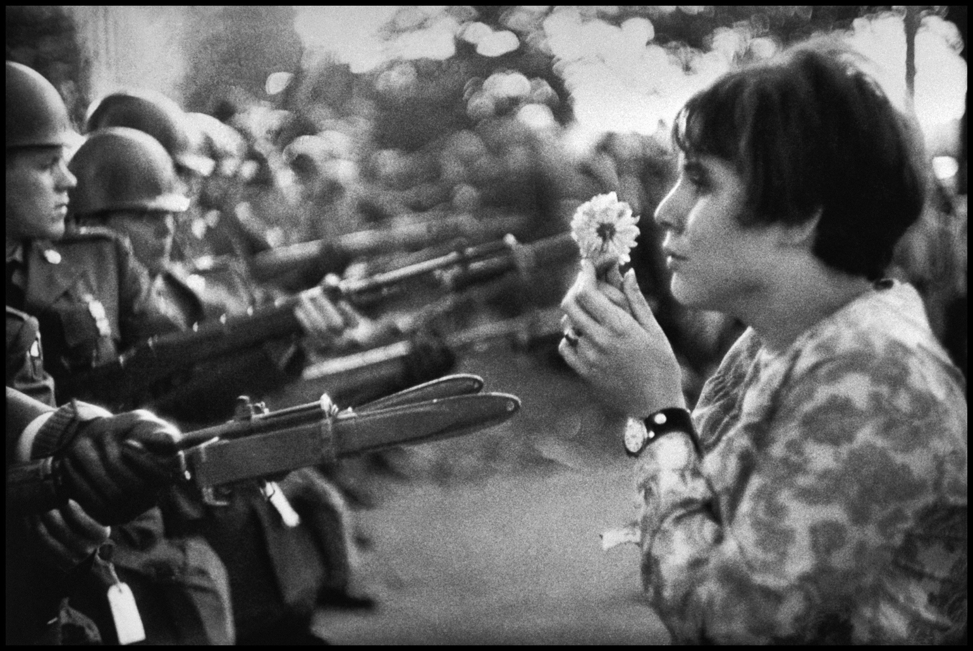

Slide 15
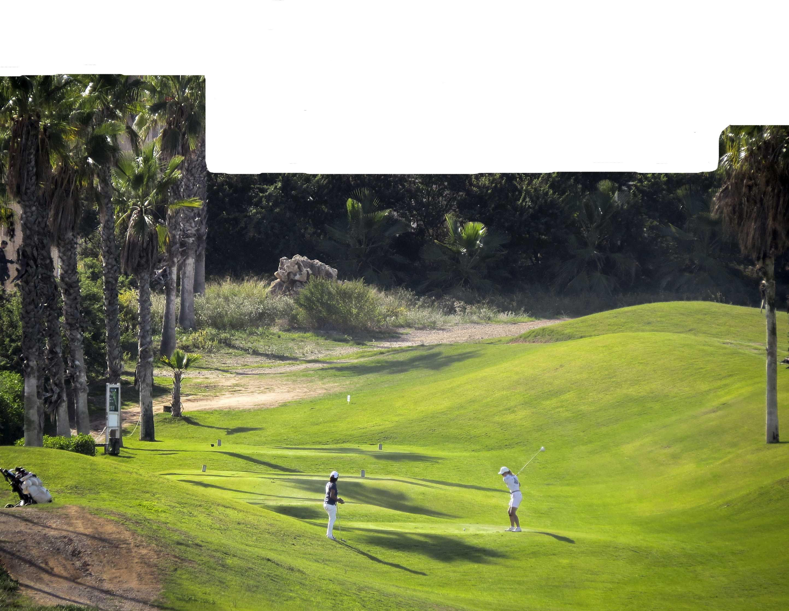

Slide 16
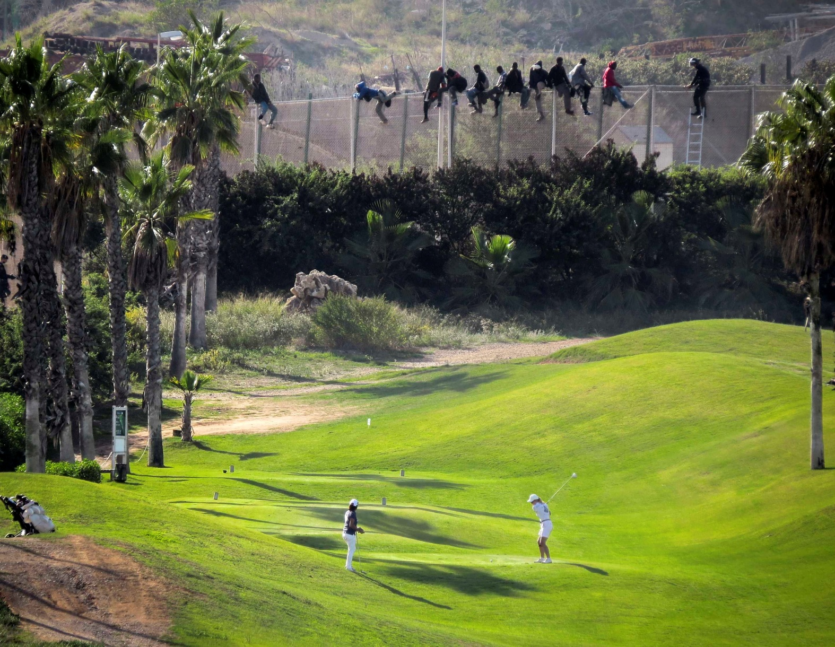

Slide 17
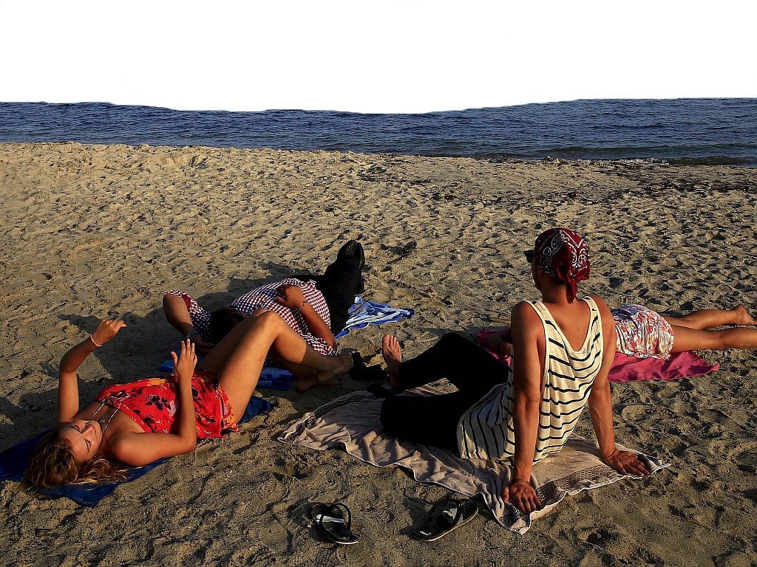

Slide 18
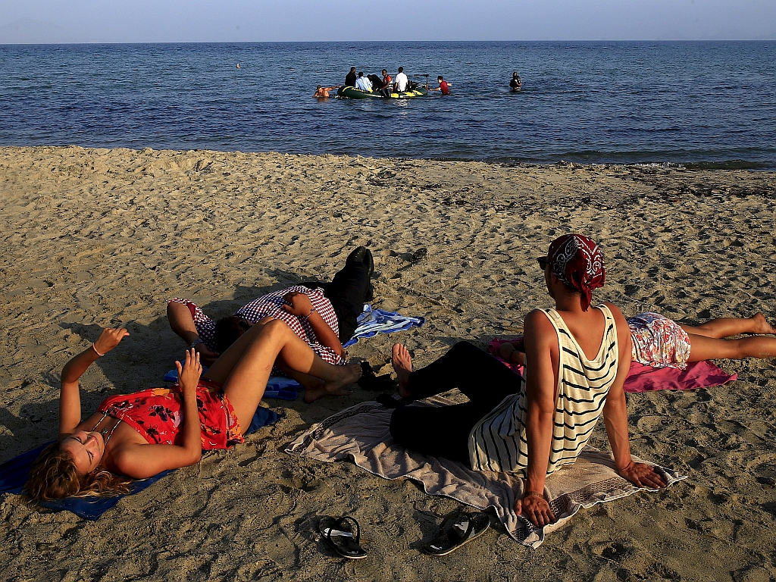

Slide 19
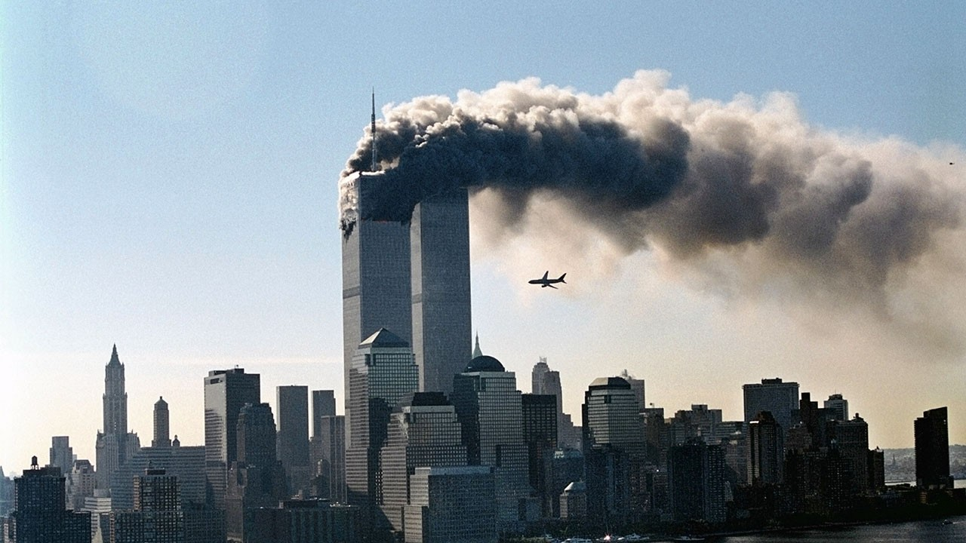

Slide 20
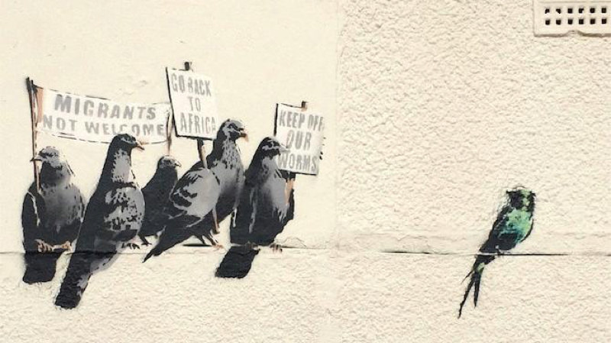

Slide 21
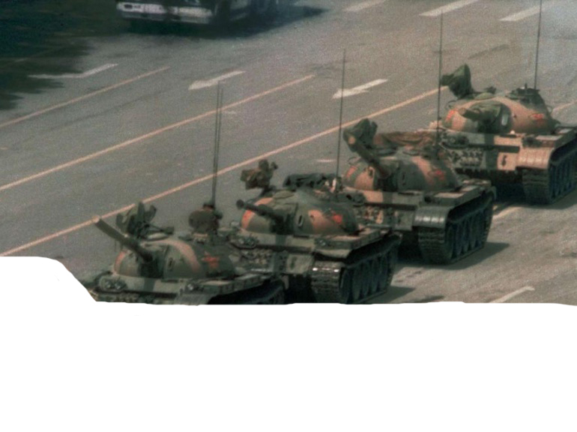
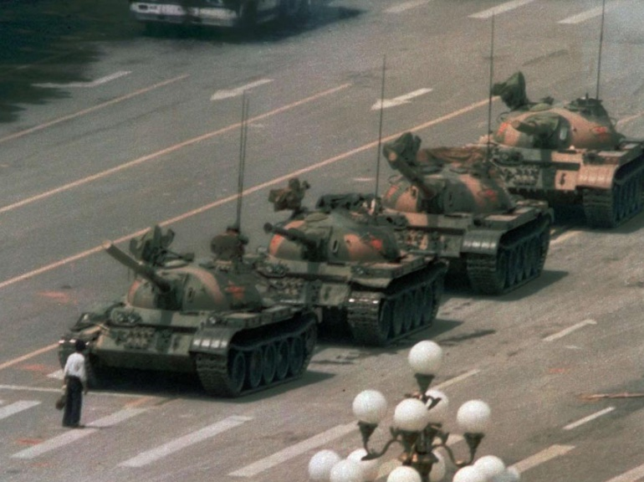

Slide 22
Activity 4: What story is being told? Media representation
Look at the headlines and decide whether they are welcoming or unwelcoming to refugees, migrants and asylum seekers.
Why do you think the newspaper report the stories in this way?
How do you think the negative headlines might make people coming to this country feel?

Slide 23
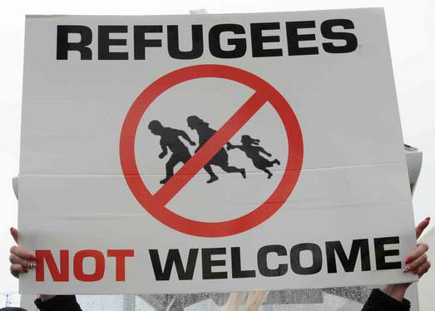
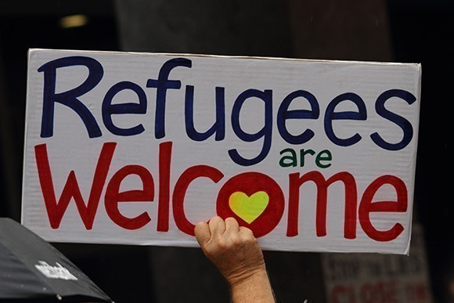

Slide 24
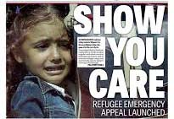

Slide 26
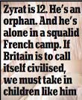
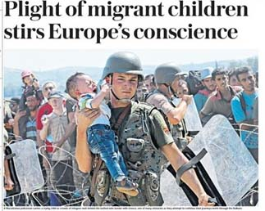

Slide 28
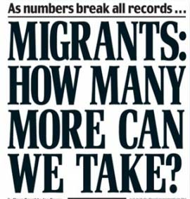
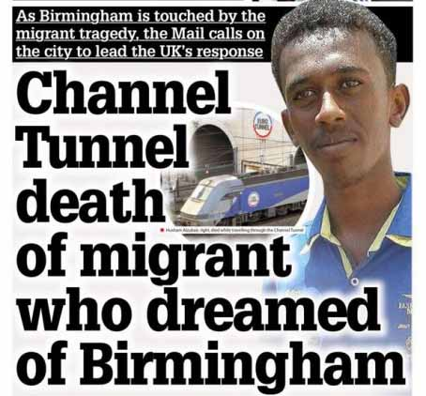

Slide 29
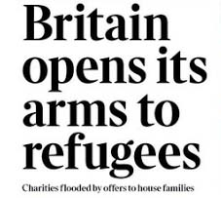
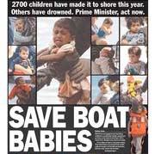

Slide 30
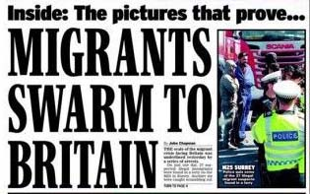

Slide 31
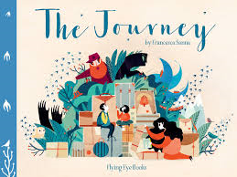
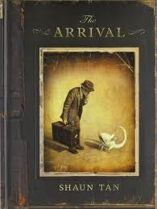
Useful children’s books for teaching refugee issues:

