Slide 1
SEALCC 2018
Building Capacity for Supporting Bilingual Learners in Primary Schools
Kim Almond (EAL Teacher)
Annabel MacWilliam (EAL Teacher)

Slide 2
Outcomes
What is the context for learning and teaching EAL in Edinburgh?
How is the EAL team in Edinburgh responding to the changing context?
What does the Edinburgh EAL capacity-building model look like?

Slide 3
Bilingual Profile in Edinburgh Schools
Percentage BME* learners: 25.8%
No. of different languages:
Most commonly spoken languages:
120+
Polish, Arabic,
Punjabi/Urdu, Mandarin, Cantonese,
Bengali
Developing bilingual learners
Learners with other additional support needs
Notes:
3

Slide 4
EAL in Edinburgh: The way forward
Increase in learners with EAL
Wider ASL context
HGIOS? 4 2.3 Learning & Teaching and 2.4 Universal Support
National Improvement Framework: focus on Literacy
EAL research base
All of the above have implications for provision

Slide 5
Research across Scotland has shown that teachers feel under-prepared and have an insufficient professional knowledge base to support the English-language development of children and young people learning English as an additional Language (EAL)
(Anderson et al, 2016; Foley et al, 2013 in
Moray House School of Education Election Briefings, 2016)

Slide 6
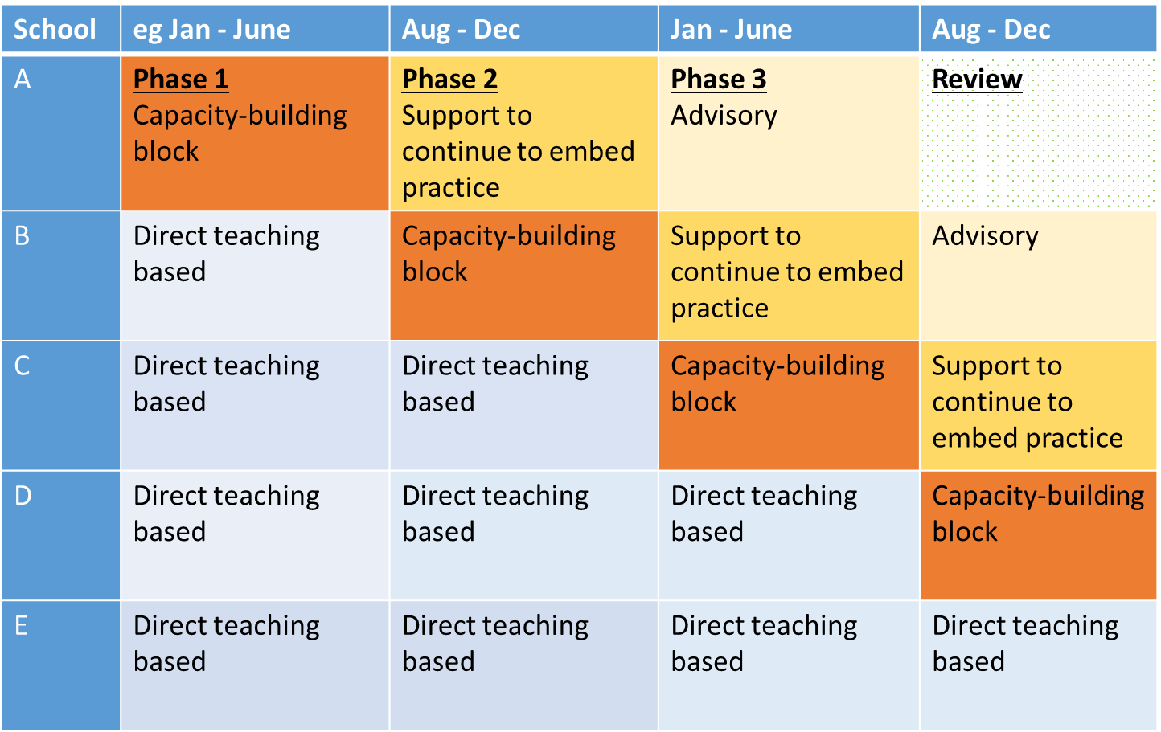

Slide 7
EAL support - Phase 1- 3
Learning and Teaching
Wider School work

Slide 8
Phases of EAL Collaborative partnership
 | Phase 1 | Phase 2 | Phase 3 | Phase 4
Focus of EAL support | Developing capacity of 3-4 class teachers’ key skills in learning and teaching. Developing capacity of whole school | Support to continue to embed and share practice within school | Advisory support to sustain approach and take forward next steps identified through evaluation of Phases 1 and 2. | Review
EAL Teacher support | 2 EAL Teachers, 2-3 full days / week | 1 EAL Teacher, 1 day / week | 1 EAL Teacher 1 morning/fortnight or month | To be confirmed
Numbers of participating schools to date | 7 | 6 | 3

Slide 9
Format: Phase 1 - Learning and Teaching
Core aims:
Analysing the language demands of the curriculum
Planning for language and content integrated learning and teaching
3-4 weeks set up, measuring start points, gathering background information | 8-10 week co-teaching block | 3-4 weeks measuring end-point, evaluations, identifying next steps (for phase 2)

Slide 10
Phase 1 - Learning and Teaching
Approaches
Teacher self-evaluation
Class observation
Joint planning
Co-teaching/team teaching
Reciprocal observations
Learner interviews
Measuring impact
Qualitative
Learner feedback/views
Teacher feedback/views
Teacher observation
Quantitative
Data (attainment)

Slide 11
IMPACT on Learning and Engagement
Pupils that usually need more support could keep up with the class/ lessons as the lessons were broken down more
J and W are much more engaged in independent tasks. Sometimes they will even attempt the harder challenges
Children have improved on their partner talk – it is now ALWAYS about the lesson/ question
Pupils have a lot more of a broader understanding of language of maths and can apply this to language elsewhere
CS, in particular has been more on task and contributing to discussions, using vocab that has been talked about
W’s participation & talking has increased enormously (compared to zero at the start!)

Slide 12
Teacher feedback
Video removed – reduced file size

Slide 13
Phase 1 – wider school development
Core aims:
Whole school development work - usually 2 main focus areas:
Stages of English (identifying, tracking, planning)
Another key area taken from SLT self evaluation

Slide 14
Why understand Stages of EAL development?
External reasons
SEEMIS/ ScotXEd census: September update on Stages of English
ASL Act (2009)
Learning and Teaching reasons
Monitoring progress
Planning teaching
Assessment of other curricular areas

Slide 15
The EAL Learner’s task
Key
Stage 1 – blue 6-18 +months
Stage 2 – orange 6-18 + months
Stage 3 – green 2-3+ years
Stage 4 – red 2-3+ years
Stage 5 – purple 2-3+ years
English language learning required for school attainment
Time
Key
Stage 1: New to English – blue Stage 4: Competent – red
Stage 2: Early Acquisition – orange Stage 5: Fluent - purple
Stage 3: Developing Competence – green

Slide 16
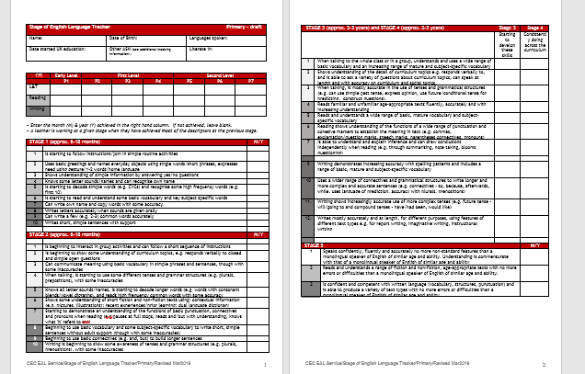
Assigning a Stage of English

Slide 17
Moderation using tracker
Listening and Talking
Case study task – which stage?
What are the features of this stage?

Slide 18
Stage 2 Features
Stage 3 Features
When talking to the whole class or in a group, understands and uses a wide range of basic vocabulary and an increasing range of mature and subject specific vocabulary
Shows understanding of the detail of curriculum topics e.g. responds verbally to and is able to ask a variety of questions about curriculum topics, can speak at length and with accuracy on social topics
When talking is mostly accurate in the use of tenses and grammatical structures (e.g can use past simple tense, express opinion, use future/conditional tense for predicting, construct questions)
Is beginning to interact in group activities and can follow a short sequence of instructions
Is beginning to show some understanding of curriculum topics, e.g. responds verbally to closed and simple open questions
Can communicate meaning using basic vocabulary in simple phrases and sentences though with some inaccuracies
When talking, is starting to use some different tenses and grammar structures (e.g. plurals, prepositions) with some inaccuracies

Slide 19
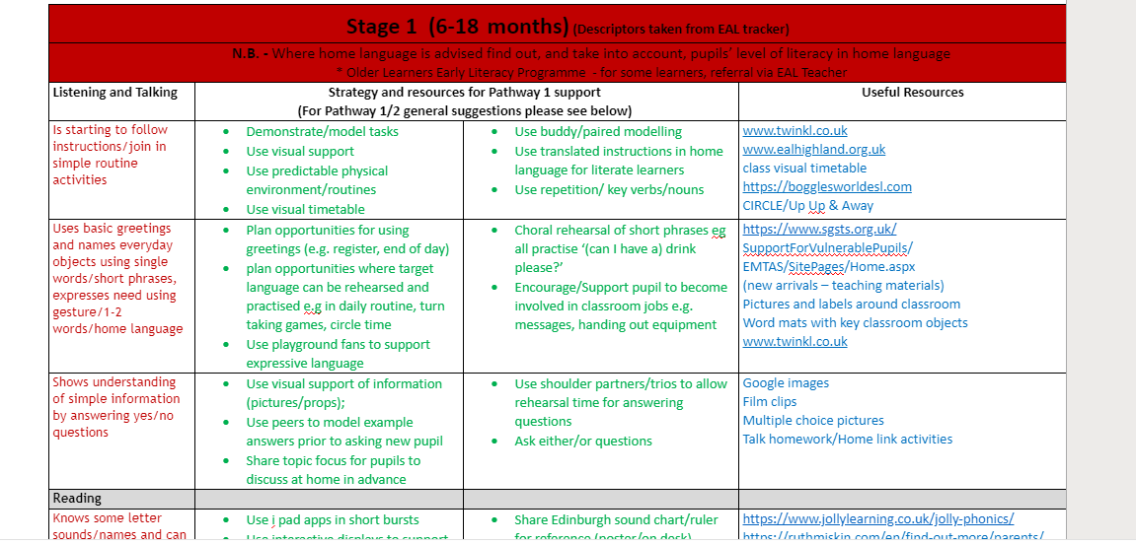
Supports and strategies by stage and descriptor

Slide 20
Impact from Phase 1: Head Teacher views
Video removed – reduced file size

Slide 21
Format: Phase 2 and 3
Staffing
Reduced EAL teacher time
Aims (developed from evaluation of Phase 1)
Embedding practice
Transfer to other areas of the curriculum
Sharing /cascading practice with stage partners: learning triads
Ongoing whole-staff training (annual, incremental)
Continued wider school work

Slide 22
Questions/Thoughts/Feedback

Slide 23
คุณขอบคุณ
謝謝
asante
cảm ơn bạn
teşekkür ederim
merci
dank u
gracias
ありがとう
takk
хвала
σας ευχαριστώ
شكرا
danke
ačiū
آپ کا شکریہ
dziękuję
cпасибо
grazie
obrigada
감사합니다
köszönöm

