Slide 1

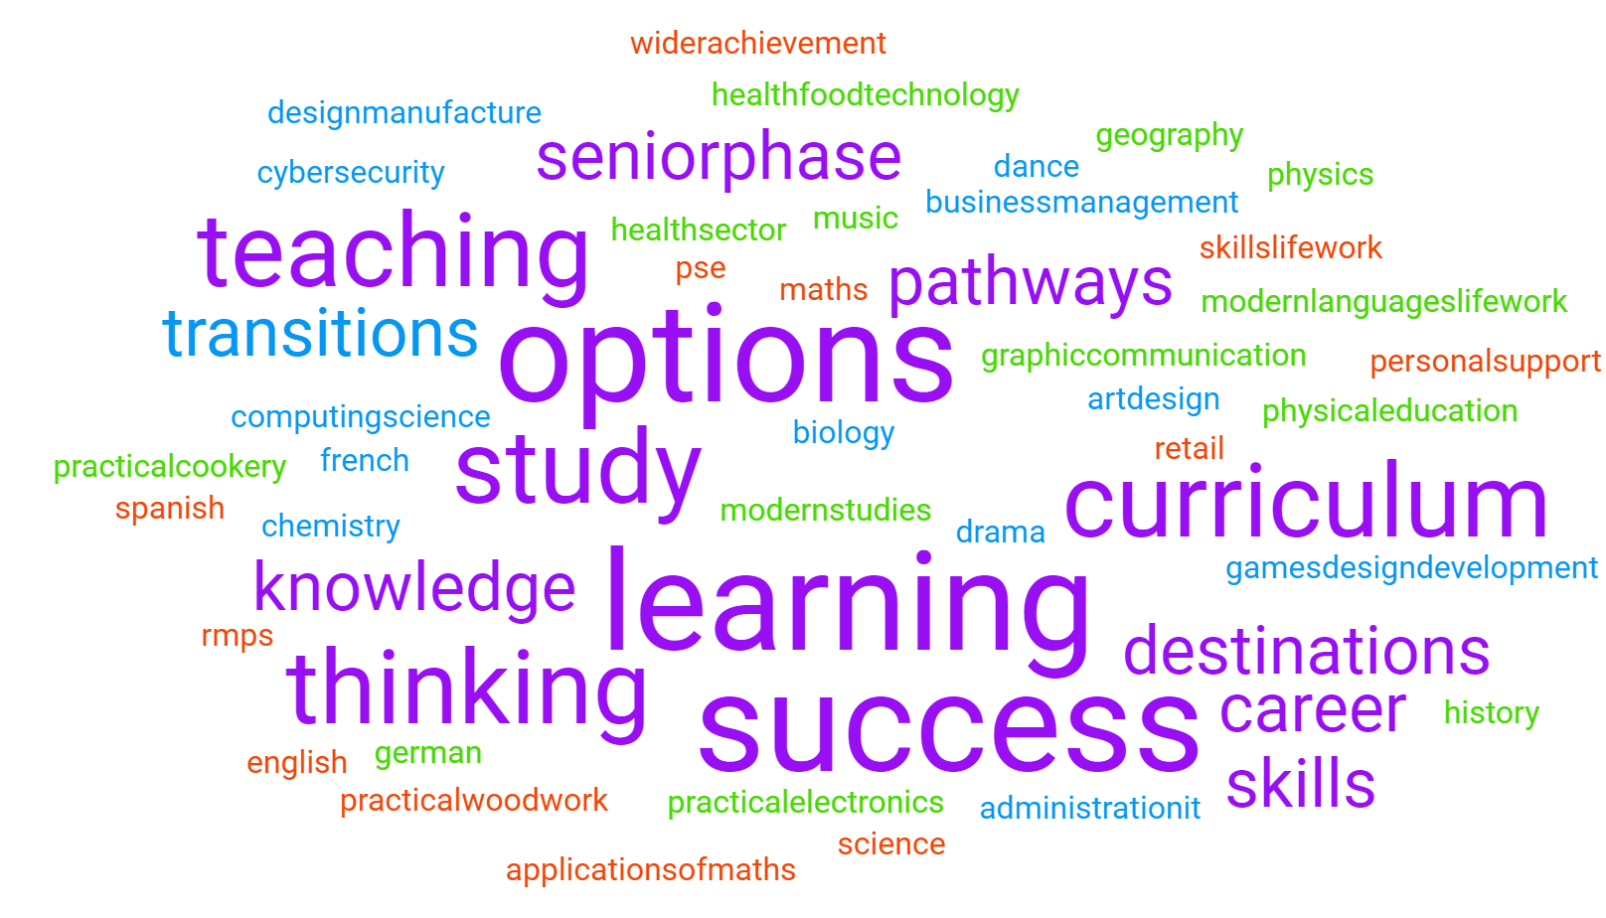
Senior Pathways Evening
Rosshall Academy
Respect Kindness Ambition Equality

Slide 2

THIS EVENING…
Options Process- K King (DHT Transitions)
Raising Attainment – A McAleese (PT Raising Attainment)
SCQF Framework – S Cunningham (PT Pathways & Achievement)
Careers/ HE FE Entry Requirements update(PT Family Engagement & Employability)
Curriculum and Careers Carousel

Slide 3

AIMS OF REVISED OPTIONS PROCESS
To enhance the transition into the Senior Phase
To reduce restriction in subject choice
To ensure that meaningful decisions are made
To ensure young people are reaching their full potential in their best areas
To raise attainment

Slide 4

Reporting/ Parents evening
Current S3
- Full reports issued December 2024
- Parents Evening complete (Nov 24)
Current S4
- Full reports issued January 2024
- Prelim Analysis
- Parents Evening complete (October 24)

Slide 5

PASTORAL CATE OPTIONS MEETINGS Revised
From 15th January
Prior access to Pathways booklet for full subject list
1:1 meeting with Pastoral Care and pupil
career interests and related subjects
Access to SDS support
subjects where the young person shows strengths
Robust tracking
subjects the young person enjoys / is most interested in
information provided by teachers in the S3 report
Progression in subjects/departments already undertaken from S2 preferences
Agreement as to subject choice

Slide 6
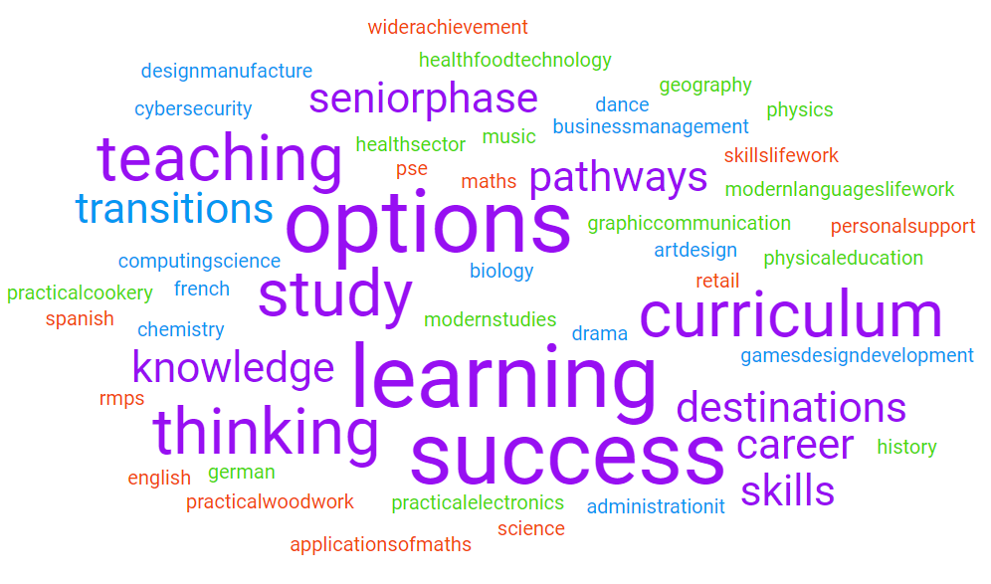
SUBJECTS STUDIED BY ALL IN S4
NQ English or ESOL (four periods per week)
NQ Maths or Applications of Maths (four periods)
Core PE (two periods)
Core RMPS (one period)
PSE (one period)
Personal Support (2 x 25-minute periods)

Slide 7
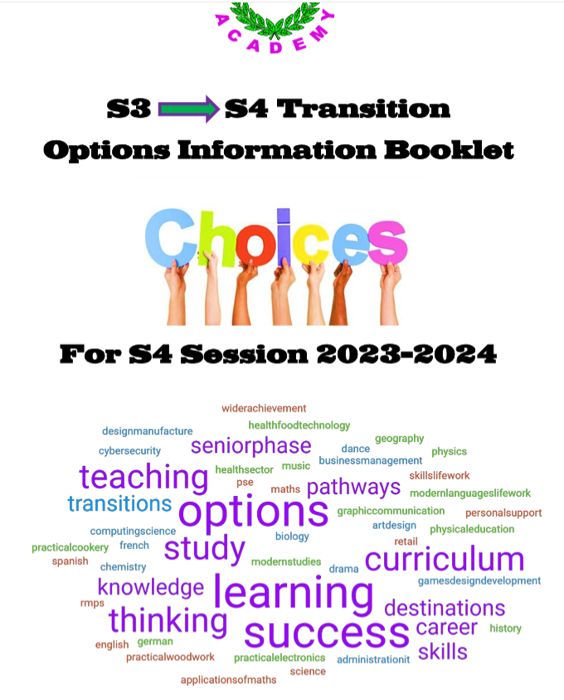
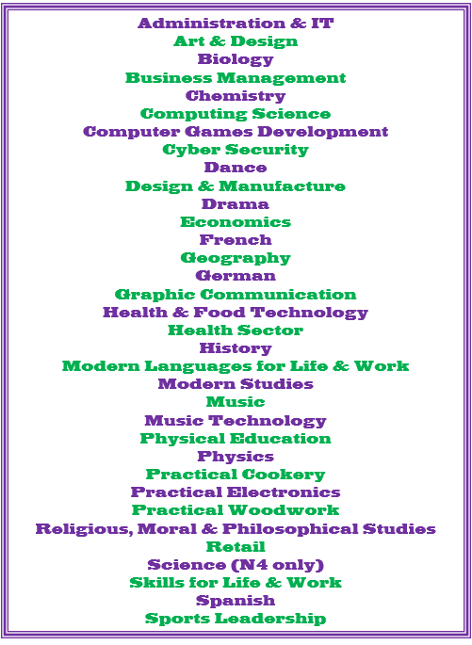
MAKING CHOICES (Options Booklet)
All pupils will choose a further five subjects
Free choice as to what these five subjects are (i.e. no column structure)
Guidance will be provided at options meeting
Everyone will select an additional two back-up subjects

Slide 8
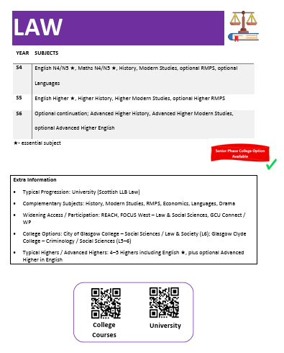

Pathways Booklet
https://blogs.glowscotland.org.uk/glowblogs/rosshall/parent-carer-info/

Slide 9
PROGRESSION INTO S5/6
Current S4 students
Will study five NQ subjects – six periods each
Where possible, select five of your seven S4 subjects for progression into S5
Consider S5 and S6 holistically
All S5 students should select English as one of your options
Current S5 students
Will study a minimum of four subjects
Where possible, aim for progression from subjects studied in S4/5
A subject studied in S4 but not in S5 could be picked up again for S6
S6 students may also opt to select a subject or subjects which you have not previously studied – you should speak to Pastoral Care and individual departments about the appropriate level of study for you

Slide 10
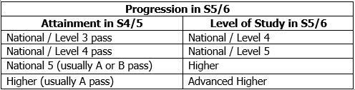

PROGRESSION INTO s5/6
Notes:
AH – several in school, plus GCU hub

Slide 11
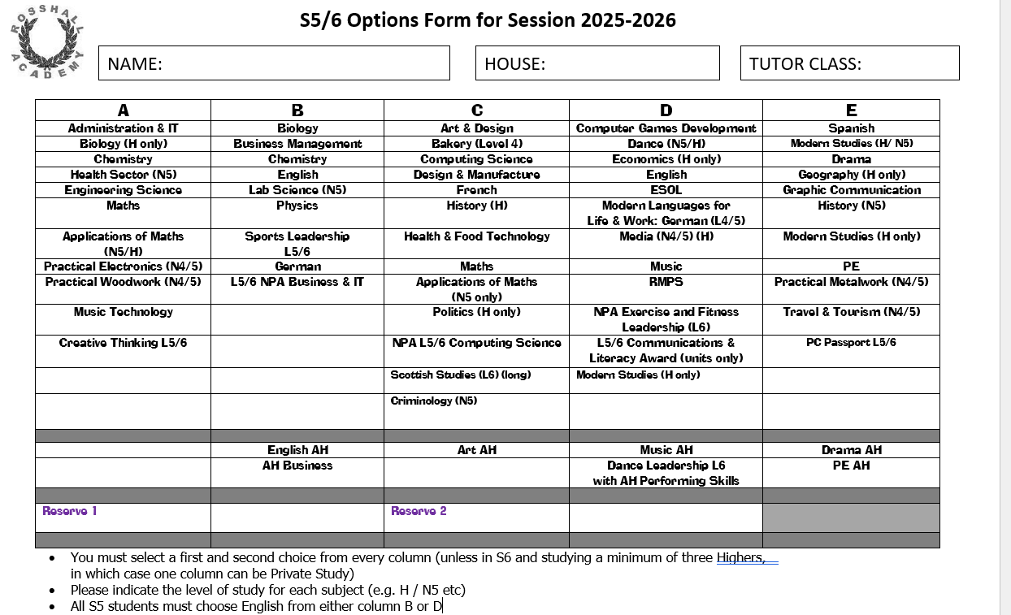
DRAFT

Slide 12
IMPORTANT INFORMATION
Pathways Booklet and options form will be emailed and will be available on the school website
Reports are issued for S3 and are due to be issued shortly for S4
You will have a meeting with your Pastoral Care teacher to discuss your options
Options must be finalised by
Friday 31st January (Current S3)
Friday 14th February (Current S4)
Additional AH / SCQF courses may be added later
You will have an opportunity to review your options through the new TT in May – August

Slide 13

Preparation Checklist
Read your report carefully
Read the Pathways booklet
Speak to your teachers to find out more about subjects &
assessment in S4/S5
Think about your possible career interest(s) & find out about the
subjects required
Identify your strongest subjects, & also the ones you enjoy &
are most interested in
Have discussions at home about the subjects you may wish to study

Slide 14

Raising Attainment Mr McAleese
Aims for presentation:
To share information about the BGE curriculum structure and the levels pupils should be working at in S3
To discuss how these pathways tie into Senior Phase qualifications
To share the S4/5/6 options/ qualifications structure

Slide 15
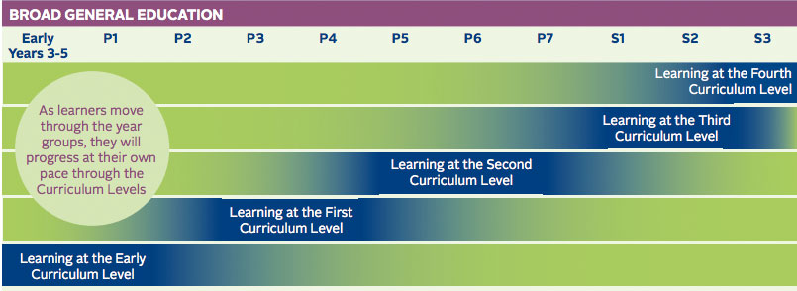
BGE Curriculum

Slide 16
Key Points of BGE
Work through experiences and outcomes at each level in eight curricular areas
Pupils work through BGE at most appropriate level within school curriculum
Evidence collected to assess level at any given stage
Designed to prepare pupils for senior phase

Slide 17
Pathways From S3
S3 S4 S5 S6
8 7 5 5
Lv4 N5 H AH
Lv4 N5 H H
Lv3 N4 N5 H
Lv3 N4 N5 N5
Lv2/3 N3/N4 N4/N5 N5
Notes:
Key point – end point at end of S4, S5 or S6 will be very different for different groups of pupils.
Two year higher or two year N5 – first year focus on NABs, 2nd year consolidate & sit exam.
Some will leave S6 with 8/9 subjects at higher / advanced higher & some with 5/6 N5

Slide 18
Qualification Structure S4
SQA NATIONAL 3/4 (internally assessed – pass/fail)
–3 Compulsory Unit Assessments
–Added Value Unit (N4 ONLY)
–All internally assessed
SQA NATIONAL 5 (external exam - passes graded at A,B and C)
–Units no longer compulsory but may still be used
–Can vary from subject to subject
–Longer exams
–Introduction of exam element to practical courses

Slide 19
SCQF - Ambassadors, Learner Pathways and Progressions

Slide 20
What is it and what does it do?
It’s Scotland’s lifelong learning framework – designed to help people of all ages and circumstances to access appropriate education and training over their lifetime, so as to fulfil their personal, social and economic potential
It helps people understand qualifications and how they relate/compare to one another
It helps people plan their learning and provides a mechanism for making better informed choices
It recognises people’s learning and gives them credit for what they’ve achieved. This means that it can support credit transfer.

Slide 21
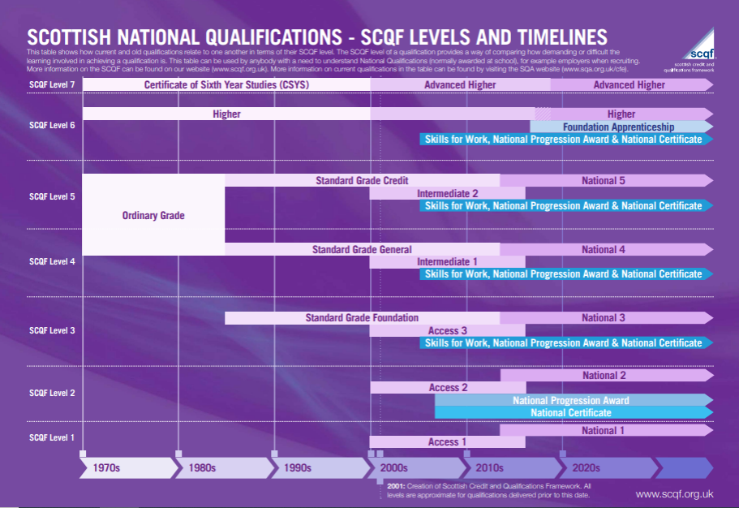

Slide 22
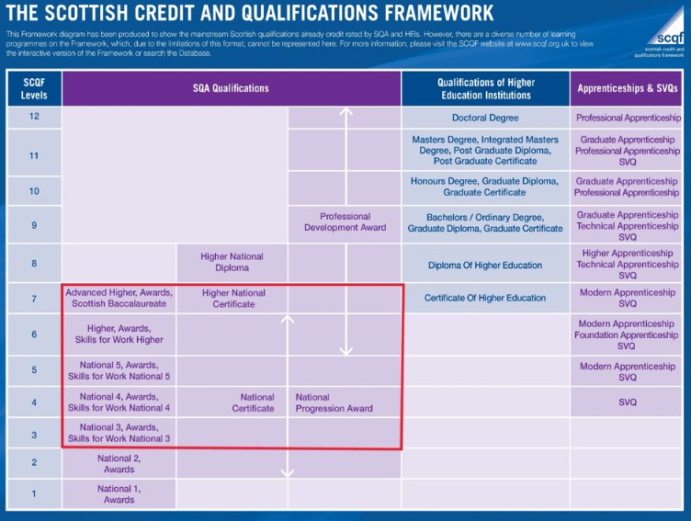
SCQF in Schools
SQA qualifications up to SCQF level 7 are offered in school ​
Nat 4 = SCQF level 4​
Nat 5 = SCQF level 5​
Higher = SCQF level 6​
Adv Higher = SCQF level 7​
Many other qualifications available include SfW, NPAs, Apprenticeship Awards

Slide 23
Mr Clelland
PT Employability & Family Engagement

Slide 24
Rosshall Academy- 2023/24 Destinations a Positive Picture…
96.9% positive destinations
College
University
Job
Training

Slide 25
Applications of Maths and University
Courses where Higher Application of Maths IS generally accepted:
Strathclyde
Law
Teaching/ Primary Teaching
Social policy
Psychology
Politics and International Relations (Social Sciences)
GCU
Accountancy
Games Development
Computing Software Development
Nursing - National
Paramedic Science

Slide 26
Applications of Maths and University
Courses where Higher Application of Maths IS NOT generally accepted:
Engineering (all types)
Digital Security
Forensics
Audio Technology
Cyber Security and Networks
Maths
Most University of Glasgow courses (see university site)

Slide 27
Download today via the school website

Slide 28
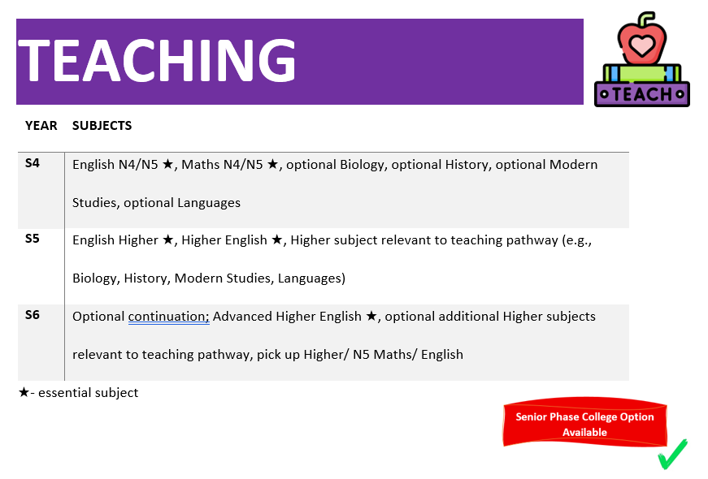

Slide 29
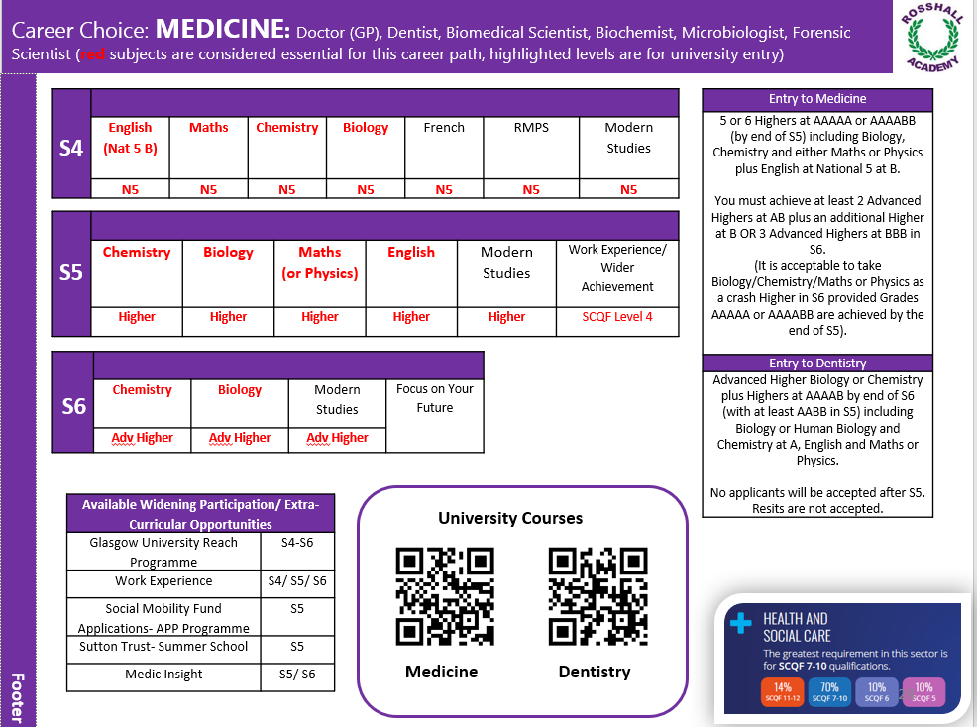

Slide 30
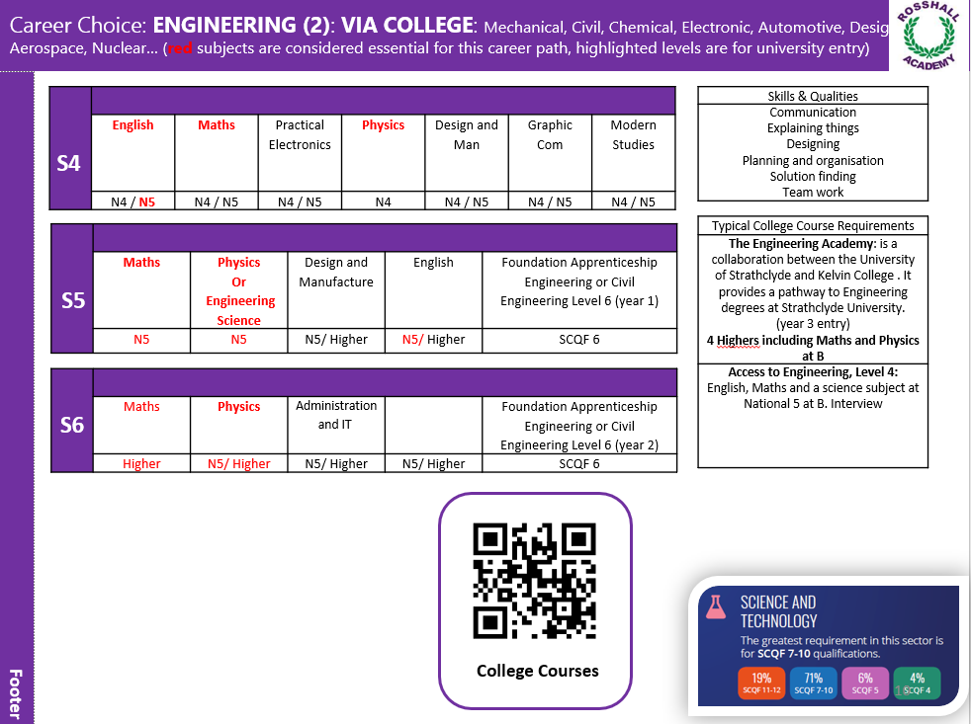

Slide 31
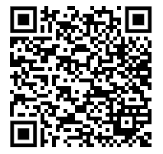
Option Pathways Booklet
Link will be sent to pupils and parents tomorrow via email

Slide 32
ENGLISH DEPARTMENT

