Slide 1
Rosshall Academy- 2021/22 Destinations a Positive Picture…
96% positive destinations
College
University
Job
Training

Slide 2
University | 68
College | 99
Training | 11
Employment | 46
Unemployed | 13
Total | 237
Grand Total
237

Slide 3
Thinking of leaving school? College applications are now open for August 2022

Slide 4
Popular progressions include…
Childcare
Engineering
Trades
Social sciences-based courses at college/ university

Slide 5
Engineering
Pupils tend to stay on until S6
Essential Subjects:
Physics (any science for Civil Engineering)- Higher A
Maths- Higher B or above by end of S6
English- Nat 5 B or above (Higher English preferred)

Slide 6
Trades/ Construction
Pupils tend to look to leave at the age of 16 (end of S4/ S5)
Essential Subjects:
Entry level college course- no qualifications needed, interview + reference
Maths- National 4
English- National 4
Apprenticeships:
National 4/5 in Maths, English and a Technical Subject or a Science.

Slide 7
Childcare (Nursery Teacher)
Pupils tend to look to leave at the age of 16 (end of S4/ S5)
Essential Subjects:
3 subjects at National 4 including English.
Interview
Work experience desired
Modern Apprenticeships:
No formal qualifications needed
Genuine desire to learn
Interview
Pupils gain SVQ Social Services (Children and Young People) at SCQF Level 7 whilst earning £9500.40 / £5.22ph p/h
See https://www.carouseltraining.co.uk/apprenticeships/faqs/ for more details

Slide 8
Medicine/ Dentistry
SQA Higher Entry Requirements (by end of S6)
AAAAA Higher at end of S5 + BBB Advanced Higher or AB Advanced Higher + B Higher in S6
Additional requirements: Highers Chemistry, Biology and Physics or Mathematics. National 5 English at Grade B.
UCAT (www.ucat.ac.uk for more information).
Interview
[above is similar for Vet Medicine and Dentistry, see university websites for more info]

Slide 9
Opportunities
We have access to lots of opportunities at Rosshall Academy
See here for more details:
https://blogs.glowscotland.org.uk/glowblogs/rosshall/current-opportunities/
https://twitter.com/RAfamilies_Jobs
https://blogs.glowscotland.org.uk/glowblogs/rosshall/weekly-bulletin/
Important pupils let us know their plans as early as possible
Surveys
Pastoral Care
Mr Clelland
Options Process

Slide 10
Widening Participation Opportunities at Rosshall Academy
Access to a Career (S4-S6)
Reach Programme (S4-S6)
Note- participation can depend on postcode/ FSM entitlement- pupils should speak to Mr Clelland individually

Slide 11
Access to a Career Programme
The Access to a Career Programme works with S4-S6 pupils interested in pursuing a career in:
Engineering
Accountancy and Finance
Teaching (Primary, Technological and RE)
Completing programme means pupils benefit from adjusted entry requirements into these degrees at university

Slide 12
Reach Programme
Reach is a programme that works with S4-S6 pupils with an interest in and ability to study a degree in
Dentistry
Law
Medicine
Veterinary Medicine and Surgery
Successful completion means gain adjusted entry requirements to the Schools of Dentistry, Law, Medicine and Veterinary Medicine at Glasgow.

Slide 13
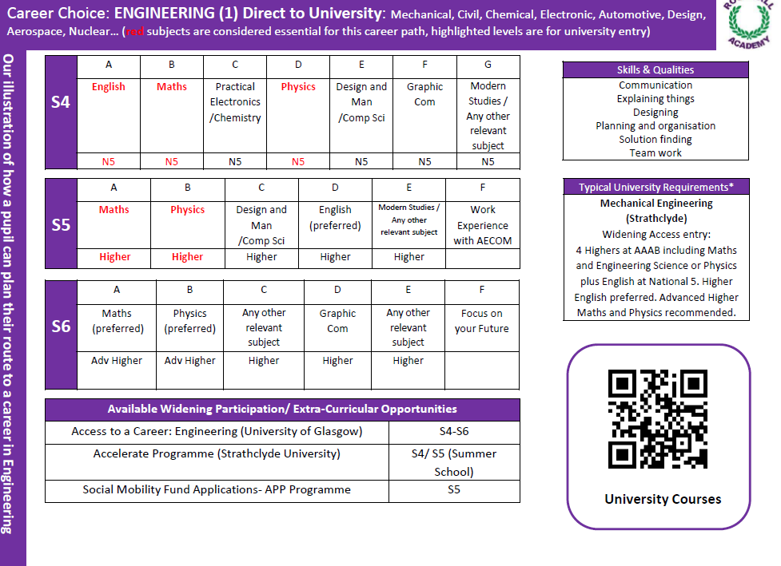

Slide 14
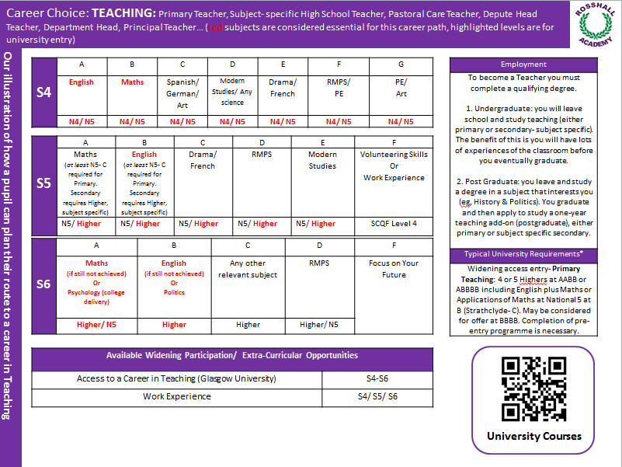

Slide 16
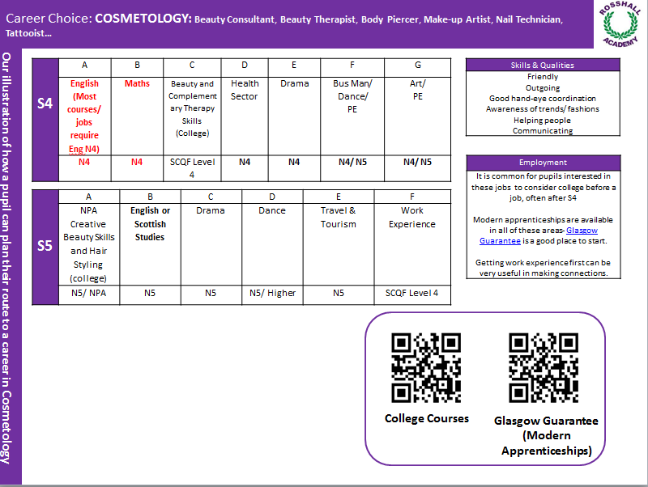

Slide 17
Suggested sites
https://www.planitplus.net/
Search engine for all courses across Scotland, includes jobs, requirements and course content info
https://www.glasgowguarantee.org/
Site that collates all available Apprenticeships/ Modern Apprenticeship available to Glasgow residents

Slide 18
Mrs Karen McConnell
PT Destinations, Partnerships and Developing Young Workforce

Slide 19
What is college as part of Senior Phase?
Pupils are enrolled with partner college.
Glasgow Clyde, City of Glasgow, Glasgow Kelvin
Completing the courses as part of Senior Phase timetable.
Mainly take place Tuesday and Thursday afternoons
Foundation Apprenticeships in S5/6
S6 Up to 3 days commitment

Slide 20
Who is this for?
Glasgow’s strategy is for 100% positive destinations for 2023.
Therefore:-
If you are offered and accept a place you need to be committed to following it through to April 2024. May 2025 or S5/S6 Foundation Apprenticeships
Target group of pupils are those who are intending to leave at the end of session 2024.
The course chosen should be directly linked to career aspirations and other subjects being chosen.
Pupils must have excellent attendance (80%), attitude and behaviour.
Other options for those who need more support.

Slide 21
Levels of Courses
Level 4-6 Courses S4- S6 (National 4/5/6/7)
Some courses have minimum entry requirements e.g. must have N5 English pass therefore only open to pupils S5 and above or may require that certain subjects are being studied e.g. a science.
Important to read the entry requirements in the prospectus – available via school webpage.
Level 1-3 Courses S4 – S6 (N2/3)

Slide 22
Two types of college courses
Glasgow Schools College Provision
Offered to local authority partners
Majority of courses run on Tuesday/Thursday afternoons
Some are offered on different days
https://www.youtube.com/watch?v=yjZv3fOeyas&feature=youtu.be
Open Doors Courses
S5/6 ONLY
Glasgow Clyde – often Cardonald Campus which is within walking distance from school
Notes:
Last year some courses offered taster session in June to selected applicants.

Slide 23
Getting to College
Free Bus travel for young people.
https://getyournec.scot/nec/?opt=NEC-Card/301
Take documents to be checked and scanned at a local library – Glasgow Life support.
All young people will be expected to apply for a card and use this to get to and from college.
Select from the local college in the first instance
Glasgow Clyde Cardonald and City of Glasgow.
Consider the time to get to college, avoid missing lessons in school. Pupils may need to travel during lunch-break.

Slide 24
What kinds of courses are available include:-
We will provide a fact sheet with links to you-tube clips for some of these courses
Construction
Hairdressing
Cosmetology
Child Care
Social Work
Uniformed Services
Food, Drink Industries
Forensics
Up in the Air and Down on the Ground
Sport Industries
Intro to Scots Law
Automotive Engineering
NPA Professional Theatre Preparation
First Aid
Cyber Security

Slide 25
Competition for places
High demand for places, limited number on each course.
On average Rosshall Academy is given between 1 and 3 places on each course.
If accepted for a course it is essential that the pupil follow through and be committed to the course for the full length of the course.

Slide 26
Foundation apprenticeship who are they for?
S5 & S6 pupils only. Applicants need to be working towards at least 1 Higher by the end of S6
Different courses are referred to as “Frameworks”
We would suggest that this is in a subject that is required subject for the course example FA Mechanical Engineering is challenging if you are not already working at Higher Physics level in S5.
Suggestion, not exclusively pupils who are choosing:-
Sitting 5 Highers – University pathway
One - three Highers – Modern Apprenticeship, college pathway

Slide 27
Foundation apprenticeship frameworks
Civil Engineering
Engineering Systems
Mechanical Engineering
Social services: Children and Young People
Social Services: Health Care
Financial Services
Business Skills
Accountancy
Software Development
Hardware System Support
Creative and Digital Media
Health and Food Science
Scientific Technologies

Slide 28
Where do these take place
Glasgow Clyde – Cardonald, Langside, Anniesland Campus
Glasgow Kelvin – Riverside and Springburn
City of Glasgow – City Campus
Transport – travelling time
Consider travelling home from Kelvin from 4pm in December.

Slide 29
How allocation of places works
Rosshall Academy will be given an allocation of places for all Senior Phase pupils.
Average number of places for each course is between 0 and 3.
Really important that if you commit to a place that it is used. ALWAYS more applications than places.

Slide 30
Things to consider
Great stepping stone to further college courses
Variety of courses available, new skills, new people, college environment – consider the days the course is available
Will be making a commitment to attend for the full course programme – level of maturity required
Pupils will be expected to keep up with any classes missed, we will work to keep time out of class to a minimum
Excellent attendance

