Slide 1
Getting to know your iPad: Homework on Teams/Office Lens

Slide 2
A Quick Reminder…
If you do not yet have your iPad – we know!
Ms Lamont and Miss Edwards will call you to get your iPad issued when we have time.
Do not come round to see us, especially during class time, ‘to get your iPad’ if we have not specifically arranged this with you. We cannot simply hand you an iPad, it takes time to set up.
No one can get your iPad on your behalf.
If you still do not have Self Service, or still have issues downloading apps, you should email your Computer Username and Asset Tag (the PT number on the back of the iPad) to Ms Lamont.

Slide 3
Common Questions/FAQ’s
Internet issues? Turn your iPad off then on again. Go to Safari. Wait for the ‘Proxy’ pop up and enter your computer username and password.
If you forget your password ask a member of staff to reset it. You must log onto a computer and change it from the default ‘welcome’ to something else.
‘Verify Apple Id’ pop up? For S 1- 4 your passcode is 020508. S5 & 6 set their own, if you have forgotten this, email Ms Lamont
Self Service issues - known issue still slowly being fixed
Battery not charging all the way? Let your iPad drain completely of battery, leave it over night not on charge, charge it in the morning. Best to do this at a weekend!
iOS update? Do this in the evening, plugged into your charger and on WiFi.
Locked out of your iPad? S1 – 4 all have the same code. S5 – 6 can see Ms Lamont for a reset.

Slide 4
Digital Ambassadors
You can also ask for help from our Digital Ambassadors!
You can contact them via twitter at @RosshallDigiAmb
You can go to the Genius Bar for in person help Tuesday Break in SF23!

Slide 5
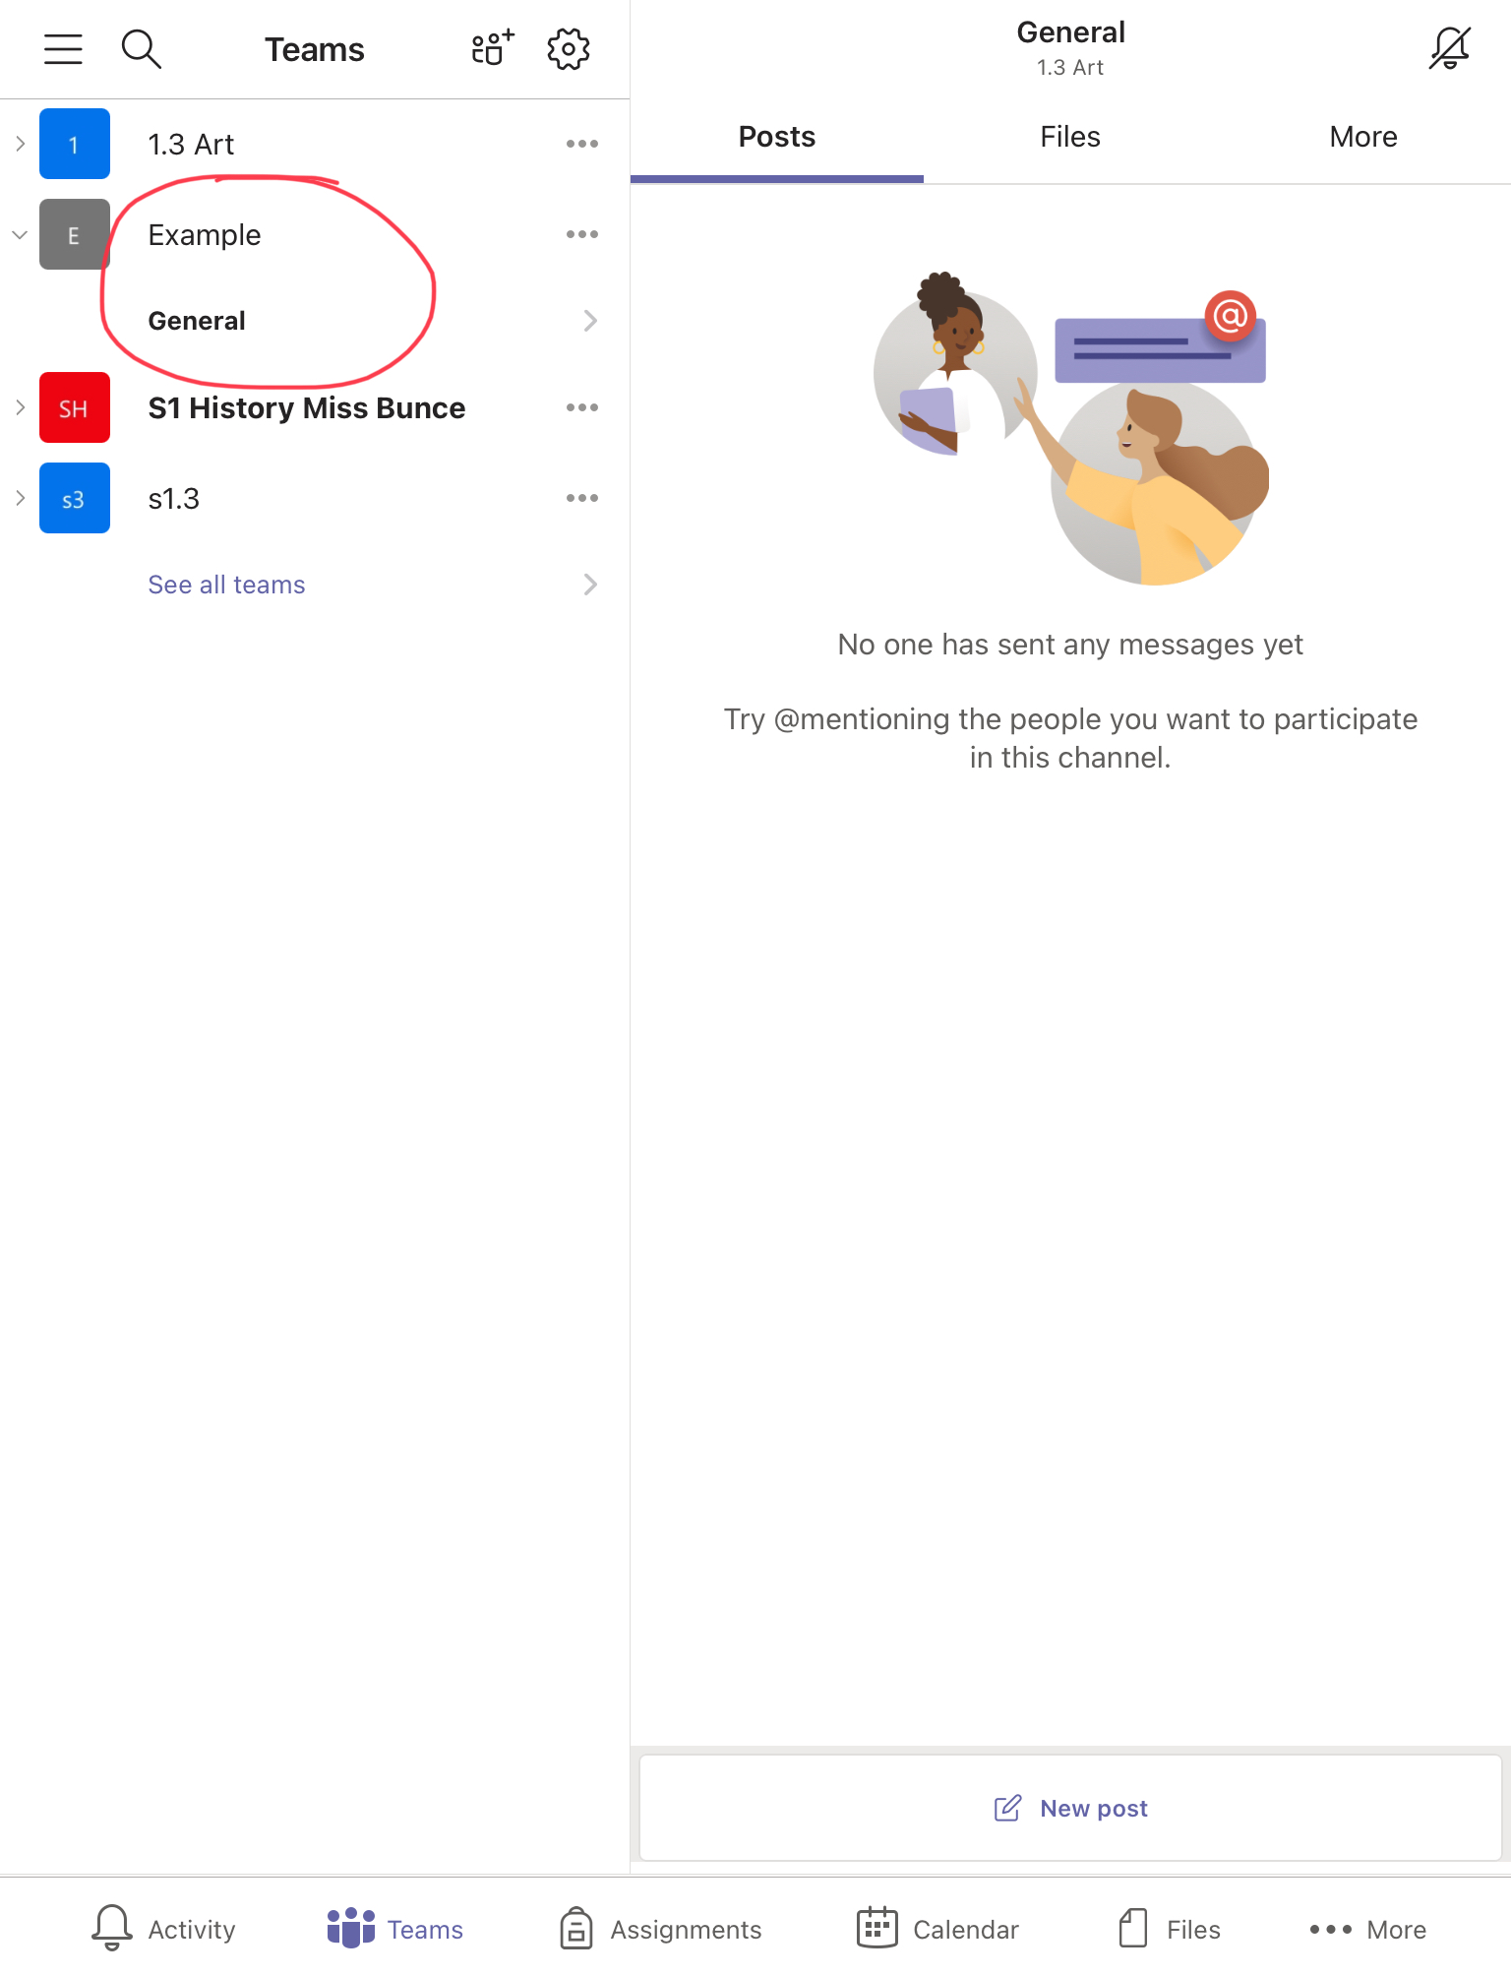
Find your Team

Slide 6
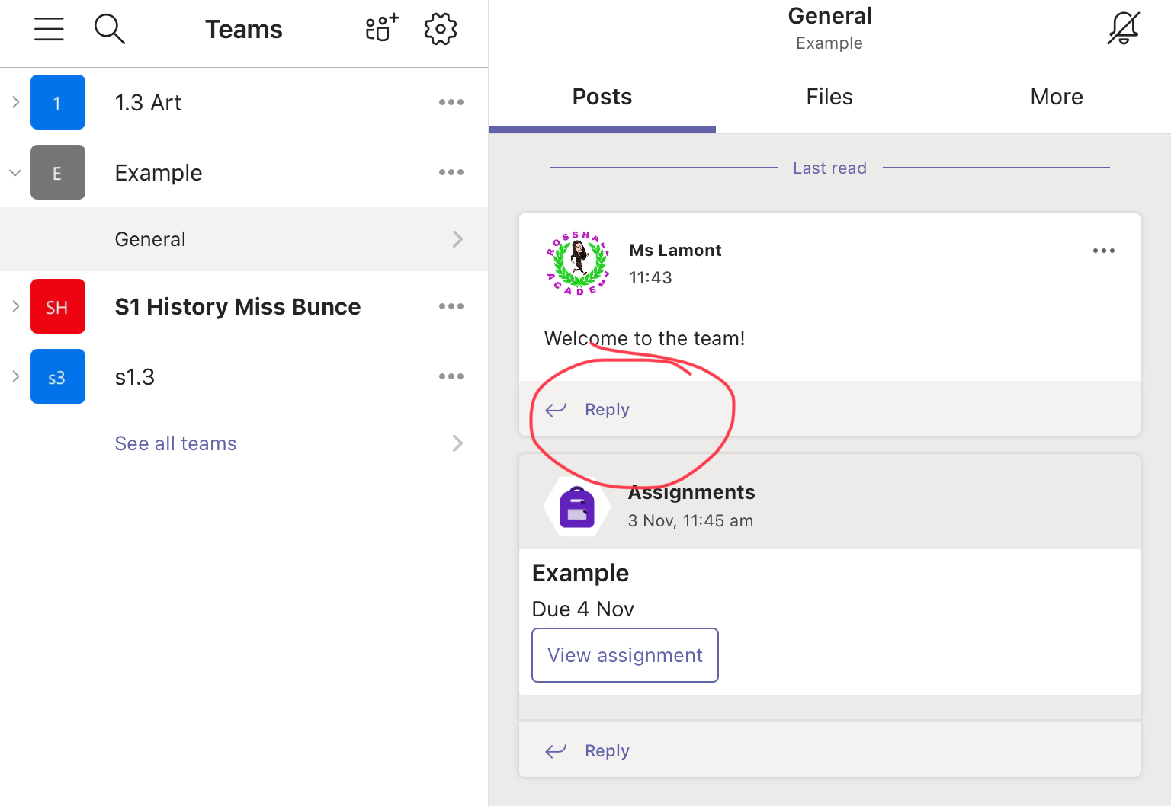
You can reply to a message from the teacher by using the Reply function.

Slide 7
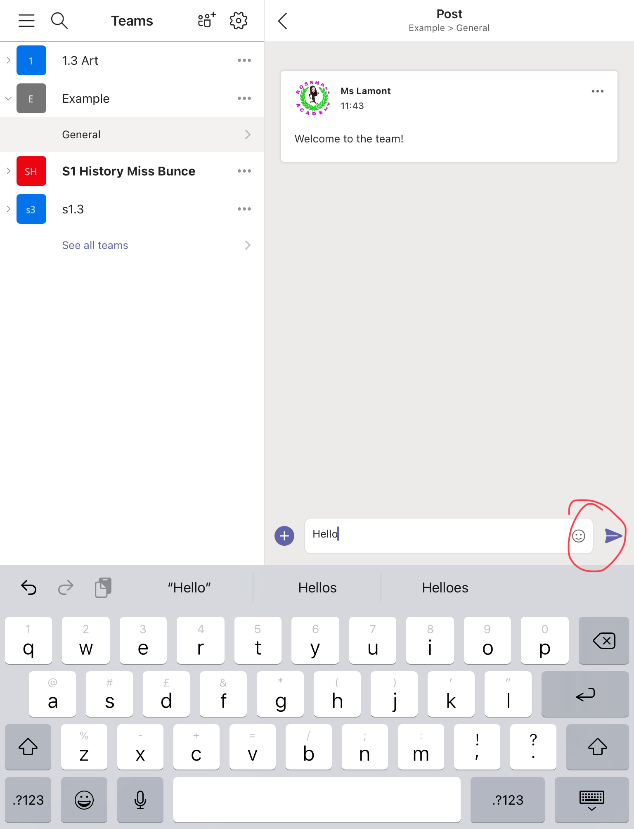
Just type in your message then hit the paper plane icon!

Slide 8
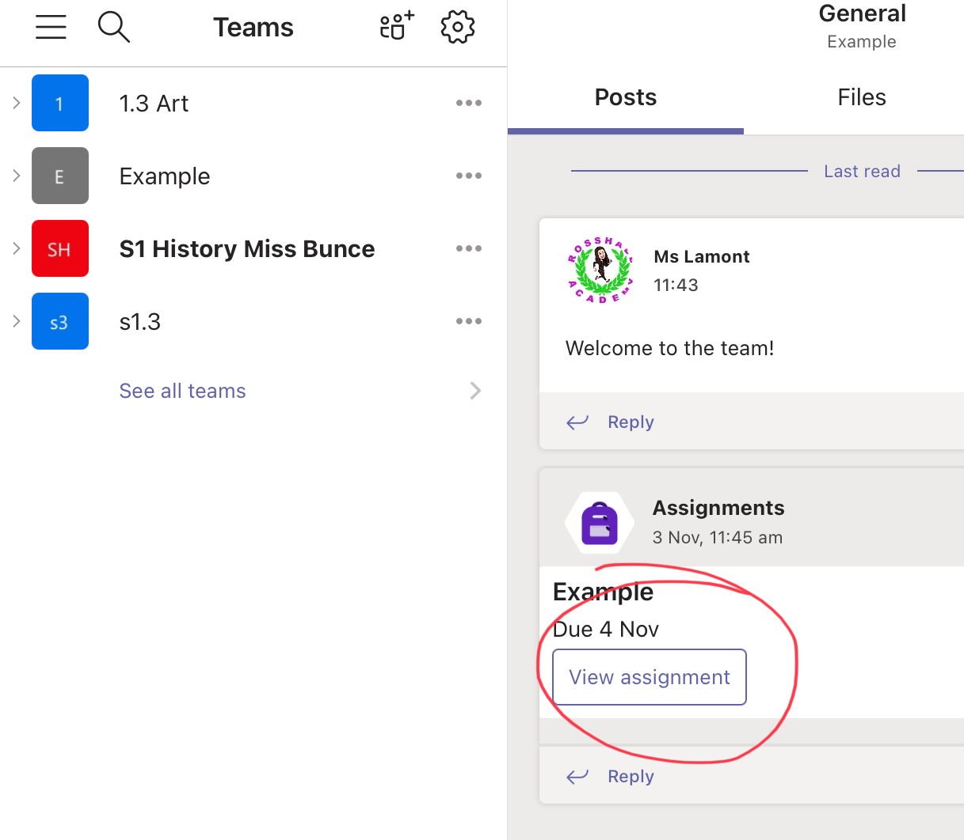
If you have homework, click on View Assignment

Slide 9
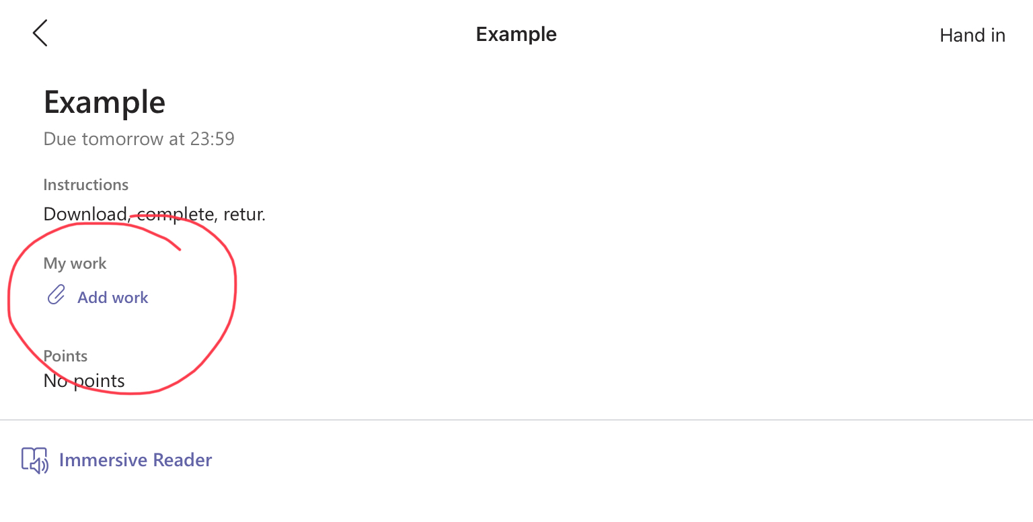
To return your homework, click on add work.

Slide 10
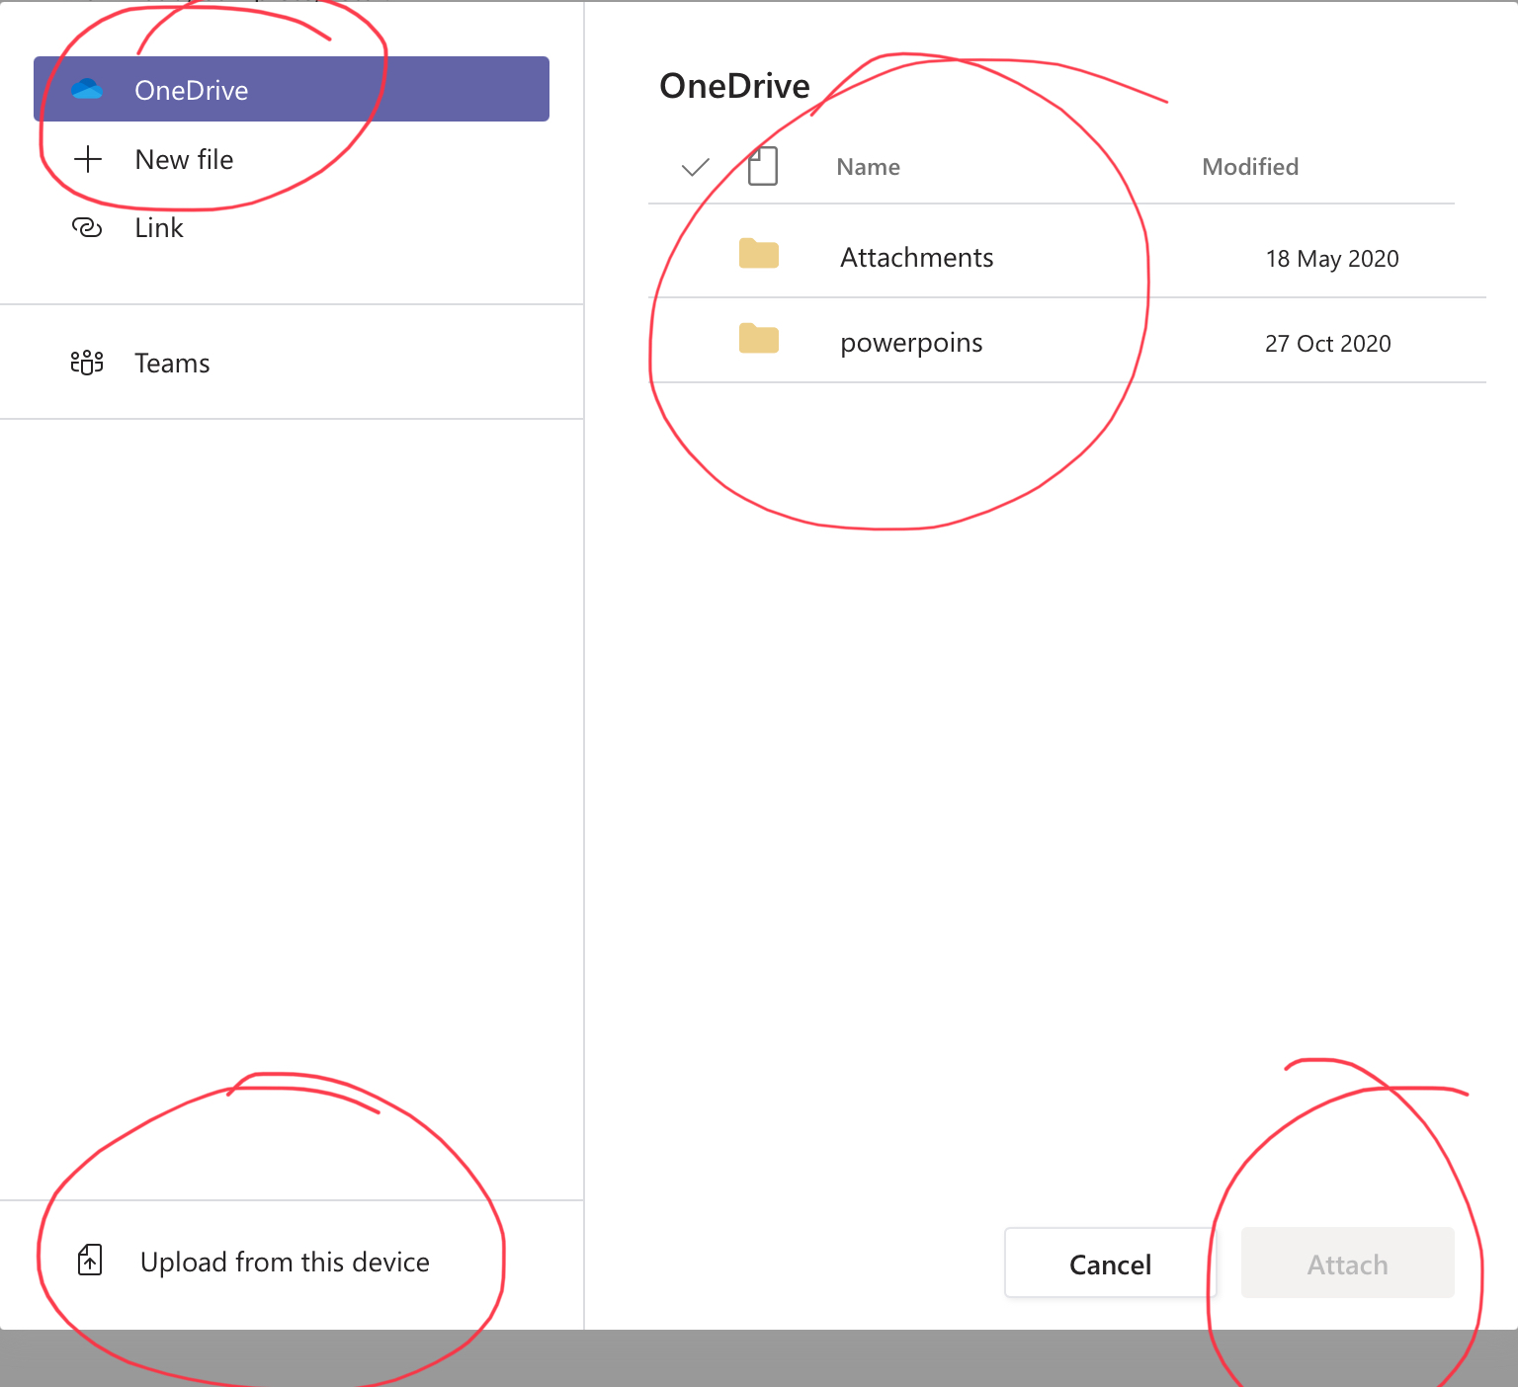
You can look through your OneDrive or files to find the document you have saved, or click ‘Upload from Device’ if it is a picture you have taken. Then click Attach.

Slide 11
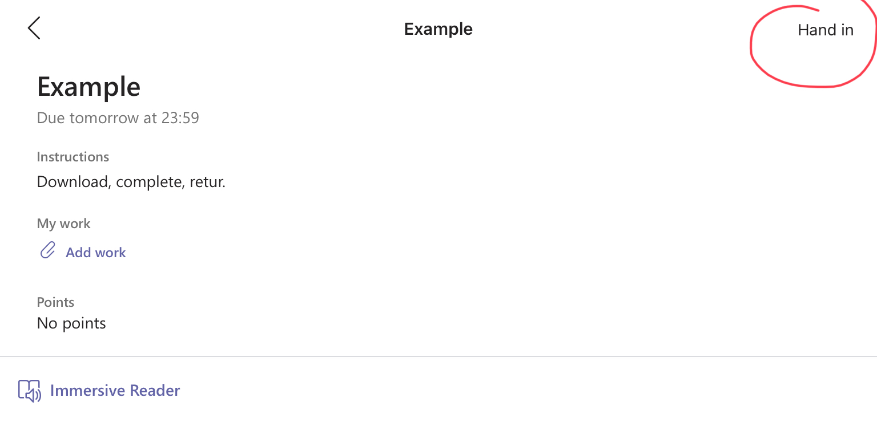
Make sure you click on ‘Hand in’!

Slide 12
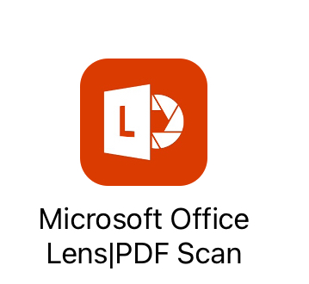
If you have written/drawn your homework, you can use the Office Lens app to upload it digitally!

Slide 13
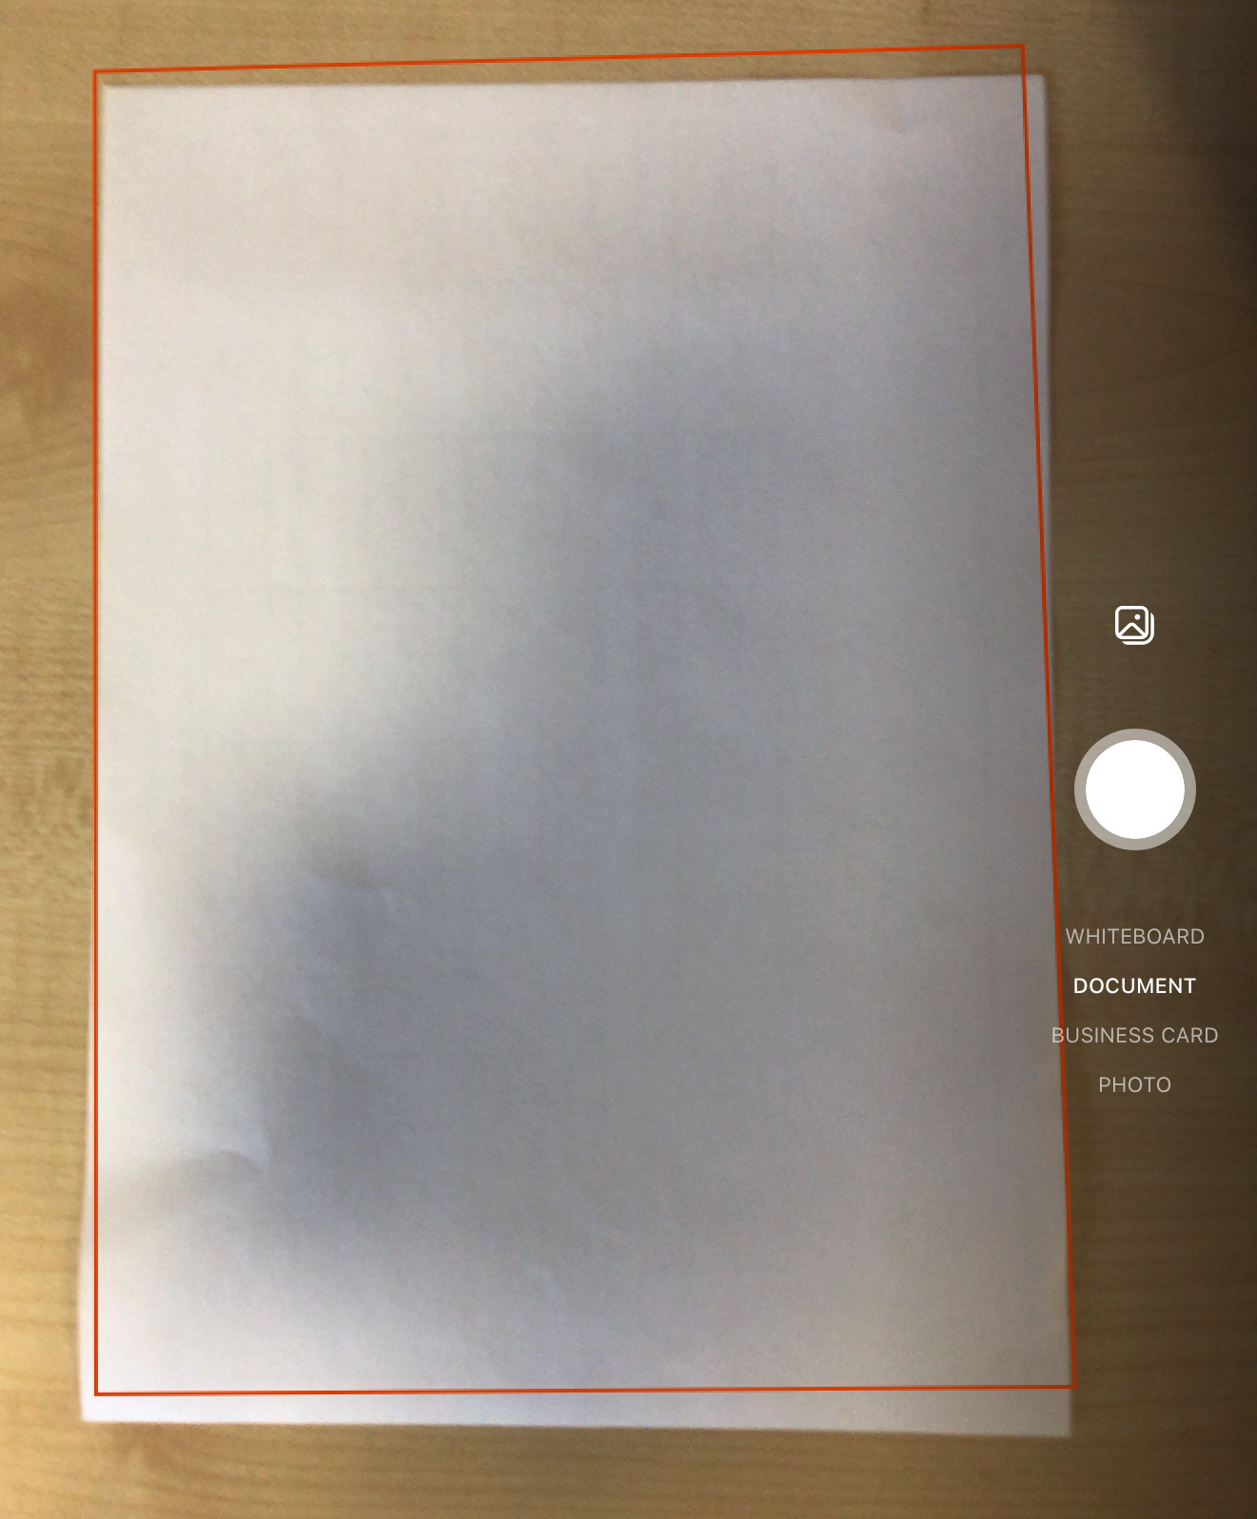
Once downloaded, open the app and line up your document.
You will see at the side that you can change what you take a photo of.
We would recommend you keep it as a document.

Slide 14
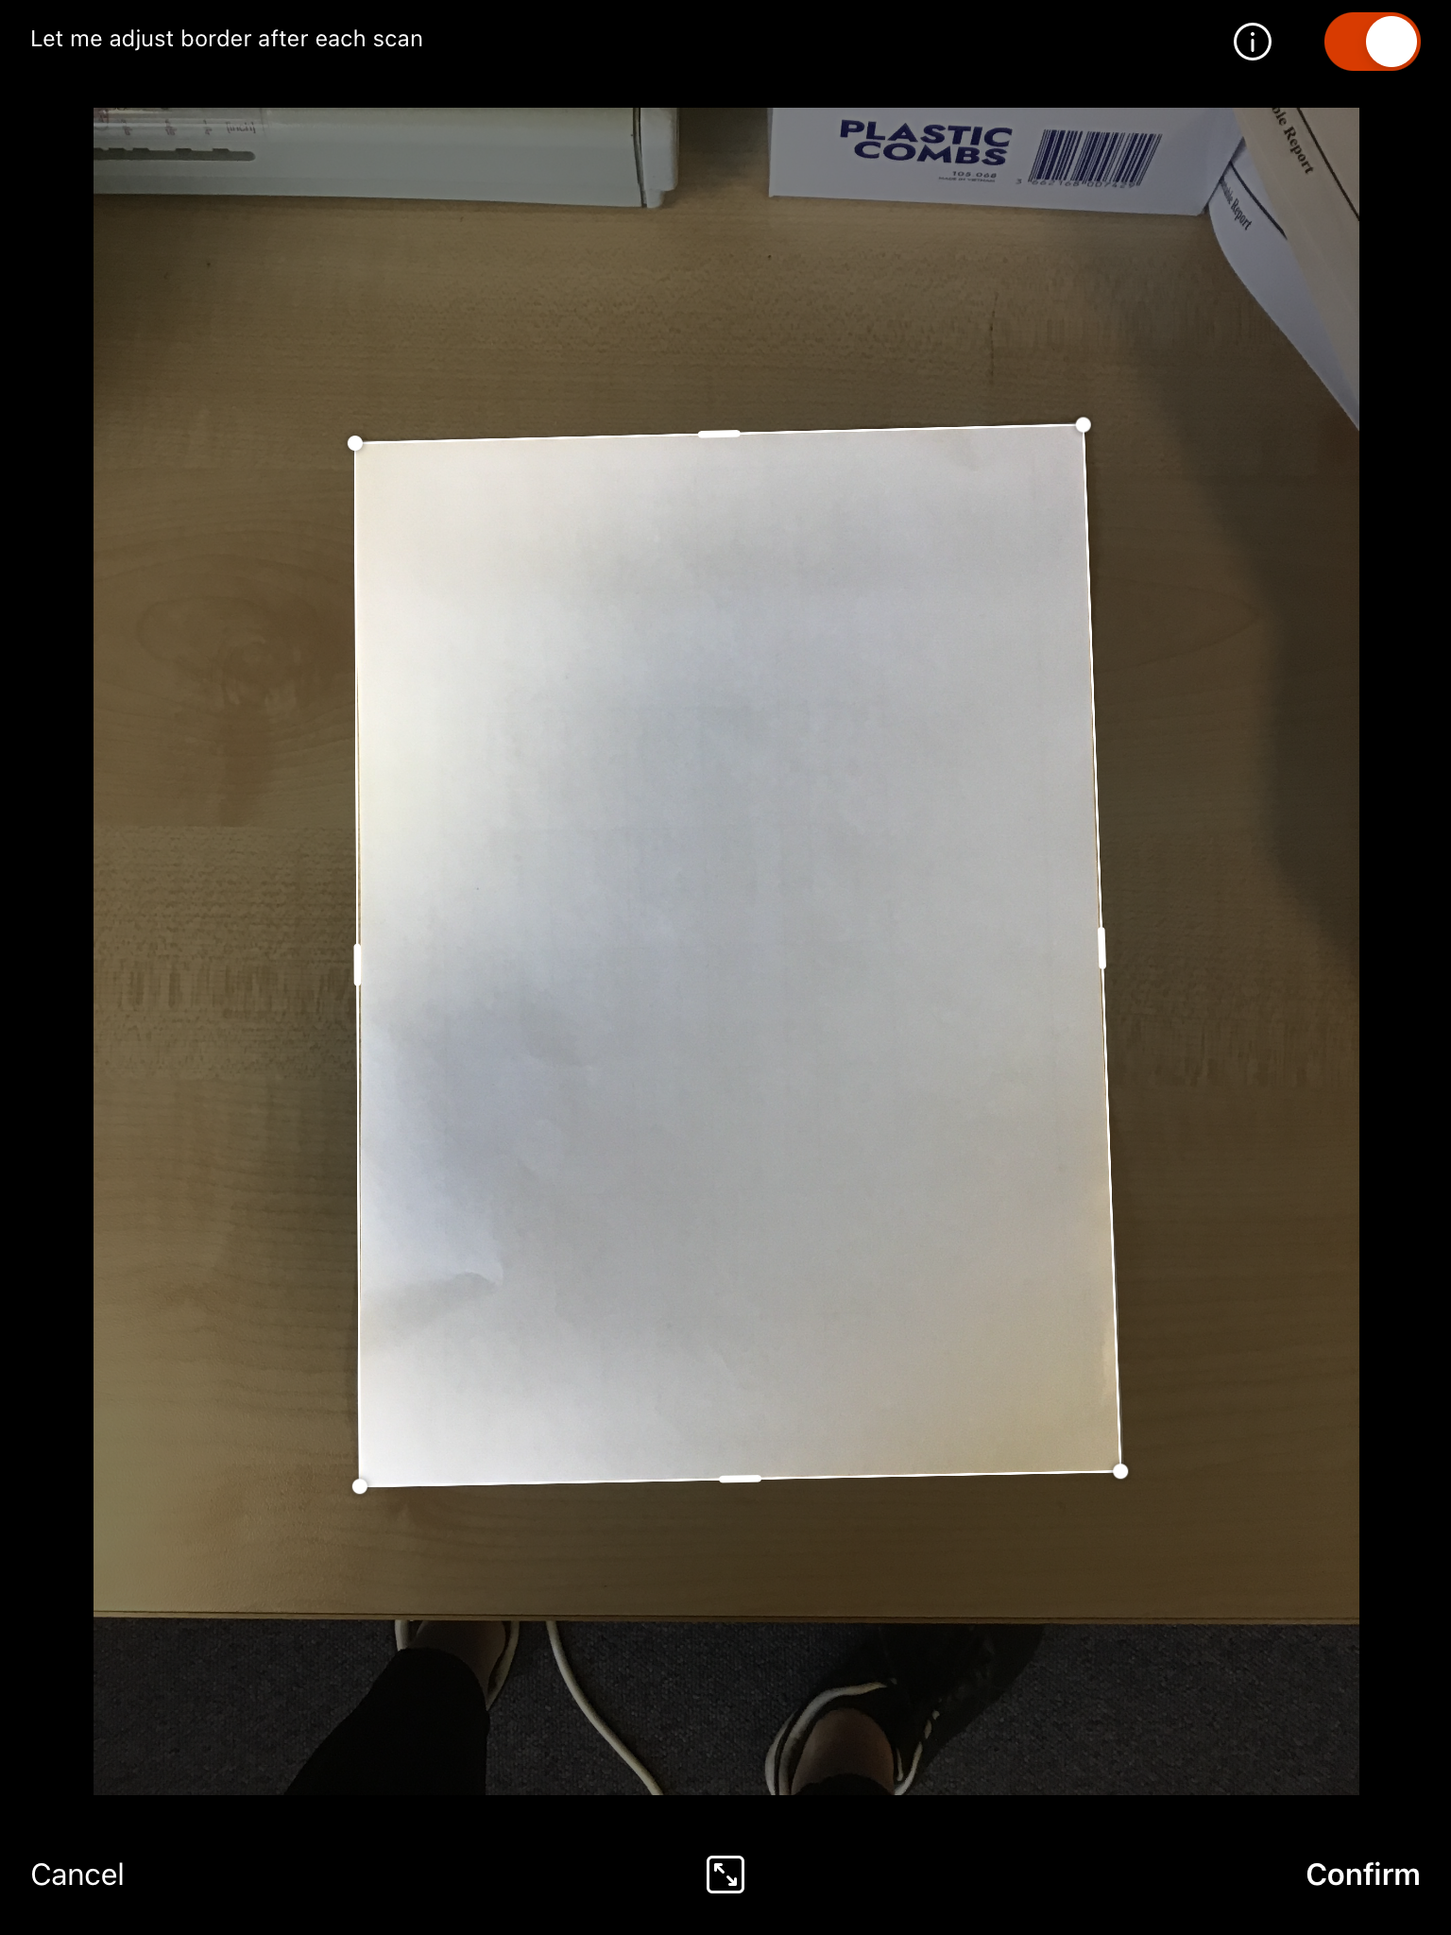
You can take your picture and adjust the borders to get rid of anything on your desk etc.

Slide 15
Your document is now ready to be cropped/edited etc.
Press done.

Slide 16
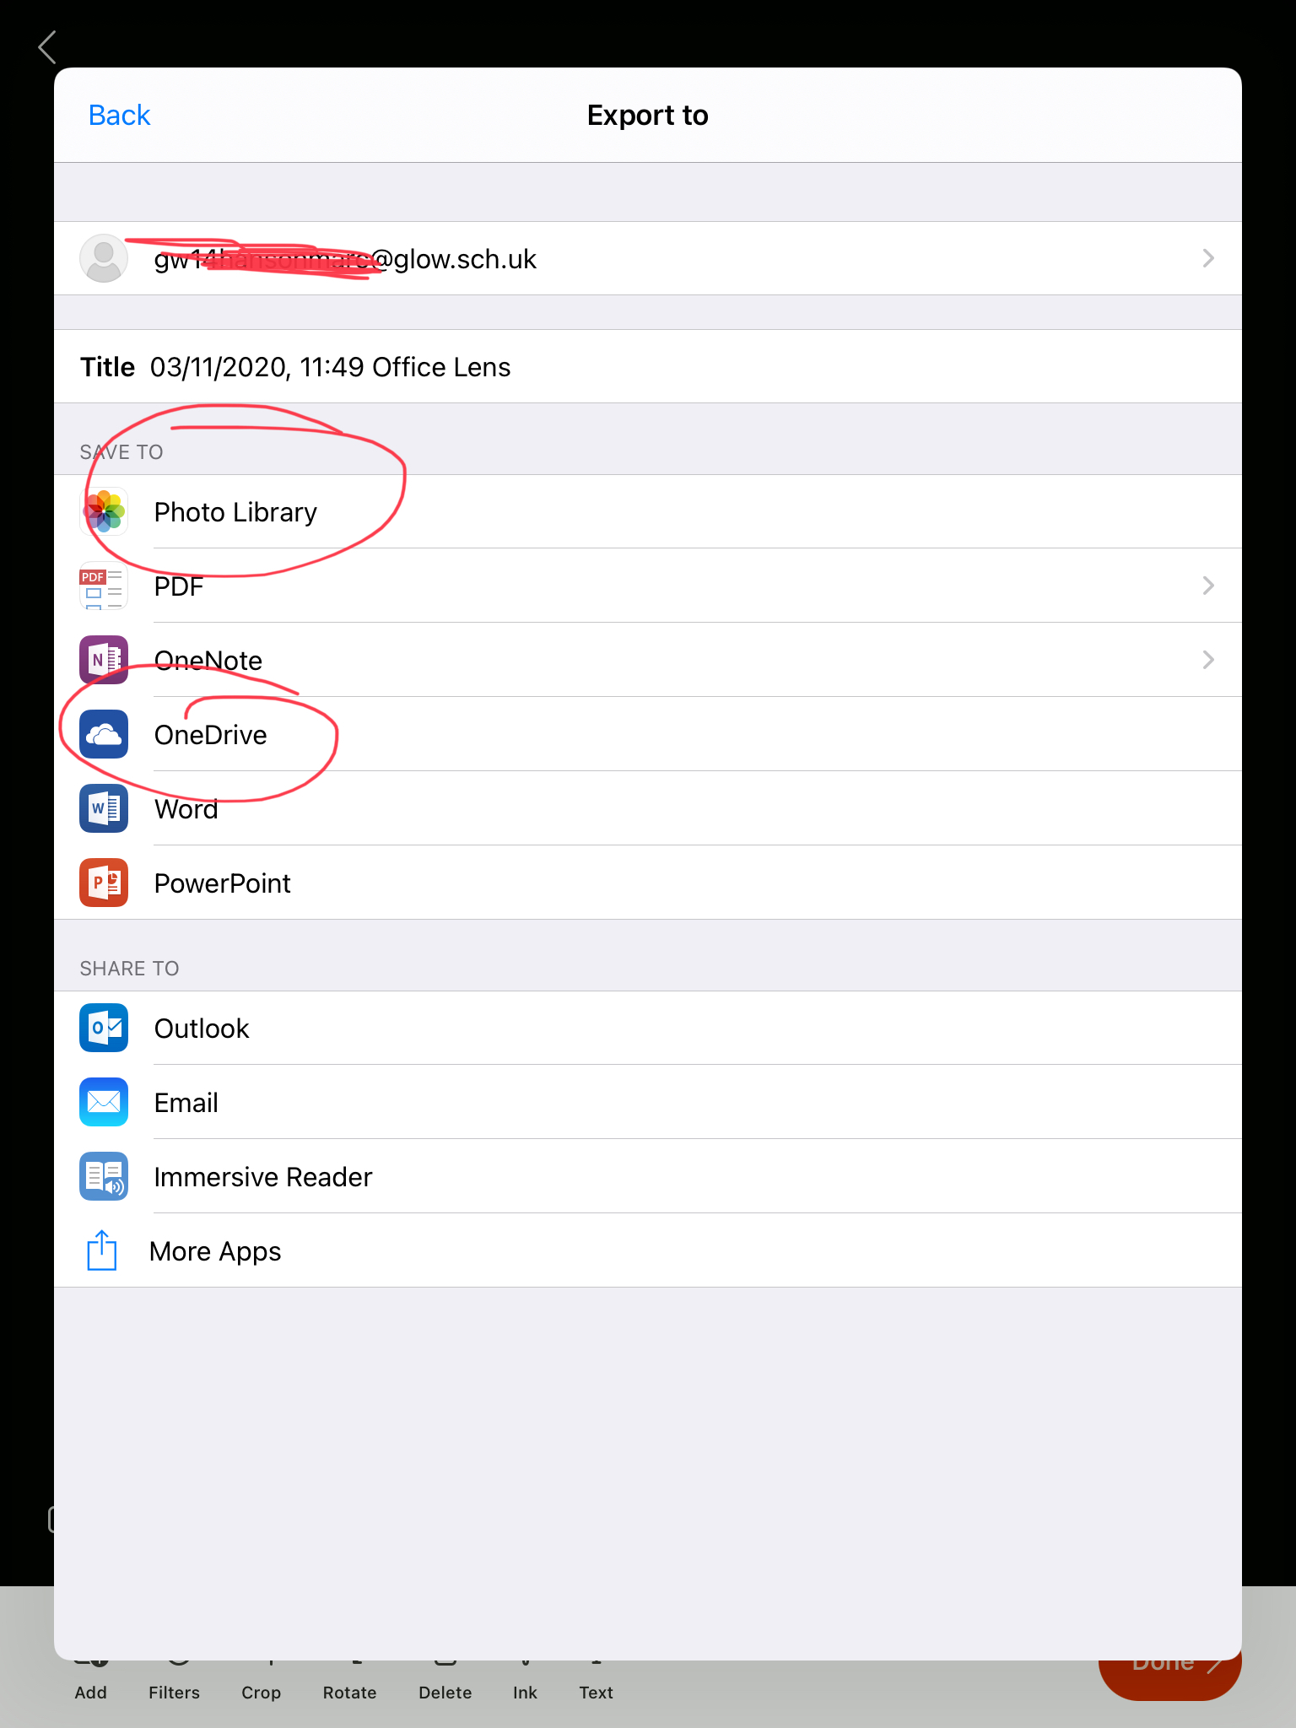
Choose where you would like to save it to.
Then go back to Teams, go to the file/photo library and upload your work!

Slide 17
Next week will focus on Showbie!
If you have any other requests for iPad tips and tricks please either email or speak to Ms Lamont.

