Slide 1
Open the Safari App

Slide 2
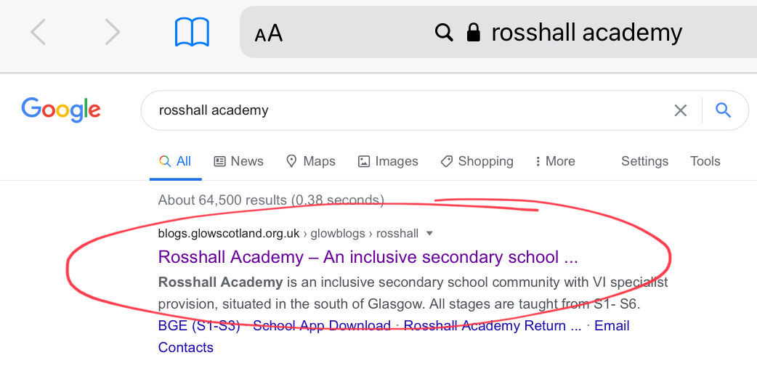
Search for Rosshall Academy
Select this website

Slide 3
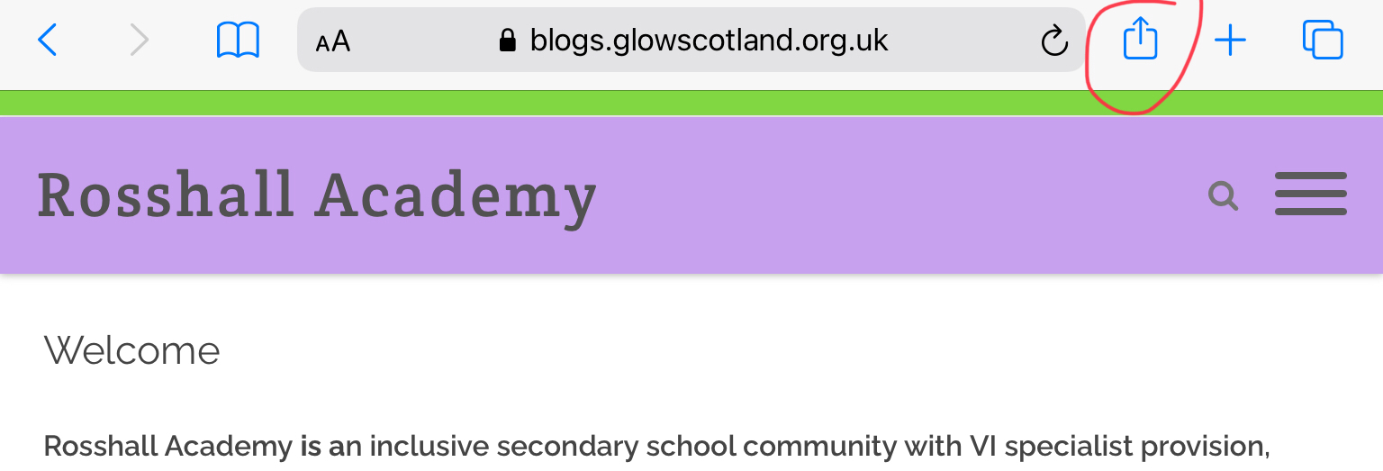
Select this icon

Slide 4
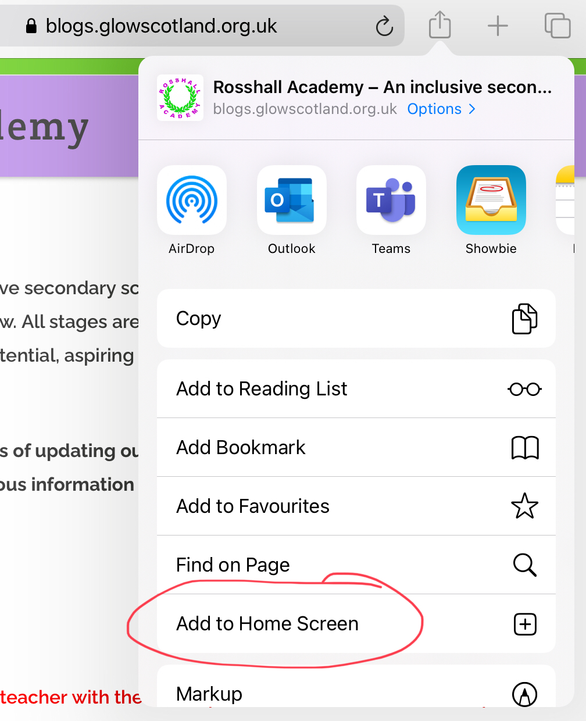
Select ‘Add to Home Screen’

Slide 5
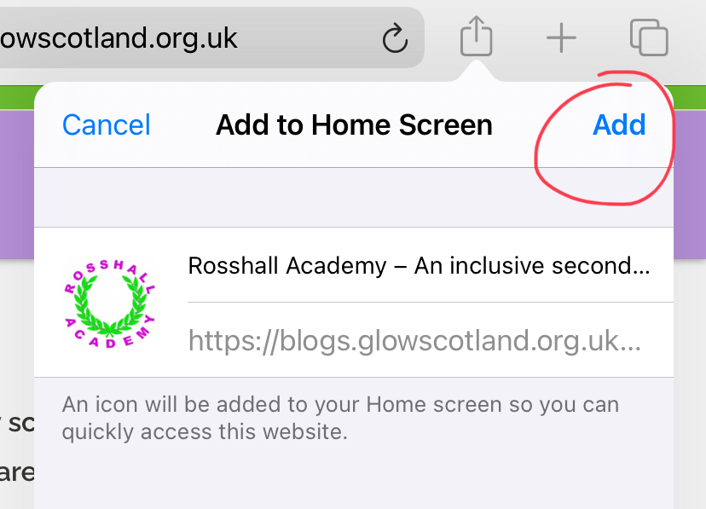
Select ‘Add’

Slide 6
You now have a Home Screen link to the Rosshall website!

